Slide 1
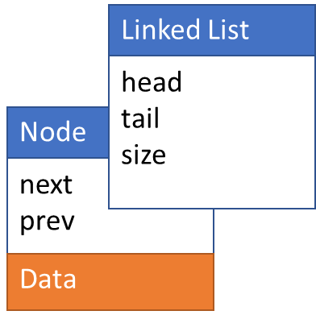
Doubly Linked List
Operations:
initialize()
append()
prepend()
insertAfter()
remove()
search()
sort()
print()
typedef struct DoublyLinkedList
{
int size;
Node *head;
Node *tail;
} LinkedList;
typedef struct node
{
int data;
struct node *next;
struct node *prev;
} Node

Slide 2
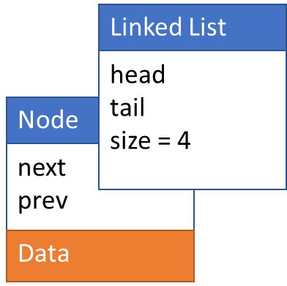
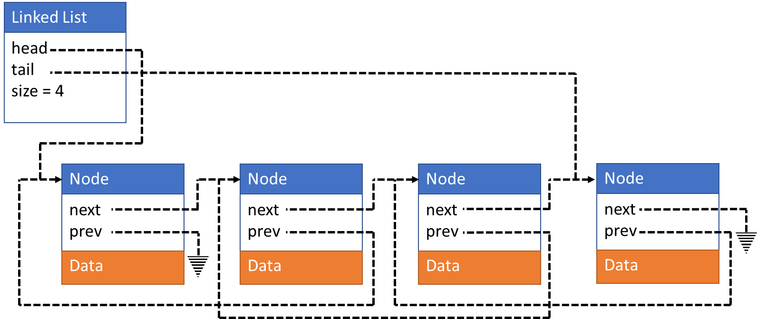
Doubly Linked List
Linked List
head
tail
size = 4
Node
Node
Node
Node
next
prev
next
prev
next
prev
next
prev
Data
Data
Data
Data

Slide 3
Initialize()

Slide 4
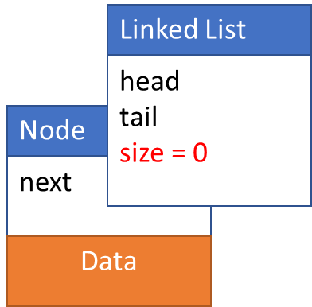
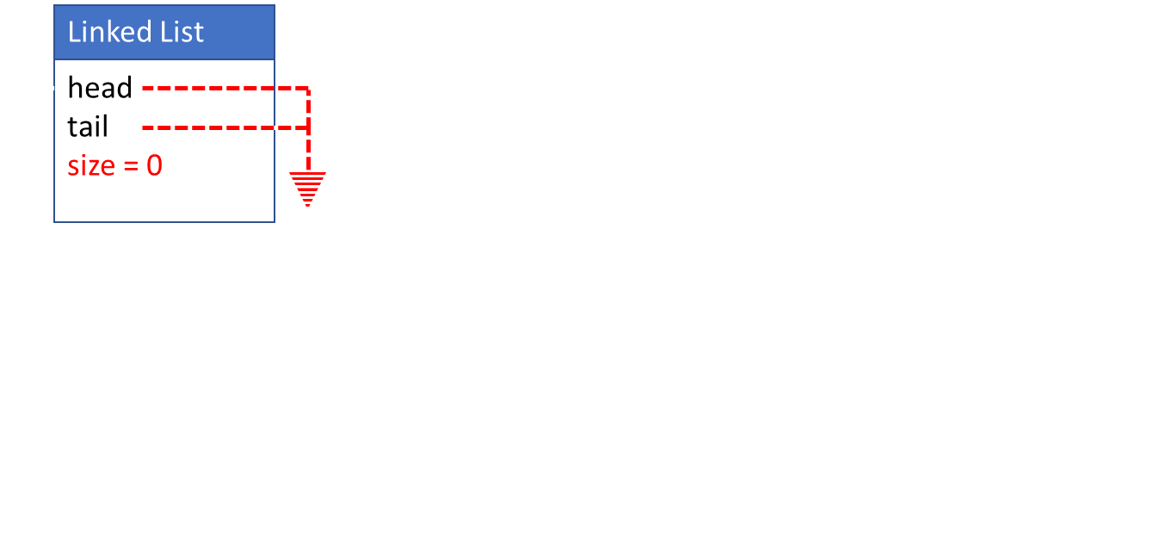
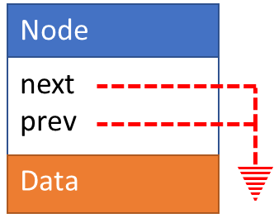
Initialize()
LinkedList* list;
list = malloc(sizeof(LinkedList));
list->head = NULL;
list->tail = NULL;
list->size = 0;
return list;
Node* initializeNode(newData)
Node *newNode;
newNode = malloc(sizeOf(Node));
newNode->data = newData
newNode->next = NULL;
newNode->prev = NULL;
return newNode;

Slide 5
append/prepend(newData) into empty list

Slide 6
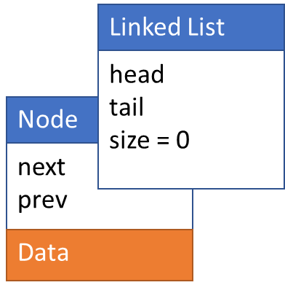
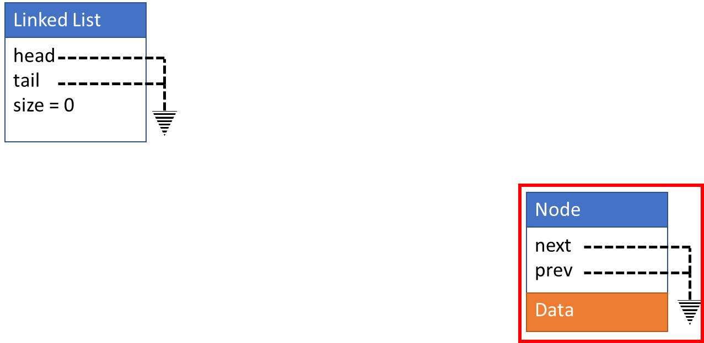
append/prepend(newData)
Create new node
Update head
Update tail
Update size
Linked List
head
tail
size = 0
Node *newNode;
newNode = intializeNode(newData);
Node
next
prev
Data

Slide 7
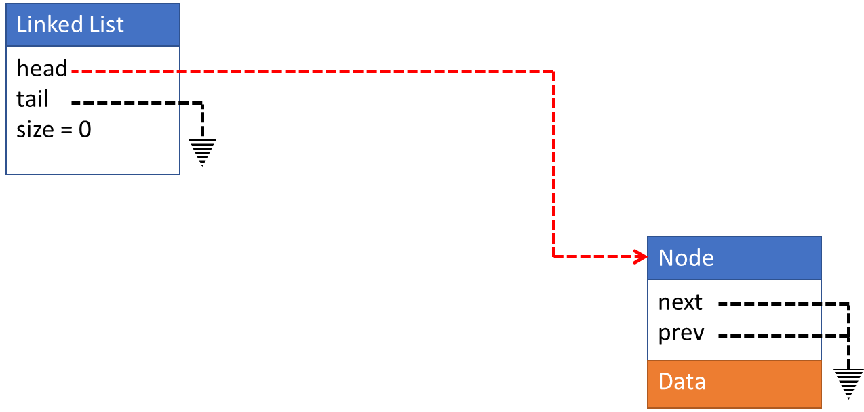
append/prepend(newData)
Create new node
Update head
Update tail
Update size
Linked List
head
tail
size = 0
list->head = newNode;
Node
next
prev
Data

Slide 8
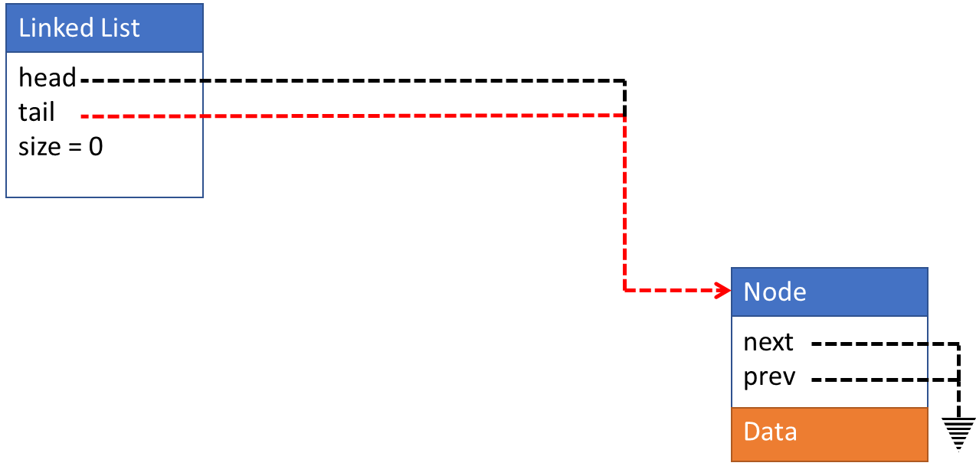
append/prepend(newData)
Create new node
Update head
Update tail
Update size
Linked List
head
tail
size = 0
list->tail = newNode;
Node
next
prev
Data

Slide 9
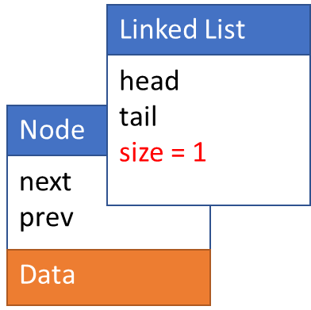
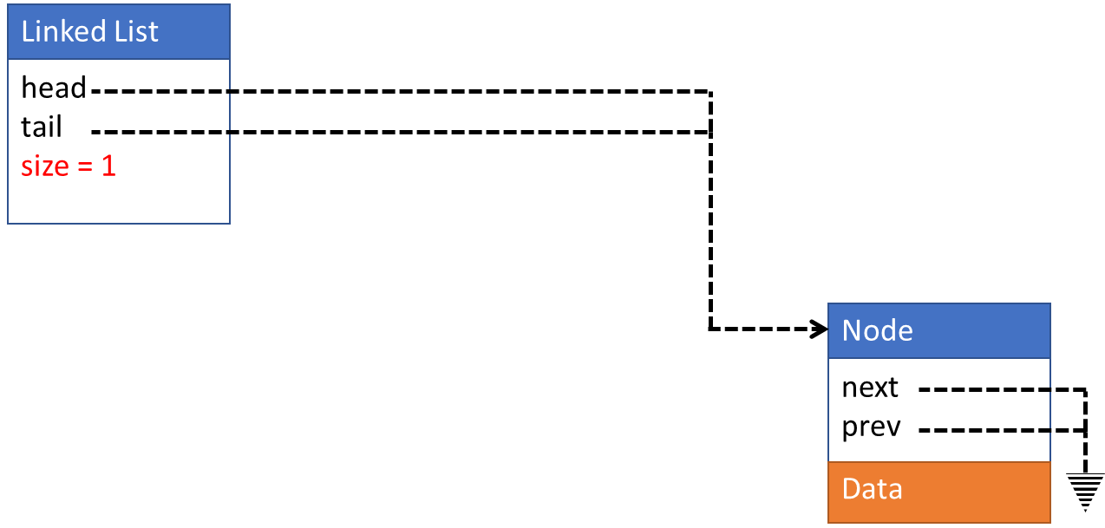
append/prepend(newData)
Create new node
Update head
Update tail
Update size
Linked List
head
tail
size = 1
list->size++;
Node
next
prev
Data

Slide 10
append(newData) into filled list

Slide 11
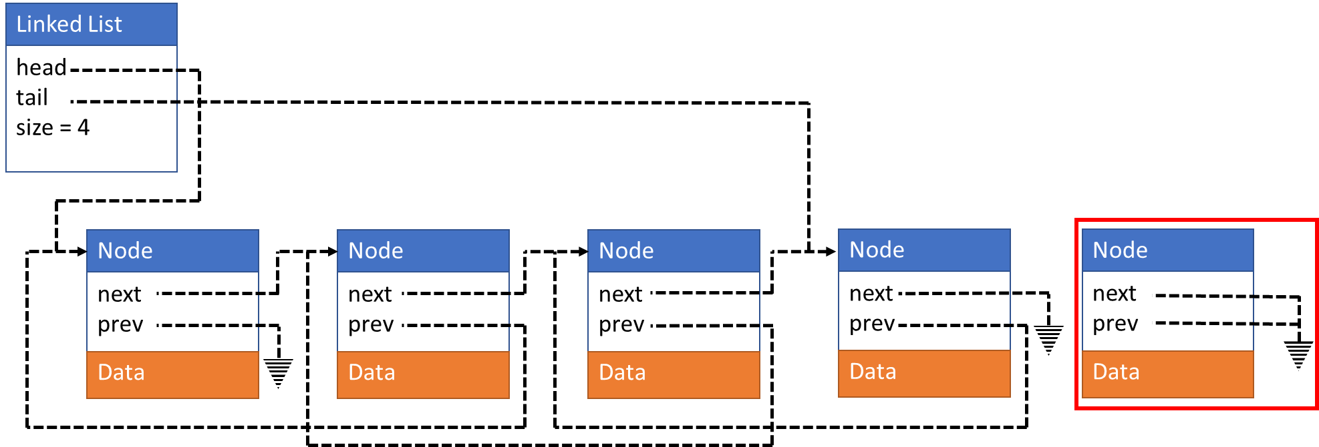
append(newData)
Create new node
Update newNode->prev
Update tail->next
Update tail
Update size
Linked List
head
tail
size = 4
Node *newNode;
newNode = intializeNode(newData);
Node
next
prev
Node
Node
Node
next
prev
Node
next
prev
next
prev
next
prev
Data
Data
Data
Data
Data

Slide 12
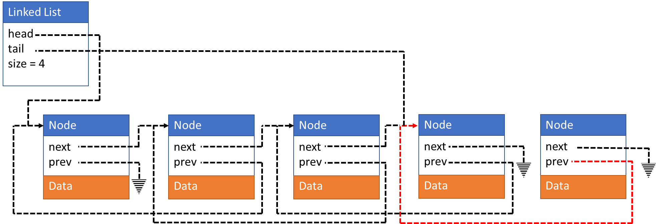
append(newData)
Create new node
Update newNode->prev
Update tail->next
Update tail
Update size
Linked List
head
tail
size = 4
newNode->prev = list->tail;
Node
next
prev
Node
Node
Node
next
prev
Node
next
prev
next
prev
next
prev
Data
Data
Data
Data
Data

Slide 13
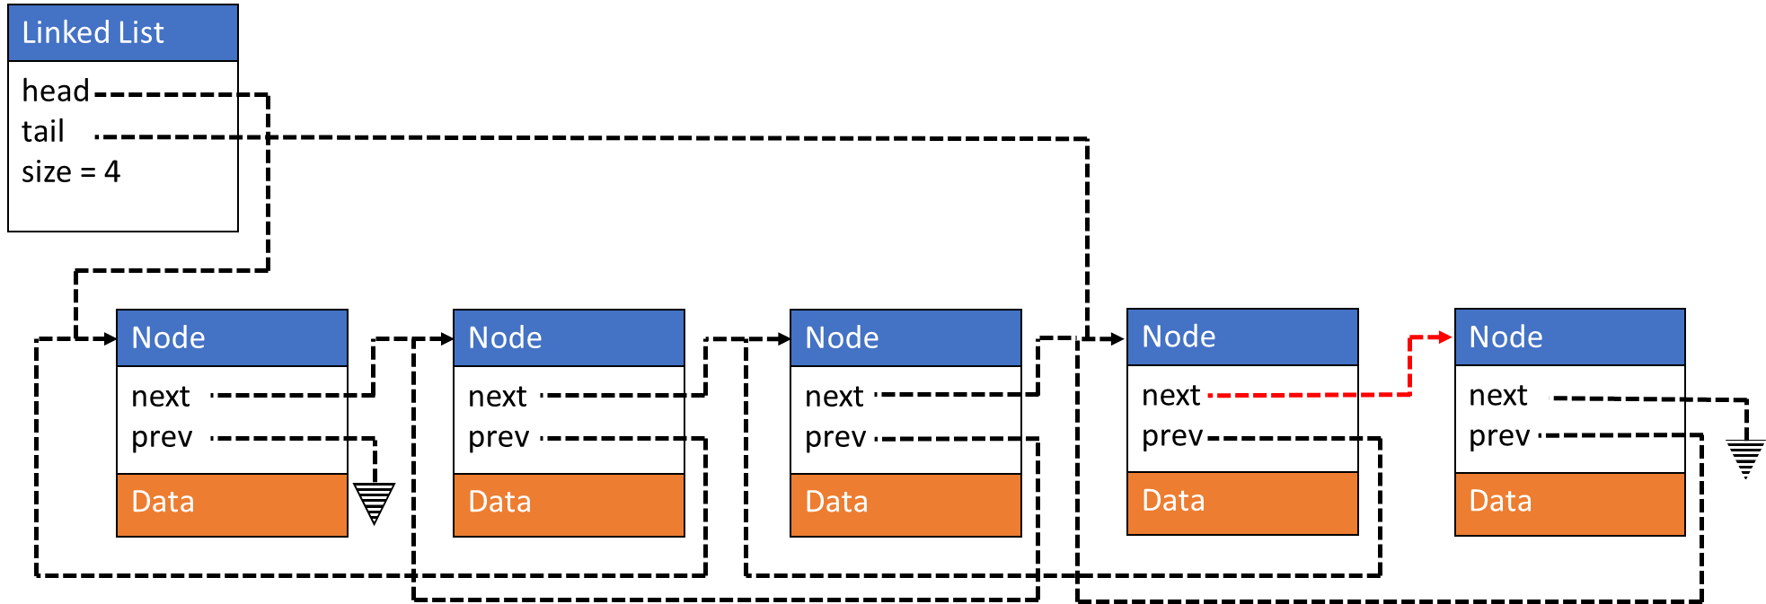
append(newData)
Create new node
Update newNode->prev
Update tail->next
Update tail
Update size
Linked List
head
tail
size = 4
list->tail->next = newNode;
Node
next
prev
Node
Node
Node
next
prev
Node
next
prev
next
prev
next
prev
Data
Data
Data
Data
Data

Slide 14
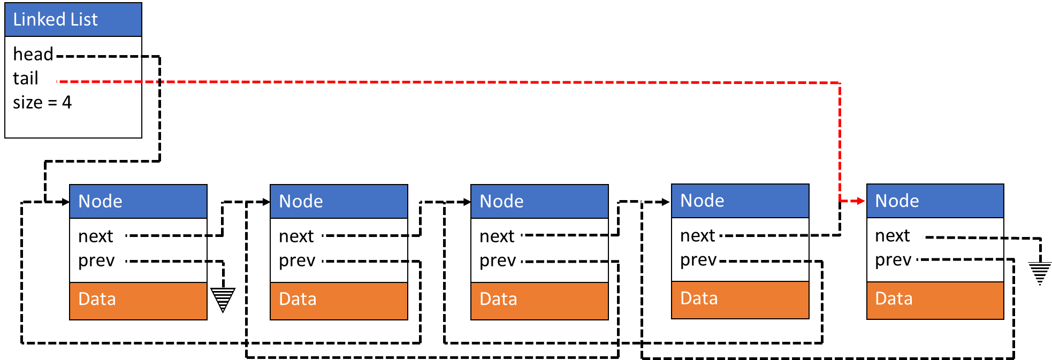
append(newData)
Create new node
Update newNode->prev
Update tail->next
Update tail
Update size
Linked List
head
tail
size = 4
list->tail = newNode;
Node
next
prev
Node
Node
Node
next
prev
Node
next
prev
next
prev
next
prev
Data
Data
Data
Data
Data

Slide 15
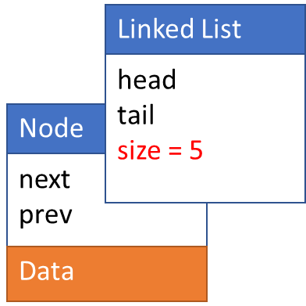

append(newData)
Create new node
Update newNode->prev
Update tail->next
Update tail
Update size
Linked List
head
tail
size = 5
list->size++;
Node
next
prev
Node
Node
Node
next
prev
Node
next
prev
next
prev
next
prev
Data
Data
Data
Data
Data

Slide 16
prepend(newData) into filled list

Slide 17
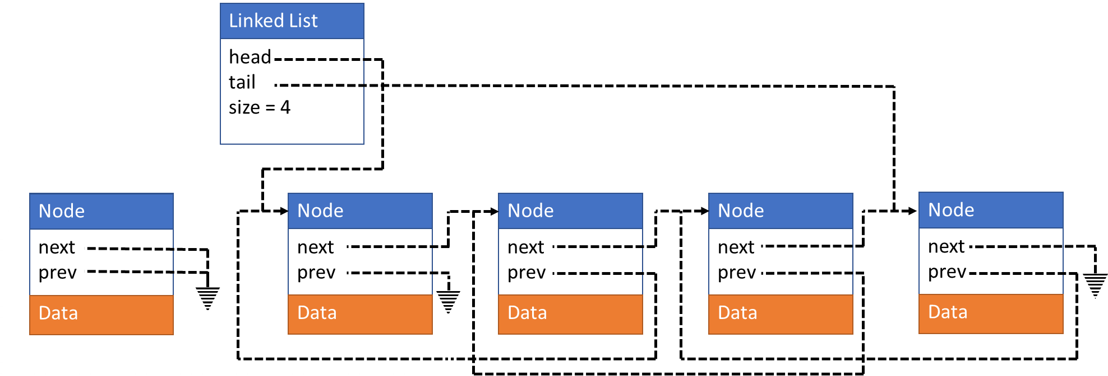
prepend(newData)
Create new node
Update newNode->next
Update head->prev
Update head
Update size
Linked List
head
tail
size = 4
Node *newNode;
newNode = intializeNode(newData);
Node
Node
Node
Node
next
prev
next
prev
next
prev
next
prev
next
prev
Node
Data
Data
Data
Data
Data

Slide 18
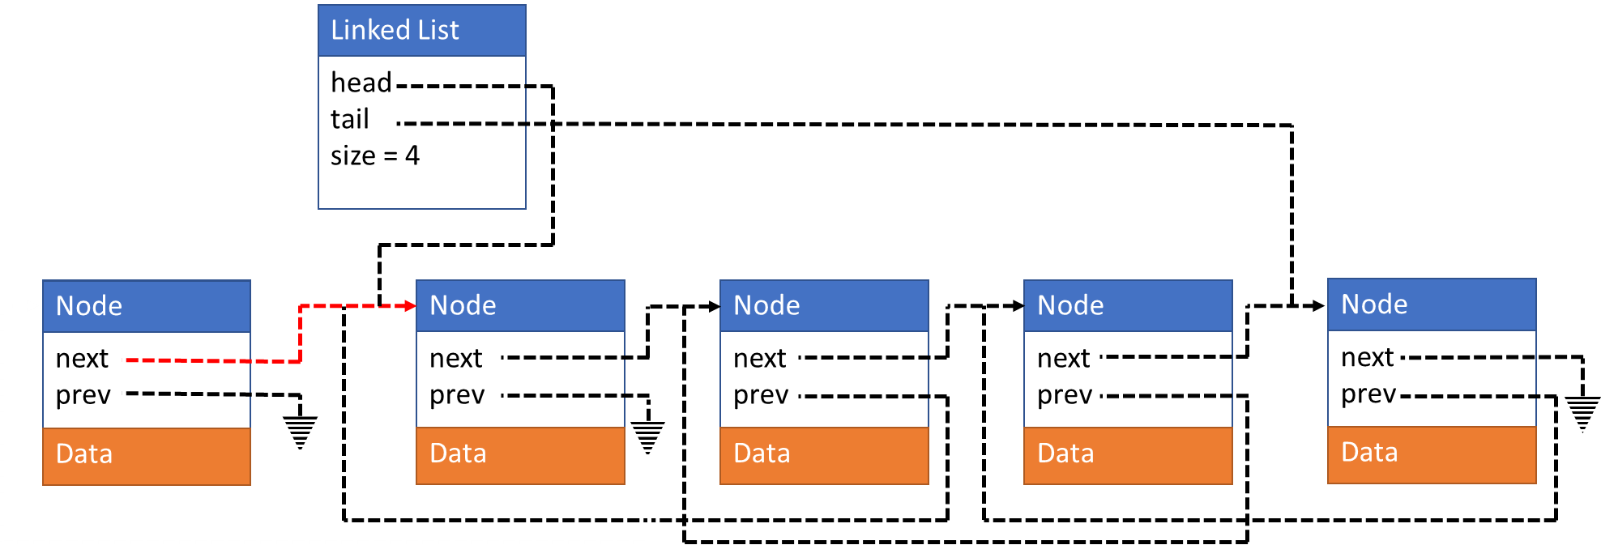
prepend(newData)
Create new node
Update newNode->next
Update head->prev
Update head
Update size
Linked List
head
tail
size = 4
newNode->next = list->head;
Node
Node
Node
Node
next
prev
next
prev
next
prev
next
prev
next
prev
Node
Data
Data
Data
Data
Data

Slide 19
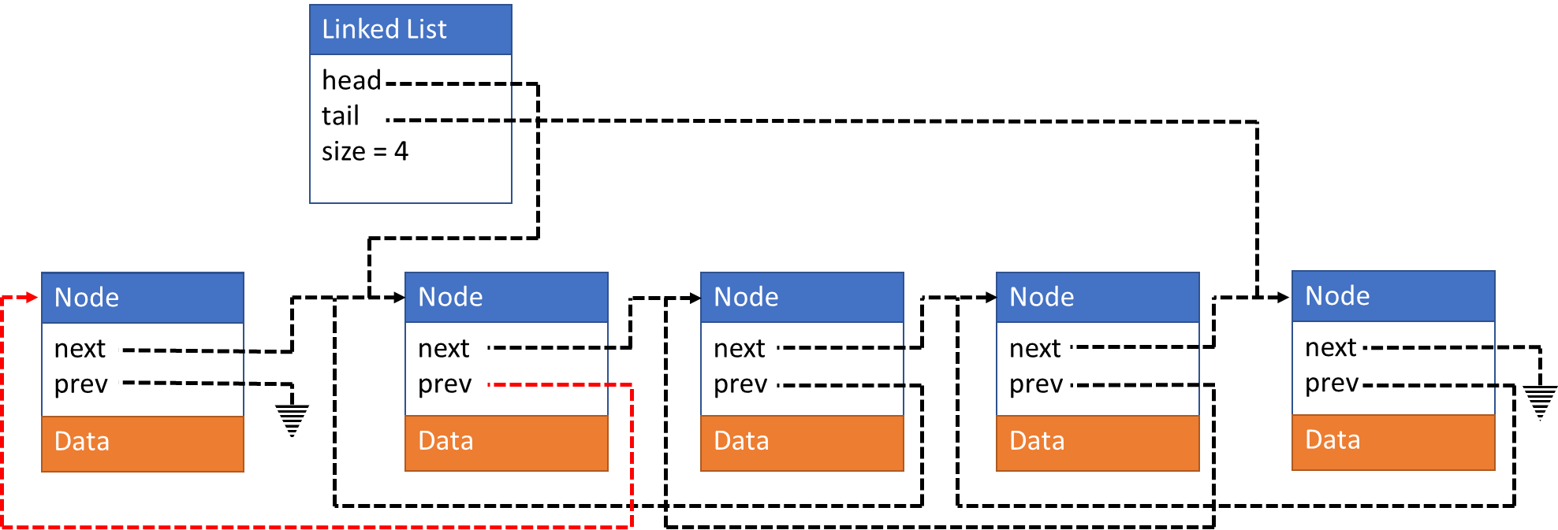
prepend(newData)
Create new node
Update newNode->next
Update head->prev
Update head
Update size
Linked List
head
tail
size = 4
list->head->prev = newNode;
Node
Node
Node
Node
next
prev
next
prev
next
prev
next
prev
next
prev
Node
Data
Data
Data
Data
Data

Slide 20
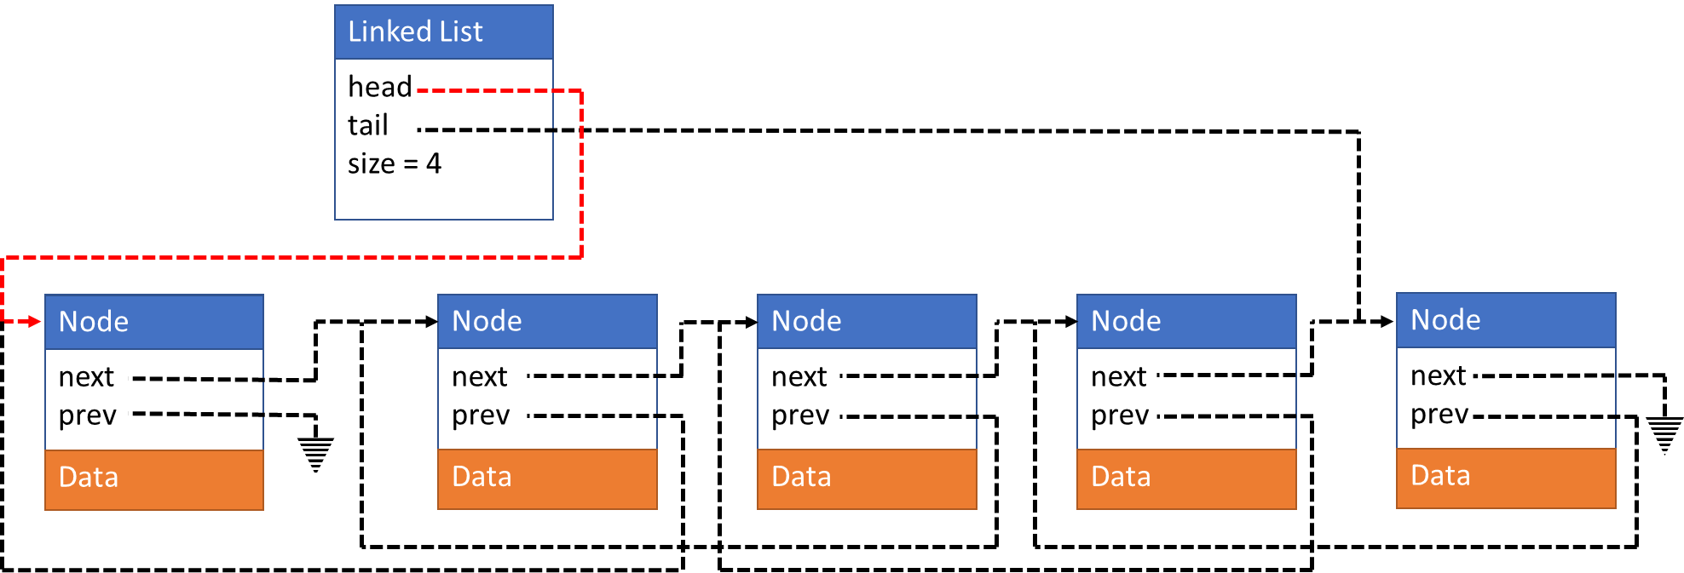
prepend(newData)
Create new node
Update newNode->next
Update head->prev
Update head
Update size
Linked List
head
tail
size = 4
list->head = newNode;
Node
Node
Node
Node
next
prev
next
prev
next
prev
next
prev
next
prev
Node
Data
Data
Data
Data
Data

Slide 21
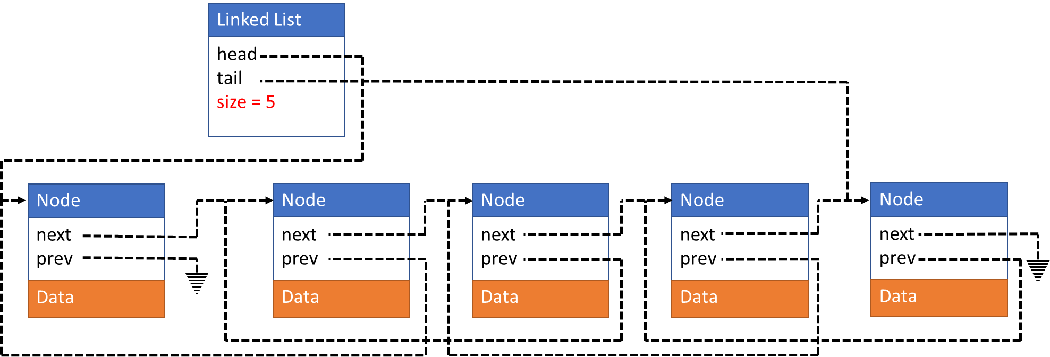
prepend(newData)
Create new node
Update newNode->next
Update head->prev
Update head
Update size
Linked List
head
tail
size = 5
list->size++;
Node
Node
Node
Node
next
prev
next
prev
next
prev
next
prev
next
prev
Node
Data
Data
Data
Data
Data

Slide 22
insertAfter(newData, afterData)
Board work

Slide 23
InsertAfter(newData, afterData)
Node *newNode;
newNode = intializeNode(newData);
Node *currentNode = list->head;
while(currentNode != NULL)
{
if(currentNode->data == afterData)
{
if(currentNode == list->tail)
{
currentNode->next = newNode;
newNode->prev = currentNode;
list->tail = newNode;
} else
{
newNode->next = currentNode->next;
newNode->prev = currentNode;
currentNode->next->prev = newNode;
currentNode->next = newNode;
}
} else {
currentNode = currentNode.next;
}
}

