Slide 1
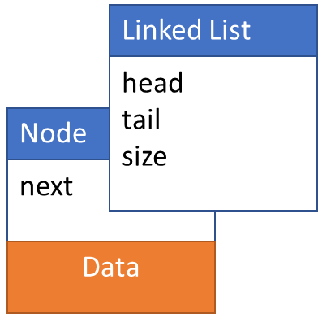
Stack ADT with Linked List
Operations:
initialize()
push()
peek()
pop()
isEmpty()
getLength()
typedef struct linkedList
{
int size;
Node *head;
Node *tail;
} LinkedList;
typedef struct node
{
int data;
struct node *next;
} Node

Slide 2
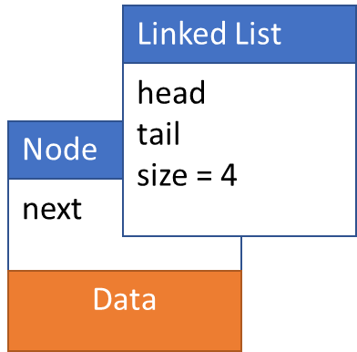
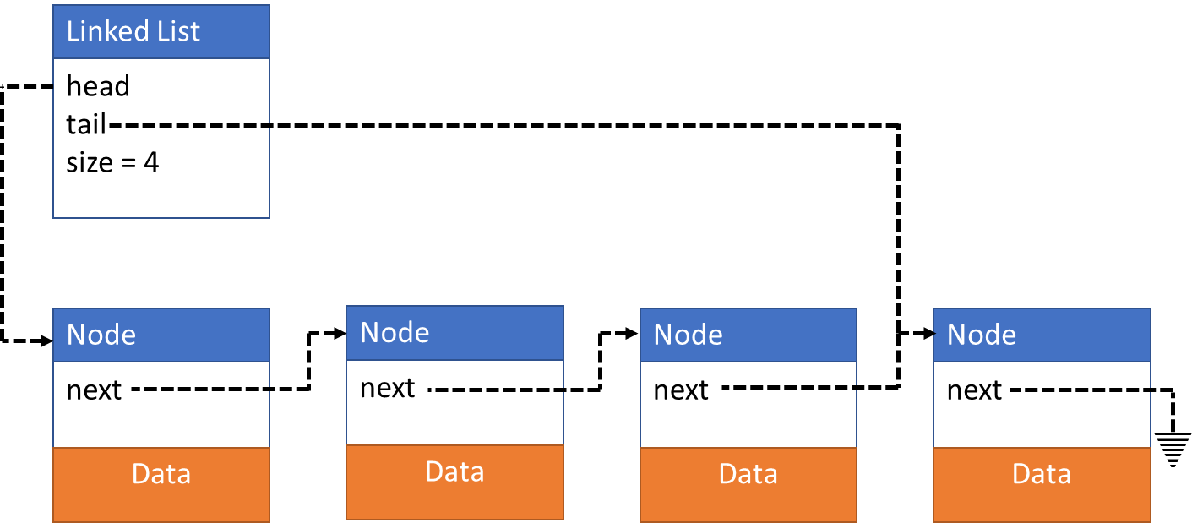
Single Linked List

Slide 3
initialize()

Slide 4
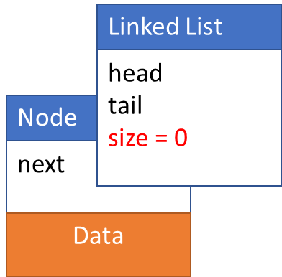
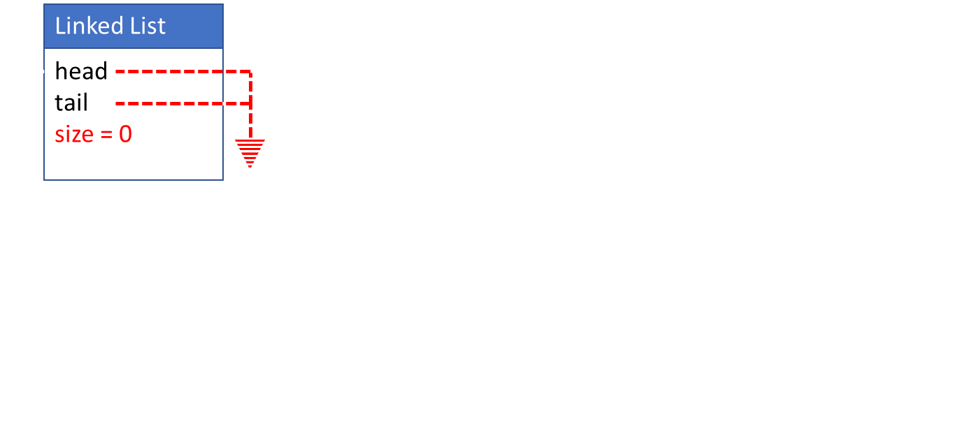
Stack* initialize()
typedef LinkedList Stack; //in header
Stack* stack;
stack = malloc(sizeof(Stack));
stack->head = NULL;
stack-> tail = NULL;
size = 0;
return stack;
Node* initializeNode(newData)
Node *newNode;
newNode = malloc(sizeOf(Node));
newNode->data = newData
newNode->next = NULL;
return newNode;

Slide 5
push(newData)
Top of Stack at Tail

Slide 6
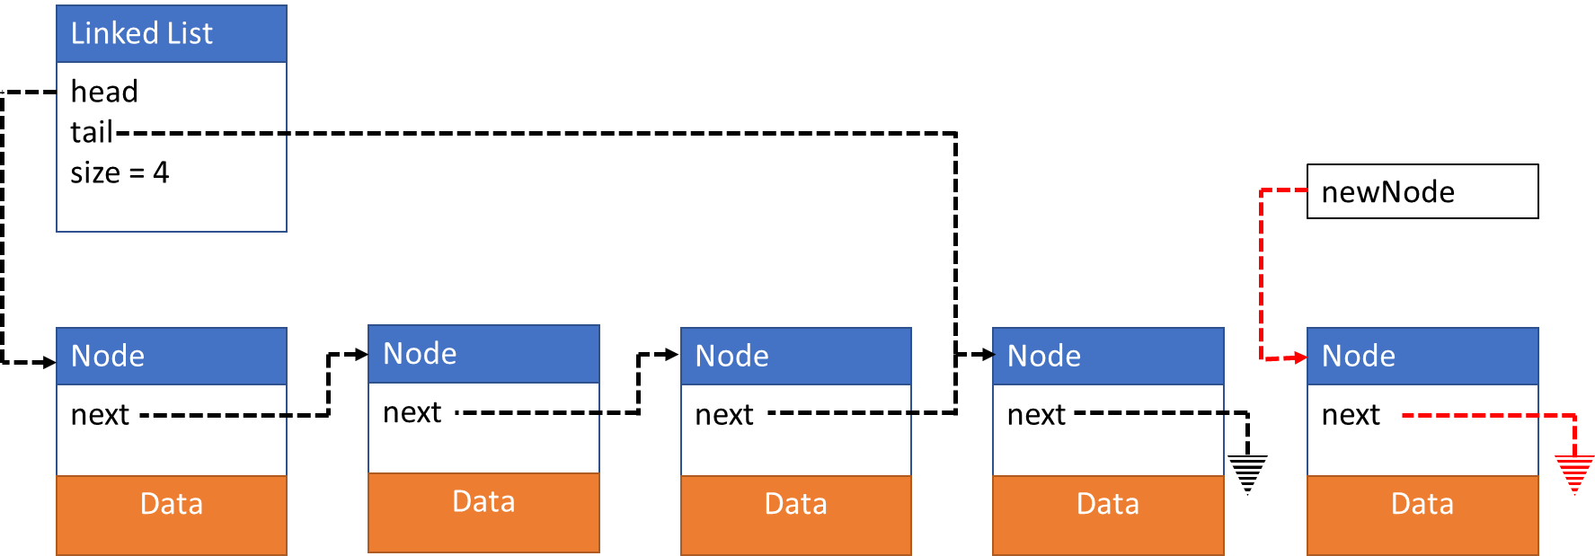
push(newData)
Create new node
Update tail->next
Update tail
Update size
Node *newNode;
newNode = intializeNode(newData);

Slide 7
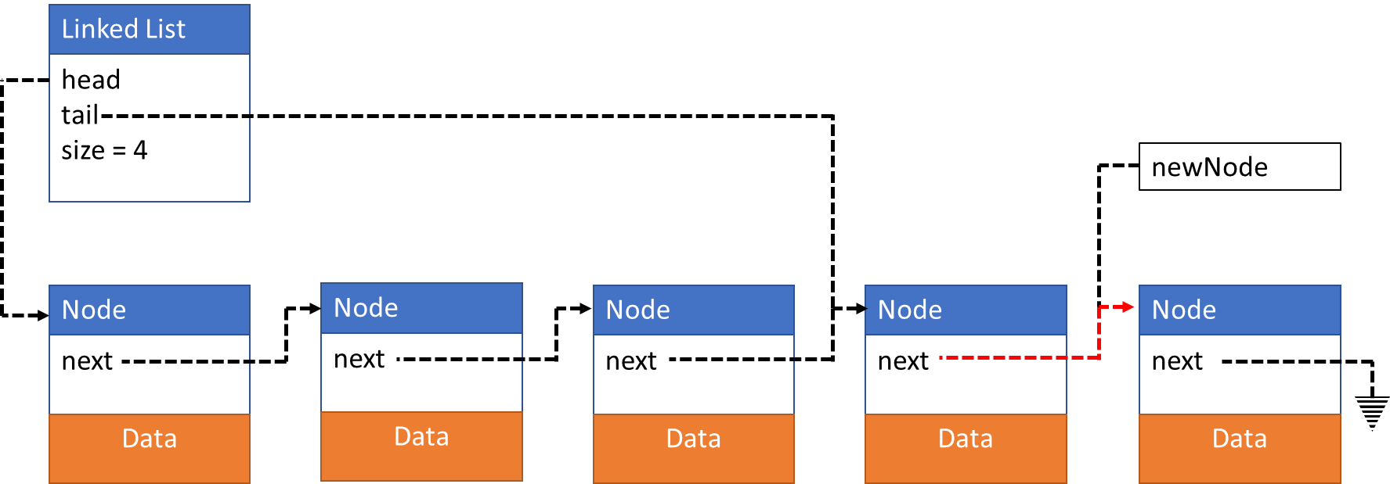
push(newData)
Create new node
Update tail->next
Update tail
Update size
stack->tail->next = newNode;

Slide 8
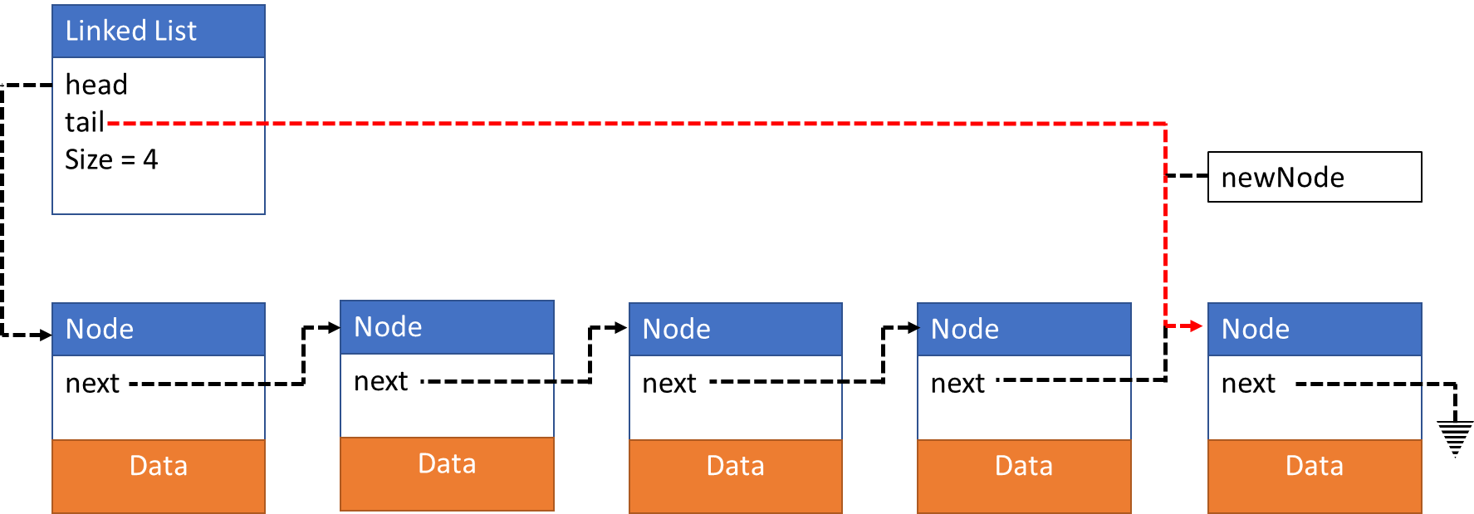
push(newData)
Create new node
Update tail->next
Update tail
Update size
stack->tail = newNode;

Slide 9


push(newData)
Create new node
Update tail->next
Update tail
Update size
stack->size = stack->size + 1;

Slide 10
push(newData)
Top of Stack at Head

Slide 11
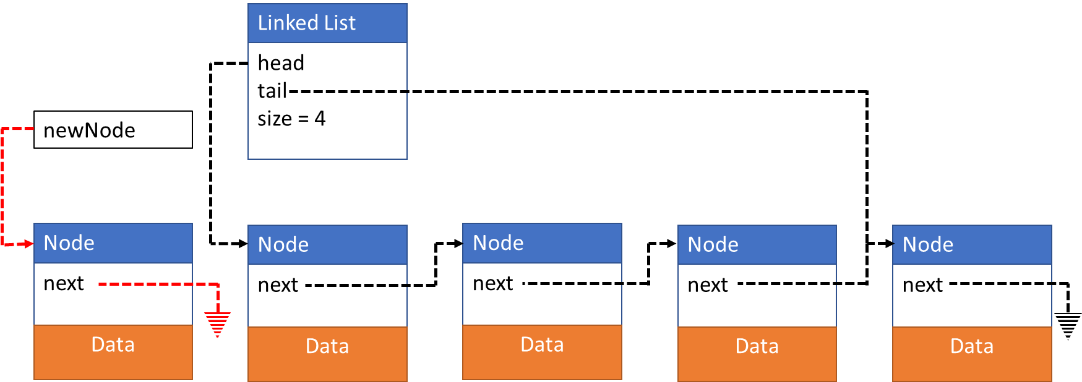
prepend(newData)
Create new node
Update newNode->next
Update head
Update size
Top of Stack at Head
Node *newNode;
newNode = intializeNode(newData);

Slide 12
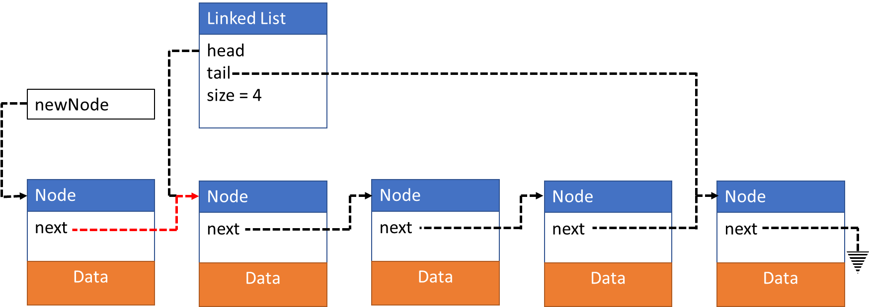
prepend(newData)
Create new node
Update newNode->next
Update head
Update size
newNode->next = stack->head;

Slide 13
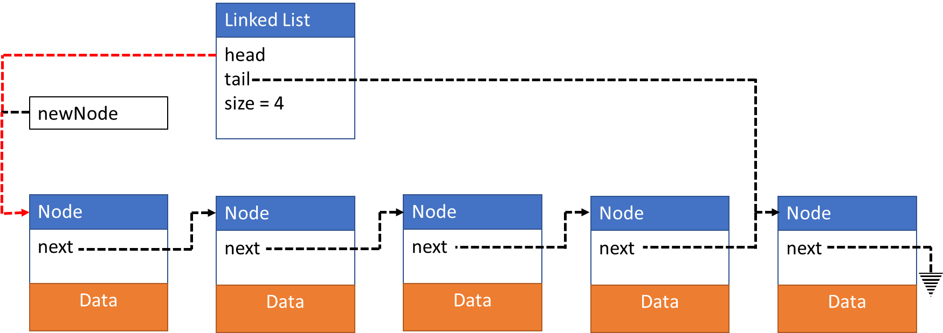
prepend(newData)
Create new node
Update newNode->next
Update head
Update size
stack->head = newNode;

Slide 14

prepend(newData)
Create new node
Update newNode->next
Update head
Update size
stack->size = stack->size + 1;

Slide 15
Data peek()
Top of Stack at Tail

Slide 16
Data peek()
Copy data at tail
Return data copy
Data returnData;
returnData = stack->tail->data;

Slide 17
Data peek()
Copy data at tail
Return data copy
return returnData;

Slide 18
Data peek()
Top of Stack at Head

Slide 19
Data peek()
Copy data at head
Return data copy
Data returnData;
returnData = stack->head->data;

Slide 20
Data peek()
Copy data at head
Return data copy
return returnData;

Slide 21
Data pop()
Board work

Slide 22
Data pop()
Top of Stack at Head | Top of Stack at Tail
Data returnData;
returnData = stack->tail->data;
Node *currentNode;
currentNode = stack->head;
for(int i = 1; i < size - 1; i++)
{
currentNode = currentNode->next;
}
currentNode->next = NULL;
free(stack->tail)
stack->tail = currentNode;
return returnData;
Data returnData;
returnData = stack->head->data;
Node *currentNode;
currentNode = stack->head->next;
free(stack->head);
stack->head = currentNode;
return returnData;

