Slide 1
Algorithm Analysis
Algorithmic complexity is concerned with how fast/slow is the algorithm?
Complexity defined as a numerical function: T(n)
What factors affect the clock-time it takes an algorithm to execute?
How do we analyze the algorithm without taking into account these factors?
Notes:
Factors: processor speed, instruction set, disk speed, other programs executing…..
How: asymptotic behavior – measure the number of operations (provided each takes a constant time)

Slide 2
Asymptotic Behavior
Concerned with how a function grows as n grows arbitrarily large
As n gets large, the function is dominated by its highest-order term
The coefficient of this term will also be overtaken as n -> ∞
Formally, T(n) = O(f(n)) when c > 0 and n > n₀
f(n)
Time
T(n)
n₀
Input (n)
Notes:
Meaning, f(n) is an upper bound for T(n) for all sufficiently large n -> infinity
Function to create red line could be: n^3 – n^2 + 1

Slide 3
Big-O – The Complete Approach
Here are the steps to compute the Big-O of an algorithm:
Determine how many steps f(n) an algorithm requires to solve a problem, in terms of the number of items n.
Keep the most significant term of that function and throw away the rest. For example:
f(n) = 3n²+3n+1 becomes f(n) = 3n²
f(n) = 2n log(n) + 3n becomes f(n) = 2n log(n)
3. Now remove any constant multiplier from the function:
f(n) = 3n² becomes f(n) = n²
f(n) = 2n log(n) becomes f(n) = n log(n)
4. This gives you your “big oh”:
f(n) = 3n²+3n+1 is therefore O(n²)
f(n) = 2n log(n) + 3n is therefore O(n log(n))

Slide 4
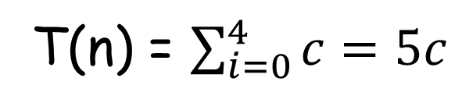
What are we counting?
Iteration: for(i=0; i<5; i++)
count++;
How many operations are completed in one loop iteration?
i and count are ints - assignment, addition, and comparison are constant time
What is the total cost of executing the loop?
i=0 happens exactly once
i++ happens 5 times
i<5 happens 6 times
count++ happens 5 times
T(n) = $\sum_{i=0}^{4}{c=5c}$
Notes:
How many operations:
- constant time - which could be the addition of each step in the loop, defined as simply c
Total Cost

Slide 5
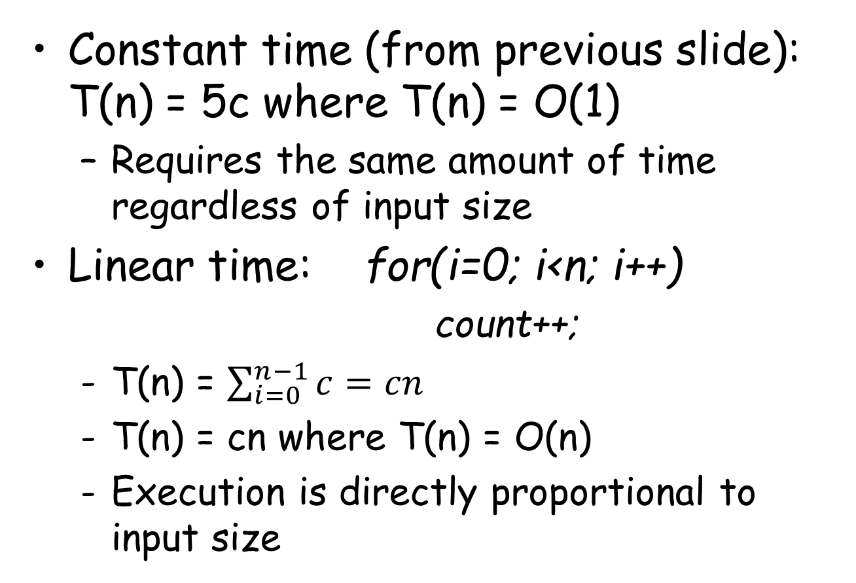
Big-O Time
Constant time (from previous slide): T(n) = 5c where T(n) = O(1)
Requires the same amount of time regardless of input size
Linear time: for(i=0; i<n; i++)
count++;
T(n) = $\sum_{i=0}^{n−1}{c=cn}$
T(n) = cn where T(n) = O(n)
Execution is directly proportional to input size

Slide 6
Big-O Time (cont.)
Logarithmic time: O(log n)
Execution time is proportional to the logarithm of the input size
Quadratic time: O(n²)
Execution time is proportional to the square of the input size

Slide 7
Big-O Simplification
Actually, if you think about it, there’s no need to compute the exact f(n) of an algorithm…
Why? Because we end up throwing away all of the lower-order terms and coefficients anyway!
All you need to do is focus on the most frequently occurring operation(s) to save time!
int arr[n][n];
for ( int i = 0; i < n; i++ )
for ( int j = 0; j < n; j++ )
arr[i][j] = 0;
f(n) =
n²
Our algorithm is O(n²).

