Slide 1

Bitcoin Sentiment Analysis
GROUP 8: CRYPTOWEB WEAVERS

Slide 2
Group members
Jonathan Okwaro
Judith Akelle
Rael Ndonye
Mucui Bernard
Winnie Onduru
Bryson Shitsukane

Slide 3
Project Outline
Business Understanding
Model Deployment
Modelling
Data Understanding
Data Preparation
Model Evaluation

Slide 4
Project overview
In the ever-evolving realm of cryptocurrency, where market sentiment can oscillate wildly within mere hours, Binance Investment Group faces a formidable challenge: How can they consistently maximize returns and minimize risks in the Bitcoin market?
The cryptocurrency market's fickle nature necessitates a sophisticated, data-driven strategy tailored to anticipate and respond to these rapid shifts. The pressing issue for Binance Investment Group is to devise a robust system that seamlessly integrates sentiment analysis with the prevailing Bitcoin market price.

Slide 5
Problem statement
In the transformative world of digital currencies, Bitcoin shines as the 'Digital Gold', reaching an unprecedented market capitalization of over $1 trillion in 2021. However, its meteoric rise is paralleled by its volatility, making investment decisions akin to navigating a stormy sea.
Addressing this, our proposed system synergizes sentiment analysis with a surface price trend analysis, tapping into platforms like Reddit. By blending tangible data with the intangible force of public sentiment, we aim to provide a compass for investors, guiding them through the intricate dance of emotions and numbers in the Bitcoin universe.

Slide 6
Project Objectives
This project seeks to create a system that leverages the power of natural language processing (NLP) and machine/deep learning to:
To develop a predictive model to gauge and predict public sentiment regarding Bitcoin, providing investment actionable insights to our stakeholder.
To determine what features/words are the most important in assisting our model to perform sentiment classification.
To determine if significant market events, like sharp price increase or decrease, can be linked with notable shifts in sentiment.
To find out the most prevalent topics or discussions in the Bitcoin subreddit.

Slide 7
Data Understanding
For our in-depth Bitcoin analysis, we obtained two datasets:
Reddit Bitcoin Data: From the Bitcoin subreddit in June 2022, we have 7,541 posts. Tied to these posts are 170,032 comments, giving us a clear view of what people are talking about.
Bitcoin Prices: From Kaggle, this dataset shows Bitcoin's price, trading volume, and market size from January 1, 2015, to November 16, 2022, with 2,876 entries.

Slide 8
Data Preparation
Data Merging
We combined comments and posts using post identifier to create a comprehensive dataset for analysis.
Data Quality Checks
Conducted thorough checks for duplicates and missing values to ensure data integrity and reliability.
Text Cleaning
Applied extensive text cleaning steps, including lowercase conversion, URL removal, expanding contractions, tokenization, stop word removal, and lemmatization.
Sentiment Analysis
Calculated polarity scores using the VADER sentiment intensity analyzer and categorizing sentiments into 'positive', 'neutral', or 'negative'.

Slide 9
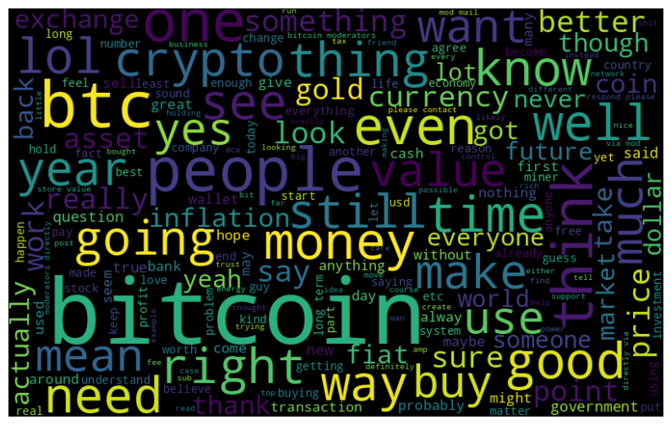
Exploratory Data Analysis
Fig 1.0 Positive Words
We can denote words such as bitcoin, good, buy, profit. Such words are inherently used in a positive context when referring to Bitcoin. They may indicate optimism, confidence in the cryptocurrency's potential, or successful trading experiences.

Slide 10
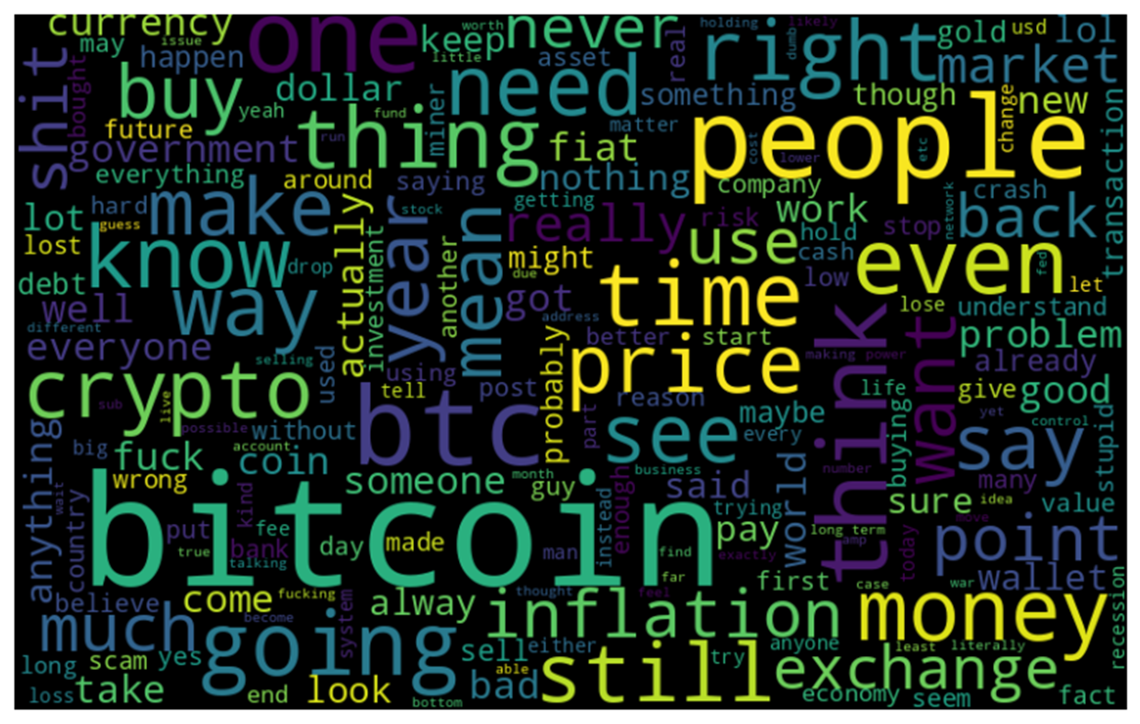
Fig 1.1 Negative Words
We can denote words such as bitcoin, inflation, scam, crash, lost. Such words are typically indicative of skepticism, concerns about Bitcoin's stability, or negative experiences in the market.

Slide 11
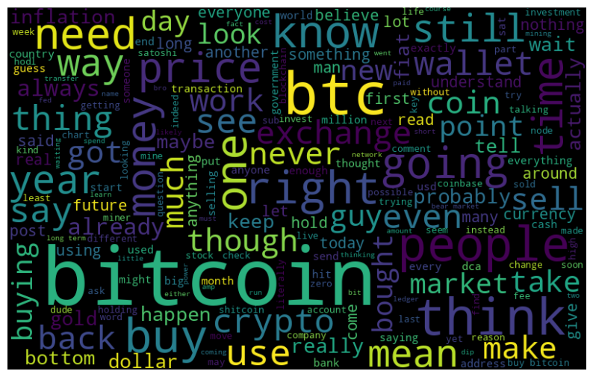
Fig 1.2 Neutral Words
We can denote words such as bitcoin, price, money, back, market, people, think, wallet. Such words often convey objective observations, factual statements, or general discussions without expressing strong positive or negative sentiments.

Slide 12
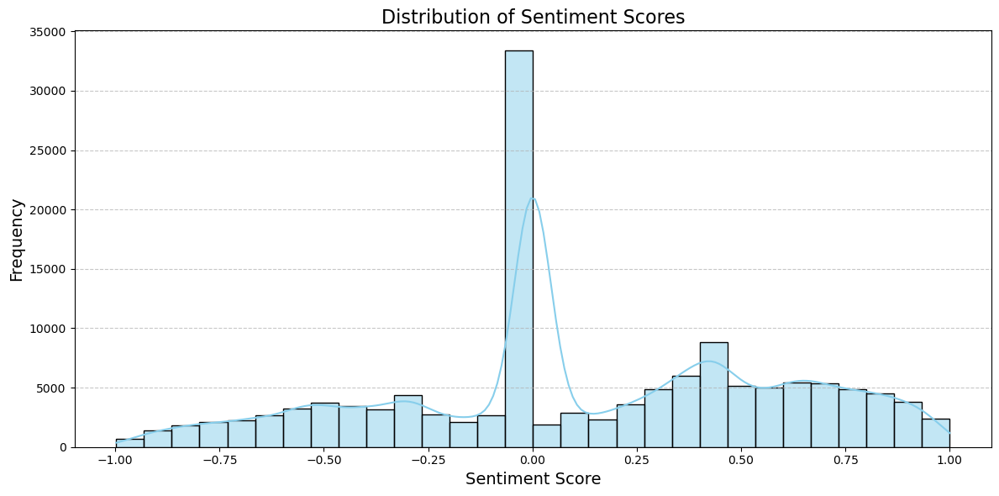
Distribution of Comments by Sentiment Scores
The majority of comments have a sentiment score of 0, indicating a neutral sentiment.
There is a significant number of negative comments between 0 and -1.
Similarly, there is a good number of positive comments between 0 and 1.

Slide 13
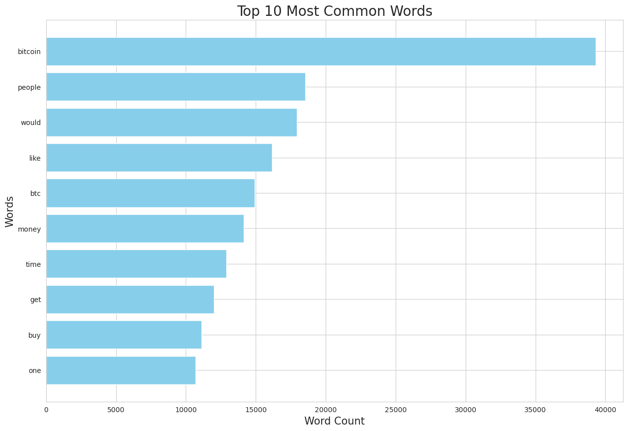
Top 10 Most Frequently Occurring Words
"Bitcoin leads the list with nearly 40k mentions, followed by 'people' at 18k, and the word 'would' at approximately 16k occurrences."

Slide 14
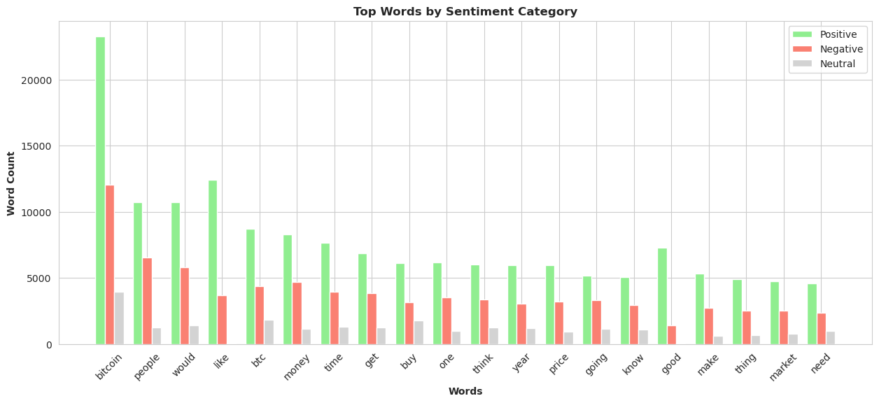
Ranking of Top 20 Word Counts in Each Sentiment Category
In all categories, “Bitcoin” word takes the top position, closely followed by 'people' and the word 'like'.

Slide 15
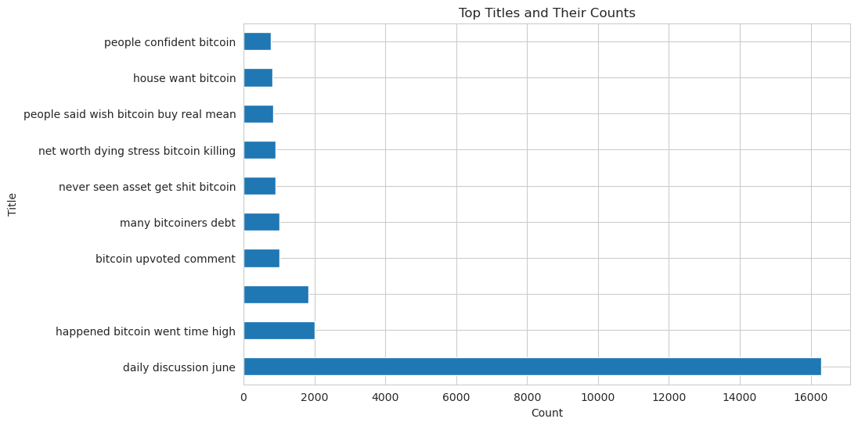
Top 10 Most Discussed Reddit Topics
Notable topics include 'daily discussion June' and 'bitcoin upvoted comment.’
Analyzing sentiments and context can provide insights into discussions.

Slide 16
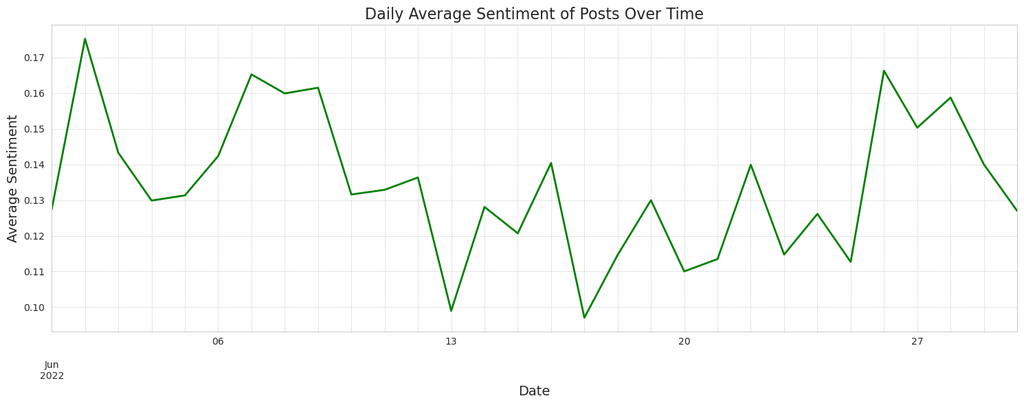
Daily Average Sentiment Across June2022
Sentiments mostly positive in June. Start and end had high positivity, mid-month dip.

Slide 17
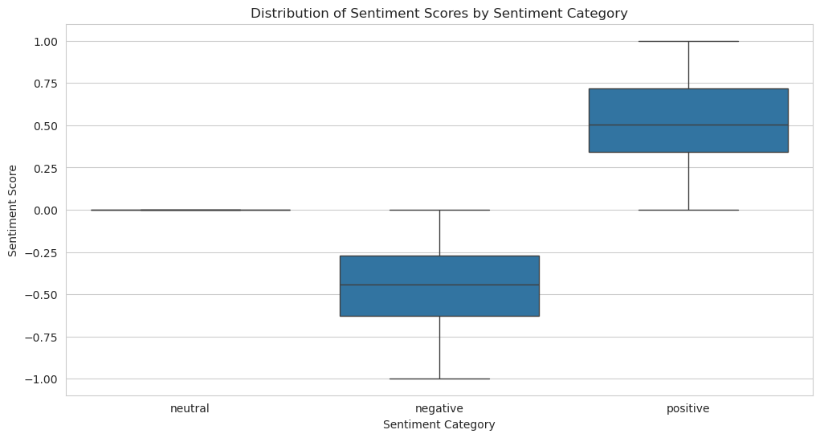
Sentiment Score by Polarity
In the boxplot:
Neutral scores: cluster around 0.
Positive sentiment: ranges from 0.35 to 0.75.
Negative sentiment : spans -0.6 to -0.25.

Slide 18
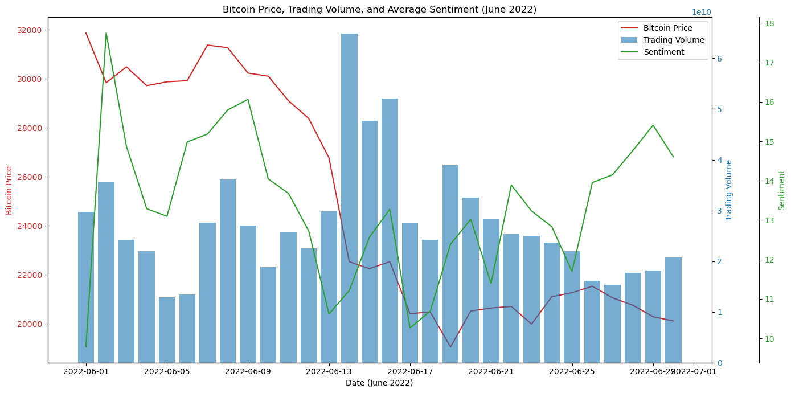
Correlation between Sentiment and Bitcoin Prices
A moderate positive correlation between sentiment and bitcoin prices

Slide 19
Modelling
Model Selection
Choose diverse feature sets: TF-IDF, Word2Vec embeddings, and Doc2Vec embeddings.
Select machine learning and deep learning algorithms
Data Splitting
Segment the data into training and testing sets for model training and evaluation.
Model Training
Fit the selected algorithm on the training data
Model Tuning
Fine-tune the model hyperparameters to optimize performance
Model Evaluation
Assess model performance using various metrics, including Accuracy, F1 Score, and ROC-AUC Score.

Slide 20
Model results
 | Model Name | Train F1-Score | Test F1-Score | Train ROC -AUC | Test ROC -AUC
Classical Models | Multinomial Naive Bayes | 0.73 | 0.699 | 0.854 | 0.814
 | Radom Forest | 0.66 | 0.63 | 0.85 | 0.82
 | XGBoost | 0.73 | 0.60 | 0.88 | 0.77
Neural Models | LSTM(Long Short-Term Memory) | 0.88 | 0.85 | 0.95 | 0.93
 | Transfer Learning(Distill Bert) | 0.91 | 0.88 | 0.97 | 0.95

Slide 21
Final Model Evaluation
Best Model Selection: Our chosen model for deployment is the tuned DistilBERT.
The model results were as follows.
F1 Score: Train - 91.87%, Test - 88.07%
ROC-AUC Score: Train - 97.25%, Test - 95.31%
Loss: Train - 0.403, Validation - 0.417
Unseen Test Data Evaluation
F1 Score: 60%
ROC-AUC: 74%
Overall, the model showed decent sentiment class differentiation capability.

Slide 22
Model Deployment
In the deployment process for the Bitcoin Sentiment Analysis application, we did the following:
Prepared a Streamlit app for user interaction and sentiment analysis.
Managed large model files using Git LFS for efficient version control.
Deployed the app on Streamlit Sharing for public access.
.

Slide 23
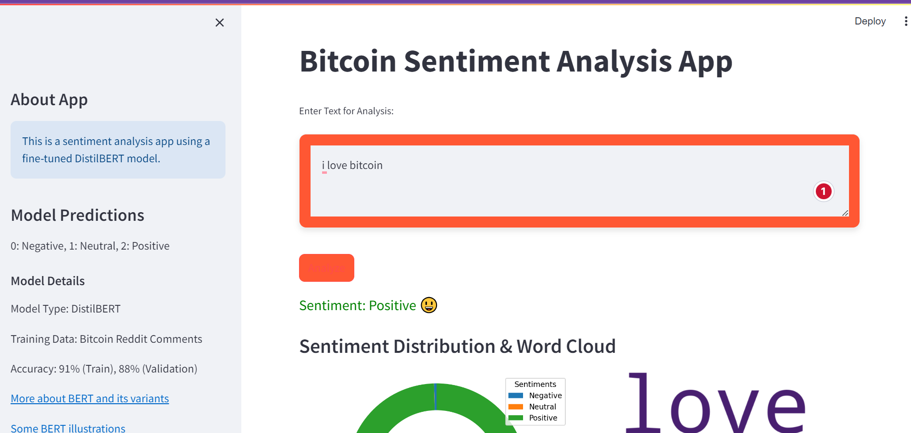

Slide 24
Conclusions
Optimal Model Selection: DistilBERT, with a train and test F1-score of 91.87% and 88.07% respectively, is the preferred choice for sentiment analysis due to its reliability.
Sentiment and Bitcoin Price Correlation: In June 2022, we found a moderate positive correlation (0.315) between Reddit sentiment and Bitcoin price, suggesting sentiment as an indicator. There's also a weak negative correlation (-0.220) with trading volume, hinting at factors like panic selling.
Feature Importance: Key terms such as "like," "good," "scam," and "lost" played significant roles in sentiment prediction, indicating diverse discussions in the Bitcoin community, from positive affirmations to concerns.

Slide 25
recommendations
Real-time Sentiment Monitoring: Integrate DistilBERT for real-time sentiment tracking across cryptocurrency platforms to respond quickly to emerging trends.
Sentiment in Investment Strategies: Use sentiment indicators as supplementary inputs for forecasting Bitcoin price movements. Adjust investments based on sentiment trends.
Monitor Trading Volumes: Watch for negative sentiment coinciding with increased trading volumes, potentially indicating buy-low opportunities.
Enhance Community Engagement: Engage with the Bitcoin community on platforms like Reddit, addressing concerns and influencing positive sentiment.
Diversify Data Sources: Expand sentiment analysis beyond Reddit to include Twitter, forums, and news articles for a comprehensive market sentiment view.

Slide 26
limitations/challenges
Computational Resources: Limited access to high-performance hardware, causing time-consuming model training.
Data Quality and Representativeness: Challenges with data quality, class imbalance, and mixed sentiments in user comments.
Temporal Limitations: Rapidly changing cryptocurrency markets require regular model updates for accuracy.

Slide 27
Next steps
Continuously improve model by training on more data for robustness.
Stay updated with emerging Bitcoin slang and terminology.
Consider external factors in data analysis (e.g., news, regulations).
Use Time Series Forecasting with multiple indicators for investment decisions.
Explore sentiment as a leading indicator with lag analysis.
Perform Granger-causality tests for predictive capabilities in strategies.

Slide 28
Thank you! Questions?

