Slide 1
21.02.2019
Hands-on Training
Data Analytics for Engineering using Python
RAMAR BOSE (Ph.D.,)
Resource Faculty
AU TVS Centre for Quality Management, Anna University.

Slide 2

DATA

Slide 3


Slide 4

Why Python ?
Statistical Engineering
Python is a very popular open source programming language.
It is the most elegant programming language that I know.
It is free.
It is powerful.

Slide 5
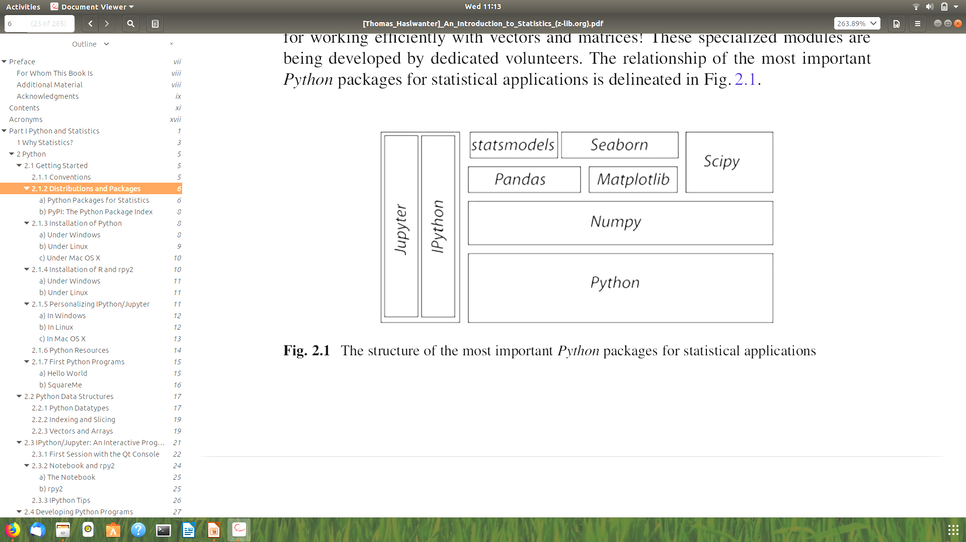
Python Packages for Statistics
Ipython 4.1.2
For interactive work.
Numpy 1.11.0
For working with vectors and arrays.
Scipy 0.17.1
All the essential scientific algorithms, including those for basic statistics.
matplotlib 1.5.1
The de-facto standard module for plotting and visualization.
pandas 0.18.0
Adds DataFrames (imagine powerful spreadsheets) to Python.
patsy 0.4.1
For working with statistical formulas.
statsmodels 0.8.0
For statistical modeling and advanced analysis.
seaborn 0.7.0
For visualization of statistical data.
Statistical Engineering
Statistical Engineering
The structure of the most important Python packages for statistical applications

Slide 6
Python Data Structures
Python Datatypes
Statistical Engineering
Statistical Engineering
Tuples to group objects of different types.
Lists to group objects of the same types.
Arrays to work with numerical data. (Python also offers the data type matrix. However, it is recommended to use arrays, since many numerical and scientific functions will not accept input data in matrix format.)
• Dictionaries for named, structured data sets.
• DataFrames for statistical data analysis.

Slide 7
Tuple( )
A collection of different things. Tuples are “immutable”, i.e., they cannot be modified after creation.
Statistical Engineering
In [1]: import numpy as np
In [2]: myTuple = ('abc', np.arange(0,3,0.2), 2.5)
In [3]: myTuple[2]
Out[3]: 2.5

Slide 8
List [ ]
Lists are “mutable”, i.e., their elements can be modified. Therefore lists are typically used to collect items of the same type (numbers, strings,..). Note that “+” concatenates lists.
Statistical Engineering
In [4]: myList = ['abc', 'def', 'ghij']
In [5]: myList.append('klm')
In [6]: myList
Out[6]: ['abc', 'def', 'ghij', 'klm']
In [7]: myList2 = [1,2,3]
In [8]: myList3 = [4,5,6]
In [9]: myList2 + myList3
Out[9]: [1, 2, 3, 4, 5, 6]

Slide 9
Array [ ]
vectors and matrices, for numerical data manipulation. Defined in numpy. Note that vectors and 1-d arrays are different: vectors CANNOT be transposed! With arrays, “+” adds the corresponding elements; and the array-method .dot performs a scalar multiplication of two arrays.
Statistical Engineering
Statistical Engineering
In [10]: myArray2 = np.array(myList2)
In [11]: myArray3 = np.array(myList3)
In [12]: myArray2 + myArray3
Out[12]: array([5, 7, 9])
In [13]: myArray2.dot(myArray3)
Out[13]: 32

Slide 10
Dictionary { }
Dictionaries are unordered (key/value) collections of content, where the content is addressed as dict['key'] . Dictionaries can be created with the command dict , or by using curly brackets {...}
Statistical Engineering
In [14]: myDict = dict(one=1, two=2, info='some information')
In [15]: myDict2 = {'ten':1, 'twenty':20,
'info':'more information'}
In [16]: myDict['info']
Out[16]: 'some information'
In [17]: myDict.keys()
Out[17]: dict_keys(['one', 'info', 'two'])

Slide 11
DataFrame
Data structure optimized for working with named, statistical data.
Statistical Engineering
Indexing and Slicing
a[start:end] - items start through end-1
a[start:] - items start through the rest of the array
a[:end] - items from the beginning through end-1
a[:] - a copy of the whole array
a[-1] - last item in the array
a[-2:] - last two items in the array
a[:-2] - everything except the last two items

Slide 12
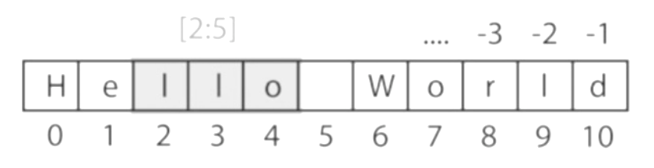
Vectors and Arrays
numpy is the Python module that makes working with numbers efficient. It is commonly imported with
Statistical Engineering
import numpy as np
Indexing starts at 0, and slicing does not include the last value

Slide 13
Vectors and Arrays
By default, it produces vectors. The commands most frequently used to generate numbers are:
np.zeros
generates zeros. Note that it takes only one(!) input. If you want to generate a matrix of zeroes, this input has to be a tuple, containing the number of rows/columns!
In [1]: import numpy as np
In [2]: np.zeros(3)
Out[2]: array([ 0., 0., 0.])
In [3]: np.zeros( (2,3) )
Out[3]: array([[ 0., 0., 0.],
[ 0., 0.,0.]])

Slide 14
Vectors and Arrays
By default, it produces vectors. The commands most frequently used to generate numbers are:
np.ones
np.random.randn
generates ones.
generates normally distributed numbers, with a mean of 0 and a standard deviation of 1.

Slide 15
Vectors and Arrays
By default, it produces vectors. The commands most frequently used to generate numbers are:
np.arange
In [4]: np.arange(3)
Out[4]: array([0, 1, 2])
In [5]: np.arange(1,3,0.5)
Out[5]: array([ 1. , 1.5, 2. , 2.5])
In [6]: xLow = np.arange(0,3,0.5)
In [7]: xHigh = np.arange(3,5,0.5)
In [8]: xLow
Out[8]: array([ 0., 0.5, 1., 1.5, 2., 2.5])
In [9]: xHigh
Out[9]: array([ 3., 3.5, 4., 4.5])
generates a range of numbers. Parameters can be start, end, steppingInterval . Note that the end-value is excluded! While this can sometimes be a bit awkward, it has the advantage that consecutive sequences can be easily generated, without any overlap, and without missing any data points

Slide 16
Vectors and Arrays
By default, it produces vectors. The commands most frequently used to generate numbers are:
np.linspace
np.array
generates linearly spaced numbers.
In [10]: np.linspace(0,10,6)
Out[10]: array([ 0., 2., 4., 6., 8., 10.])
generates a numpy array from given numerical data.
In [11]: np.array([[1,2], [3,4]])
Out[11]: array([ [1, 2], [3, 4] ])

Slide 17

Pandas
Data Structures for Statistics

Slide 18
Data Handling
Common Procedures
In statistical data analysis, labeled data structures have turned out to be immensely useful. To handle labeled data in Python, pandas introduces the so-called DataFrame objects. A DataFrame is a two-dimensional labeled data structure with columns of potentially different types. You can think of it like a spreadsheet or SQL table. DataFrames are the most commonly used pandas objects.
import numpy as np
import pandas as pd
t = np.arange(0,10,0.1)
x = np.sin(t)
y = np.cos(t)
df = pd.DataFrame({'Time':t, 'x':x, 'y':y})
Code_Run

Slide 19
Data Handling
Notes on Data Selection
While pandas’ DataFrames are similar to numpy arrays, their philosophy is different, and I have wasted a lot of nerves addressing data correctly.
numpy
handles “rows” first. E.g., data[0] is the first row of an array
pandas
starts with the columns. E.g., df['values'][0] is the first element of the column 'values' .

Slide 20
Grouping
pandas offers powerful functions to handle missing data which are often replaced by nan’s (“Not-A-Number”). It also allows more complex types of data manipulation like pivoting. For example, you can use data-frames to efficiently group objects, and do a statistical evaluation of each group.
The following data are simulated (but realistic) data of a survey on how many hours a day people watch the TV, grouped into “m”ale and “f”emale responses
import pandas as pd
import matplotlib.pyplot as plt
data = pd.DataFrame({
'Gender': ['f', 'f', 'm', 'f', 'm',
'm', 'f', 'm', 'f', 'm', 'm'],
'TV': [3.4, 3.5, 2.6, 4.7, 4.1, 4.1,
5.1, 3.9, 3.7, 2.1, 4.3]
})
Code_Run

Slide 21

Statsmodels
Tools for Statistical Modeling

Slide 22
Statsmodels
Statsmodels provides classes and functions for the estimation of many different statistical models, as well as for conducting statistical tests and statistical data exploration. An extensive list of result statistics are available for each estimator.
Statsmodels also allows the formulation of models with the popular formula language based on the notation introduced by Wilkinson and Rogers (1973), and also used by S and R.
Linear Regression
Generalized Linear Models
Generalized Estimating Equations
Robust Linear Models
Linear Mixed Effects Models
Regression with Discrete Dependent Variables
ANOVA
Time Series analysis
Models for Survival and Duration Analysis
Statistics (e.g., Multiple Tests, Sample Size Calculations, etc.)
Nonparametric Methods
Generalized Method of Moments
Empirical Likelihood
Graphics functions
A Datasets Package
Code_Run

Slide 23
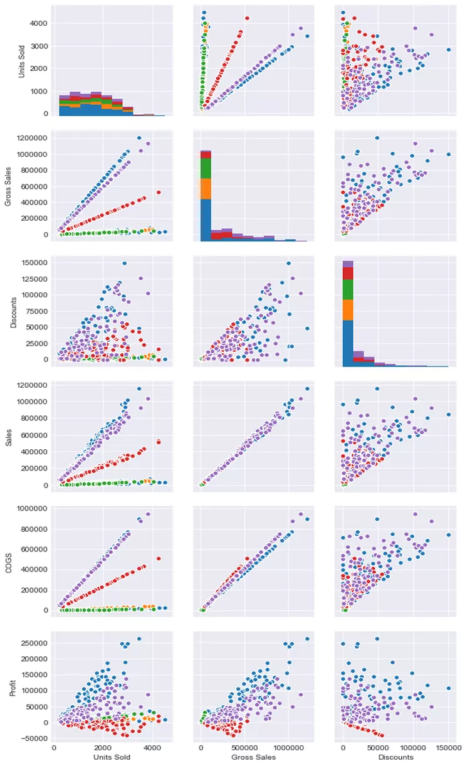
Seaborn
Data Visualization

Slide 24
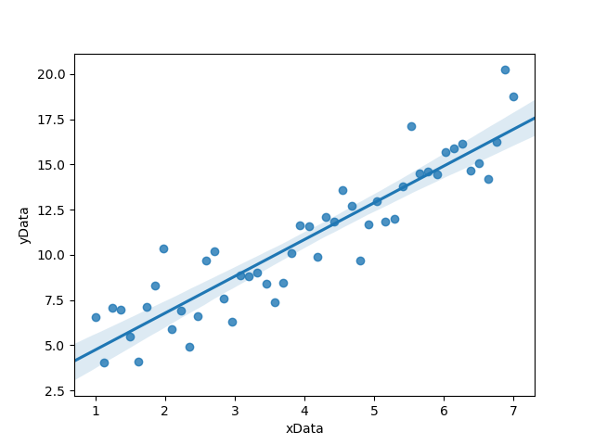
Seaborn
seaborn is a Python visualization library based on matplotlib. Its primary goal is to provide a concise, high-level interface for drawing statistical graphics that are both informative and attractive
Code_Run

Slide 25
Displaying Statistical Dataset

Slide 26
Univariate Data
Scatter Plots
Histograms
Kernel-Density-Estimation (KDE) Plots
Cumulative Frequencies
Error-Bars
Box Plots
Grouped Bar Charts
Pie Charts
Programs: Data Display

Slide 27
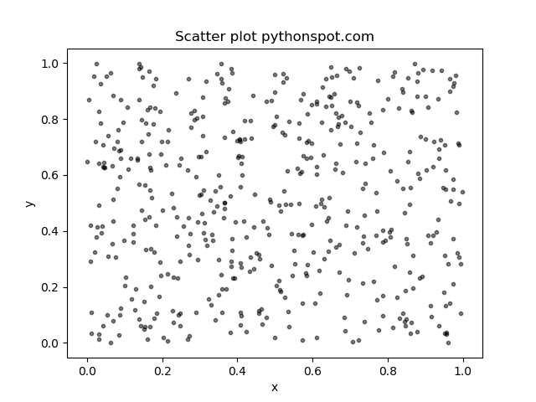
Scatter Plots
A scatter plot is a two-dimensional data visualization that uses dots to represent the values obtained for two different variables - one plotted along the x-axis and the other plotted along the y-axis.
Scatter plots are used when you want to show the relationship between two variables. Scatter plots are sometimes called correlation plots because they show how two variables are correlated.
Code_Run
Scatter plot with groups

Slide 28
Histograms
Histograms provide a first good overview of the distribution of your data. If you divide by the overall number of data points, you get a relative frequency histogram; and if you just connect the top center points of each bin, you obtain a relative frequency polygon.
plt.hist(x, bins=25)
Code_Run
Code_Run 1

Slide 29
Kernel-Density-Estimation (KDE) Plots
Kernel Density Plots, Density Trace Graph. A Density Plot visualises the distribution of data over a continuous interval or time period. This chart is a variation of a Histogram that uses kernel smoothing to plot values, allowing for smoother distributions by smoothing out the noise.
Code_Run

Slide 30
Cumulative Frequencies
A cumulative frequency curve indicates the number (or percent) of data with less than a given value. This curve is very useful for statistical analysis, for example when we want to know the data range containing 95 % of all the values. Cumulative frequencies are also useful for comparing the distribution of values in two or more different groups of individuals.
Code_Run

Slide 31
Error-Bars
Error-bars are a common way to show mean value and variability when comparing measurement values. Note that it always has to be stated explicitly if the error-bars correspond to the standard deviation or to the standard error of the data.
Code_Run

Slide 32
Box Plots
Boxplots are frequently used in scientific publications to indicate values in two or more groups. The bottom and top of the box indicate the first quartile and third quartile, respectively, and the line inside the box shows the median.
Code_Run

Slide 33
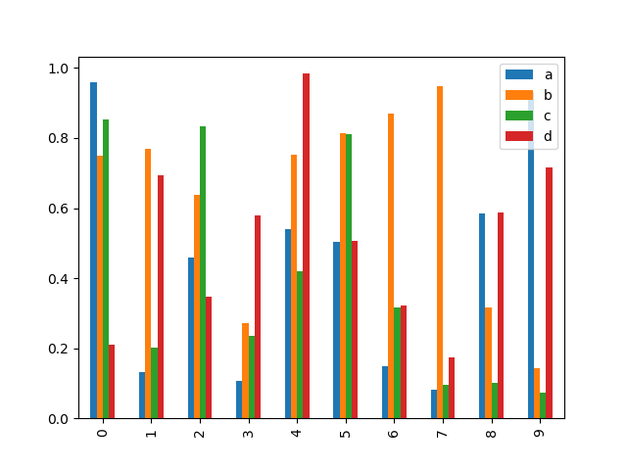
Grouped Bar Charts
the plotting abilities of pandas can facilitate the generation of useful graphs,
Code_Run

Slide 34
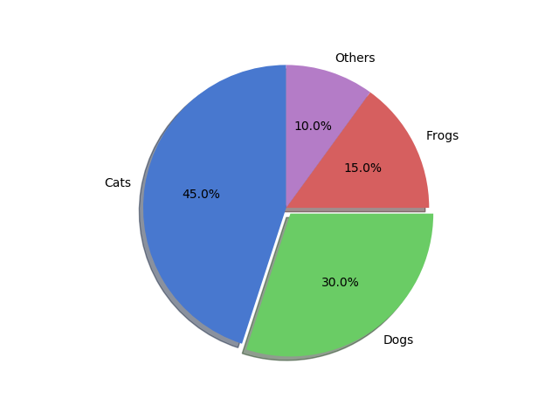
Pie Charts
Pie charts can be generated with a number of different options
Code_Run

Slide 35
Linear Regression Model

Slide 36
Simple Linear Regression
Simple linear regression is an approach for predicting a response using a single feature.
h(x_i) represents the predicted response value for ith observation.
b_0 and b_1 are regression coefficients and represent y-intercept and slope of regression line respectively.
Code_Run

Slide 37
Multiple Linear Regression
Given below is the implementation of multiple linear regression technique on the Boston house pricing dataset using Scikit-learn.
Code_Run

Slide 38
Thank you..!
https://goo.gl/Lj3wzf

