Slide 1
HACKERZDOM TUTORIALS
Final year degree project
Don bosco college, sulthan bathery
Team members:
Sibin mathew
Hemant p hareesh
Joby george
Under the guidance of Fr.johny jose

Slide 2
Topic
A tutorial website that provides students with courses on basic computer science topics.

Slide 3
Brief
This website provides quality classes to students for a low price.
Provides features that help in testing what they learned.
Topics come under 3 sections: level 1 , level 2 , level3 This helps a student to approach our site in the best way possible.

Slide 4
Software Development Life Cycle
An SDLC model is a conceptual framework describing all activities in a software development project from planning to maintenance.

Slide 5
Waterfall Model
The waterfall model is a software development methodology strategy which relies on following a set sequence of actions from top to bottom in the form of a waterfall. Its stages are closely aligned with the software development life cycle (SDLC) from which it evolved.

Slide 6
Steps of waterfall model
Requirement gathering & Analysis
Design
Coding
Testing
Implementation

Slide 7
REQUIREMENT GATHERING AND ANALYSIS

Slide 8
System Analysis
It is a process of collecting and interpreting facts, identifying the problems, and decomposition of a system into its components. System analysis is conducted for the purpose of studying a system or its parts in order to identify its objectives.

Slide 9
System Analyst
The Analyst who carries out the system analysis must know what information to gather, where to find it, how to collect it, and what to make of it. The proper use of tools for gathering information is the key to successful analysis.

Slide 10
The tools used in this project for this are the traditional
Interview
Questionnaire
On-site observations

Slide 11
Requirements
Less data consuming
Video quality and playback options
Search bar should be provided to search the contents of the website.
Should not be overcrowded with advertisements.
Provide switches to go from bottom to top, links to other websites to read more and links to give info about keywords.
Provide options to convert language, provide feedback, post complaints, ask questions and view most-viewed or most-attended topics/courses.
Provide facilities for online tests.
Provide attractive interface to users(use flip, dark mode etc.).
Create website that is compatible with most devices and browsers.
Should load faster, should be able to make notes or video offline.

Slide 12
There should be 2 main people other than the user and admin to make the site efficient- Content developer and Inspector
Admin should be able to add inspectors, approve content developers and add videos and content, view users, view videos and content accepted by inspector and accept payments and view payment details.
Inspector should be able to view contents provided by admin and make sure it is relevant and if necessary should be able to add to website and else should be able to remove those.
Students should be able to view courses(and demo classes) see their progress, attend tests and request for contents not available in this site. To create interest in students badges can be made given based on their progress.

Slide 13
Log sessions of course for student: It is very useful to the student if whatever the student has learned until then are recorded and shown to the user in his dashboard for this, each time the user logs in and learns something it should be recorded and progress of a user in his course should be shown.
Login easily using google or facebook.
Provide details on what all you can do in this site(welcome note/guide).
Anybody can contribute contents to admin.
Live projects -we can work on sample projects, materials available in pdf, inbuilt text editors(we can use online editors without downloading software).

Slide 14
EXISTING SYSTEM
1. The current systems include tutorial sites with huge payment.
2. Uses complicated language, difficult accent.
3. Quality of videos are controlled automatically.
4. Provides demo videos for users
5. Some sites allow users to provide video classes to admin for money.
6. Current systems provide interactive interface, provide tests.

Slide 15
Disadvantages of existing system
1. Most systems do not take feedback.
2. Some sites do not allow users to control video quality, playback.
3. Quality of content, not user friendly.
4. Some websites use lot of data.
5. Classes in native language is not available
6. Most websites are not compatible with certain browsers and interface is same in different devices.

Slide 16
Proposed System
requirements being implemented in this tutorial site

Slide 17
1)Video quality and playback options-users are able to change the quality of videos as per their convenience.
2)search bar to search for topics and contents .
3)3 levels:level-0:is a responsive page where content gets updated everyday.level-2:is tutorial videos and content and level-3:totally pratical class.
4)provides no advertisements.
5)Provide switches to go from bottom to top, links to other websites to read more and links to give info about keywords.
6)provides feedback and comments to ask doubt.
7)Provide facilities for online tests.
8)Provide attractive interface to users(use flip, dark mode etc.).

Slide 18
9)Create website that is compatible with most devices and browsers.Admin should be able to add videos and content, view users, view videos and content accepted by inspector and accept payments and view payment details.
10)Inspector should be able to view contents provided by admin and make sure it is relevant and if necessary should be able to add to website and else should be able to remove those.
11)Students should be able to view courses(and demo classes) see their progress, attend tests and request for contents not available in this site. To create interest in students badges can be made given based on their progress.
12)Log sessions of course for student: It is very useful to the student if whatever the student has learned until then are recorded and shown to the user in his dashboard for this, each time the user logs in and learns something it should be recorded and progress of a user in his course should be shown.
13)Provide details on what all you can do in this site(welcome note/guide).
14)Anybody can contribute contents to admin.

Slide 19
Advantage of proposed system
Anybody can contribute contents to admin.
Students can also earn money my making content.
Compatible with most devices and browsers.
Less advertisement and can clear doubts.
Video quality and playback options for users.
Easy, efficient and less time consuming.
high speed response to users.

Slide 20
Feasibility study
Economical feasibility
Development of this application is economical feasible. The organization or hypermarket need not spend much money for the accomplishment of the project since the resources required for the development of system is already available. Even after the development, the organization need not be in a position to invest more on maintenance and hence the system is economically feasible.

Slide 21
Technical feasibility
It involves determining whether or not a system can actually constructed to solve the problem at hand. The proposed system is technically feasible. Since the necessary technology exist in the organization and also will not be much difficulty in getting the required resources for the development and for the maintenance of the system as well. Ph p and android has a neutral architecture.

Slide 22
Operational feasibility
Proposed system is beneficial because they can be turned into information system will meet the organization’s operating requirements.

Slide 23
Modules
ADMINISTRATOR MODULE
Admin should be able to add videos and content, view users, view videos and content accepted by inspector and accept payments and view payment details.
INSPECTOR MODULE
Inspector should be able to view contents provided by admin and make sure it is relevant and if necessary should be able to add to website and else should be able to remove those.
STUDENT MODULE
Students should be able to view courses(and demo classes) see their progress, attend tests and request for contents not available in this site. To create interest in students badges can be made given based on their progress.
TEACHER MODULE
Provide content to the admin which are inspected by the inpector and approved or rejected by the same.if approved they get money for the work.

Slide 24
SOFTWARE REQUIREMENT SPECIFICATION
Operating system: windows 10
Front end: PHP
Back end: MySQL

Slide 25
Design
DFD
Use case Diagram
ER diagram
Class diagram

Slide 26
Unified Modeling Language
The Unified Modeling Language is a general-purpose, developmental, modeling language in the field of software engineering that is intended to provide a standard way to visualize the design of a system.

Slide 27
Use Case Diagram
The purpose of a use case diagram in UML is to demonstrate the different ways that a user might interact with a system.

Slide 28
In the Unified Modeling Language (UML), a use case diagram can summarize the details of your system's users (also known as actors) and their interactions with the system. To build one, you'll use a set of specialized symbols and connectors. An effective use case diagram can help your team discuss and represent:
Scenarios in which your system or application interacts with people, organizations, or external systems
Goals that your system or application helps those entities (known as actors) achieve
The scope of your system

Slide 29
symbols and notation
Use cases: Horizontally shaped ovals that represent the different uses that a user might have.
Actors: Stick figures that represent the people actually employing the use cases.
Associations: A line between actors and use cases. In complex diagrams, it is important to know which actors are associated with which use cases.
Packages: A UML shape that allows you to put different elements into groups. Just as with component diagrams, these groupings are represented as file folders.

Slide 30
Class Diagram
Class diagrams are one of the most useful types of diagrams in UML as they clearly map out the structure of a particular system by modeling its classes, attributes, operations, and relationships between objects.

Slide 31
Basic components of a class diagram
Classes
Attributes
Methods
Member access modifiers
All classes have different access levels depending on the access modifier (visibility). Here are the access levels with their corresponding symbols:
Public (+)
Private (-)
Protected (#)
Package (~)

Slide 32
Interactions of class diagram
Inheritance

Slide 33
DFD
A data flow diagram (DFD) maps out the flow of information for any process or system. It uses defined symbols like rectangles, circles and arrows, plus short text labels, to show data inputs, outputs, storage points and the routes between each destination. Data flowcharts can range from simple, even hand-drawn process overviews, to in-depth, multi-level DFDs that dig progressively deeper into how the data is handled.

Slide 34
Symbols and Notations Used in DFDs
External entity: an outside system that sends or receives data, communicating with the system being diagrammed
Process: any process that changes the data, producing an output.
Data store: files or repositories that hold information for later use, such as a database table or a membership form.
Data flow: the route that data takes between the external entities, processes and data stores.

Slide 35
What is an ER diagram?
An Entity Relationship (ER) Diagram is a type of flowchart that illustrates how “entities” such as people, objects or concepts relate to each other within a system. ER Diagrams are most often used to design or debug relational databases in the fields of software engineering

Slide 36
The components of an ER diagram
Entity:A definable thing—such as a person, object, concept or event—that can have data stored about it
Relationship:How entities act upon each other or are associated with each other.
Attribute:A property or characteristic of an entity
Cardinality:Defines the numerical attributes of the relationship between two entities or entity sets

Slide 37
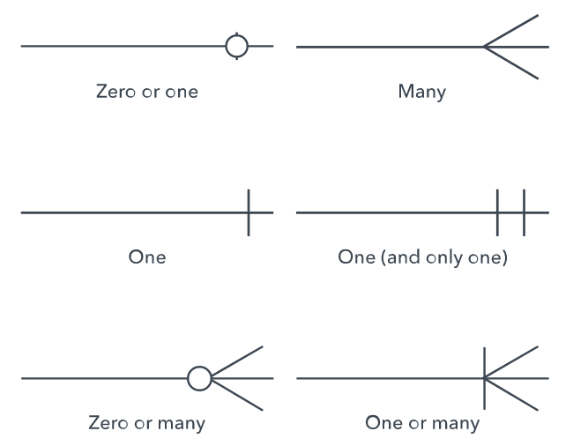

Slide 38
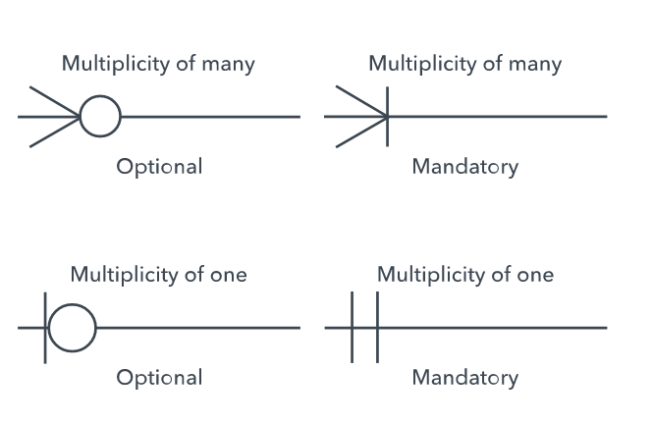

Slide 39
Styles
Chen notation style
Crow’s Foot/Martin/Information Engineering style
Bachman style

Slide 40
UML Diagrammimg tools
Start UML
Lucid Chart

Slide 42
Table Design
login
column name | data type | constraint
login_id | integer | primary key
email | varchar(18)
password | varchar(20)
role

Slide 43
student details
column name | data type | constraint
login_id | integer
student_id | integer | primary key
name | varchar(15)
gender | varchar(10)
country | varchar(10)
state | varchar(10)
phone number | integer
age | integer
last login | date

Slide 44
content
column name | data type | constraint
content_id | integer | primary key
content name | varchar(18)
inspector approved | boolean
content depth | integer
people viewed | integer
developer id | integer
content length | integer
paid | boolean

Slide 45
content developer
column name | data type | constraint
developer id | integer | primary key
name | varchar(18)
quali_doc | varchar(18)
expertise | varchar(10)
admin_aproved | boolean
login_id | integer

Slide 46
inspector
column name | data type | constraint
inspector_id | integer | primary key
email | varchar(18)
name | varchar(18)
login_id | integer

Slide 47
inspector expertise
column name | data type | constraint
expertise id | integer | primary key
inspector_id | integer
expertise | varchar(10)

Slide 48
search
column name | data type | constraint
keyword | varchar(15) | primary key
value | integer

Slide 49
approvals
column name | data type | constraint
content id | integer | composite key
inspector id | integer
approved | boolean

Slide 50
inspector feedback
column name | data type | constraint
inspector_id | integer | composite key
content id | integer
feedback | varchar(100)

Slide 51
student log
column name | data type | constraint
student_id | integer | composite key
content_id | integer
paused time | time
rating | integer
date(paid for course on) | date
watch time | time
request
column name | data type | constraint
student_id | integer | primary key
requests | varchar(100)
date | integer

Slide 52
tests
column name | data type | constraint
test number | varchar(6) | composite key
content id | integer
question_num | integer
question | varchar(100)
option a | varchar(50)
option b | varchar(50)
option c | varchar(50)
option d | varchar(50)
answer option | char(1)
dificulty level | integer

Slide 53
payment
column name | data type | constraint
trans_num | varchar(18) | primary key
email | varchar(18)
content id | integer
transaction date | varchar(10)
transaction amount | integer

Slide 54
content keyword
column name | data type | constraint
keyword id | integer | primary key
content id | integer
keyword | varchar(15)
blacklist
column name | data type | constraint
inspector id | integer | primary key
content id | integer

Slide 55
test attended
column name | data type | constraint
student_id | integer | composite key
content id | integer
test number | integer
badges | small int
Suggestion
column name | data type | constraint
suggestion id | integer
developer_id | integer | primary key
suggestion | varchar(100)
date | integer

Slide 56
stud_feedback
column name | data type | constraint
student_id | integer | composite primary key
content id | integer
feedback | varchar(100)
topics
column name | data type | constraint
topic name | varchar(30) | primary key

Slide 57
Thank you…../…./….

