Slide 1
HACKERZDOM TUTORIALS
Final year degree project
Don bosco college, sulthan bathery
Team members:
Sibin mathew
Hemant p hareesh
Joby george
Under the guidance of Dr.Fr.johny jose

Slide 2
Topic
A tutorial website that provides students with courses on basic computer science topics.

Slide 3
Brief
This website provides quality classes to students for a low price.
Provides features that help in testing what they learned.
Topics come under 3 sections: level 1 , level 2 , level3 This helps a student to approach our site in the best way possible.

Slide 4
Software Development Life Cycle
An SDLC model is a conceptual framework describing all activities in a software development project from planning to maintenance.
Some of the SDLC models are:
Iterative Model
Spiral Model
Agile Model
Prototype Model

Slide 5
Waterfall Model
The waterfall model is a software development methodology strategy which relies on following a set sequence of actions from top to bottom in the form of a waterfall. Its stages are closely aligned with the software development life cycle (SDLC) from which it evolved.

Slide 6
Steps of waterfall model
Requirement gathering & Analysis
Design
Coding
Testing
Implementation

Slide 7
REQUIREMENT GATHERING AND ANALYSIS

Slide 8
System Analysis
It is a process of collecting and interpreting facts, identifying the problems, and decomposition of a system into its components. System analysis is conducted for the purpose of studying a system or its parts in order to identify its objectives.

Slide 9
System Analyst
The Analyst who carries out the system analysis must know what information to gather, where to find it, how to collect it, and what to make of it. The proper use of tools for gathering information is the key to successful analysis.

Slide 10
Methods to gather information are:
Interview
Questionnaire
On-site observations
Literature review
Visiting similar sites

Slide 11
Existing System
The current systems include tutorial sites with huge/less payment.
Some sites uses complicated language, difficult accent.
Quality of videos are controlled automatically.
Provides demo videos for users.
Some sites allow users to provide video classes to admin for money.
Current systems provide interactive interface, provide tests.

Slide 12
Drawbacks of Existing System
Do not take feedback.
Some sites do not allow users to control video quality, playback.
Poor quality of content, not user friendly.
Some websites use lot of data.
Classes in native language is not available
Most websites are not compatible with certain browsers and interface is same in different devices.
Some sites provide either only text material or only videos.
Does not give option to understand the learning level of students

Slide 13
Software Requirement specification
or Requirements

Slide 14
Proposed System
requirements being implemented in this tutorial site

Slide 15
Video quality and playback options-users are able to change the quality of videos as per their convenience.
Search bar to search for topics and contents .
3 levels.
Provides no advertisements.
Provide switches to go from bottom to top, links to other websites to read more and links to give info about keywords.
Provides feedback and comments to ask doubt.
Provide facilities for online tests.
Provide attractive interface to users(use flip, dark mode etc.).

Slide 16
Create website that is compatible with most devices and browsers.
Role of admin
Role of inspector
Students
Provide details on what all you can do in this site(welcome note/guide).
Anybody can contribute contents to admin.

Slide 17
Advantage of proposed system
Anybody can contribute contents to admin.
Students can also earn money my making content.
Compatible with most devices and browsers.
Less advertisement and can clear doubts.
Video quality and playback options for users.
Easy, efficient and less time consuming.
high speed response to users.

Slide 18
Feasibility study
Economical feasibility
Development of this application is economical feasible. Economic feasibility also known as cost/benefit analysis is a procedure to determine the benefits and savings that are expected from a candidate system and compare them with cost. If benefits outweigh costs, then the decision is made to design and implement the system.

Slide 19
Technical feasibility
It involves determining whether or not a system can actually constructed to solve the problem at hand. The proposed system is technically feasible. Since the necessary technology exist and the required resources for the development and maintenance is easily available as well.

Slide 20
Behavioral Feasibility
People are inherently resistant to change, and computers have been known to facilitate change.
In this project there is minimum behavioural feasibility as the users are mainly students and are already very well aware of tutorial sites and skilled enough to use a computer properly.

Slide 21
Legal Feasibility
Legal feasibility is the study to know if the proposed project conform the legal and ethical requirements. Content we distribute should be our own, it should not be copied from any other source, if done we should reference it .

Slide 22
Modules
ADMINISTRATOR MODULE
Admin should be able to add videos and content, view users, view videos and content accepted by inspector and accept payments and view payment details.
INSPECTOR MODULE
Inspector should be able to view contents provided by admin and make sure it is relevant and if necessary should be able to add to website and else should be able to remove those.
STUDENT MODULE
Students should be able to view courses(and demo classes) see their progress, attend tests and request for contents not available in this site. To create interest in students badges can be made given based on their progress.
TEACHER MODULE
Provide content to the admin which are inspected by the inpector and approved or rejected by the same.if approved they get money for the work.

Slide 23
Design
DFD
Use case Diagram
ER diagram
Class diagram (since OOP paradigm is used)

Slide 24
Unified Modeling Language
The Unified Modeling Language is a general-purpose, developmental, modeling language in the field of software engineering that is intended to provide a standard way to visualize the design of a system.

Slide 25
UML Diagrammimg tools
Start UML
Lucid Chart

Slide 26
Use Case Diagram
The purpose of a use case diagram in UML is to demonstrate the different ways that a user might interact with a system.

Slide 27
symbols and notation
Use cases: Horizontally shaped ovals that represent the different uses that a user might have.
Actors: Stick figures that represent the people actually employing the use cases.
Associations: A line between actors and use cases. In complex diagrams, it is important to know which actors are associated with which use cases.
Packages: A UML shape that allows you to put different elements into groups. Just as with component diagrams, these groupings are represented as file folders.

Slide 28
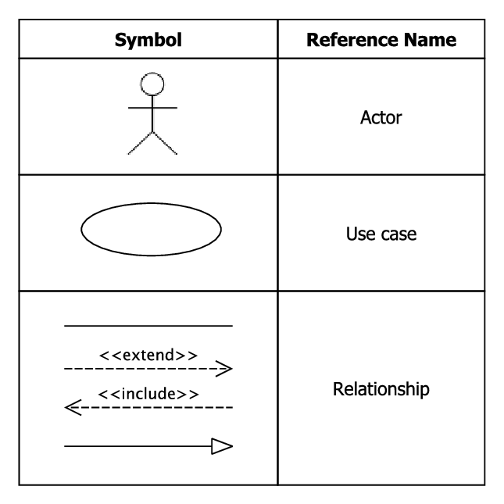

Slide 29
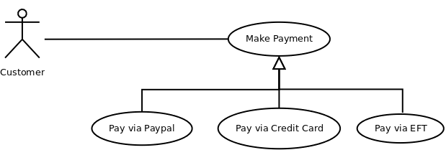

Slide 30
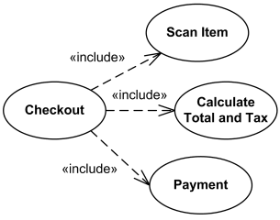

Slide 31
Class Diagram
Class diagrams are one of the most useful types of diagrams in UML as they clearly map out the structure of a particular system by modeling its classes, attributes, operations, and relationships between objects.

Slide 32
Basic components of a class diagram
Classes
Attributes
Methods
Member access modifiers
All classes have different access levels depending on the access modifier (visibility). Here are the access levels with their corresponding symbols:
Public (+)
Private (-)
Protected (#)
Package (~)

Slide 33
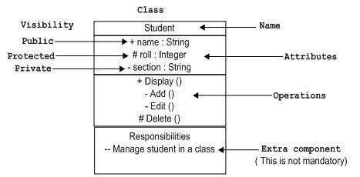

Slide 34
DFD
A data flow diagram (DFD) maps out the flow of information for any process or system. It uses defined symbols like rectangles, circles and arrows, plus short text labels, to show data inputs, outputs, storage points and the routes between each destination. Data flowcharts can range from simple, even hand-drawn process overviews, to in-depth, multi-level DFDs that dig progressively deeper into how the data is handled.

Slide 35
What is an ER diagram?
An Entity Relationship (ER) Diagram is a type of flowchart that illustrates how “entities” such as people, objects or concepts relate to each other within a system. ER Diagrams are most often used to design or debug relational databases in the fields of software engineering

Slide 36
The components of an ER diagram
Entity:A definable thing—such as a person, object, concept or event—that can have data stored about it
Relationship:How entities act upon each other or are associated with each other.
Attribute:A property or characteristic of an entity
Cardinality:Defines the numerical attributes of the relationship between two entities or entity sets

Slide 37
Styles
Chen notation style
Crow’s Foot/Martin/Information Engineering style
Bachman style
Here we are using crow foot model

Slide 38
Entity
Attribute Attribute Attribute Attribute

Slide 39
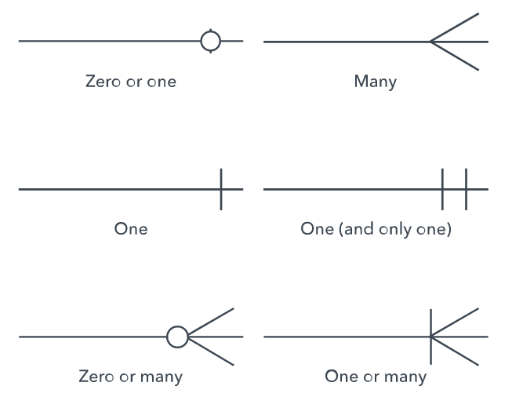

Slide 40
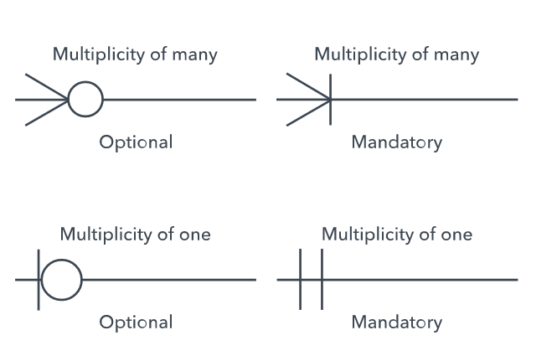

Slide 41
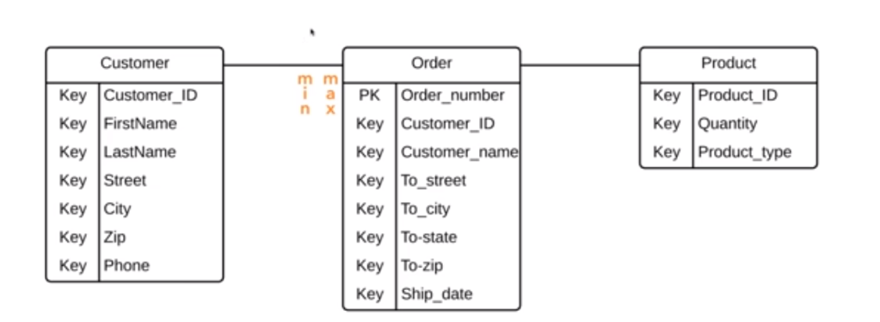

Slide 42
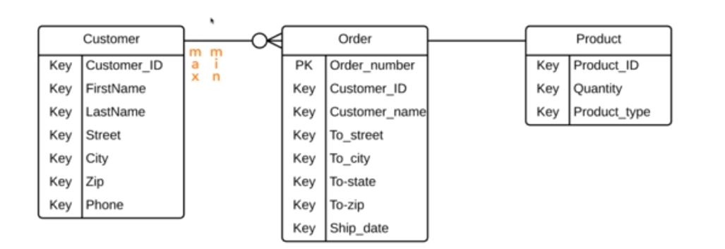

Slide 43
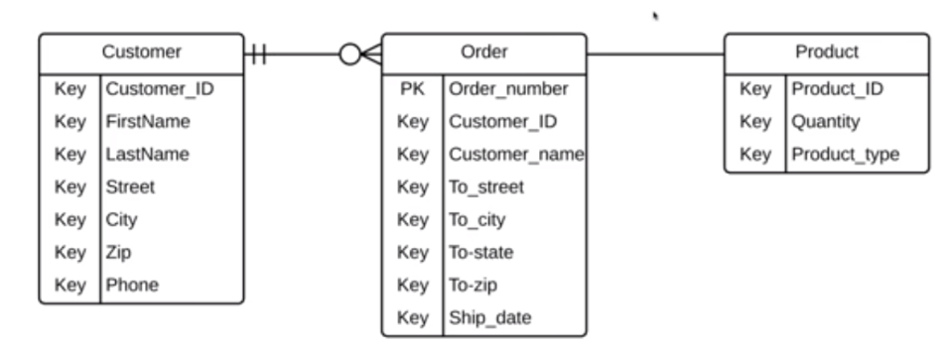

Slide 44
Table Design
login
column name | data type | constraint
login_id | integer | primary key
email | varchar(18)
password | varchar(20)
role | varchar(20)

Slide 45
student details
column name | data type | constraint
login_id | integer | foreign key
student_id | integer | primary key
name | varchar(15)
gender | varchar(10)
country | varchar(10)
state | varchar(10)
phone number | integer
age | integer
last login | date

Slide 46
content
column name | data type | constraint
content_id | integer | primary key
content name | varchar(18)
inspector approved | boolean
content depth | integer
people viewed | integer
developer id | integer
content length | integer
paid | boolean

Slide 47
content developer
column name | data type | constraint
developer id | integer | primary key
name | varchar(18)
quali_doc | varchar(18)
expertise | varchar(10)
admin_aproved | boolean
login_id | integer | foreign key

Slide 48
inspector
column name | data type | constraint
inspector_id | integer | primary key
email | varchar(18)
name | varchar(18)
login_id | integer | foreign key

Slide 49
inspector expertise
column name | data type | constraint
expertise id | integer | primary key
inspector_id | integer
expertise | varchar(10)

Slide 50
search
column name | data type | constraint
keyword | varchar(15) | primary key
value | integer

Slide 51
approvals
column name | data type | constraint
content id | integer | composite key
inspector id | integer
approved | boolean

Slide 52
inspector feedback
column name | data type | constraint
inspector_id | integer | composite key
content id | integer
feedback | varchar(100)

Slide 53
student log
column name | data type | constraint
student_id | integer | composite key
content_id | integer
paused time | time
rating | integer
date(paid for course on) | date
watch time | time
request
column name | data type | constraint
student_id | integer | primary key
requests | varchar(100)
date | integer

Slide 54
tests
column name | data type | constraint
test number | varchar(6) | composite key
content id | integer
question_num | integer
question | varchar(100)
option a | varchar(50)
option b | varchar(50)
option c | varchar(50)
option d | varchar(50)
answer option | char(1)
dificulty level | integer

Slide 55
payment
column name | data type | constraint
trans_num | varchar(18) | primary key
email | varchar(18)
content id | integer
transaction date | varchar(10)
transaction amount | integer

Slide 56
content keyword
column name | data type | constraint
keyword id | integer | primary key
content id | integer | foreign key
keyword | varchar(15)
blacklist
column name | data type | constraint
inspector id | integer
content id | integer

Slide 57
test attended
column name | data type | constraint
student_id | integer | composite key
content id | integer
test number | integer
badges | small int
Suggestion
column name | data type | constraint
suggestion id | integer | primary key
developer_id | integer | Foreign key
suggestion | varchar(100)
date | integer

Slide 58
stud_feedback
column name | data type | constraint
student_id | integer | composite primary key
content id | integer
feedback | varchar(100)
topics
column name | data type | constraint
topic name | varchar(30) | primary key

Slide 59
Normalisation

Slide 60
First Normal Form (1NF)
Each column contain atomic values.
In each column value stored should be of same datatype.
Each column should have unique name.

Slide 61
Second Normal Form (2 NF)
Should be in 1NF.
Should not have any partial dependencies.

Slide 62
Third Normal Form (3NF)
Should be in 2NF.
Should not have transitive dependency.

Slide 63
Boyce-Codd Normal Form (3.5NF)
Should be in 3NF.
For any dependency A => B , A should be a super key

Slide 64
Fourth Normal Form (4NF)
Should satisfy BCNF
No multivalued dependency should be there. ( A=>B is multivalued dependency if a single value of A has more than one value of B in a table [for multivalued dependency there should be min. 3 columns] then B and other columns should not depend on each other.

Slide 65
CODING
OOP paradigm
Form validations
Sublime text editor
Otp
Github

Slide 66
Testing
Unit Testing (module wise testing)
Integration Testing
Validation Testing (checking with the requirements)
Output Testing
User Acceptance Testing (for clients)

Slide 67
FUTUTRE
E-mail ids can be changed
Text along with video will be given
Security issues
Search bar
Dark mode
Inspector analysis will be completed
Provide tutorials in many native languages.
Students can be assigned with a guide.

Slide 68
Less data consuming
Should load faster, should be able to make materials and video offline.
Login easily using Google or Facebook.
Study materials available in pdf also.
Live projects

Slide 69
REFERENCES
Systems Analysis and Design : Elias M. Awad
Principles of Software Engineering : Rohitkhurana

Slide 70
Thank you…../…./….

