Slide 1
A Benchmark Suite for Serverless Computing
AWS Lambda - Microsoft Azure Functions - Google Cloud Functions - IBM Cloud Functions
Master Thesis - Final Presentation
Pascal Maissen pascal.maissen@unifr.ch
March 2, 2020
Swiss Joint Master of Science in Computer Science, University of Neuchâtel

Slide 2
Table of contents
Problem Description and Motivation
Serverless - Function as a Service (FaaS)
Proposed solution
Implementation
Demo
Results
Summary and Discussion

Slide 3
Problem Description and Motivation
Trend towards cloud computing
Many (smaller) businesses are not interested in managing and maintaining hardware, VMs or operating systems
Solution: Serverless computing
Focus on Function as a Service (Faas)
Not much effort so far to test, benchmark and compare offered platforms

Slide 4

FaaS - Overview
High-level serverless FaaS platform architecture
Edge Master
User interface
Dispatcher
Worker
…
Event queue
function main() { return {
payload:'Hello!'
};
}
code
code
API
gateway
code
Cloud event sources
Worker
…
Worker
code |  | code
code |  | code
Source: Castro, Paul ; Ishakian, Vatche ; Muthusamy, Vinod ; Slominski, Aleksander:
The Rise of Serverless Computing. In: Commun. ACM 62 (2019), November, Nr. 12, 44–54. http://dx.doi.org/10.1145/3368454. – DOI 10.1145/3368454. – ISSN 0001–0782

Slide 5
FaaS - Characteristics
Stateless
Automatic scaling
No hardware and server management
Paid per usage
Usage: Application backends and data processing

Slide 6
FaaS - Challenges
Performance
Scalability
Usability
Pricing
Limitations

Slide 7
Proposed Solution
Benchmark suite for serverless computing
Packaged with Docker
Easy to use
4 Clouds:
AWS Lambda
Azure Functions
Google Functions
IBM Functions
4 Runtimes:
Node.js (JavaScript)
Python
Go
.NET Core (C#)
5 Tests:
Latency
Factors (CPU)
Matrix (CPU)
File system
Custom

Slide 8









Implementation - Overview
Deployment
AWS CLI
Azure CLI
Google Cloud CLI
IBM Cloud CLI
zip
node
golang
dotnet
AWS Lambda
Orchestration
& testing
Node.js (main)
Web UI/API
localhost:3001
Azure Functions
Results
InfluxDB
Users
Google Cloud Functions
Grafana
Web UI
localhost:3000
IBM
Cloud Functions
Benchmarking
wrk2
Visualization

Slide 9
Implementation - Functionality
Main application:
Deployment and cleanup of tests
Testing: Observer general performance and handling
Benchmarking: Load test a function
Pricing: Theoretical and practical
Results:
Stored into InfluxDB
Visualization in Grafana

Slide 10
Demo

Slide 11
Results - Cold Start
Cold Start Effect
Azure Google
AWS
IBM
5000
4000
3000
2000
1000
0
Latency [ms]
Go
.NET
.NET
Go
Go
.NET
Python
Python
Python
Python
Node.js
Node.js
.NET (win)
Node.js
Node.js
Node.js (win)

Slide 12
Results - General Performance
Execution time of faas−fact (Python)
AWS Azure Google IBM
12000
10000
8000
6000
4000
2000
0
Time [ms]
128 MB
256 MB
512 MB
1024 MB
128 MB
256 MB
128 MB
256 MB
512 MB
2048 MB
1536 MB
1024 MB
1024 MB
2048 MB
1024 MB
2048 MB

Slide 13
Results - Load Test (Average Latency)
AWS
Azure
Python
Azure (win)
Google
Go (Azure unsupported)
IBM
3
2.5
2
1.5
1
0.5
0
Node.js
30
25
20
15
10
5
0
7
6
5
4
3
2
1
0
7
6
5
4
3
2
1
0
.NET (Google unsupported)
Average Latency [ms, x1000]
10
25
50
100
200
400
800
10
25
50
100
200
400
800
10
25
50
100
200
400
800
10
25
50
100
200
400
800
Request Rate
Request Rate
Request Rate
Request Rate

Slide 14
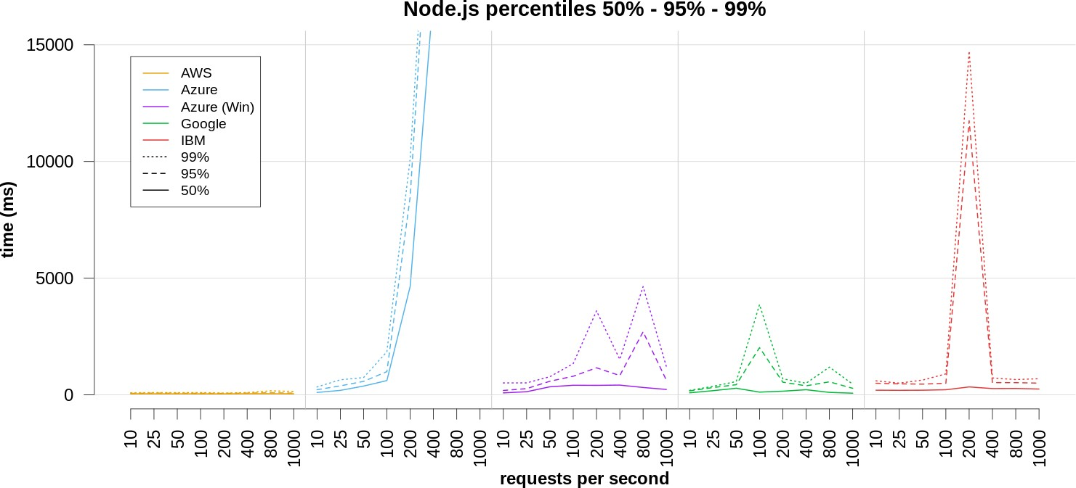
Results - Load Test (Percentiles)

Slide 15
Future Work
General optimizations and improvements
Plotting integration (e.g. R)
Continuous deployment
More detailed load test
Real world application benchmark
Test docker images instead of given runtimes

Slide 16
Summary and Discussion
Testing: Important to test and optimize the code
Execution time
Memory needed
Save costs
Scaling: Test a scenario as close as possible to the actual load. Clouds and runtimes can differ a lot in scaling.
Pricing: Estimate prices according to test results and not just using the offered pricing calculator
No standard: There is no standard framework between the clouds
Serverless can be a valid option depending on the workload and the requirements. This suite helps with the analysis and the decision.

