Slide 1
Web Technology
Part 4:
JavaScript Language – p.2

Slide 2
Understanding Forms
Forms are a way of collecting information from Web Site visitor
Forms Components :
Input Field 1
Text 1
Input Field 2
Text 2
Form – input fields container
Input fields – components providing client data input
Buttons – to call the form action (submit, reset)
Submit

Slide 3
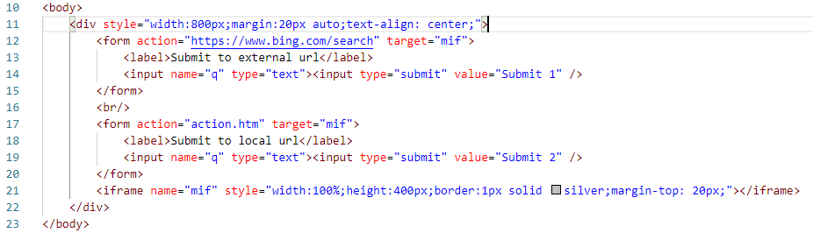
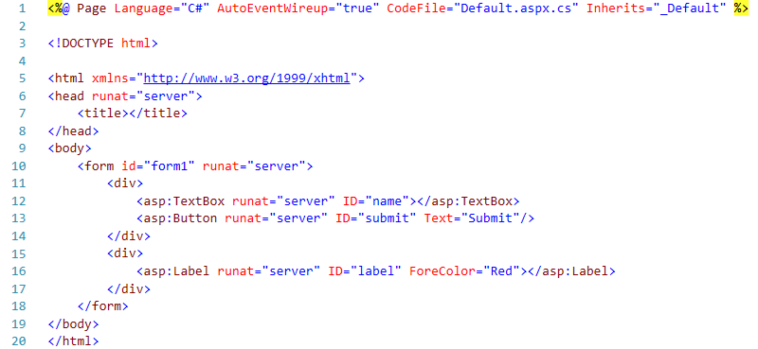
Defining Form in HTML
Main Form Attributes:
name
id
method
action
target

Slide 4
Input Elements
HTML 4
HTML 5
button
checkbox
file
hidden
image
password
radio
reset
submit
text
textarea
select
color
date
datetime
date-time local
email
month
number
range
search
tel
time
url
week
<output>

Slide 5
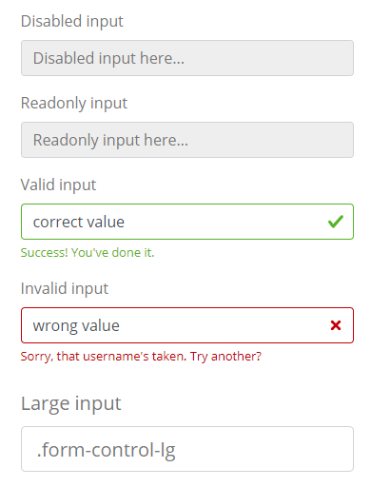
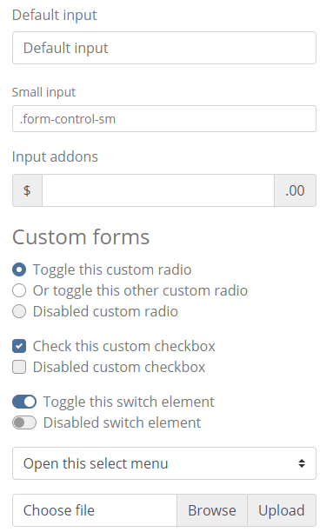
Input Elements and Bootstrap

Slide 6
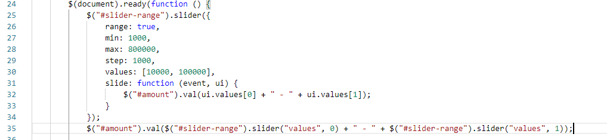

Example 1 of Custom Input Element
https://jqueryui.com/slider/#range

Slide 7

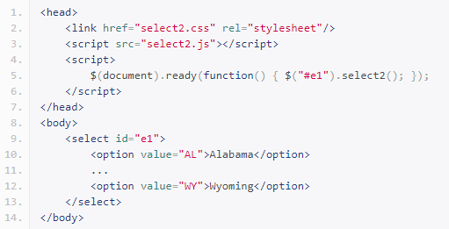
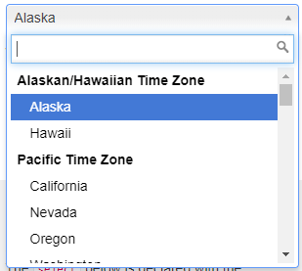
Example 2 of Custom Input Element
https://select2.github.io/select2/
https://select2.org/

Slide 8
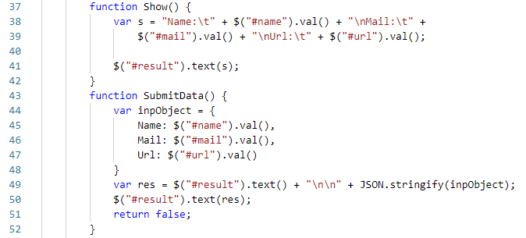
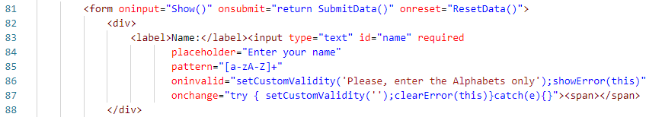
Client-Side Action
Additional processing before the form action

Slide 9
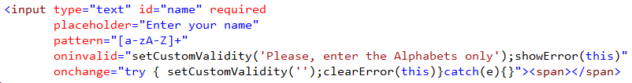
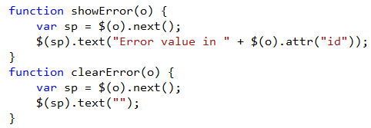

Client-Side Validation
Validation pattern (additionally to type):
Additional processing for validation:

Slide 10
Examples and Exercises
Explanations of the Lab 3 exercise
Usage of the new form elements (new_input_elements.htm)
Usage of dev. environment (Chrome, FF, IE)
Example project – client side table with search, filter, sort
References – JSON viewer
http://jsonviewer.stack.hu/

