Slide 1
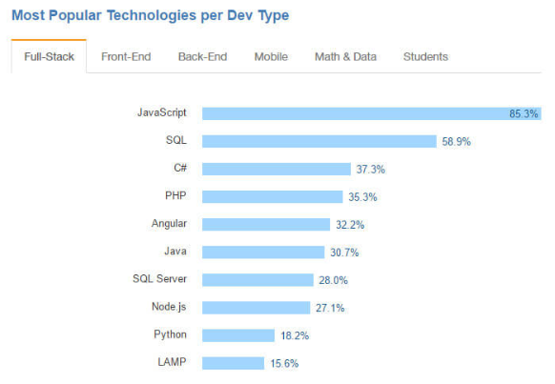
Web Technology
Part 5:
JavaScript Language – p.3
JQuery
https://thenewstack.io/javascript-popularity-surpasses-java-php-stack-overflow-developer-survey

Slide 2
About jQuery 1
What is jQuery?
jQuery is an Open-Source JavaScript framework that simplifies cross-browser client side scripting.
Animations
DOM manipulation
AJAX
Extensibility through plugins
jQuery was created by John Resig and released 01/06
Most current release is 3.4.1 (11/2018)
Notes:
Open Source JavaScript framework.
Jquery was created by John Resig in 2006 and since then has exploded into popularity in the web community.

Slide 3
About jQuery 1
Why should you use it?
Easy to learn! It uses CSS syntax for selection
Its tiny 82KB (24KB, minified and Gzipped)
Documented api.jquery.com & Supported forum.jquery.com
Cross browser compatibility: IE 6+, FF 2+
It is the most used JavaScript library on the web today
74.6% of top 1 million sites use JavaScript use jQuery.
https://trends.builtwith.com/javascript/jQuery <- See, I'm not a liar..
Notes:
It uses CSS rules to grab DOM elements that's why its so easy to use, because we all know how to address com elements with css already.
Its really small, it loads really fast in most browsers.
The community is great. I had a question once about how to do something for the new homepage. I asked the question before i left work and had a response by my ride home.
And its compatible with most major browsers. If you make something that works in FF itll work in IE6 guaranteed.

Slide 4
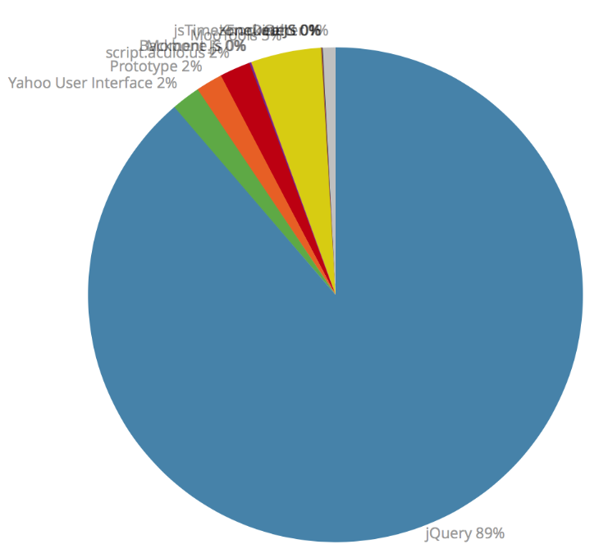
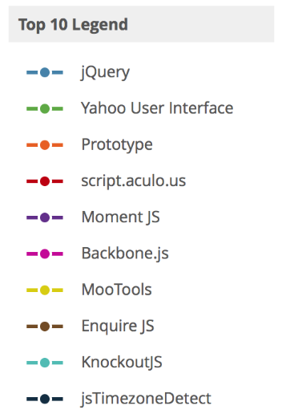
JavaScript Library Usage
https://www.quora.com/What-is-the-future-of-jQuery-for-2017-and-later
Notes:
Swf object is for putting flash on a page, the closest actual pure JavaScript framework is prototype.
And don’t forget that jQueryUI, a part of jQuery is included in this list, above even mootools.

Slide 5
Who Uses jQuery?
Google
Amazon
IBM
Microsoft
Twitter
Dell
docs.jquery.com/Sites_Using_jQuery
Notes:
You can see this list on their website.
Microsoft just announced that they are going to be dedicating coder time and resources to improving jQuery core, and its plugins. This is HUGE.
Mention anti microsoft sentiment, and the fact that even microsoft wants IE6 to die.

Slide 6
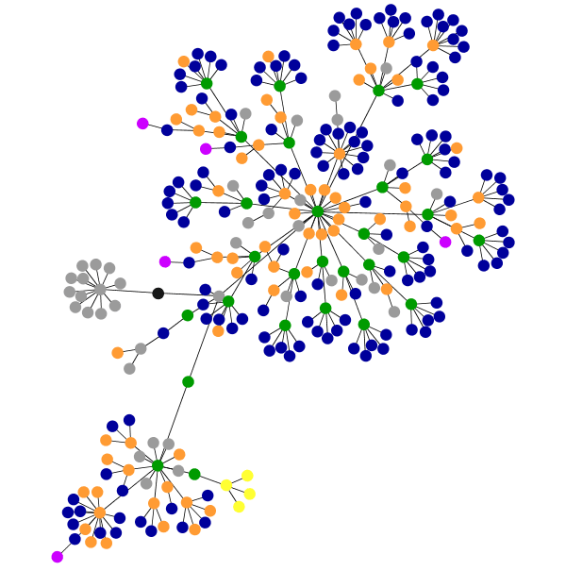
What Is The DOM?
The DOM is the html document code. From the
<!DOCTYPE> to the </html>
The DOM is loaded top to bottom, so include your scripts at the bottom of the page for best performance.
The DOM is "ready" when everything on the page has loaded.
Stylesheets
JavaScripts
Images
Notes:
The Document Object Model.
The DOM is everything you write in your html documents, images, css, all your tags, everything.
The DOM is a mess. There are a million different ways to accomplish things within it and many different doctypes and uppercase and lowercase are allowed attributes that sometimes need quotes, and othertimes don’t. jQuery is coded around all those inconsistencies.
jQuery can modifiy the DOM, but it cant do so untill the DOM is ready.

Slide 7
Wait!!
In order to make sure that jQuery can find the element you asked it for, your browser needs to have loaded it (the DOM needs to be ready).
Q. How can I be sure my code runs at DOM ready?
A. Wrap all your jQuery code with the document ready function:
$(document).ready(function(){ // $(function(){…});
// insert sweet, sweet jQuery code here…
});
Notes:
So we wrap all our jQuery code inside some code. Its called the document ready function, and it is only run after all your page has loaded.
Shorthand is
$(function(){
});

Slide 8
Loading jQuery
In order to use jQuery you need to load it.
You can include it locally on your own server:
<script src="js/jquery.js">
Or use one of the CDN's (Content Delivery Network) made available:
ajax.googleapis.com/ajax/libs/jquery/2.0.0/jquery.min.js
ajax.microsoft.com/ajax/jquery/jquery-2.0.0.js
CDN's are Gzipped and minified
Notes:
Loading from the CDN’s is usually the fastest way, because if you are downloading from one place, you can be downloading from another place at the same time.
We usually load it on our servers.

Slide 9
First Steps
Html:
<p>Hello World!</p>
Script:
$(function(){
$("p").addClass("isRed");
});
Resulting html:
<p class="isRed">Hello World! </p>
Notes:
So lets see what we’re up against.
We begin with a plain P tag and end with a p tag with a class of isCool
Lets break it down on the next page
DEMO

Slide 10
Break It Down Now!
$(function(){// = $(document).ready(function(){
$
("p")
.addClass("isCool");
Initiates the jQuery function
Grabs a DOM element using a CSS selector.
Built in method that adds a class to the jQuery Collection
Selector is in quotes.
Class is in quotes.
$
=
jQuery
Creates a jQuery “Collection”
ends with a semicolon.
<p>
});
Notes:
We check for the DOM to be ready by the $(function() wrapper
We use the $ to initialize a jquery function
Then we surround a CSS selector with parenthesis and quotes (all P’s will be selected)
Then I initiate a jquery method called addClass and tell it what class to add.
It's a good thing to note that I don't add a . Before isCool when adding removing classes. Most methods are alike in how they are called, be careful to check to api to see how to use each method.
I end with a semicolon just like most lines of javascript code
And then close the document ready wrapper
Double quotes can be swapped with single quotes. Same rules apply as normal html or javascript, if you use one you have to end one before switching to the other.

Slide 11
Basic Selectors Are Belong To Us
Uses the same syntax you use to style elements in CSS!
$("p")
$("#foo")
$(".foo")
<div>
id="foo"
class="foo"
<p>
$("div")
api.jquery.com/category/selectors/
Notes:
Here you can see some of the basic css selectors supported by jquery
Simple things that you've seen a lot before.
Div p classes etc
In order to not select everything, make sure to be specific with your CSS selector

Slide 12
Add Class
jQuery:
$("p").addClass("sophisticated");
Before:
<p>
After:
<p class="sophisticated">
Notes:
I want to make this p tag classy,
So I’m going to use the addClass method on it and add the sophisticated class to it you see the before and after html
Note the lack of . Before the class name, that’s only needed for selection

Slide 13
Remove Class
jQuery:
$("p").removeClass("sophisticated");
Before:
<p class="sophisticated">
After:
<p class="">
Notes:
I remove classes with a different method, but the way in which I do it stays the same.
If there were other classes on the p tag they would stay intact
DEMO

Slide 14
Hide and Show
jQuery:
$("div").show();
$("div").hide();
Before:
<div style="display:none;">
After:
<div style="display:block;">
Notes:
You can show a div by running the show method.
There is a hide method as well.
DEMO

Slide 15
text() and html()
jQuery:
$("#myID").text("After");
Before:
<p id="myID">Before</p>
After:
<p id="myID">After</p>
jQuery:
$("#myID").html("<b>After</b>");
Before:
<p id="myID">Before</p>
After:
<p id="myID">After</p>
Notes:
Text will change the inner text of a DOM element
DEMO.

Slide 16
Chain Most Methods Together
$("p")
.addClass("sophisticated")
.text("Hello World!")
.show();
Notes:
Methods can be separated across multiple lines. Or kept on the same line
This is a best practice for code readability
Make sure you end your chain with a semicolon;
DEMO

Slide 17
Click Event
$("#myID").click(function(){
$(this).text("Is Cool"); // this = #myID
alert("Hello ORT!");
});
$("#myID").click(function(event){ $(this).text("Is Cool");
alert(“Hello ORT!");
event.preventDefault();//Prevents default action
});
Notes:
Click events are a bit different.
In order to have code run when you click you need to declare a function to encapsulate the code you want to run
We create an anonymous function that calls this element (#eric)
And it changes the text to Is Cool and throw a javascript alert
If we wanted to prevent the default action, say href=“index.html”
Then we call event inside the parenthesis after the function and call event.preventDefault() to prevent the default action of the button

Slide 18
Some of Basic Methods
.show()
.wrap("<a></a>")
.parent("p")
.next(), .prev()
Show a hidden element
wrap an element with <a>
Select parent <p>
Get next/previous element
.val()
Get/Set Value
api.jquery.com/
Notes:
Plenty of examples of basic methods within jQuery.

Slide 19
Dual Purpose Methods
$("#foo").text();
$("#foo").text("foo");
Notes:
Getters and setters. These are jquery methods that can give you a value or set a value.
You can set a variable to any of these getters
Text can get a value or set a value

Slide 20
Use jQuery To Get
$("p").text();
=== "ORT"
myVar = $("p").text();
myVar === "ORT"
Notes:
To get a value you call a method with empty parens. Some functions are different, please check api ex css uses a different syntax
Normally youd set a variable equal to a value of a jquery method getter.
Both of these functions do the same

Slide 21
Use jQuery To Set
$("p").text("Alex");
<p>Alex</p>
myVar = "Alex"; $("p").text(myVar);
myVar === "Alex" <p>Alex</p>
<p>Eric</p>
Notes:
Set a value by including the new value in quotes is how u set it to a literal value
Or reference a variable by not using quotes.
Both do the same thing

Slide 22
JQuery Plugins
plugins.jquery.com
Examples of JQuery plugins:
Tooltip
CKEditor
Highstock

