Slide 1
Scheduling
Benjamin Shelton
Garrett Morris

Slide 2
What is a Process?
There are several definitions:
A program in execution; An instance of a program running on a computer; The entity that can be assigned to and executed on a processor; A unit of activity characterized by the execution of a sequence of instructions, a current state, and an associated set of system resources
Two essential elements of a process are: Program Code and A Set of Data associated with the code

Slide 3
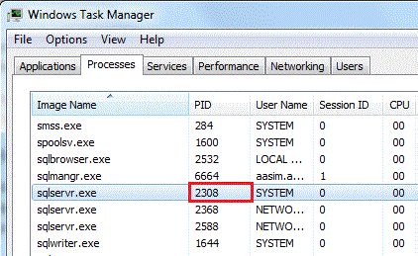
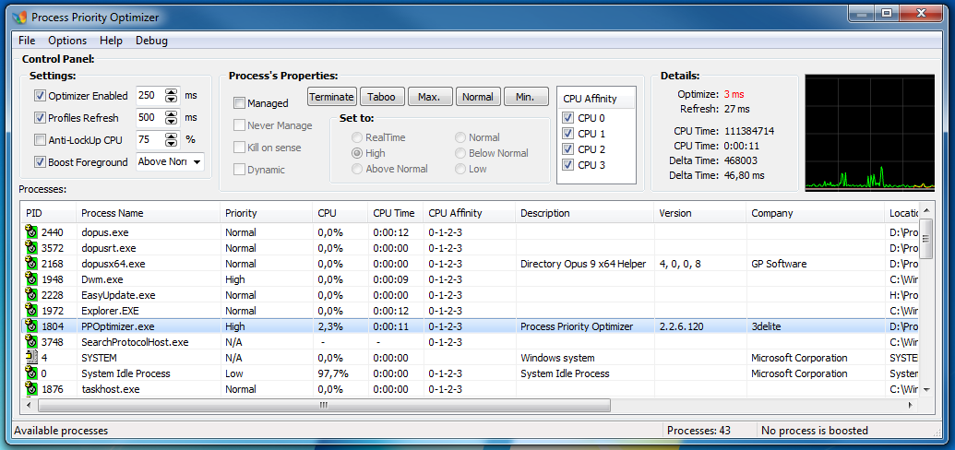
Process Identifiers
At any given time, a process can be uniquely characterized by a number of elements:
Identifier: A unique identifier associated with this process, to distinguish it from all other processes
State: If the process is currently executing, it is in the running state
Priority: Priority level relative to other processes
Program Counter: The address of the next instruction in the program to be executed.

Slide 4
Process Identifiers Cont.
Memory Pointers: Includes pointers to the program code and data associated with this process, plus any memory blocks shared with other processes.
Context Data: These are data that are present in registers in the processor while the process is executing.
I/O Status Information: Includes outstanding I/O requests, I/O devices assigned to the process, a list of files in use by the process, and so on.
Accounting Information: May include the amount of processor time and clock time used, time limits, account numbers, and so on.
All of this information is stored in the process control block. This data structure is managed by the OS.

Slide 5
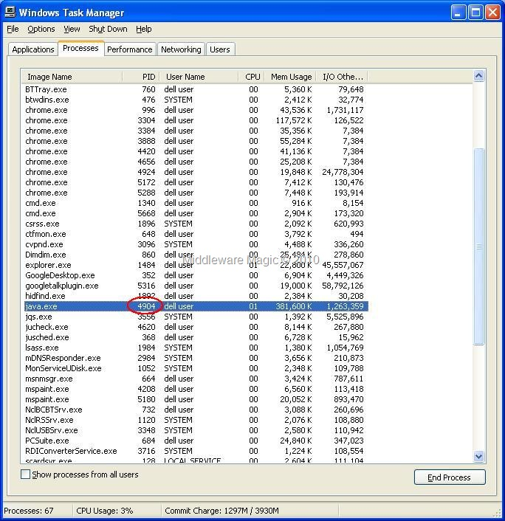

Slide 6
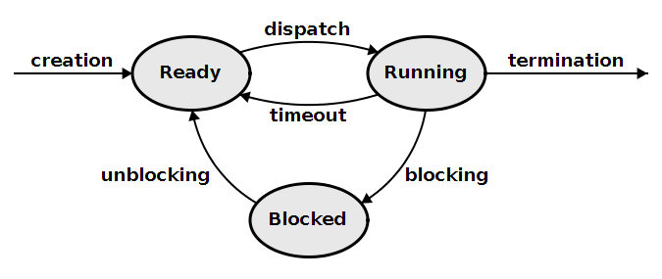
Process States for Scheduling Algorithms
Process States tell the scheduling algorithm what state the process is in. This allows it to handle what’s going on with all of the processes.
Created/New: When a process is first created it becomes a “created” or “new” process. In this state, it awaits a transition into the “ready” state.
Ready: A ready process has been loaded into main memory and is waiting for execution by the CPU. There may be multiple processes in this state which are “concurrently running” even though the CPU can only handle one process at a time. Ready processes are generally loaded into a queue. Other processes that are waiting for another event (I/O, waiting for internet connection, loading something from memory, etc) are not in the ready queue (and thus not “ready”)
Running: A process is being run by the CPU. Only one process may be run at a time per CPU core, and they are either run in user mode or kernel mode

Slide 7
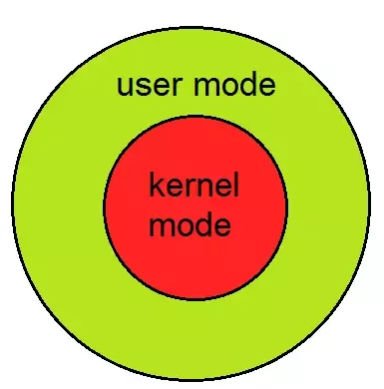
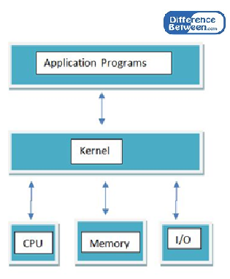
Process States Cont.
Kernel Mode: Has access to everything (user and kernel addresses), unrestricted access to hardware including execution of privileged instructions (E.G. I/O instructions or halt instructions), A system call from a user program causes a switch to kernel mode.
User Mode: May only access their own instructions and data, if the user mode instructions calls an OS service it switches to kernel mode. This mode is important because it keeps each process encapsulated, preventing it from changing data in other processes. Also no direct access to any hardware device is allowed.
Waiting: When a process is waiting to be assigned to a processor. Considered ready but not in the queue.

Slide 8
Process States cont.
Blocked: When a process cannot continue without an external change in state or an event occuring, it becomes blocked. This could be something as simple as waiting for a printer, waiting for user input, or require access to a critical section (generally protected by a semaphore or a mutex). The process is still being run by the CPU in this state and may be swapped out depending on the scheduling algorithm.
Terminated: A process may be terminated when it is completed or the process being killed. The program is no longer running but remains in the process table as a “zombie process” until its parent process calls the wait system call to read its exit status, which causes the process is removed from the table, ending the process’s lifetime. If the parent process does not call the wait function then the table will continue to filling up, leading to a resource leak (such as a memory leak).

Slide 9

Pre-Emptive vs. Non Pre-Emptive
Both are methods of scheduling algorithms.
Pre-emptive means that processes may be interrupted in order to let another process on.
This requires more overhead when switching processes from running to ready states, and can allow high priority processes to take the place of lower priority processes on the CPU.
Non preemptive means that a process will not be stopped until either it terminates or it blocks itself to wait for I/O or to request some OS service.
The pros are that the CPU doesn’t have to work with as much overhead, but it may lead to smaller runtime processes having to wait on longer run times to complete.

Slide 10
Short-Term Scheduling Criteria
Main goal of short-term scheduling is to allocate processor time so that the system’s behavior is optimized.
The various scheduling algorithms are weighed against a set of criteria in order to do this
Most criteria can be separated into two groups: User-oriented and System-oriented

Slide 11
User-Oriented criteria
These criteria relate to the behavior of the system as perceived by the individual user.
An example of this is response time, which is how much time passes after a submission request and the process’ output.
We want to use a scheduling algorithm that minimizes this time, so a threshold can be set. The goal of the scheduling algorithm would be to stay under that threshold.

Slide 12
System-Oriented criteria
These criteria focus on the efficiency and effectiveness of the processor.
An example of one of these criteria is throughput, which measures the rate that processes are completed.
This criteria focuses on system performance, which is not something that an average user base is concerned with.

Slide 13
User-Oriented vs. System-Oriented
User-oriented criteria are important to consider on all systems.
System-oriented criteria are much less important in a single-user environment.
Single-user systems usually don’t care about optimal processor utilization.
Most users will benefit more from process responsiveness as opposed to throughput

Slide 14
Performance Related
Another way to classify criteria is to consider their impact on overall performance
Applies to both user-oriented and system-oriented criteria
Performance related criteria can be quantified and can be measured easily. The previous examples of response time and throughput are both performance related.
Non-performance related criteria are qualitative in nature or cannot be measured easily. An example of this would be predictability. Measuring predictability is not as easy.

Slide 15
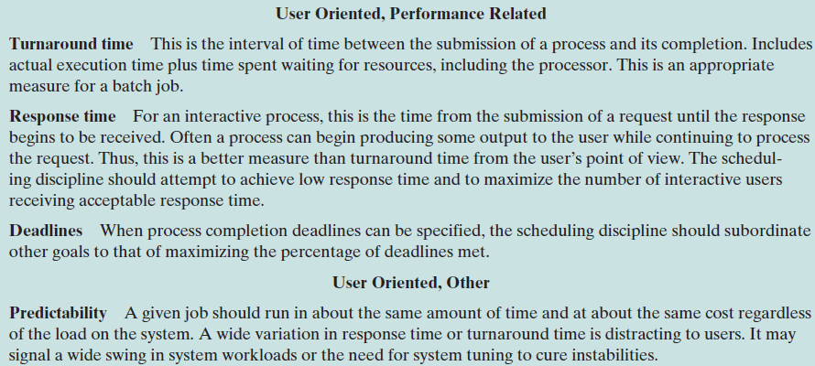

Slide 16
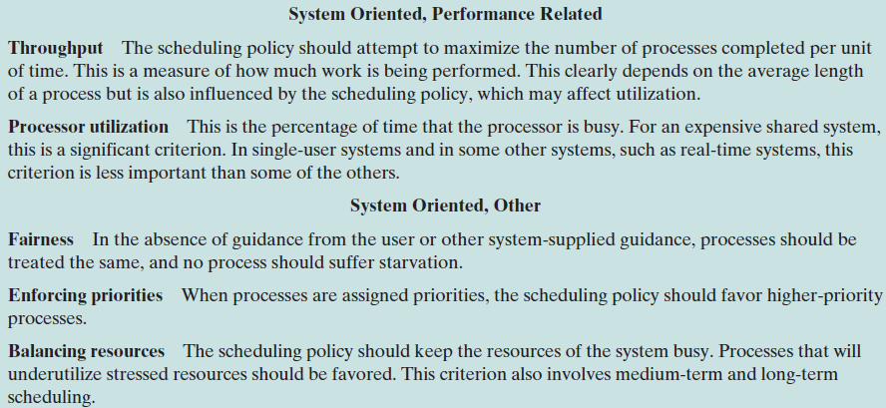

Slide 17
First Come First Serve (FCFS)
Simplest of all the scheduling algorithms
Also referred to as First In First Out (FIFO)
When each process is ready, it joins a queue of other processes that are also ready. When the current process is finished, the process that has been waiting the longest in the queue is selected to go next.

Slide 18
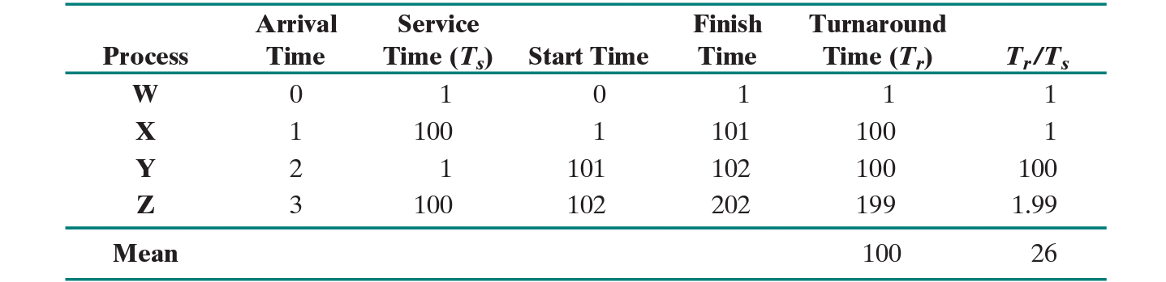
FCFS works much better for longer processes
Process Y’s turnaround time is 100 times the length as its service time
This will happen whenever a short process arrives after a long process

Slide 19
FCFS (cont.)
Tends to favor processor-bound processes over I/O bound processes
This is usually bad because when a processor-bound process is running, all I/O processes must wait. This leads to all I/O devices being idle, even though there is potential work for them.
Generally, not an acceptable scheduler by itself. It is often used in addition to a priority scheme.

Slide 20
FCFS advantages and disadvantages
Advantages: very simple, no complex logic, starvation never occurs
Disadvantages: once a process has begun, it cannot be stopped (non-preemptive); short processes end up waiting a long time if stuck behind long processes

Slide 21
Shortest Process Next (SPN) or Shortest Job First
SPN is an algorithm that uses an approach aimed at reducing the bias in favor of long processes that is found in FCFS
It is a nonpreemptive policy in which the process with the shortest expected processing time is selected next
This means that when a process joins the queue, it jumps ahead of all processes longer than itself

Slide 22
Shortest Process Next (cont.)
When compared to FCFS, overall performance is significantly improved in terms of response time.
However, the variability of response time gets increased. This can be seen even more-so for longer processes.
An issue with SPN is that the programmer must know or estimate the required processing time for each process. If the estimate is too far under the actual running time, the system may abort the job.

Slide 23
SPN advantages and disadvantages
Advantages: shortest jobs execute first, so there is not as much waiting; throughput is increased because more jobs get executed in shorter amount of time
Disadvantages: exact process time must be known, which is not always possible; larger processes will sometimes end up in starvation because of how they take

Slide 24
Longest Job First (LJF)
This scheduling algorithm is the exact opposite of SPN, as it gives priority to processes with the longest burst time.
It is non-preemptive.

Slide 25
Shortest Remaining Time First (SRTF)
Preemptive version of Shortest Job First algorithm
Processes are ran based upon how much time left in execution. Innately the current process being run will be picked (due to the time left until completion becoming smaller and smaller as the process runs). The only time that the current running process will be taken off is if a new process that has shorter time gets added to the queue.
Rarely used outside of specialized environments because it requires accurate estimates of runtime of each process

Slide 26
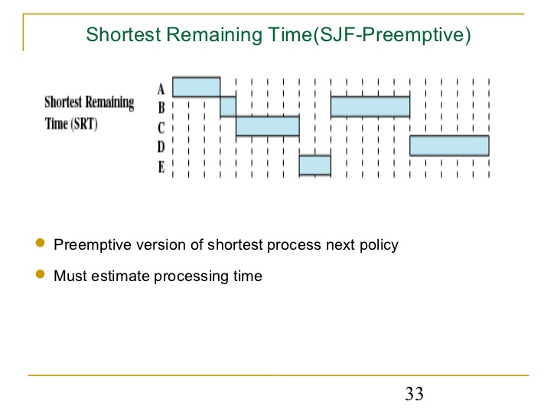

Slide 27
SRTF: Pros and Cons
Pros:
Short processes handled very quickly, system requires very little overhead because it only has to make a decision when a new process is added. When this happens it only has to compare the currently running process to the new one rather than comparing it with all of the other processes in the queue.
Cons:
May hold long processes to the point of starvation if short processes are continuously added. This can be avoided by adding a heavy-tailed distribution

Slide 28
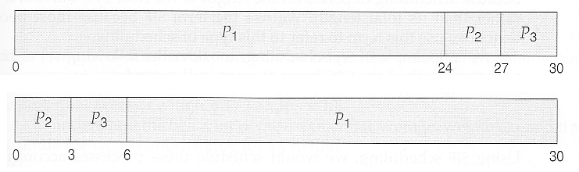
Longest Remaining Time First (LRTF)
The exact opposite of SRTF Algorithm, and preemptive version of Longest Job First algorithm.
An obvious difference is as a process runs it becomes more and more likely to be kicked off, there is a clock that checks after a certain time interval if a process needs to be swapped.
Is much more susceptible to process starvation due to the nature of the algorithm.

Slide 29

Round Robin
Uses Preemption based on a clock. A clock interrupt is generated at period intervals; when this occurs, the currently running process is placed in the ready queue, and the next ready job is selected on a first come first serve basis. Is also known as time slicing (an individual slice is referred to as a “time quantum”).
The main issue is the length of the time slice, if very short then short processes will move through the system relatively quickly. Also, there is a lot of overhead with the clock interrupt and performing the various functions to fetch the processes, so very short time quanta should be avoided.
A general rule is that the time quantum should be slightly greater than the time required for a typical interaction or process function. If it is less, then most processes will require at least 2 time quanta. As for the opposite idea: longer than average time quanta makes the round robin algorithm degenerate into first come first serve

Slide 30
Round Robin cont.
Another drawback is its relative treatment of processor-bound and I/O-bound processes. Generally an I/O has a shorter run time than a processor-bound process. This leads to I/O-bound processes using the processor for a short amount of time then blocking for I/O; it waits for the I/O operation to complete and then joins the ready queue. A processor-bound process generally uses a complete time quantum while executing and immediately returns to the ready queue. Processor-bound processes tend to get an unfair portion of processor time, which results in poor performance for I/O-bound processes, inefficient use of I/O devices, and an increase in the variance of response time.
A fix for this is an auxiliary queue that holds the I/O-bound processes when they must wait, and when a new process is set to be run this auxiliary queue is looked at before the ready queue. When a process is taken from this auxiliary queue, the time spent on the processor is calculated as the time of a single quanta minus the time the process spent earlier on the processor. Research suggests this method is better than “Round Robin Fairness”

Slide 31
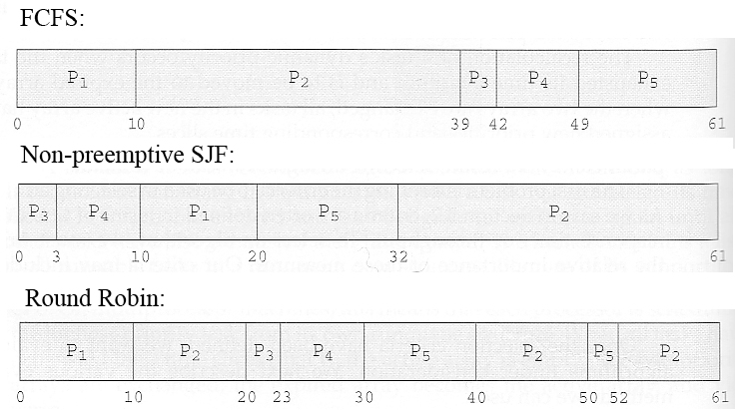

Slide 32
