Slide 1

Machine Learning: Movie Recommender System
CMPS 5433-Deep Learning with Dr. Eduardo Colmenares
Benjamin Shelton and Garrett Morris

Slide 2

What is Machine Learning?
A computer program is said to learn from experience E with respect to some task T and some performance measure P, if its performance on T, as measured by P, improves with experience E.

Slide 3


Recommender Systems
Recommender Systems seek to predict the “rating” or “preference” a user would give to an item
Our Recommender System recommends movies that users would like based upon how they rated previous movies they’ve watched.
Due to the way the data set was set up we were unable to come up with a valid algorithm to guess what rating they would give the movie.

Slide 4
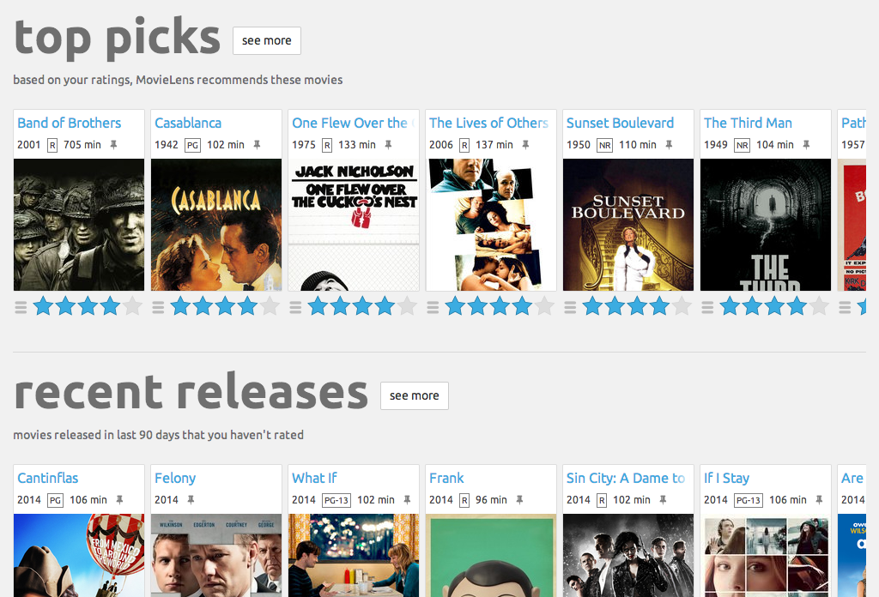
The MovieLens Dataset
We opted for the smaller of 2 available datasets that MovieLens provides
Contains 1000836 ratings of 9742 movies
610 Users between March 29, 1996 and September 24, 2018
Describes 5-star rating where each user has rated at least 20 movies

Slide 5
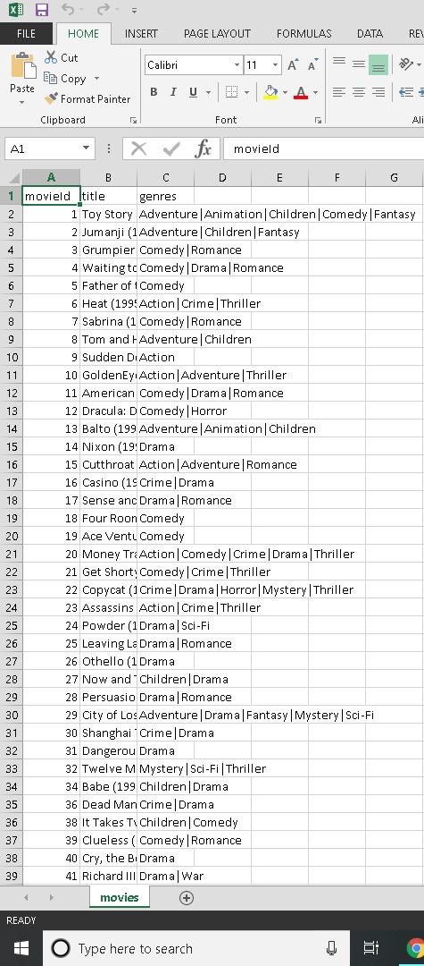
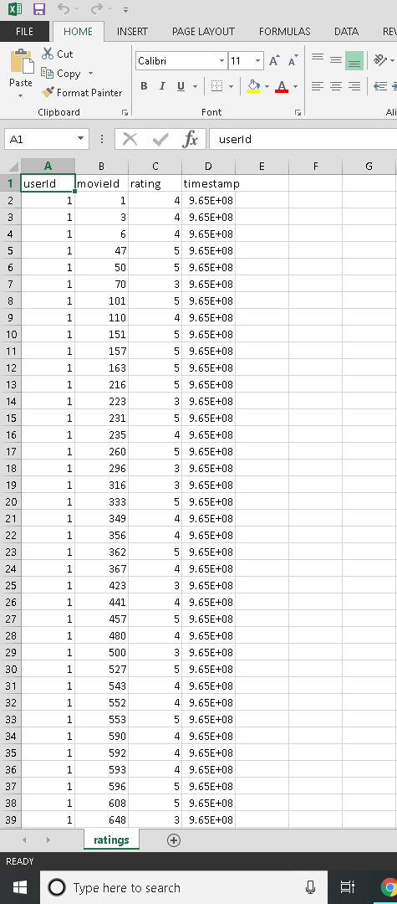
2 Principle Files
Movies.csv
Ratings.csv

Slide 6

Program Demonstration

Slide 7
What We Learned
Recommend movies, not guess the user’s rating of it
Machine Learning may seem daunting at first

Slide 8
Credits
We used Andrew Ng’s Recommender System Algorithm.
MovieLens
F. Maxwell Harper and Joseph A. Konstan. 2015. The MovieLens Datasets: History and Context. ACM Transactions on Interactive Intelligent Systems (TiiS) 5, 4: 19:1–19:19. <https://doi.org/10.1145/2827872>

