Slide 1
Cs3520 web Site Application
Created by – Wei Su
Baljot Malhi

Slide 2
SnapMail – texting Application
Overview
SnapMail is a Web based Application running on JavaEE and tomcat Server. Stay connected with friends by sending text messages and receiving text messages.

Slide 3
SnapMail
Features
Easy access to application by registering an account and logging in.
Friendly user interface for smooth transition through different pages in app.
Send Text messages to the users and friends that you know by typing their username.
Retrieve messages from other users and friends through the app.
Check messages sent by different users on a list in easy to read format.

Slide 4
SnapMAIL
Continued…
List of messages with option for user to clean the inbox by deleting messages.
Messages are stored in database for user to read it whenever user wants by retrieving it.
Separate signup for Admin to send Newsletter and Updated info about new Features added to the SnapMail Application.
Admin can send email notifications to user for important messages.

Slide 5
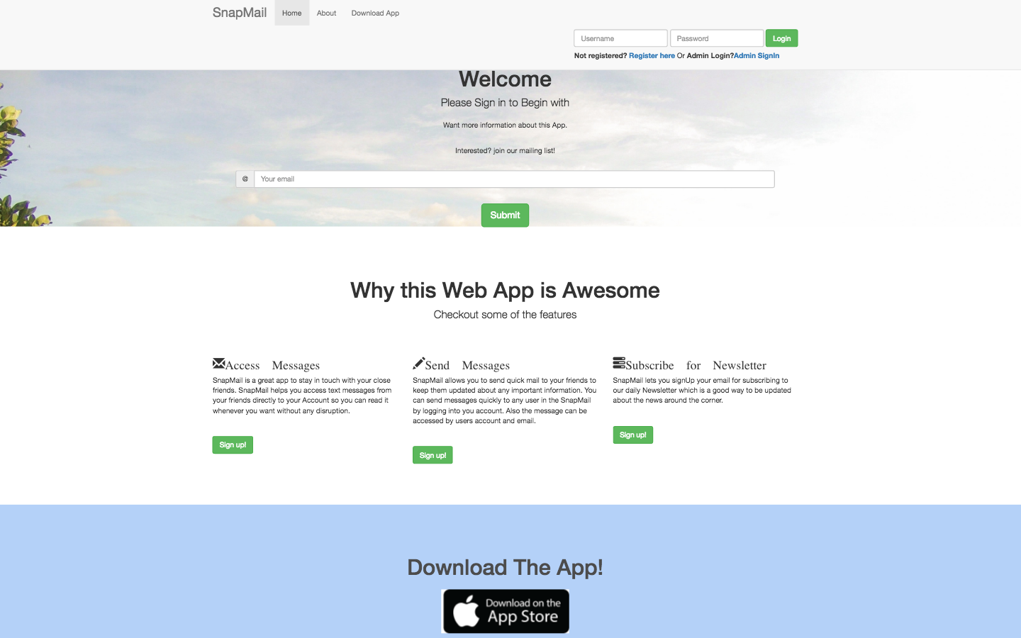
SNApMail - home login page

Slide 6
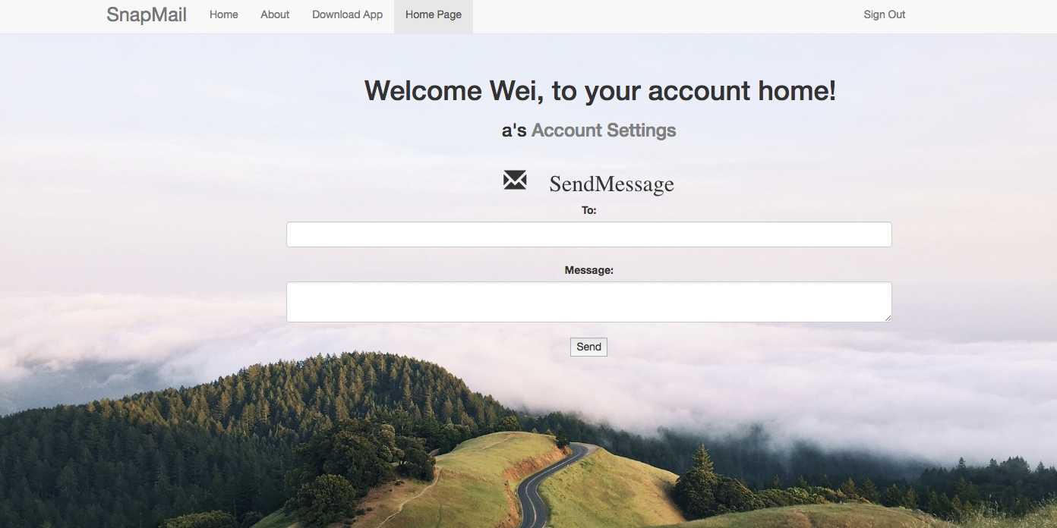
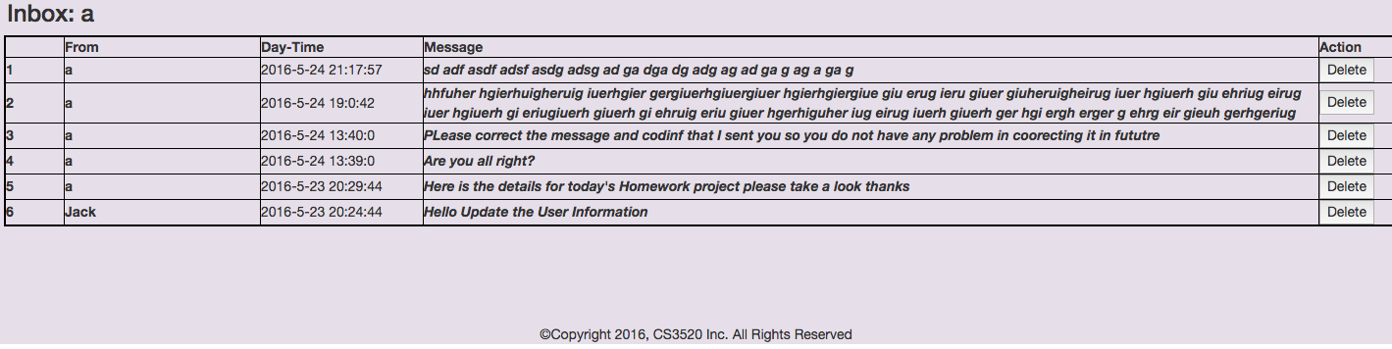
Snapmail – user home page

Slide 7
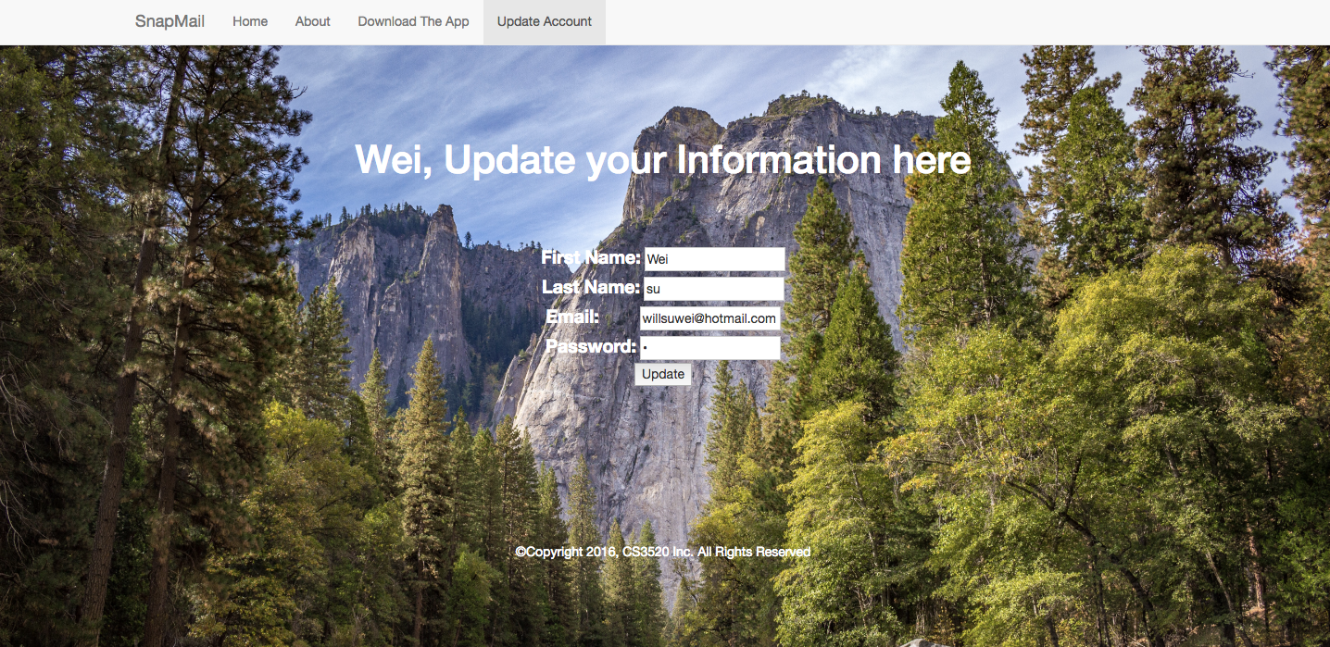
SnapMail – user update info page

Slide 8
Snapmail
Technologies Used
Heavy use of html tags, JSP pages, Cascading Style sheets.
Bootstrap for text decoration and UI enchancements.
MySQL database for retrieving and storing user information, messages and time.
JSTL, expression language and servlet classes for web application.
dynamically generated table using the JSTL retrieving information from DBMS.
Utilizing the MVC architecture for better development of the application

Slide 9
Snapmail
Difficulties in App develpoment
Challenges faced in setting up MySQL database connection with SnapMail Application.
Solving errors involved with servlet classes and JSP pages.
Working out with JSP, MySql and Java code to make a meaningful working page was confusing at times.

Slide 10
SnapMail

