Slide 1
2023 Google Capstone Project
CREEKSIDE BUSINESS INTELLIGENCE FIRM
The impact on “Cup of Joe’s” coffee sales during time of day and day’s of the week, and how can we improve next month’s sales numbers?
BY: BRITTANY E. SPEARS
Last Updated: 10/13/2023

Slide 2
The Business Task
Company
Context
Problem statement
Cup of Joe’s, a fictional coffee house company, has sought out the help of Creekside Business Intelligence Firm, another fictional company for help in preparing the launch of a new marketing campaign for their existing line of coffee products for the summer season. Joe wants to know if certain days of the week or time of day has any impact on sales. If so, how he can use that to his advantage in his next advertising campaign using sales data from the previous month.
The marketing department at “Cup of Joe’s” has assigned me with the task of providing sales insights for the month of May, and what products they should endorse in the new ad.
How does time of day and day of the week have impact on “Cup of Joe’s” sales numbers and how can we improve next months profit margin.

Slide 3
Executive Summary
Who are my stakeholders?
Where is my data from? How did I clean it?
Hypothesis
Target Audience
Joe, Owner and CEO of Cup of Joe’s coffee house.
Joe’s Marketing Department
Joe’s Customers
Data Manipulation
I found my sample dataset on Kaggle.com chosen at random. This dataset is based off real-world problems and data isn’t factual, real, or verified information.
Removed duplicate values
Used filter to check for any existing spelling errors
TRIM function to clear any white space, which there was none.
Resolved Missing Currency Values
Find & Replace Function to rename words in columns to help better understand data. (Ctrl+H)
My prediction
I strongly predict that coffee sales are better during certain times of the day, especially morning’s. Considering it’s a very common morning beverage by the everyday consumer. Certain days of the week also play big role on coffee sales. For example, after a long weekend Monday’s-Wednesday’s can have a huge impact on a customer schedule who’s just getting back to work. So, you may see an uptick in sales during those days as well. I strongly believe these findings are going to impose even more questions that we’ll have to obtain additional data for, these questions will be bringing us one step closer to resolving similar concerns in the future.

Slide 4
The Impact
max growth
April 2019 Profits

Slide 5
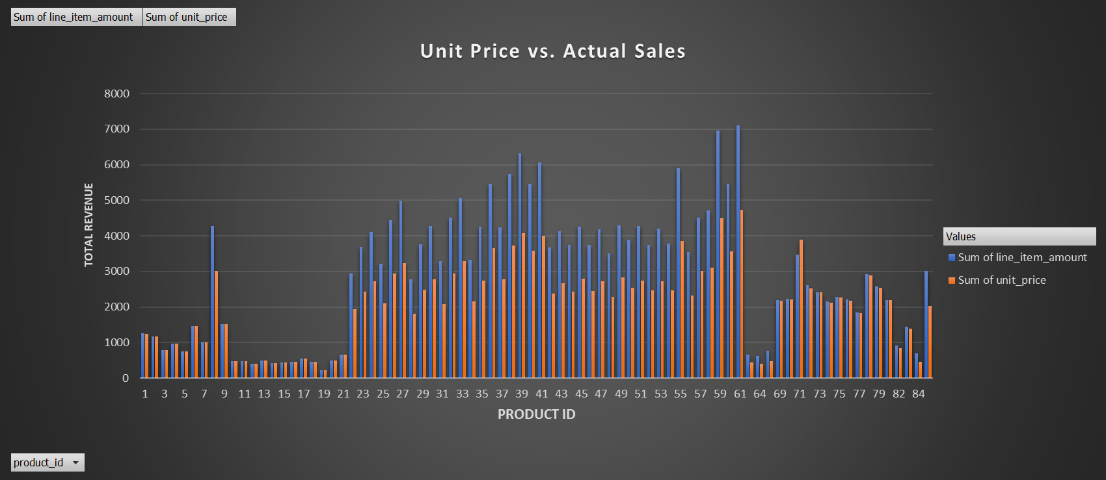
April 2019 Sales Numbers
This graph is a representation of “Cup of Joe’s” April’s 2019 profit margins per product. The unit or invested price vs. actual revenue returned.
Top 3 Best-Selling Products Included
Product Number’s:
61, 59, 39.
Top 3 Least-Selling Products Included Product Number’s:
19, 12, 13

Slide 6
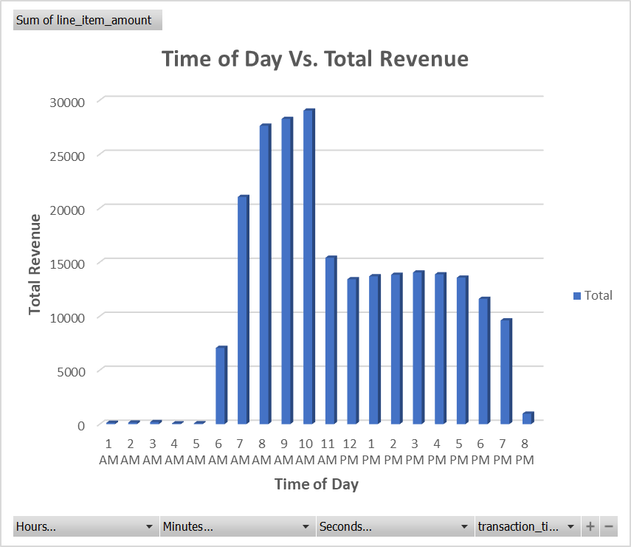
Average coffee sales during work day hours
Cup of Joe’s made the most amount of profit during 10AM rush. However, primetime selling hours would be between 6am and 11AM. With a slight increase in sales during 2pm-4pm in the afternoon.
With the lowest revenue being between the hours of 1am-5am and closing time at 8PM.

Slide 7
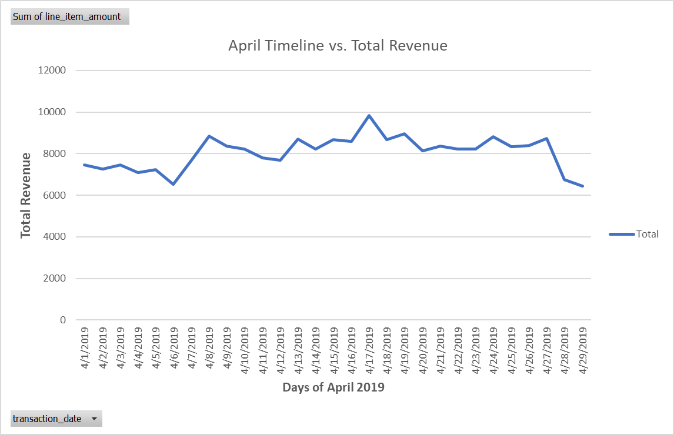
Revenue on a Timeline…
Cup of Joe’s had steady sales overall, for the month of April. However, you can see a clear decrease in sales toward the beginning and end of the month.
Results vary significantly, and indicates no distinct pattern for repeating high or low sales on a particular day of the week. However, with Tableau I was able to create an additional chart determining that Monday’s were the highest in sales.
Highest point of sale days were:
Monday’s (4/8/19) with the highest amount of revenue earned as $39,614.00
Saturday (4/13/19)
Wednesday(4/17/19)
Lowest point of sale days were:
Saturday(4/6/2019)
Friday(4/12/29)
Monday (4/29/19)

Slide 8
Key Takeaways

Slide 9
What should Cup of Joe’s Coffee House start doing now after identifying these trends?
Account for lower sales numbers towards the beginning and end of the month.
Prepare for a surge in coffee sales during 10am rush, but focus on increasing sales numbers between prime-time selling hours of 6am-11AM and 2PM-4PM.
Consider how you can optimize promotional offers during slower hours to bring in more sales.
Include best selling products 61,59, and 39 in new marketing ad campaign to boost future profit.
Create a customer survey so we can solidify preference in coffee products for the season.
Test new strategies and accumulate new data.

Slide 10
Conclusions

Slide 11
Additional is data needed, and current data poses new questions…
After carefully analyzing the data from April, it’s my professional conclusion that 10AM is the best selling time of day and Mondays are the highest earning day of the week at “Cup of Joe’s” coffee house. Joe’s marketing team should be sure to feature the top-rated coffee products #61, #59, and #39 in the new marketing campaign as these are Cup of Joe’s best sellers. However, I believe having sales numbers from 3 months prior could give us more concrete answers on distinct customer buying patterns.
To improve Mays sales numbers, I strongly encourage that the prime-time selling hours between 6AM-11AM are properly utilized. Also, employee’s are taking action by providing excellent customer service and pushing sales, especially during the slower times of day between 3am-6am and 6pm-8pm. Be sure to stay aware of the decline of sales between Tuesdays-Saturdays and what might be contributing to it. Lastly, pushing any promotional offers with every sale during the beginning and end of the month could positively impact sales.
Having these type of customer incentives such as, promotional offers, discounts, point system toward next purchase on future transactions could create customer urgency to buy again and boost future sales. Although, additional data is needed to determine its validity. I recommend that a customer survey is created to fill in the gaps of this missing data. Once the ad is publicized, I predict it will attract new customers based on April’s sales numbers & popularity rates on those specified best-selling products previously mentioned. But again, we need to collect additional data to further analyze:
1. What might be preventing customers from purchasing coffee on a specific day or time?
2. Would creating a promotional offer or deals for popular coffee products increase sales?
3. Would creating a customer feedback survey answer these questions. As well as, help Cup of Joe’s improve on anything we might be missing? For example, Is customer service needs being met? Is wait time longer than expected? Are prices too high? Coffee flavors we could work on (etc.)

Slide 12
Projects
Dataset used(Kaggle):
https://www.kaggle.com/datasets/ylchang/coffee-shop-sample-data-1113
SQLProject (Microsoft SQL Server Management Studio 2019):
https://github.com/Bspears711/SQLPortfolio-/blob/main/CoffeeSalesData
*** SQL Code listed only displays it’s first 10 rows of data and did not assist in analyzing or drawing conclusions on this project, SQL Code is for viewing purposes only and showcases ability to perform select, where, insert into, joins, and union queries*
Excel Project:
https://docs.google.com/spreadsheets/d/1ki5Vh6Hxerjj0F_MV7hv8mpfJEbZyF4EJvIng6TSWaE/edit?usp=sharing
Data Visualizations (Tableau):
https://public.tableau.com/views/CupOfJoeSalesDashboard/Dashboard1?:language=en-US&:display_count=n&:origin=viz_share_link

Slide 13
Google Coursera Tools Utilized
This project is in relation to my certificate earned by Google’s Data Analytics Course on Coursera | Degrees, Certificates, & Free Online Courses “Choose your own path” Capstone Project to include in my Data Analysis Portfolio.
Google’s Data Analysis Process Goals accomplished: Ask, Prepare, Process, Analyze, Share, Act.
Ask. I stated and re-defined the business task, to make it easier to break down the large task into smaller more manageable tasks.
Prepare. The sample dataset was already prepared and gathered via Kaggle: Your Machine Learning and Data Science Community, which was available for immediate analysis. Data is for a fictional company and is no way verified or collected by a real company.
Process. All data was cleaned, completed, made relevant, and checked for errors on Microsoft Excel. All SQL Queries were made in part by Microsoft SQL Server Management 2019.
Analyze. I analyzed the cleaned sales report data from coffee sales and was able to provide resolutions.
Share. Through Google Slides, I was able to share my insights and recommendations to stakeholders.
Act. Based on my findings, stakeholders are able to take action on the next steps to help their business keep improving.

Slide 14
Data Analytics Certification
Verify my certificate at:
https://coursera.org/share/92443b9aae50bd970867ba3bfcf27068
Completed By: September 2023
Expiration Date: N/A
Thank you for your consideration!

