Slide 1
Chapter 07
Object Oriented Programming (SEng 2202)
Graphical User Interface

Slide 2
INTRODUCTION | AWT, SWING, JavaFX
AWT, SWING, JavaFX are APIs. All of them used to develop GUI
what is GUI? GUI is an interface that interacts with user and source code.
It makes the software user friendly. So, Users interact with the interface and that interface interacts with source code.
Example of GUI- Calculator, All buttons shown on-screen are components of GUI.
The user is not interacting directly with code.

Slide 3
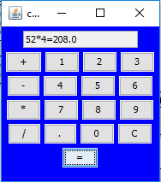

Slide 4
What is AWT? Its full form is Abstract Window Toolkit.
Released in 1995 with java. It’s an API used to develop GUI for Windows-based applications in the Java programming language.
AWT is Platform dependent i.e, its components display according to the Architecture of the operating system.
To use its components import java.awt.package.
AWT components are heavyweight which means components use resources of the operating system.
So, Programmers have control over it as the looks of components vary on different platforms.
Hence, It doesn’t follow MVC ( Model View Architecture Model ) where Model means data, View Architecture means presentation and Controller means Interface between model and view.

Slide 5
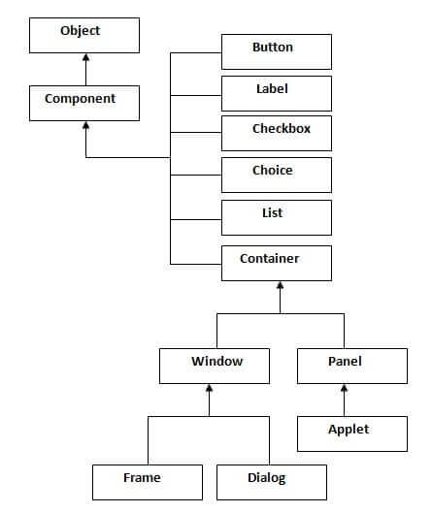
Hierarchy of AWT

Slide 6
What is SWING?
It’s an API used to develop GUI for desktop-based applications in the Java programming language.
It was released in 1997 built on AWT.
its components display does not depend on the architecture of the operating system.
To use SWING components import javaX, swing package.
This package provides classes for SWING API like textField, label, text Area, etc.
However, SWING components are lightweight which means components do not use many resources of the operating system.
so, It follows MVC ( Model View Architecture Model )
SWING built on top of AWT API. However, it is also an extended version of itself. SWING has more components than it. like the Radio button.

Slide 7
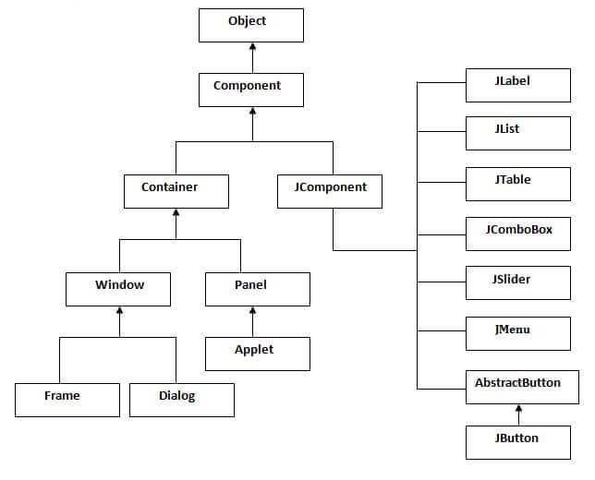
Hierarchy of SWING

Slide 8
JavaFX
Also, To work with JavaFX no prerequisite knowledge of any other technology required.
However, The package needed to import javaFX.util has a graphical processing unit.
It provides graphics pipelines which accelerate graphical processing without external storage.
JavaFX also provides canvas and printing APIs, support drag and drop facility, etc.
Hence, Styling provided by JavaFX is like CSS.
the number of components in JavaFX is more than AWT but less than SWING.

Slide 9
Tabular difference
CHARACTERISTIC | AWT | SWING | JavaFX
DEPENDENCY | Platform dependent | Platform independent | Platform independent
WEIGHT OF COMPONENT | Heavyweight | Lightweight | Lightweight
CURRENTLY IN USE | Discarded | Use it in a few places. | Currently in use
PLUGGABLE | Does Not support a pluggable look and feel | support pluggable look and feel. Components look the same on all systems | support pluggable look and feel. Components look the same on all systems.
MVC | Does Not Follow MVC | Follow MVC | Follow MVC.
NO. OF COMPONENTS | less | More than AWT | More than AWT but less than SWING.
PACKAGE | java.awt.package | javax.swing | javafx.util
RELEASED | 1995 | 1997 | 2008

Slide 10
Example on Swing
import javax.swing.*;
import java.awt.*;
public class Input {
public static void main(String []args)
{
int a=Integer.parseInt(JOptionPane.showInputDialog("Enter a number"));
int b=Integer.parseInt(JOptionPane.showInputDialog("Enter a number"));
int gcf=1;
int lcm=a*b,m;
for(int i=2;i<=a&&i<=b;i++)
{
if (a%i==0 && b%i==0)
gcf=i;
}

Slide 11
String str="The GCF of "+a+" and "+b+" is "+gcf;
if(a>b)
m=a;
else
m=b;
for(;m<=a*b;m++)
{
if(m%a==0 && m%b==0)
{
lcm=m;
break;
}
}
str+="\nThe LCM of "+a+" and "+b+" is "+lcm;
JOptionPane.showMessageDialog(null,str);
}
}

