Slide 1

World Happiness Assessment
What Drives Happiness??

Slide 2
Gross Happiness Product
GDP per Capita
Social Support
Healthy Life Expectancy
Freedom to Make life Choices
Generosity
Perceptions of Corruption

Slide 3
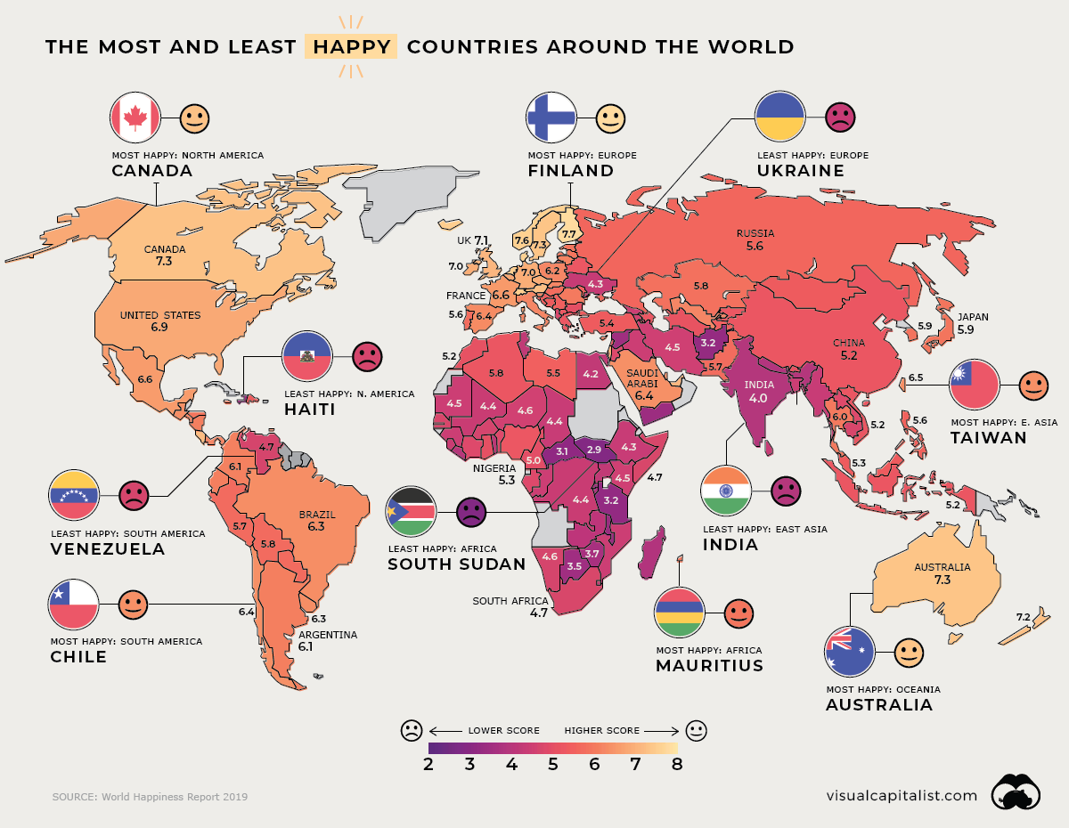

Slide 4
Happiness in Numbers
Does Money = Happiness?
Well-Being?
Social support?
Generosity?

Slide 5
Hypothesis
GDP, Social Support, and Healthy life expectancy are heavily correlated with happiness
Corruption has a negative impact on happiness

Slide 6
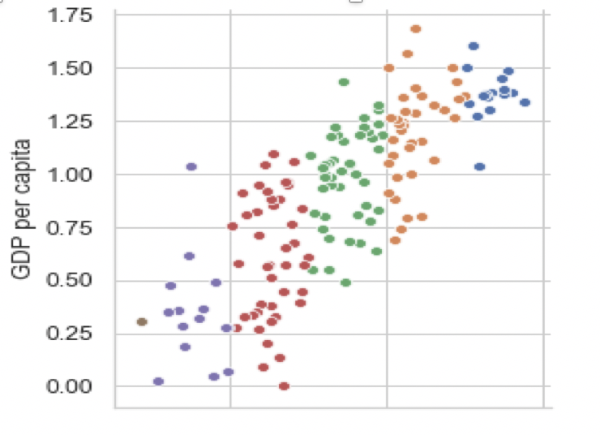
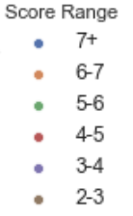
GDP vs Happiness score

Slide 7
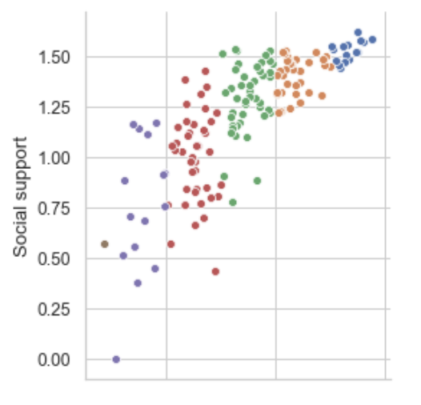
Social Support vs Happiness Score

Slide 8
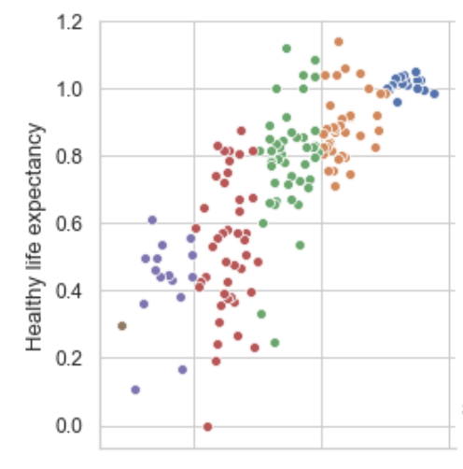
Healthy Life Expectancy vs Happiness Score

Slide 9
Other Factors
Corruption
Freedom of Choice
Generosity

Slide 10
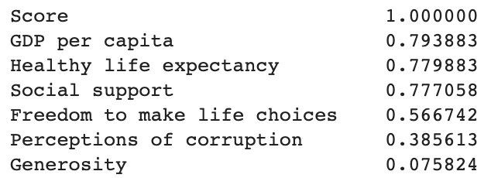
Correlation of Factors to Happiness

Slide 11
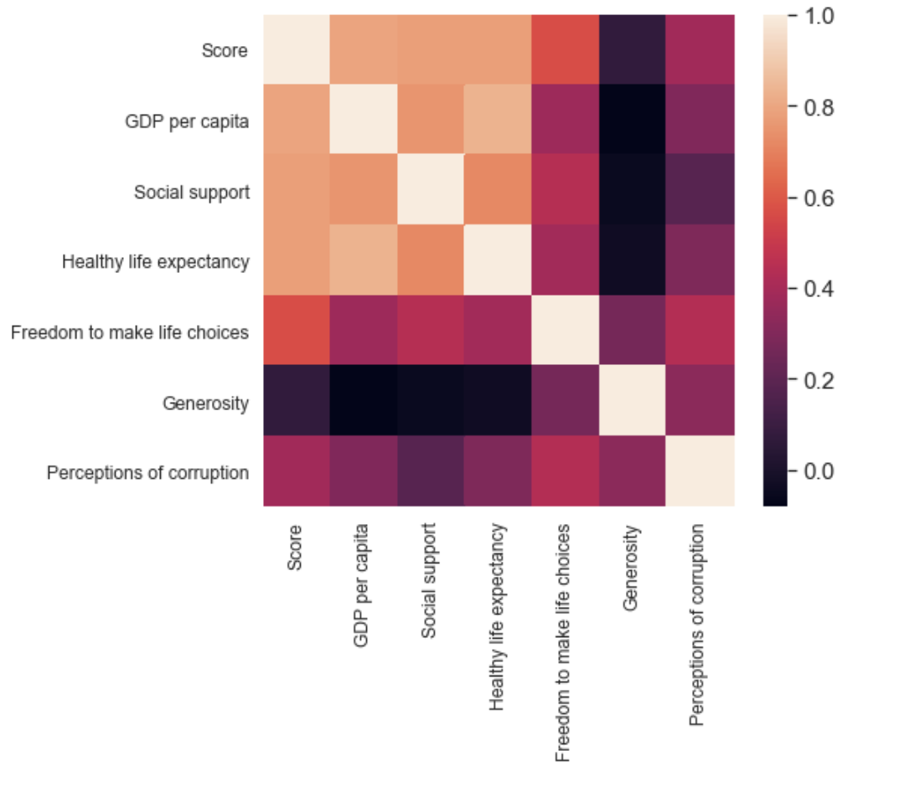

Slide 12
How did I test these??
Exploratory data analysis
Histograms
Boxplots
Scatterplots
Heatmapping

Slide 13
Conclusion
GDP +
Social Support+
Healthy Life Expectancy+
Notes:
Generosity, freedom of choice, perception of corruption did not have much of an effect

Slide 14
QUESTIONS???

