Slide 1
USING ARTIFICIAL INTELLIGENCE TO AUTOMATE DEPLOYMENT OF MTD OPERATION
Wai Him Ho (22701889)
Supervisor: Jin Hong

Slide 2
BACKGROUND (MTD)
Moving Target Defense (MTD)
Applying system reconfiguration (e.g., VM migration, IP shuffling) to dynamically change the available attack surface.
Operation based MTD (How to move):
Shuffling
Diversity
Redundancy

Slide 3
BACKGROUND (MTD)
MTD Deployment types (When to move)
Traditional (Time based MTD)
Periodically deploy MTD
Using AI to deploy MTD (Event based MTD)
Uses Intrusion Detect System(IDS) to trigger MTD deployment
More dynamic and adaptive

Slide 4
PREVIOUS WORK
MTD
Wenxiao Zhang compare shuffling and diversity (S + D) type with different MTD deployment strategies(randomly, alternatively and simultaneous) using the MTDSimTime simulator [1].
MTD Automation
J.H Cho et al. introduced an Efficient Moving Target Defense (EVADE) system that uses density optimization (DO)-based greedy MTD and Deep Reinforcement Learning- based MTD to alters network topology to thwart attackers [2].
SECURITY METRICS
Alavizadeh et al. have incorporated commonly used static metrics including the
attack cost(AC), return on attack(RoA), system risk(R) and reliability into evaluating the security of the cloud environment within the context of the Hierarchical Attack Representation Model (HARM) [3].

Slide 5
LIMITED PREVIOUS WORKS AND GAPS
Limited research on dynamic metrics in the aspect of using AI to deploy MTD
Adversary too simplistic
Limited works in using AI to deploy different MTD types
Insufficient analysis on the effect of MTD on network(network performance)

Slide 6
OUR WORK
CONTRIBUTION
Wai Him Ho (22701889) | Joo Kai Tay (22489437)
Incorporate metrics into the model Data Collection pipeline External improvement (i.e. Static degrade factor) | Model Development Reactive to attackers Incorporate sensitivity analysis
Develop a reinforcement learning model:
Utilizes different metrics to optimize its reward and deploy a single MTD based on network metrics
Include static degrade factor
Reactive to different attackers
Incorporate IDS sensitivity rating

Slide 7
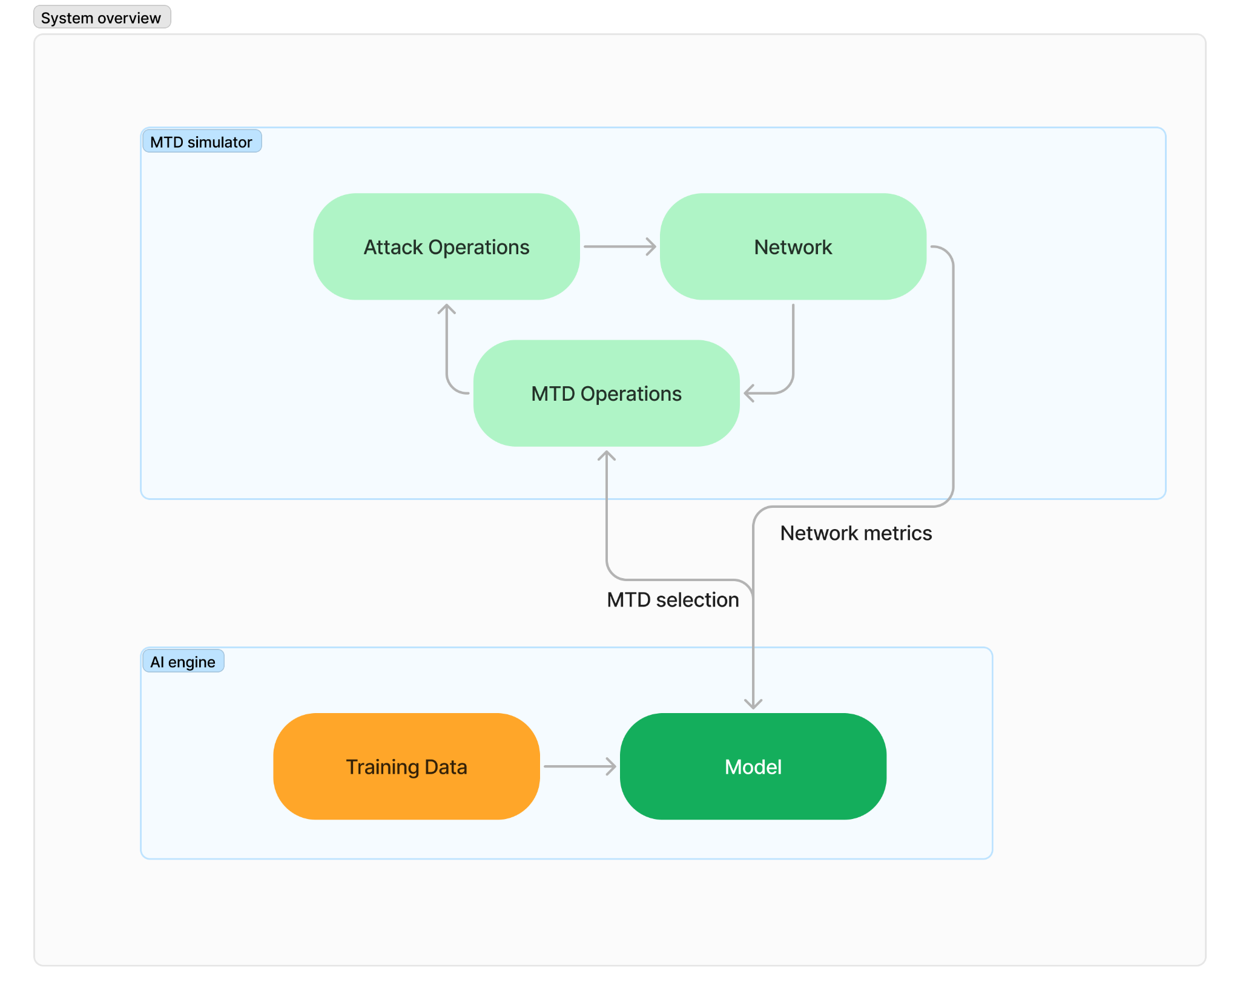
SYSTEM OVERVIEW - MTDSIM

Slide 8
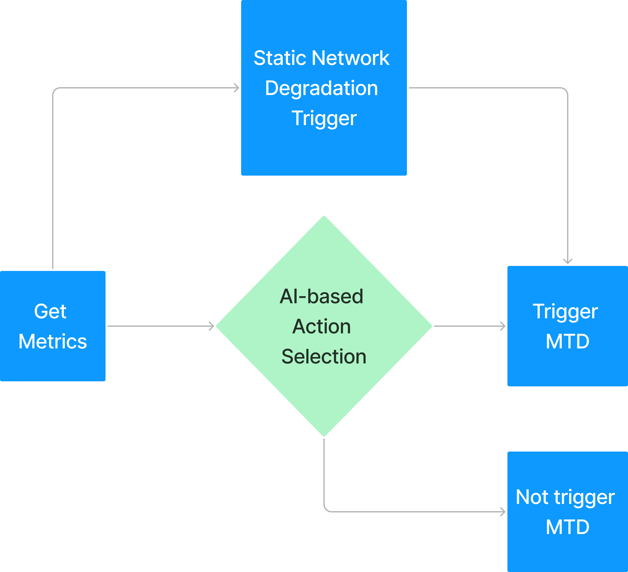
MTD DEPLOYMENT

Slide 9
INDIVIDUAL RESEARCH QUESTIONS
Investigating the use of different security metrics for reward optimization
Do models that optimizes on dynamic metrics perform better than models that optimizes on static metrics?
Do models that optimizes on all metrics perform better than models that optimizes on a single metric
Do the best new models outperform previous best models?

Slide 10
EXPERIMENT
Dynamic Features
Attack Success Rate (ASR)
Shortest Path Variability (SPV)
MTD Execution Frequency (MEF)
Mean Time to Compromise (MTTC)
Time Since Last MTD (TSLM)
Static Features
Host Compromise Ratio (HCR)
Exposed Endpoints (EE)
Attack Path Exposure (APE)
Risk (RISK)
Return on Attack (ROA)

Slide 11
MTD TYPES
CompleteTopologyShuffle: Completely regenerates the network, preserving the hosts from previously network.
IPShuffle: Assigning existing host’s Ip address to a new random address
OSDiversity: Switching between different Operating System types and versions
ServiceDiversity: Update the services running on the hosts' nodes within a network

Slide 12
EXPERIMENT
 | All MTD | CompleteTopologyShuffle | IPShuffle | OSDiversity | ServiceDiversity
All Features
Host Compromise Ratio
Exposed Endpoints
Attack Path Exposure
Attack Success Rate
Return on Attack
Shortest Path Variability
Risk
MTD Execution Time
Mean Time to Compromise
Time Since Last MTD
Optimize the reward using selected feature(s) and deploy the selected MTD(s)
E.g. ROA + IP shuffle

Slide 13
EVALUATION SCORE
Each metric will scaled according to the NO MTD(Baseline) scheme:
Attack Success Rate (ASR)
Return on Attack (ROA)
Attack Path Exposure (APE)
Risk (RISK)
Mean Time to Compromise (MTTC)
Greater SUM =
BETTER Performance

Slide 14
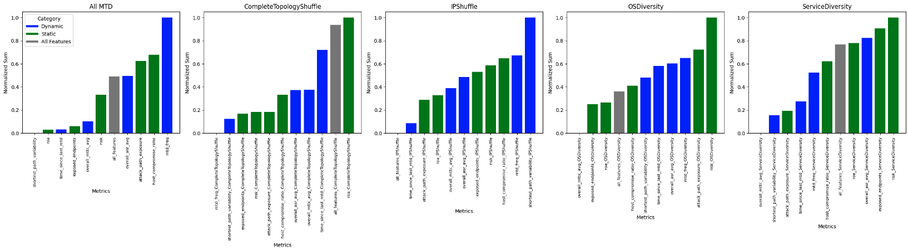
OPTIMIZING REWARD USING SINGLE/ALL FEATURES

Slide 15
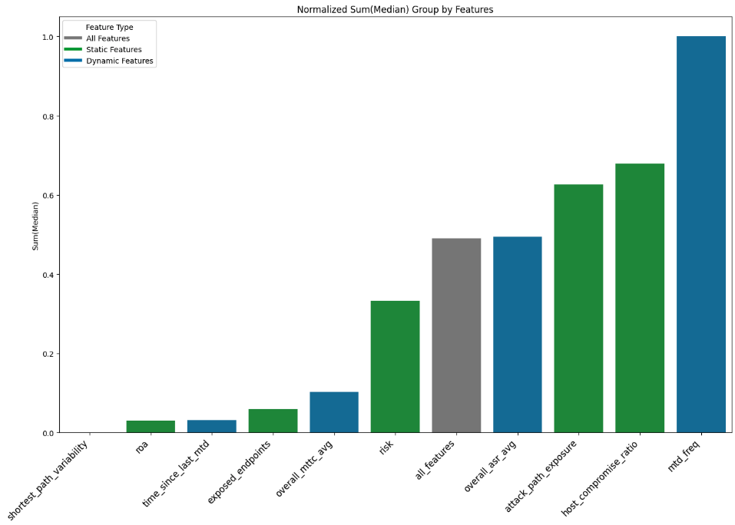
MEDIAN SCORE GROUP BY FEATURES
1. Do models that optimizes on dynamic metrics perform better than models that optimizes on static metrics?
No significant difference
E.g. ROA Score is the median of:
ROA (All MTD)
ROA CompleteTopology
ROA IP Shuffling
ROA OSDivesity
ROA ServiceDiversity

Slide 16
OVERALL RANKING GROUP BY FEATURES
2. Do models that optimizes on all metrics perform better than models that optimizes on a single metric?
Optimizing on all features does NOT perform better than optimizing on a single feature

Slide 17
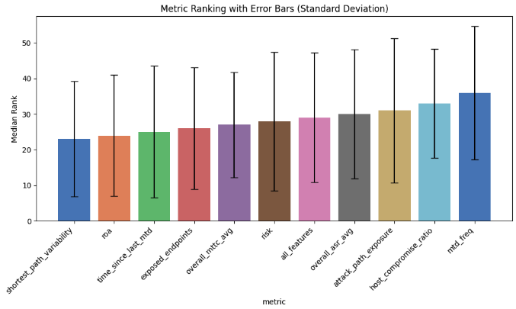
METRICS RANKING
BEST (55)
Note: 55 models in total
MTD Frequency
Host Compromise Ratio
WORSE (1)

Slide 18
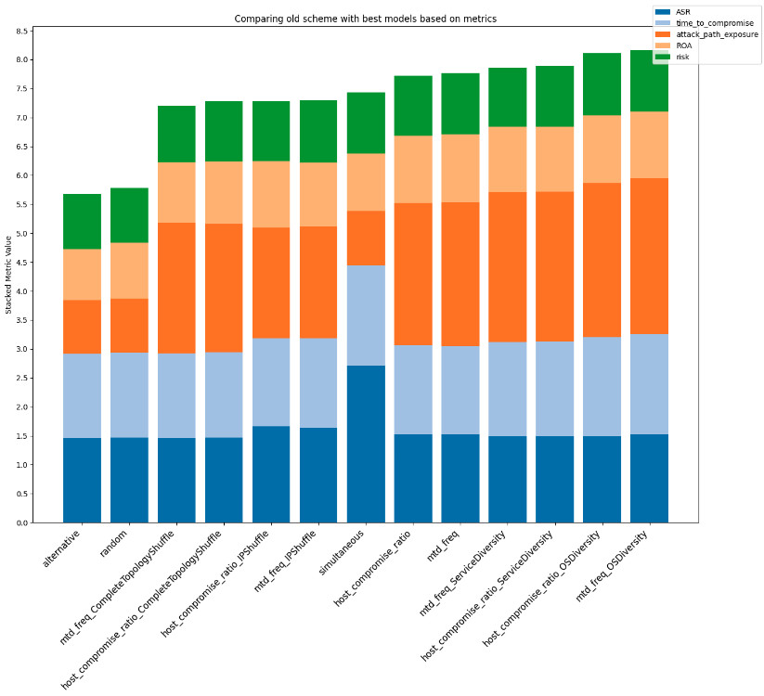
COMPARING SCHEMES
3. Do the best new models outperform best previous models?
New best models : MTD frequency and Host Compromised Ratio models
1. They perform better except in shuffling schemes
2. They perform better in attack path but not in attack success rate(ASR)

Slide 19
CONCLUSION
The advantage of optimising a single dynamic feature versus over a single static feature for reward is not significant
Optimizing for all features in reward doesn’t necessarily outperform other models
MTD Frequency and Host Compromised Ratio perform the best
Current best models outperform previous models except on shuffling schemes

Slide 20
LIMITATIONS AND FUTURE WORK
1. Model developed using simulator
Need to test with real life scenario
2. Limited examination of intersections between metrics
3. Limited amount of MTD types
4. Improve adversary/attacker complexity

Slide 21
REFERENCE
[1] Wenxiao Zhang. Evaluating multiple moving target defense in the time domain. 2023
[2] Qisheng Zhang, Jin-Hee Cho, Terrence Moore, Dan Kim, Hyuk Lim, and Frederica Nelson. EVADE: Efficient Moving Target Defense for Autonomous Network Topology Shuffling Using Deep Reinforcement Learning, pages 555–582. 05 2023.
[3] H. Alavizadeh, S. Aref, D. Kim, and J. Jang-Jaccard. Evaluating the security and economic effects of moving target defense techniques on the cloud. IEEE Transactions on Emerging Topics in Computing, 10(04):1772–1788, Oct 2022.

