Slide 1
projector
Created by: Daniel Patai

Slide 2
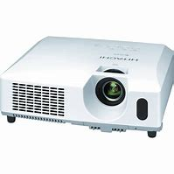
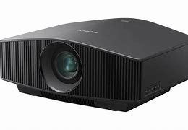
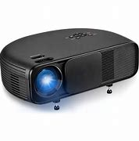
type
DLP (Digital Light Processing): This technology uses a digital chip for projecting images.
LCD (Liquid Crystal Display): LCD projectors employ a liquid crystal panel to display images.
Laser Projectors: These projectors use laser light to create images.
LED Projectors: Projectors of this type use LED lamps as a light source.

Slide 3
Brightness
Resolution
The projector's resolution determines the detail of the projected image. Common resolutions include XGA (1024x768), WXGA (1280x800), 1080p (1920x1080), and 4K (3840x2160).
Lumen is the unit used to measure the brightness of a projector. The higher the lumen value, the brighter the projected image. The choice of brightness depends on ambient light conditions and the size of the projected surface.

Slide 4
Contrast Ratio Portability
Contrast ratio indicates the difference between bright and dark areas on the image. A higher contrast ratio results in a sharper and more distinguishable image.
Portable projectors are available, suitable for easy transportation and use in various locations for presentations or movie nights.

Slide 5
Connectivity Options Lifespan andMaintenance:
Projectors come with various connectivity options such as HDMI, VGA, USB, audio output, etc. It's important to check if the projector can be connected to your devices.
It's crucial to examine the lifespan of the projector lamp and whether it is easily replaceable. Additionally, check how often the projector needs cleaning or maintenance.

Slide 6
Thank you for your attention

