Slide 1
Basic MIPS Architecture
Notes:
8am class in 113 IST
Cabinet combination 5581
The projector combination (if needed, can tell if monitor screen comes awake with a key pad on it) is 1988
Choose one (central) projection mode, use resident PC, login with your CAC account, and go to slide mode (by touching on your “windows” window you can make it full screen-or not).
Second class at 9:45 in 104 Rackley – just behind Kern. Same cabinet combination. Have to turn on projector with remote control (in the cabinet) and lower the screen (controls on the wall behind the podium – light controls there as well).
Be sure to lock everything up when you are done!

Slide 2
The Processor: Datapath & Control
Our implementation of the MIPS is simplified
  memory-reference instructions: lw, sw
  arithmetic-logical instructions: add, sub, and, or, slt
  control flow / branch instructions: beq, j
Generic implementation
  use the program counter (PC) to supply the instruction address and fetch the instruction from memory (and update the PC)
  decode the instruction (and read registers)
  execute the instruction
All instructions (except j) use the ALU after reading the registers
How? memory-reference? arithmetic? control flow?
Fetch
PC = PC+4
Exec
Decode
Notes:
memory reference use ALU to compute addresses
arithmetic use the ALU to do the require arithmetic
control use the ALU to compute branch conditions.

Slide 3
Clocking Methodologies
The clocking methodology defines when signals can be read and when they are written
  An edge-triggered methodology
Typical execution
  read contents of state elements
  send values through combinational logic
  write results to one or more state elements
State
element
1
Combinational
logic
State
element
2
clock
one clock cycle
Assumes state elements are written on every clock cycle; if not, need explicit write control signal
  write occurs only when both the write control is asserted and the clock edge occurs

Slide 4
Fetching Instructions
Fetching instructions involves
  reading the instruction from the Instruction Memory
  updating the PC to hold the address of the next instruction
Add
4
Instruction
Memory
PC
Read
Address
Instruction
  PC is updated every cycle, so it does not need an explicit write control signal
  Instruction Memory is read every cycle, so it doesn’t need an explicit read control signal

Slide 5
Decoding Instructions
Decoding instructions involves
  sending the fetched instruction’s opcode and function field bits to the control unit
Control
Unit
Read Addr 1
Register
File
Read
Data 1
Instruction
Read Addr 2
Write Addr
Read
Data 2
Write Data
  reading two values from the Register File
    Register File addresses are contained in the instruction

Slide 6
Executing R Format Operations
R format operations (add, sub, slt, and, or)
  perform the (op and funct) operation on values in rs and rt
  store the result back into the Register File (into location rd)
31
25
20
15
10
5
0
R-type:
op
rs
rt
rd
shamt
funct
RegWrite
ALU control
Read Addr 1
Register
File
Read
Data 1
Instruction
Read Addr 2
overflow
ALU
zero
Write Addr
Read
Data 2
Write Data
  The Register File is not written every cycle (e.g. sw), so we need an explicit write control signal for the Register File

Slide 7
Executing Load and Store Operations
Load and store operations involves
  compute memory address by adding the base register (read from the Register File during decode) to the 16-bit signed-extended offset field in the instruction
  store value (read from the Register File during decode) written to the Data Memory
  load value, read from the Data Memory, written to the Register File
RegWrite
ALU control
MemWrite
overflow
Read Addr 1
zero
Register
File
Read
Data 1
Address
Instruction
Read Addr 2
Data
Memory
ALU
Read Data
Write Addr
Read
Data 2
Write Data
Write Data
Sign
Extend
MemRead
16
32

Slide 8
Executing Branch Operations
Branch operations involves
  compare the operands read from the Register File during decode for equality (zero ALU output)
  compute the branch target address by adding the updated PC to the 16-bit signed-extended offset field in the instr
Add
Branch
target
address
4
Add
Shift
left 2
ALU control
PC
Read Addr 1
zero
(to branch control logic)
Register
File
Read
Data 1
Instruction
Read Addr 2
Write Addr
ALU
Read
Data 2
Write Data
Sign
Extend
16
32

Slide 9
Executing Jump Operations
Jump operation involves
  replace the lower 28 bits of the PC with the lower 26 bits of the fetched instruction shifted left by 2 bits
Add
4
4
Jump
address
Instruction
Memory
Shift
left 2
28
PC
Read
Address
Instruction
26

Slide 10
Creating a Single Datapath from the Parts
Assemble the datapath segments and add control lines and multiplexors as needed
Single cycle design – fetch, decode and execute each instructions in one clock cycle
  no datapath resource can be used more than once per instruction, so some must be duplicated (e.g., separate Instruction Memory and Data Memory, several adders)
  multiplexors needed at the input of shared elements with control lines to do the selection
  write signals to control writing to the Register File and Data Memory
Cycle time is determined by length of the longest path

Slide 11
Control signals for Fetch, Reg, and Memory
Add
RegWrite
ALUSrc
ALU control
MemWrite
MemtoReg
4
ovf
zero
Instruction
Memory
Read Addr 1
Register
File
Read
Data 1
Address
Read Addr 2
Data
Memory
PC
Read
Address
Instruction
Read Data
Write Addr
ALU
Read
Data 2
Write Data
Write Data
MemRead
Sign
Extend
16
32
What determines the values needed on these control signals?

Slide 12
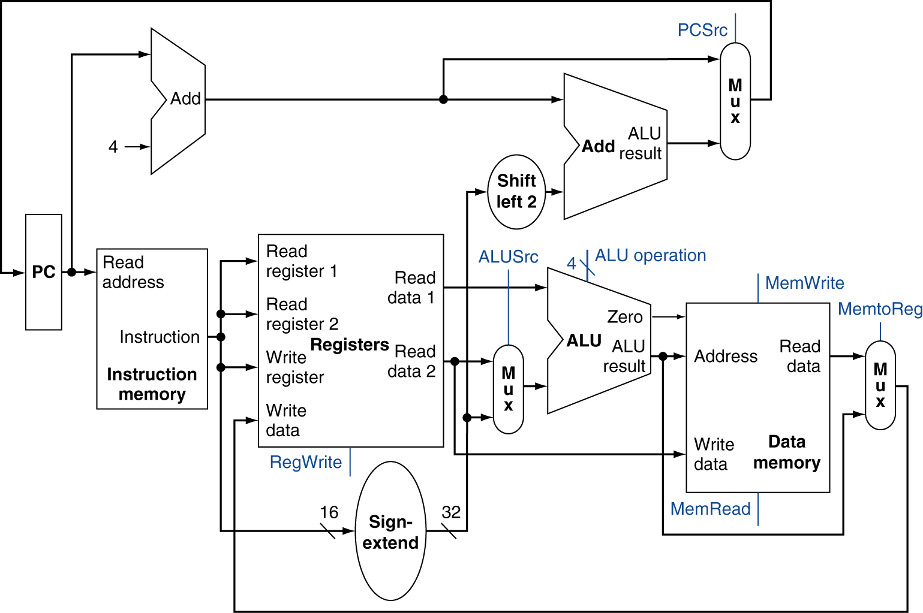
Full Datapath
Chapter — The Processor — <number>
Notes:
Morgan Kaufmann Publishers
Chapter 4 — The Processor

Slide 13
Adding the Control
Selecting the operations to perform (ALU, Register File and Memory read/write)
Controlling the flow of data (multiplexor inputs)
31
25
20
15
10
5
0
R-type:
op
rs
rt
rd
shamt
funct
31
25
20
15
0
Observations
  op field always in bits 31-26
  addr of registers to be read are always specified by the rs field (bits 25-21) and rt field (bits 20-16); for lw and sw rs is the base register
  addr. of register to be written is in one of two places – in rt (bits 20-16) for lw; in rd (bits 15-11) for R-type instructions
  offset for beq, lw, and sw always in bits 15-0
I-Type:
op
rs
rt
address offset
31
25
0
J-type:
op
target address

Slide 14
Control
The control unit is responsible for setting all the control signals so that each instruction is executed properly.
  The control unit’s input is the 32-bit instruction word.
  The outputs are values for the blue control signals in the datapath.
Most of the signals can be generated from the instruction opcode alone, and not the entire 32-bit word.
To illustrate the relevant control signals, we will show the route that is taken through the datapath by R-type, lw, sw and beq instructions.

Slide 15
R-type instruction path
The R-type instructions include add, sub, and, or, and slt.
The ALUOp is determined by the instruction’s “func” field.
0
M
u
x
1
Add
PC
4
Add
Shift
left 2
PCSrc
RegWrite
Read
address
Instruction
[31-0]
I [25 - 21]
MemWrite
MemToReg
Read
register 1
Read
data 1
I [20 - 16]
ALU
Read
address
Read
data
1
M
u
x
0
Instruction
memory
Read
register 2
Zero
0
M
u
x
1
Read
data 2
0
M
u
x
1
Result
Write
address
Write
register
Data
memory
Registers
Write
data
I [15 - 11]
Write
data
ALUOp
ALUSrc
MemRead
RegDst
I [15 - 0]
Sign
extend

Slide 16
lw instruction path
An example load instruction is lw $t0, –4($sp).
The ALUOp must be 010 (add), to compute the effective address.
0
M
u
x
1
Add
PC
4
Add
Shift
left 2
PCSrc
RegWrite
Read
address
Instruction
[31-0]
I [25 - 21]
MemWrite
MemToReg
Read
register 1
Read
data 1
I [20 - 16]
ALU
Read
address
Read
data
1
M
u
x
0
Instruction
memory
Read
register 2
Zero
0
M
u
x
1
Read
data 2
0
M
u
x
1
Result
Write
address
Write
register
Data
memory
Registers
Write
data
I [15 - 11]
Write
data
ALUOp
ALUSrc
MemRead
RegDst
I [15 - 0]
Sign
extend

Slide 17
sw instruction path
An example store instruction is sw $a0, 16($sp).
The ALUOp must be 010 (add), again to compute the effective address.
0
M
u
x
1
Add
PC
4
Add
Shift
left 2
PCSrc
RegWrite
Read
address
Instruction
[31-0]
I [25 - 21]
MemWrite
MemToReg
Read
register 1
Read
data 1
I [20 - 16]
ALU
Read
address
Read
data
1
M
u
x
0
Instruction
memory
Read
register 2
Zero
0
M
u
x
1
Read
data 2
0
M
u
x
1
Result
Write
address
Write
register
Data
memory
Registers
Write
data
I [15 - 11]
Write
data
ALUOp
ALUSrc
MemRead
RegDst
I [15 - 0]
Sign
extend

Slide 18
beq instruction path
One sample branch instruction is beq $at, $0, offset.
The ALUOp is 110 (subtract), to test for equality.
The branch may or may not be taken, depending on the ALU’s Zero output
0
M
u
x
1
Add
PC
4
Add
Shift
left 2
PCSrc
RegWrite
Read
address
Instruction
[31-0]
I [25 - 21]
MemWrite
MemToReg
Read
register 1
Read
data 1
I [20 - 16]
ALU
Read
address
Read
data
1
M
u
x
0
Instruction
memory
Read
register 2
Zero
0
M
u
x
1
Read
data 2
0
M
u
x
1
Result
Write
address
Write
register
Data
memory
Registers
Write
data
I [15 - 11]
Write
data
ALUOp
ALUSrc
MemRead
RegDst
I [15 - 0]
Sign
extend

Slide 19
ALU Control
ALU used for
  Load/Store: F = add
  Branch: F = subtract
  R-type: F depends on funct field
ALU control | Function
0000 | AND
0001 | OR
0010 | add
0110 | subtract
0111 | set-on-less-than
1100 | NOR
Chapter 4 — The Processor — <number>
Notes:
Morgan Kaufmann Publishers
Chapter 4 — The Processor

Slide 20
ALU Control
Assume 2-bit ALUOp derived from opcode
  Combinational logic derives ALU control
opcode | ALUOp | Operation | funct | ALU function | ALU control
lw | 00 | load word | XXXXXX | add | 0010
sw | 00 | store word | XXXXXX | add | 0010
beq | 01 | branch equal | XXXXXX | subtract | 0110
R-type | 10 | add | 100000 | add | 0010
 |  | subtract | 100010 | subtract | 0110
 |  | AND | 100100 | AND | 0000
 |  | OR | 100101 | OR | 0001
 |  | set-on-less-than | 101010 | set-on-less-than | 0111
Notes:
Morgan Kaufmann Publishers
Chapter 4 — The Processor

Slide 21
Control signal table
sw and beq are the only instructions that do not write any registers.
lw and sw are the only instructions that use the constant field. They also depend on the ALU to compute the effective memory address.
ALUOp for R-type instructions depends on the instructions’ func field.
The PCSrc control signal (not listed) should be set if the instruction is beq and the ALU’s Zero output is true.
Operation | RegDst | RegWrite | ALUSrc | ALUOp | MemWrite | MemRead | MemToReg
add | 1 | 1 | 0 | 010 | 0 | 0 | 0
sub | 1 | 1 | 0 | 110 | 0 | 0 | 0
and | 1 | 1 | 0 | 000 | 0 | 0 | 0
or | 1 | 1 | 0 | 001 | 0 | 0 | 0
slt | 1 | 1 | 0 | 111 | 0 | 0 | 0
lw | 0 | 1 | 1 | 010 | 0 | 1 | 1
sw | X | 0 | 1 | 010 | 1 | 0 | X
beq | X | 0 | 0 | 110 | 0 | 0 | X

Slide 22
Generating control signals
The control unit needs 13 bits of inputs.
  Six bits make up the instruction’s opcode.
  Six bits come from the instruction’s func field.
RegDst
RegWrite
Read
address
Instruction
[31-0]
I [31 - 26]
ALUSrc
ALUOp
I [5 - 0]
Control
MemWrite
Instruction
memory
MemRead
MemToReg
PCSrc
Zero

Slide 23
R-type Instruction Data/Control Flow
0
Add
Add
1
4
Shift
left 2
PCSrc
ALUOp
Branch
MemRead
Instr[31-26]
Control
Unit
MemtoReg
MemWrite
ALUSrc
RegWrite
RegDst
ovf
Instr[25-21]
Read Addr 1
Instruction
Memory
Read
Data 1
Address
Instr[20-16]
Register
File
zero
Read Addr 2
Data
Memory
PC
Read
Address
Instr[31-0]
0
Read Data
1
Write Addr
ALU
1
Read
Data 2
0
Instr[15 -11]
Write Data
0
Write Data
1
Instr[15-0]
Sign
Extend
ALU
control
16
32
Instr[5-0]
Notes:
For lecture

Slide 24
Load Word Instruction Data/Control Flow
0
Add
Add
1
4
Shift
left 2
PCSrc
ALUOp
Branch
MemRead
Instr[31-26]
Control
Unit
MemtoReg
MemWrite
ALUSrc
RegWrite
RegDst
ovf
Instr[25-21]
Read Addr 1
Instruction
Memory
Read
Data 1
Address
Instr[20-16]
Register
File
zero
Read Addr 2
Data
Memory
PC
Read
Address
Instr[31-0]
0
Read Data
1
Write Addr
ALU
1
Read
Data 2
0
Instr[15 -11]
Write Data
0
Write Data
1
Instr[15-0]
Sign
Extend
ALU
control
16
32
Instr[5-0]
Notes:
For class handout – have a student come forward and mark the connections in the datapath that are active. And show the state of the control lines.

Slide 25
Load Word Instruction Data/Control Flow
0
Add
Add
1
4
Shift
left 2
PCSrc
ALUOp
Branch
MemRead
Instr[31-26]
Control
Unit
MemtoReg
MemWrite
ALUSrc
RegWrite
RegDst
ovf
Instr[25-21]
Read Addr 1
Instruction
Memory
Read
Data 1
Address
Instr[20-16]
Register
File
zero
Read Addr 2
Data
Memory
PC
Read
Address
Instr[31-0]
0
Read Data
1
Write Addr
ALU
1
Read
Data 2
0
Instr[15 -11]
Write Data
0
Write Data
1
Instr[15-0]
Sign
Extend
ALU
control
16
32
Instr[5-0]
Notes:
For lecture

Slide 26
Branch Instruction Data/Control Flow
0
Add
Add
1
4
Shift
left 2
PCSrc
ALUOp
Branch
MemRead
Instr[31-26]
Control
Unit
MemtoReg
MemWrite
ALUSrc
RegWrite
RegDst
ovf
Instr[25-21]
Read Addr 1
Instruction
Memory
Read
Data 1
Address
Instr[20-16]
Register
File
zero
Read Addr 2
Data
Memory
PC
Read
Address
Instr[31-0]
0
Read Data
1
Write Addr
ALU
1
Read
Data 2
0
Instr[15 -11]
Write Data
0
Write Data
1
Instr[15-0]
Sign
Extend
ALU
control
16
32
Instr[5-0]
Notes:
For class handout – have a student come forward and mark the connections in the datapath that are active. And show the state of the control lines.

Slide 27
Branch Instruction Data/Control Flow
0
Add
Add
1
4
Shift
left 2
PCSrc
ALUOp
Branch
MemRead
Instr[31-26]
Control
Unit
MemtoReg
MemWrite
ALUSrc
RegWrite
RegDst
ovf
Instr[25-21]
Read Addr 1
Instruction
Memory
Read
Data 1
Address
Instr[20-16]
Register
File
zero
Read Addr 2
Data
Memory
PC
Read
Address
Instr[31-0]
0
Read Data
1
Write Addr
ALU
1
Read
Data 2
0
Instr[15 -11]
Write Data
0
Write Data
1
Instr[15-0]
Sign
Extend
ALU
control
16
32
Instr[5-0]
Notes:
For lecture

Slide 28
Adding the Jump Operation
Instr[25-0]
1
Shift
left 2
28
32
26
0
PC+4[31-28]
Add
0
Add
1
4
Shift
left 2
Jump
PCSrc
ALUOp
Branch
MemRead
Instr[31-26]
Control
Unit
MemtoReg
MemWrite
ALUSrc
RegWrite
RegDst
ovf
Instr[25-21]
Read Addr 1
Instruction
Memory
Read
Data 1
Address
Instr[20-16]
Register
File
zero
Read Addr 2
Data
Memory
PC
Read
Address
Instr[31-0]
0
Read Data
1
Write Addr
ALU
1
Read
Data 2
0
Instr[15 -11]
Write Data
0
Write Data
1
Instr[15-0]
Sign
Extend
ALU
control
16
32
Instr[5-0]
Notes:
For lecture
Good exam questions
Add jalr rs,rd 0 rs 0 rd 0 9
jump to instr whose addr is in rs and save addr of next inst (PC+4) in rd
Add the PowerPC addressing modes of update addressing and indexed addressing (will have to expand the RegFile to be three read port and two write port)
Add andi, ori, addi - have to have both a signextend and a zeroextend and choose between the two, will have to augment the ALUop encoding (since can’t get the op information out of the funct bits as with R-type)
Add mult rs, rt with the result being left in hi|lo - so also include the mfhi and mflo instructions (will have to add a multiplier, the hi and lo registers and then a couple of muxes and their control).
Add barrel shifter

Slide 29
Single Cycle Datapath with Control Unit
0
Add
Add
1
4
Shift
left 2
PCSrc
ALUOp
Branch
MemRead
Instr[31-26]
Control
Unit
MemtoReg
MemWrite
ALUSrc
RegWrite
RegDst
ovf
Instr[25-21]
Read Addr 1
Instruction
Memory
Read
Data 1
Address
Instr[20-16]
Register
File
zero
Read Addr 2
Data
Memory
PC
Read
Address
Instr[31-0]
0
Read Data
1
Write Addr
ALU
1
Read
Data 2
0
Instr[15 -11]
Write Data
0
Write Data
1
Instr[15-0]
Sign
Extend
ALU
control
16
32
Instr[5-0]
Notes:
Note mux control inputs have been swapped (for three of the muxes) from the last picture to be consistent with the book.

