Slide 1
Introduction
A.1 What is Pipelining?
A.2 The Major Hurdle of Pipelining-Structural Hazards
  Data Hazards
  Control Hazards
A.3 How is Pipelining Implemented
A.4 What Makes Pipelining Hard to Implement?
A.5 Extending the MIPS Pipeline to Handle Multi-cycle Operations
Appendix A - Pipelining

Slide 2
What Is Pipelining
Laundry Example
Ann, Brian, Cathy, Dave
each have one load of clothes
to wash, dry, and fold
Washer takes 30 minutes
Dryer takes 40 minutes
“Folder” takes 20 minutes
A
B
C
D
Appendix A - Pipelining

Slide 3
What Is Pipelining
6 PM
7
8
9
10
11
Midnight
Time
30
40
20
30
40
20
30
40
20
30
40
20
T
a
s
k
O
r
d
e
r
A
B
C
D
Sequential laundry takes 6 hours for 4 loads
If they learned pipelining, how long would laundry take?
Appendix A - Pipelining

Slide 4
What Is Pipelining
Start work ASAP
6 PM
7
8
9
10
11
Midnight
Time
30
40
40
40
40
20
T
a
s
k
O
r
d
e
r
A
Pipelined laundry takes 3.5 hours for 4 loads
B
C
D
Appendix A - Pipelining

Slide 5
Pipelining Lessons
What Is Pipelining
6 PM
7
8
9
Pipelining doesn’t help latency of single task, it helps throughput of entire workload
Pipeline rate limited by slowest pipeline stage
Multiple tasks operating simultaneously
Potential speedup = Number pipe stages
Unbalanced lengths of pipe stages reduces speedup
Time to “fill” pipeline and time to “drain” it reduces speedup
Time
T
a
s
k
O
r
d
e
r
30
40
40
40
40
20
A
B
C
D
Appendix A - Pipelining

Slide 6
Instruction Set Implementation
We first need to look at how instructions in the MIPS64 instruction set are implemented without pipelining. We’ll assume that any instruction of the subset of MIPS64 can be executed in at most 5 clock cycles.
The five clock cycles will be broken up into the following steps:
    Instruction Fetch Cycle
    Instruction Decode/Register Fetch Cycle
    Execution Cycle
    Memory Access Cycle
    Write-Back Cycle

Slide 7
Instruction Fetch (IF) Cycle
The value in the PC represents an address in memory. The MIPS64 instructions are all 32-bits in length. Figure 2.27 shows how the 32-bits (4 bytes) are arranged depending on the instruction.
First we load the 4 bytes in memory into the CPU.
Second we increment the PC by 4 because memory addresses are arranged in byte ordering. This will now represent the next instruction. (Is this certain???)
ENGR9861 Winter 2007 RV

Slide 8
Instruction Decode (ID)/Register Fetch Cycle
Decode the instruction and at the same time read in the values of the register involved. As the registers are being read, do equality test incase the instruction decodes as a branch or jump.
The offset field of the instruction is sign-extended incase it is needed. The possible branch effective address is computed by adding the sign-extended offset to the incremented PC. The branch can be completed at this stage if the equality test is true and the instruction decoded as a branch.
ENGR9861 Winter 2007 RV

Slide 9
Instruction Decode (ID)/Register Fetch Cycle (continued)
Instruction can be decoded in parallel with reading the registers because the register addresses are at fixed locations.
ENGR9861 Winter 2007 RV

Slide 10
Execution (EX)/Effective Address Cycle
If a branch or jump did not occur in the previous cycle, the arithmetic logic unit (ALU) can execute the instruction.
At this point the instruction falls into three different types:
    Memory Reference: ALU adds the base register and the offset to form the effective address.
    Register-Register: ALU performs the arithmetic, logical, etc… operation as per the opcode.
    Register-Immediate: ALU performs operation based on the register and the immediate value (sign extended).

Slide 11
Graphically Representing MIPS Pipeline
Can help with answering questions like:
  How many cycles does it take to execute this code?
  What is the ALU doing during cycle 4?
  Is there a hazard, why does it occur, and how can it be fixed?
IM
Reg
ALU
DM
Reg

Slide 12
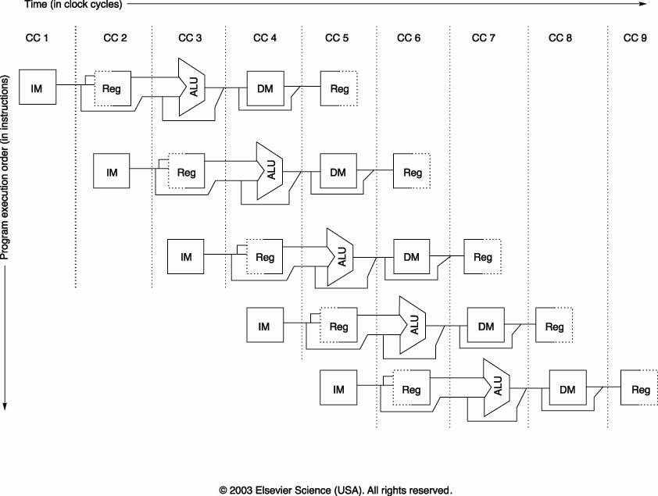
Memory Access (MEM) Cycle
If a load, the effective address computed from the previous cycle is referenced and the memory is read. The actual data transfer to the register does not occur until the next cycle.
If a store, the data from the register is written to the effective address in memory.

Slide 13
Why Pipeline? For Performance!
Time (clock cycles)
Once the pipeline is full, one instruction is completed every cycle, so CPI = 1
Inst 0
IM
Reg
ALU
DM
Reg
I
n
s
t
r.
O
r
d
e
r
Inst 1
IM
Reg
ALU
DM
Reg
Inst 2
IM
Reg
ALU
DM
Reg
Inst 3
IM
Reg
ALU
DM
Reg
Inst 4
IM
Reg
ALU
DM
Reg
Time to fill the pipeline

Slide 14
Can Pipelining Get Us Into Trouble?
Yes: Pipeline Hazards
  structural hazards: attempt to use the same resource by two different instructions at the same time
  data hazards: attempt to use data before it is ready
    An instruction’s source operand(s) are produced by a prior instruction still in the pipeline
  control hazards: attempt to make a decision about program control flow before the condition has been evaluated and the new PC target address calculated
    branch instructions
Can always resolve hazards by waiting
  pipeline control must detect the hazard
  and take action to resolve hazards
Notes:
Note that data hazards can come from R-type instructions or lw instructions

Slide 15
Dealing With Structural Hazards
A structural hazard is dealt with by inserting a stall or pipeline bubble into the pipeline. This means that for that clock cycle, nothing happens for that instruction. This effectively “slides” that instruction, and subsequent instructions, by one clock cycle.
This effectively increases the average CPI.

Slide 16
A Single Memory Would Be a Structural Hazard
Time (clock cycles)
Reading data from memory
lw
Mem
Reg
ALU
Mem
Reg
I
n
s
t
r.
O
r
d
e
r
Inst 1
Mem
Reg
ALU
Mem
Reg
Inst 2
Mem
Reg
ALU
Mem
Reg
Inst 3
Mem
Reg
ALU
Mem
Reg
Inst 4
Reading instruction from memory
Mem
Reg
ALU
Mem
Reg
Fix with separate instr and data memories (I$ and D$)

Slide 17
Register Usage Can Cause Data Hazards
Dependencies backward in time cause hazards
add $1,
IM
Reg
ALU
DM
Reg
I
n
s
t
r.
O
r
d
e
r
sub $4,$1,$5
IM
Reg
ALU
DM
Reg
and $6,$1,$7
IM
Reg
ALU
DM
Reg
or $8,$1,$9
IM
Reg
ALU
DM
Reg
xor $4,$1,$5
IM
Reg
ALU
DM
Reg
Read before write data hazard
Notes:
For class handout

Slide 18
Register Usage Can Cause Data Hazards
Dependencies backward in time cause hazards
add $1,
IM
Reg
ALU
DM
Reg
sub $4,$1,$5
IM
Reg
ALU
DM
Reg
and $6,$1,$7
IM
Reg
ALU
DM
Reg
or $8,$1,$9
IM
Reg
ALU
DM
Reg
xor $4,$1,$5
IM
Reg
ALU
DM
Reg
Read before write data hazard
Notes:
For lecture

Slide 19
Loads Can Cause Data Hazards
Dependencies backward in time cause hazards
lw $1,4($2)
IM
Reg
ALU
DM
Reg
I
n
s
t
r.
O
r
d
e
r
sub $4,$1,$5
IM
Reg
ALU
DM
Reg
and $6,$1,$7
IM
Reg
ALU
DM
Reg
or $8,$1,$9
IM
Reg
ALU
DM
Reg
xor $4,$1,$5
IM
Reg
ALU
DM
Reg
Load-use data hazard
Notes:
Note that lw is just another example of register usage (beyond ALU ops)

Slide 20
One Way to “Fix” a Data Hazard
Can fix data hazard by waiting – stall – but impacts CPI
add $1,
IM
Reg
ALU
DM
Reg
I
n
s
t
r.
O
r
d
e
r
stall
stall
sub $4,$1,$5
IM
Reg
ALU
DM
Reg
and $6,$1,$7
IM
Reg
ALU
DM
Reg

Slide 21
Another Way to “Fix” a Data Hazard
Fix data hazards by forwarding results as soon as they are available to where they are needed
add $1,
IM
Reg
ALU
DM
Reg
I
n
s
t
r.
O
r
d
e
r
sub $4,$1,$5
IM
Reg
ALU
DM
Reg
and $6,$1,$7
IM
Reg
ALU
DM
Reg
or $8,$1,$9
IM
Reg
ALU
DM
Reg
xor $4,$1,$5
IM
Reg
ALU
DM
Reg
Notes:
For class handout

Slide 22
Another Way to “Fix” a Data Hazard
Fix data hazards by forwarding results as soon as they are available to where they are needed
add $1,
IM
Reg
ALU
DM
Reg
I
n
s
t
r.
O
r
d
e
r
sub $4,$1,$5
IM
Reg
ALU
DM
Reg
IM
Reg
ALU
DM
Reg
and $6,$1,$7
or $8,$1,$9
IM
Reg
ALU
DM
Reg
xor $4,$1,$5
IM
Reg
ALU
DM
Reg
Notes:
For lecture
Forwarding paths are valid only if the destination stage is later in time than the source stage.
Forwarding is harder if there are multiple results to forward per instruction or if they need to write a result early in the pipeline

Slide 23
Forwarding with Load-use Data Hazards
lw $1,4($2)
IM
Reg
ALU
DM
Reg
I
n
s
t
r.
O
r
d
e
r
sub $4,$1,$5
IM
Reg
ALU
DM
Reg
and $6,$1,$7
IM
Reg
ALU
DM
Reg
or $8,$1,$9
IM
Reg
ALU
DM
Reg
xor $4,$1,$5
IM
Reg
ALU
DM
Reg
Notes:
For class handout

Slide 24
Forwarding with Load-use Data Hazards
lw $1,4($2)
IM
Reg
ALU
DM
Reg
I
n
s
t
r.
O
r
d
e
r
sub $4,$1,$5
IM
Reg
ALU
DM
Reg
and $6,$1,$7
IM
Reg
ALU
DM
Reg
or $8,$1,$9
IM
Reg
ALU
DM
Reg
xor $4,$1,$5
IM
Reg
ALU
DM
Reg
Will still need one stall cycle even with forwarding
Notes:
For lecture
Note that lw is just another example of register usage (beyond ALU ops)
Need to stall even with forwarding when data hazard involves a load

Slide 25
Branch Instructions Cause Control Hazards
Dependencies backward in time cause hazards
beq
IM
Reg
ALU
DM
Reg
I
n
s
t
r.
O
r
d
e
r
lw
IM
Reg
ALU
DM
Reg
Inst 3
IM
Reg
ALU
DM
Reg
Inst 4
IM
Reg
ALU
DM
Reg

Slide 26
One Way to “Fix” a Control Hazard
Fix branch hazard by waiting – stall – but affects CPI
I
n
s
t
r.
O
r
d
e
r
beq
IM
Reg
ALU
DM
Reg
stall
stall
stall
lw
IM
Reg
ALU
DM
Reg
Inst 3
IM
Reg
ALU
DM
Notes:
Another “solution” is to put in enough extra hardware so that we can test registers, calculate the branch address, and update the PC during the second stage of the pipeline. That would reduce the number of stalls to only one.
A third approach is to prediction to handle branches, e.g., always predict that branches will be untaken. When right, the pipeline proceeds at full speed. When wrong, have to stall (and make sure nothing completes – changes machine state – that shouldn’t have). Will talk about these options in more detail in next,next lecture.

Slide 27
Corrected Datapath to Save RegWrite Addr
Need to preserve the destination register address in the pipeline state registers
IF/ID
ID/EX
EX/MEM
Add
4
Shift
left 2
Add
MEM/WB
Instruction
Memory
Read Addr 1
Data
Memory
Register
File
Read
Data 1
Read Addr 2
PC
Read
Address
Read
Data
Write Addr
ALU
Address
Read
Data 2
Write Data
Write Data
Sign
Extend
16
32
Notes:
For class handout

Slide 28
Corrected Datapath to Save RegWrite Addr
Need to preserve the destination register address in the pipeline state registers
IF/ID
ID/EX
EX/MEM
Add
4
Shift
left 2
Add
MEM/WB
Instruction
Memory
Read Addr 1
Data
Memory
Register
File
Read
Data 1
Read Addr 2
PC
Read
Address
Read
Data
Write Addr
ALU
Address
Read
Data 2
Write Data
Write Data
Sign
Extend
16
32
Notes:
For lecture

Slide 29
MIPS Pipeline Control Path Modifications
All control signals can be determined during Decode
  and held in the state registers between pipeline stages
ID/EX
EX/MEM
IF/ID
Control
Add
MEM/WB
4
Shift
left 2
Add
Instruction
Memory
Read Addr 1
Data
Memory
Register
File
Read
Data 1
Read Addr 2
PC
Read
Address
Read
Data
Write Addr
ALU
Address
Read
Data 2
Write Data
Write Data
Sign
Extend
16
32

