Slide 1
Chapter 1 : Introduction
The Ideas of Computer Science
Abstraction
The Abstract Data Type (ADT)
The Python programming language

Slide 2
Computer Science
Computers have become more and more complex
Problems have become both more complex and large in size and scale
Computer Science is concerned on how to solve problems with computers
The Science part is to create repeatable foundations and principals to apply to these problems

Slide 3
You have already learned to develop a program that solves a problem given in a problem statement.
You have learned that this can be hard and involve a lot of complexity
But there are some fundamental ideas that can related to the problem solving process that can be used to help

Slide 4
Two important ideas in this Chapter
Review the framework within which computer science and the study of algorithms and data structures must fit
The Python programming language and an overview of Object Oriented Programming I will be doing a little more than in the miller book to cover more Object Oriented and functional programming.

Slide 5
Computer Science - CS
Algorithm (since 300 b.c.)
step-by-step list of instructions for solving any instance of the problem that might arise
study of solutions to problems as well as the study of problems with no solutions.
computable – problems with algorithmic solutions
CS is also the study of abstraction

Slide 6
Abstraction
what actions do you do to control an object
Automobile control
from a driver perspective
simple set of controls
from a automotive mechanic perspective
must know a lot of details about 'under the hood'
What is your interface

Slide 7
Abstraction
The user of a interface as part of an abstraction – called a client
>>> import math
>>> math.sqrt(16)
4.0
>>>
sqrt()
n
square root of n
This is procedural abstraction

Slide 8
What Is Programming?
Programming is the process of taking an algorithm and encoding it into a notation, a programming language, so that it can be executed by a computer.
Computer science is not the study of programming.

Slide 9
What Is Programming?
Programming is an important part of Computer Science
Programming is how we implement a working representation of our algorithm solution

Slide 10
Algorithm Solution
Describe the problem
Data needed for the problem instance
Steps need to produce Result
Computer languages provide notation to represent
Data type constructs
Control structure constructs

Slide 11
Basic Control constructs
1 – sequential steps
2 – selection for decision making
3 – iteration for repetitive control
4 – procedure abstraction (functions)
needed to simplify and avoid duplication

Slide 12
Data Constructs
All data in computer are sequence of bits
Data types are how we associate meaning to these bits
Data types are also related common ways we represent data in the problem
strings, whole number, fractions, bank balance etc.,

Slide 13
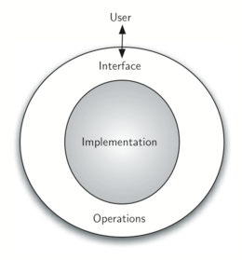
Abstract Data Type - ADT
Similar to abstraction of code using procedure abstraction, but for data
Create a abstraction for new data types
We call these an ADT or abstract data type

Slide 14
ADT
The user or client of a ADT has a set interface that they can rely on certain predefined operations to work

Slide 15
Consider the integer type, you expect it to have operations for add, subtract, multiply and divide.
As long as the integer type of data implements the standard operations and works, you don't care how the operation is carried out 'under the hood', on what form of bits in the computer represent the integer.
This provides an implementation-independent view of the data.

Slide 16
Date example
An ADT for a date may have the following interface methods to work on a date
get the number days to another date
get the week number of the year
advance the date by a number of days
set the the date to new m/d/y
return the date in a specific format: Feb 2,2014 2/2/14 February 2nd, 2014

Slide 17
Why Study Algorithms?
Seeing how to solve different problems with various approaches will teach us how to recognize patterns of problem solving.
Different Algorithms to solve the same problem will use different computer resources
Some problems my be intractable
We may have to decide on different approaches because of the trade offs
Also look at the Princeton first 11 slides for more.

Slide 19
Intro to Python

Slide 20
Every piece of data is object
In python everything is an object
What is an object:
It has data (state) and methods (the interface)
A class defines how an instance of a object behaves
Actual data items are called objects
“an object is a instance of a class”

Slide 21
Built in Atomic types
Two numeric types:
int ( holds whole numbers, no limits)
float (holds floating point numbers – 64 bit )
Standard operators + - * /
Note that / on two integers will result in float (2.7 python does integer divide)
% does modulus as in C++ and java
// will always do integer divide in python 3+
** does power (exponentiation) i.e. 2**8

Slide 22
The None type
A variable may be assigned the special value None to indicate it does not have a value
None evaluates to False

Slide 23
Lets look at examples
+ -
/ in 3.4 create float result
// does integer divide
% does modulus
** does power
and or True False not

Slide 24
boolean type and compare ops
Boolean type has values True and False
You can use the operators not and or
False or True
Not (False and True)
You can use all the comparison ops > >= < <= == and != as in C++ and java
but you can't use && or || or ! for boolean operators

Slide 25
Assignment Op
= is the assignment operator
a variable is created when its name is used the first time on the left of a = operator
the variable will point to the data that is the result of the expression on the right side.
It is the data (object) that has the value and type, not the variable
Example: amount = 45.55 # amount variable is created, and it refers to a float object with value 45.55

Slide 26
assignment with existing variable
When a variable already exists, and you assign a new value to it, then the variable will now point to the new value.
x = 199 x is created and it is assigned to point to int object with data 00
x = "abc" x is assigned to point to new object type str with value of "abc", it no longer points to old 199

Slide 27
Each assignment creates a new memory location for new object
after
theSum = 1
theSum
1
type int

Slide 28
Each assignment creates a new memory location for new object
after
theSum = 1
theSum
1
type int
then after theSum = 2
theSum
2
type int

Slide 29
Each assignment creates a new memory location for new object
after
theSum = 1
theSum
1
type int
then after theSum = 2
theSum
2
type int
then after theSum = "abc"
theSum
"abc"
type str

Slide 30
Precedence table from lowest to highest priority
Operator | Description
lambda | Lambda expression
if – else | Conditional expression
or | Boolean OR
and | Boolean AND
not x | Boolean NOT
in, not in, is, is not, <, <=, >, >=, !=, == | Comparisons, including membership tests and identity tests
| | Bitwise OR
^ | Bitwise XOR
& | Bitwise AND
<<, >> | Shifts
+, - | Addition and subtraction
*, /, //, % | Multiplication, division, remainder
+x, -x, ~x | Positive, negative, bitwise NOT
** | Exponentiation
x[index], x[index:index], x(arguments...), x.attribute | Subscription, slicing, call, attribute reference
(expressions...), [expressions...], {key:value...}, {expressions...} | Binding or tuple display, list display, dictionary display, set display

Slide 31
Built in Collection classes

Slide 32
Ordered collections
Strings "this is a simple string\nover two lines”
Strings are immutable (read only)
Lists – lists are like arrays with extra operations
Tuples – are like arrays that can’t be changed
They are immutable

Slide 33
Unordered collections
Set: a collection of unique objects
Dictionary: a collection of key/value pairs

Slide 34
Lists
A list is an ordered collection of zero or more references to Python data objects.
Lists are written as comma-delimited values enclosed in square brackets.
The empty list is simply [ ]
The items in a list can be of mixed types
i.e: [ "John", 1.7, 1.8, "A", 99 ]

Slide 35
operators on list and any python sequence type
Operation Name | Operator - examples | Explanation
indexing | [ ] list[4] | Access an element of a sequence
concatenation | + list1 + list2 | Combine sequences together
repetition | * list1 * 3 | Concatenate a repeated number of times
membership | in "john" in list | Ask whether an item is in a sequence
length | len len(list) | Ask the number of items in the sequence
slicing | [ : ] list[2:5] | Extract a part of a sequence

Slide 36
How index works
list = ["Joe", 1.8,2,"A",99]
"Joe" | 1.7 | 2 | "A" | 99
0 | 1 | 2 | 3 | 4
-5 | -4 | -3 | -2 | -1
index
>>> list[1]
1.7
>>> list[-2]
"A"
>>> list[2:3] #called a slice
[2,"A"]

Slide 37
How slice works
a[start:end] # items start through end-1
a[start:] # items start through the rest of the array
a[:end] # items from the beginning through end-1
a[:] # a copy of the whole array
The other feature is that start or end may be a negative number, which means it counts from the end of the array instead of the beginning. So:
a[-1] # last item in the array
a[-2:] # last two items in the array
a[:-2] # everything except the last two items

Slide 38
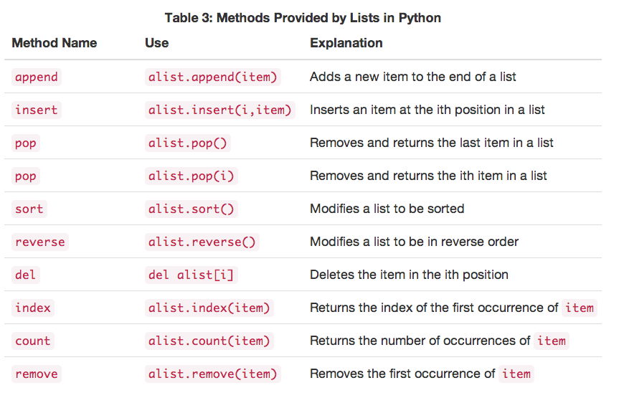

Slide 39
What are methods
functions in programming languages have a name, take parameters, and can return a result
methods are the interface to an object
They are 'called' on the object, can have parameters, and can return a result
object_reference.method( param1, param2)
alist.insert(3,"John Doe") # insert into alist

Slide 40
Object oriented perspective
Think of method calls on object as sending a 'message' to that object
alist.insert(3,"John Doe") send a message
insert 'john doe' at after index 3
to the alist object

Slide 41
integers and floats are objects two
dir(object) will return list of methods
all the operators have a method
+ has the method __add_
To call methods on int or float put the use parentheses around the number:
(23).__add__(4)

Slide 42
range function
The range function creates a range object that represents a sequence of integers
range(5) create 0,1,2,3,4
range(5,10) creates 5,6,7,8,9
range(5,10,2) creates 5,7,9
range(4,1,-1) creates 4,3,2
range(s,e,i) creates a sequence s, s+i, s+2*i, … s+n*i where this last term in before e in the sequence
and range can be converted into a list with the list function: list(range(10)) -> [0,1,2,3,4,5,6,7,8,0]

Slide 43
Strings

Slide 44
literal strings
"hello world" is an example of a literal string
in python 3+, these strings are unicode
older python, strings are ASCII
you can make strings with either " or '
"Hello" 'this is a string'
escape chars \n \r \\ \' \"
Strings are immutable!
"Over \u0e55\u0e57 57 flavours" << insert unicode chars (probably won't work)

Slide 45
>>> "David"
'David'
>>> myName = "David"
>>> myName[3]
'i'
>>> myName*2
'DavidDavid'
>>> len(myName)
5

Slide 46
Since strings are sequences, all of the sequence operations described above work as you would expect. In addition, strings have a number of methods, some of which are shown in Table 4. For example,
>>> myName
'David'
>>> myName.upper()
'DAVID'
>>> myName.center(10)
' David '
>>> myName.find('v')
2
>>> myName.split('v')
['Da', 'id']
Note that if you use the split method with no parameters, it will split on any whitespace (spaces, tabs, or new lines)

Slide 47
doc strings
There is a third type of string you can use called a doc string. It has two functions
use to create multiline string data: s = """this is the first line this is a second line and we will end with a indented line"""
use to self document your program

Slide 48
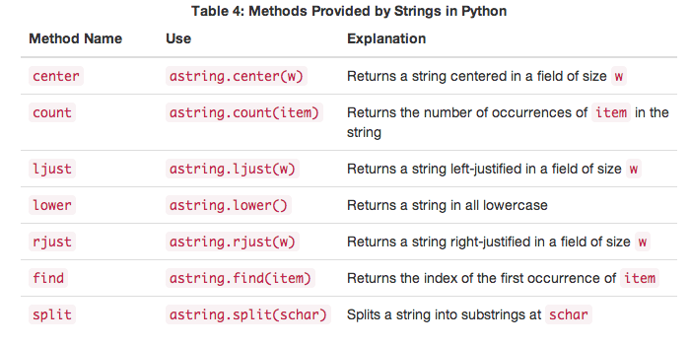

Slide 49
List vs. Strings
Strings are immutable, they can not be modified, any method that appears to modify a string is really making a new string like the slice operator
Lists can be modified, and the objects they refer to can be modified if the object is not immutable, or replaced if it is.

Slide 50
Tuples
Tuples are just like lists but the tuple is immutable. Once created, it can not be changed
Tuples use () instead of []
Example ( 3.14, 2.17, "Joe") is a tupple of two floats and one string

Slide 51
Sets
Set is like a set in math. It is a collection of unique things
Sets us {} and the elements of a set have to be unique
{ "apple", "corn", "salmon" }
Sets are not considered sequential

Slide 52
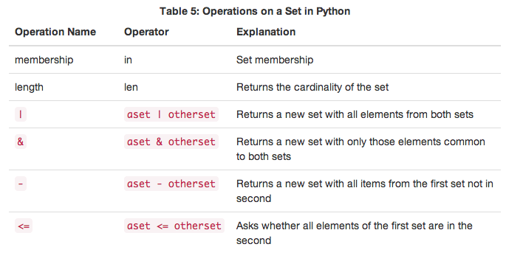

Slide 53
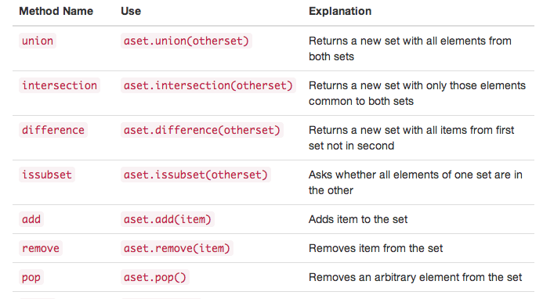

Slide 54
dictionary
Examples:
capitals = {'Iowa':'DesMoines','Wisconsin':'Madison'}
days = {1:'Mon', 2:'Tue', 3:'Wed', 4:'Thr',5:'Fri'}
access
>> capitals['Wisconsin']
Madison
Dictionaries are like arrays but the index is usually a string (can be any immutable object). The index is called a key and the object referenced is called the value ( Know as key/value pairs )

Slide 55
Example
capitals = {'Iowa':'DesMoines','Wisconsin':'Madison'}
print(capitals['Iowa'])
capitals['Utah']='SaltLakeCity'
print(capitals)
capitals['California']='Sacramento'
print(len(capitals))
for k in capitals:
print(capitals[k]," is the capital of ", k)

Slide 56
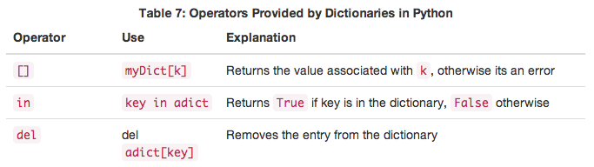
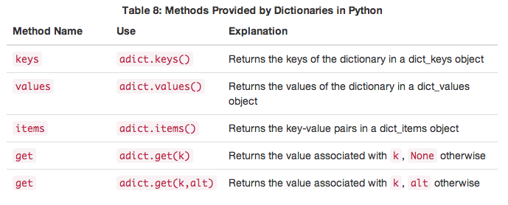

Slide 57
Input
input with a prompt
example
name = input("enter name: ")
age = int(input("enter age: "))
h = float(input("enter height in meters: "))
the input function always returns a string, you have to use the int() or float() function to convert to a numeric type when needed

Slide 58
formating strings or output
We have only shown you print() with one parameter, but you can use multiple parameters and even a 'named' parameter to have more control
print with just multple parameters print each parameter as a string separated by one space.
the named parameter sep="something" will replace the spaces bewteen with something

Slide 59
and if you add the end="something" then it will end with something instead of a new line
>>> print("Hello")
Hello
>>> print("Hello","World")
Hello World
>>> print("Hello","World", sep="***")
Hello***World
>>> print("Hello","World", end="***")
Hello World***>>> <- note no new line

Slide 60
String % formating operator
print(aName, "is", age, "years old")
Tom is 23 years old
s = "%s is %d years old" % (aName,age)
print(s)
The string has format codes which always start with a % and end with a character that indicate the type of formmating: %s and %d are the format codes above
Note that there is a Python 3 way to format that is different (see https://docs.python.org/3/library/string.html#format-string-syntax)

Slide 61
format codes
%d %i - for integer
%f - for float
%.2f - for float with 2 decimals (money)
%.3f - for float with 3 decimals
%s - string
%x - integer as hexadecimal
%% - just output a single % char

Slide 62
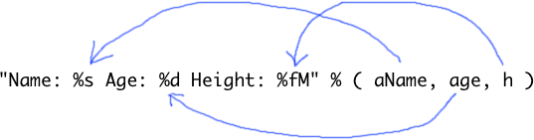
Name: Tom Age: 34 Height: 1.8M
general syntax format_string % tuple
the value of each tuple item fills in where the format code is
ddd
Note is like printf() in C which is available in most languages

Slide 63
Control Structures
if if … else if … elif … elif … else for … in …
while …

Slide 64
NO { } for bodies
Python uses indentation in place of special delimiter characters to group bodys of loops, functions, and any other 'block' of code
: on end of statement starts block
While loop
i = 0
while i < 10:
i += 1
print(i)
print("loop is done")
NOTE: Convention is to use 4 spaces (not tab) for each indent level

Slide 65
Simple IF
if age > 21:
canDrink = true
cv = True # can vote
print( "can vote:"%(cv)
NOTE: Convention is to use 4 spaces (not tab) for each indent level
body
of
if

Slide 66
Nested If
if age > 21:
if height > 1.8: # in meters
print("draft this person")
else:
print("too short for draft")
else:
print("to young for draft")
NOTE: Convention is to use 4 spaces (not tab) for each indent level

Slide 67
python version of if else if else if else
if score > 90:
print("A")
elif score > 80:
print("B")
elif score > 70:
print("C")
elif score > 60:
print("D")
else:
print("F")

Slide 68
the for loop
syntax
for item in sequence:
statements in body
example:
for i in (1,2,3,5,7,11,13):
print( i, ".", end=' ')
print('') # newline
1 . 2 . 3 . 5 . 7 . 11 . 13 .

Slide 69
range in for loop
for i in range(1,10,2):
print( "%d "%(i), end=' ')
print('') # newline
1 3 5 7 9
equivalent to c and java counting for loops
for i in range(3):
print(i)
will print 0 1 2 each on a line

Slide 70
Python has shortcut called list comprehension
it uses a loop like construct inside of a list or tuple [] or () to create the sequence of that type
sqlist = [ x*x for x in range(5)]
creates [0, 1, 4, 9, 16]
you can filter the result by adding a if clause
[ x*x for x in range(5) if x%2 != 0]
creates [ 1, 9] # squares that are odd

Slide 71
Exceptions
Syntax error happens when interpreter detects error in your code
runtime errors detected by the interpreter are called exceptions
import math
print(math.sqrt(-23))
Traceback (most recent call last):
File "<stdin>", line 1, in <module>
ValueError: math domain error

Slide 72
fatal errors vs recoverable errors
fatal errors are ones that your program just quits, this is usually because you program does not gracefully handle something correctly
Some errors can be detected and then you can write code to recover from the error and your program keeps running

Slide 73
example of try … exception
import math
n = float(input('type number:'))
try:
print(math.sqrt(n))
except:
print("bad value for sqrt")
print("using absolute of your input")
print(math.sqrt(abs(n)))
print("goodbye")

Slide 74
you can also 'raise' your own errors
use raise RuntimeError( msg )
import math
n = float(input('type number:'))
if n < 0:
m = "you can't use a negative number"
raise RuntimeError( m )
print("goodby")

Slide 75
defining functions
since python does implicit type, you don't need return type or parameter types
you use the def declaration to declare functions i.e.
def average( list ):
acc = 0.0
for x in list:
acc += x
return acc / len(list)
print( average( [1,3,7,11] )

Slide 76
Newton's sqrt Method
Sir Isaac Newton developed a technique to compute square roots. (pre calculator)
The algorithm for finding the square root of n
set guess to n divided by 2
replace the guess with ½ of the guess + n/guess:
repeat step 2 until the answer is close enough.

