Slide 1
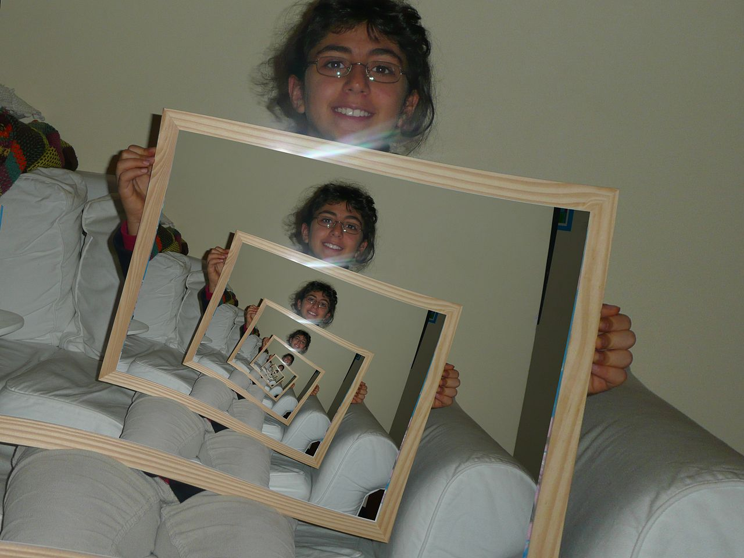
Recursion | Chapter 4
"Droste effect 1260359-3" by Nevit Dilmen (talk) - Own work. Licensed under CC BY-SA 3.0 via Wikimedia Commons - http://commons.wikimedia.org/wiki/File:Droste_effect_1260359-3.jpg#/media/File:Droste_effect_1260359-3.jpg

Slide 2
Recursion Definition
Recursion is the process of defining a problem (or the solution to a problem) in terms of (a simpler version of) itself.

Slide 3
For example, we can define the operation
"find your way home" as:
If you are at home, stop moving.
Take one step toward home.
"find your way home".
Here the solution to finding your way home is two steps (three steps). First, we don't go home if we are already home. Secondly, we do a very simple action that makes our situation simpler to solve. Finally, we redo the entire algorithm.

Slide 4
Python example
count down from some number n to 1
def countDown(n):
print( n )
if n > 1:
countdown( n-1 )
see code

Slide 5
book example: sum a list
sum list of numbers [ 2, 5, 10 ]
Think about + works on two operands
so you can add the first item on list to the sum of the rest of the list
i.e. we get this sequence
sum( [2, 5, 10]) = 2 + sum of [5, 10 ]
sum( [ 5, 10] ) = 5 + sum( [ 10 ])
sum( [ 10 ] ) = 10 + sum( [ ] )
we can have sum of empty list return 0

Slide 6
python book example (modified)
def sum_list(a_list):
if len(a_list) == 0: # empty
return 0
return a_list[0] \
+ sum_list(a_list[1:])
see code

Slide 7
Three Laws of Recursion like the robots of Asimov, recursion must follow 3 laws
A recursive algorithm must have a base case (when to stop)
A recursive algorithm must move toward the base case
A recursive algorithm must call itself recursively

Slide 8
visualize it friendly code
def sum_list(a_list):
if len(a_list) == 0: # empty
return 0
item1 = a_list[0]
rest = sum_list(a_list[1:])
return item1 + rest
total = sum_list( [ 10, 3, 7 ] )

Slide 9
Step by Step

Slide 10
sum([1,3,5,7])
= 1 +

Slide 11
sum([1,3,5,7])
= 1 +
sum([3,5,7])
= 3 +

Slide 12
sum([1,3,5,7])
= 1 +
sum([3,5,7])
= 3 +
sum([5,7])
= 5 +

Slide 13
sum([1,3,5,7])
= 1 +
sum([3,5,7])
= 3 +
sum([5,7])
= 5 +
sum([7])
= 7 +

Slide 14
sum([1,3,5,7])
= 1 +
sum([3,5,7])
= 3 +
sum([5,7])
= 5 +
sum([7])
= 7 +
sum([])
= 0

Slide 15
sum([1,3,5,7])
= 1 +
sum([3,5,7])
= 3 +
sum([5,7])
= 5 +
sum([7])
= 7 +
sum([])
= 0

Slide 16
sum([1,3,5,7])
= 1 +
sum([3,5,7])
= 3 +
sum([5,7])
= 5 +
sum([7])
= 7 +
0
sum([])
= 0

Slide 17
sum([1,3,5,7])
= 1 +
sum([3,5,7])
= 3 +
sum([5,7])
= 5 +
7
sum([7])
= 7 +
0
sum([])
= 0

Slide 18
sum([1,3,5,7])
= 1 +
sum([3,5,7])
= 3 +
12
sum([5,7])
= 5 +
7
sum([7])
= 7 +
0
sum([])
= 0

Slide 19
sum([1,3,5,7])
= 1 +
15
sum([3,5,7])
= 3 +
12
sum([5,7])
= 5 +
7
sum([7])
= 7 +
0
sum([])
= 0

Slide 20
sum([1,3,5,7])
= 1 +
15
16
sum([3,5,7])
= 3 +
12
sum([5,7])
= 5 +
7
sum([7])
= 7 +
0
sum([])
= 0

Slide 21
Converting a Number to a string representation of any base
Same problem as in chapter 3 that used a stack, but we will use recursion

Slide 22
How we are going to do it
look at base 10 and the number 769
suppose we have convStr = '0123456789'
Its easy to convert any number n less than 10, it is just convStr[n] – our base case
Now if we can work toward the base case, by peeling a number off the original, we can use recursion
Well we can use n // 10 and n % 10 to get the original 769 into 76 and 9

Slide 23
now we can use base
what works with base 10 will work with base 2 to 16, we just use n // base and n % base to split off one digit and expand our lookup string to "0123456789ABCDEF"

Slide 24
the code
def toStr(n,base):
digits = '01234567890ABCDEF'
if n < base:
return digits[n]
return toStr(n // base,base) \
+ digits[n % base]

