Slide 1
Chapter 2: Algorithm Analysis
Lecture slides to read along with:
"Problem Solving with algorithms and data structures using python, 2nd ed."
by Brad Miller and David Ranum, Luther College
slides by Gerry Jenkins

Slide 2
Objectives
Why is algorithm analysis important
Be able to use Big-O to describe execution time
Know the common Big-O categories
Understand Big-O timing for common operations on lists and dictionaries in Python
Know how to measure (benchmark) simple python programs

Slide 3
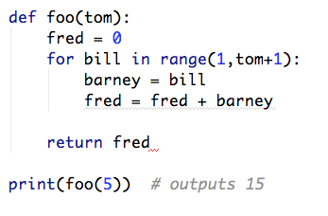
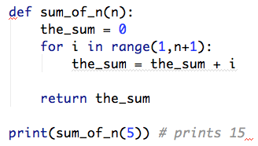
Compare two programs for adding: 1 + 2 + 3 + 4 +… + n
Which program is better?

Slide 4
What to compare
you can compare memory size, readability, self-commenting, speed, or other things
What we will be more in computing resources:
speed and memory
Speed will be our most important criteria when comparing two programs
Why not memory size?

Slide 5
Measure algorithm to solve a problem
We are interested in various computing problems and measuring the speed of one algorithm A vs. another algorithm B for solving the same problem.
One way to do this is to actually write both and 'benchmark' their speed by timing them.

Slide 6
Algorithm A
import time # cleaned up version to sum 1 + 2 + 3 up to n # with timer added
def sum_of_n(n): # algorithm A start = time.time() # system time in seconds the_sum = 0 for i in range(1,n+1): the_sum += i stop = time.time() # stop time return the_sum, stop-start
print("times for n = ", 100000)
for times in range(5): print( "Sum is %d required %10.7f seconds"%(sum_of_n(10000)))

Slide 7
Algorithm A
times for n = 100000
Sum is 50005000 required 0.0011640 seconds
Sum is 50005000 required 0.0011241 seconds
Sum is 50005000 required 0.0010769 seconds
Sum is 50005000 required 0.0010211 seconds
Sum is 50005000 required 0.0010970 seconds
times for n = 10,000, 100,000, 1,000,000, 100,000,000
Sum up to 10000 required 0.0019689 seconds
Sum up to 100000 required 0.0175431 seconds
Sum up to 1000000 required 0.1773720 seconds
Sum up to 100000000 required 11.6861229 seconds

Slide 8
Algorithm A & B
Algorithm A:
times for n = 10,000, 100,000, 1,000,000, 100,000,000
Sum up to 10000 required 0.0019689 seconds
Sum up to 100000 required 0.0175431 seconds
Sum up to 1000000 required 0.1773720 seconds
Sum up to 100000000 required 11.6861229 seconds
Algorithm B:
times for n = 10,000, 100,000, 1,000,000, 100,000,000
Sum up to 10000 required 0.0000012 seconds
Sum up to 100000 required 0.0000010 seconds
Sum up to 1000000 required 0.0000010 seconds
Sum up to 100000000 required 0.0000041 seconds

Slide 9
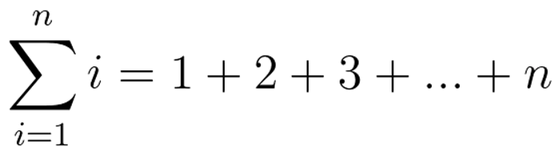
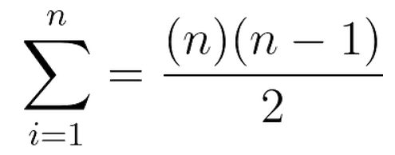
Summation symbol
Can be simplified to algorithm B

Slide 10
Algorithm B:
times for n = 10,000, 100,000, 1,000,000, 100,000,000
Sum up to 10000 required 0.0000012 seconds
Sum up to 100000 required 0.0000010 seconds
Sum up to 1000000 required 0.0000010 seconds
Sum up to 100000000 required 0.0000041 seconds
Timed will vary wildly depending on computer speed, memory, language, compiler
Can we somehow characterize algorithm speed independent of these factors?

Slide 11
Big-O (Omega)
Approach, break the algorithm into the number of steps involved and examine that
We could count the number of assignments
So in Algorithm A we have:
the_sum = 0 # 1 assignment to the_sum for i in range(1,n+1): # n assignments to i the_sum += i # n assignments to the_sum
Total of 1 + 2n assignments

Slide 12
We denote this total 1 + 2n as a special function: T(n) where n is know as the size of the problem
In algorithm A, T(n) = 1 + 2n
As n gets really big, the first term (1) is insignificant to the second term 2n

Slide 13
T(n) = 1 + 2n
since we are really interested in how algorithms 'scale' to really big problems, we will be interested in the term that way over shadows the other terms.

Slide 14
Consider if we had the following formula for an algorithm
T(n) = 9023 + 11n + n² + 2n³
As n grows big 1000, 100000, 100000000, of the four terms, 2n³ will start to dominate the others. This term is called the Order of magnitude term. It can be symbolized by the Order of magnitude function O(f(n)) where f(n) is the largest term in the T(n) expression

Slide 15
T(n) = 9023 + 11n + n² + 2n³
so for this T(n) since 2n³ is the dominate term, we can say that in O(f(n) is O( n³ )
We also drop the constant multiplier in the term 2n³ of the 2
We say f(n) = n³ or simply that this algorithm is O(n³) or we say "this algorithm is Big-O of n cubed"

Slide 16
Note that some algorithms time depend of the data, so they may have a different Big-O characteristic for the worst time, the average time and the best time.

Slide 17
Basic Big-O's
f(n) | Name
1 | Constant
log n | Logarithmic
n | Linear
n log n | Log Linear
n² | Quadratic
n³ | Cubic
2^{n} | Exponential
n! | Factorial

Slide 18
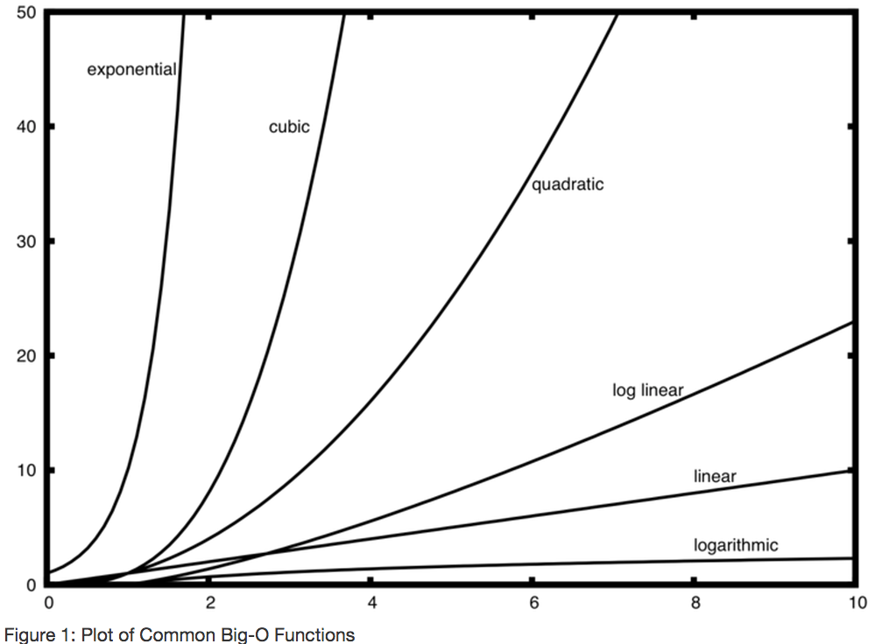
©2014 Brad Miller and David Ranum

Slide 19
Example 1
a = 5
b = 6
c = 10
for i in range(n):
for j in range(n):
x = i * i
y = j * j
z = i * j
for k in range(n):
w = a * k + 45
v = b * b
d = 33
T(n) = 3 + 1n + 3n² + 3n + 1 =
3n² + 4n + 4
is O(n²)

Slide 21
Example 2 Anagram detector
Next we are going to look at several algorithms written in python that detect if one string is an anagram of another.
'heart' and 'earth' are anagrams since you can rearrange the letters of 'heart' to get 'earth'

Slide 22
anagramSolution
We will define a function called anagramSolution(s1, s2)
that takes two strings and returns True if they are anagrams and False otherwise

Slide 23
anagramSolution1
Solution 1 – checking off
algorithm idea:
for each char c1 of s1
for each char c2 of s2
if c1 == c2 then mark c2 in s2
anagram if we marked off all of s2
see code anagram1.py, some details remain above, what if strings are different sizes?

Slide 24
anagramSolution2
Solution 2 – sort compare
algorithm idea:
sort each string then see if they are the same
see code anagram2.py, some details remain above, what if strings are different sizes?

Slide 25
anagramSolution2
Solution 2 – sort compare
It appears at first to be O(n)
but what about cost of
list(s1) - this is O(n)
and list sort this is O(n log n)
so the sort is the dominate term

Slide 26
anagramSolution3
Solution 2 – brute force
a brute force solution involves tying all combinations
so if we are comparing if dog is anagram for god we would create a list of all possible combination of dog and then see if god is in list
list:
dog dgo odg dgo god gdo

Slide 27
how many combination for heart:
If you have n letters, you have n choices for first letter
for each of those you then have n-1 for second
and then n-2 for next
'heart' is 5 letters so you have 5 x 4 x 3 x 2 x 1 for n of 5, this is n factorial (n!) which is slowest of any Big-O we will ever talk about.

