Slide 1
Solving a Maze
recursive solutions to decision trees

Slide 2
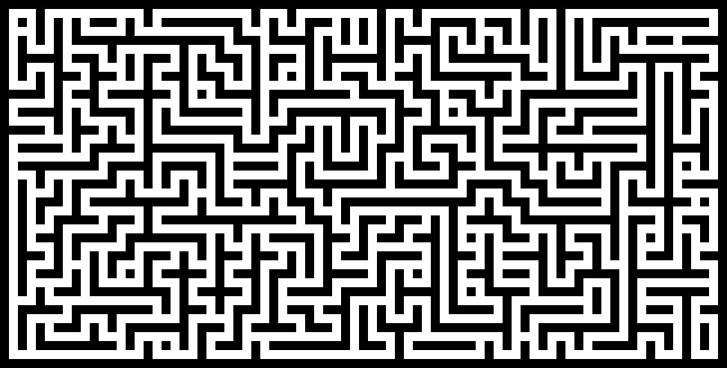
A MAZE (how to solve)

Slide 3
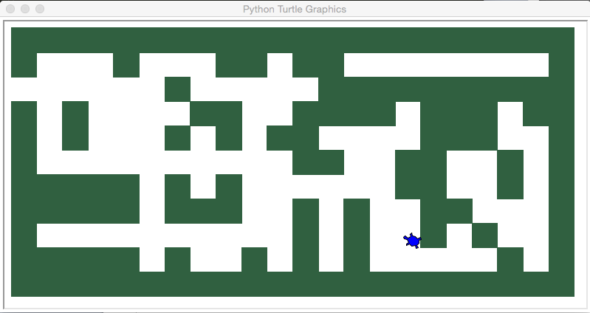
With turtle simplify, make the use a grid, and walls are just a solid grid cell (green)

Slide 4
Basic Step
From where turtle is
if you are outside the maze, you have succeeded
if you can not move in any direction, you have failed
if you can move to north square then go there and recurse back to step 1
if you can move to south square then go there and recurse back to step 1
if you can move to west square then go there and recurse back to step 1
if you can move to east square then go there and recuse back to step 1
RULE: You can not move to anyplace you have been (leave crumb)

Slide 5
def searchFrom(maze, startRow, startColumn): # try each of four directions from this point until we find a way out. # base Case return values:
maze.updatePosition(startRow, startColumn) # We hit obstacle, return false
if maze[startRow][startColumn] == OBSTACLE : return False
if maze[startRow][startColumn] == TRIED or maze[startRow][startColumn] == DEAD_END: return False # We have found a square that has already been explored
if maze.isExit(startRow,startColumn): # leave color showing path maze.updatePosition(startRow, startColumn, PART_OF_PATH) return True # succeeded maze.updatePosition(startRow, startColumn, TRIED)
# Otherwise, use logical short circuiting to try each direction # in turn (if needed) found = searchFrom(maze, startRow-1, startColumn) or \ searchFrom(maze, startRow+1, startColumn) or \ searchFrom(maze, startRow, startColumn-1) or \ searchFrom(maze, startRow, startColumn+1) if found: maze.updatePosition(startRow, startColumn, PART_OF_PATH) else: maze.updatePosition(startRow, startColumn, DEAD_END) return found

Slide 6
input file: maze2 file
++++++++++++++++++++++ + + ++ ++ + + ++++++++++ + + ++ ++++ +++ ++ + + + + ++ +++ + + ++ ++ + + +++++ + + ++ + + +++++ +++ + + ++ + + + + S+ + + +++++ + + + + + + ++++++++++++++++++++++

Slide 7
code to read file
mazeFile = open(mazeFileName,'r') rowsInMaze = 0 for line in mazeFile: # get next line into string line = line.rstrip("\r\n") # remove invisibles rowList = [] col = 0 for ch in line: # process each char in line rowList.append(ch) # add to list if ch == 'S': # remember start position self.startRow = rowsInMaze self.startCol = col col = col + 1 rowsInMaze = rowsInMaze + 1 self.mazelist.append(rowList) # add row to maze columnsInMaze = len(rowList)

Slide 8
special characters in maze array
blank – empty cell
+ wall
O part of path (solution path)
. bread crumb – tried
- dead end

Slide 9
General backtrack technique
any maze type problem
generalized to problems picking different paths and eventually finding a best path
chess, checkers, tic tack toe application
also can be used to find shortest solution
When return from recursion, we automatically backtrack

