Slide 1
Sierpinski Triangle
fractal shapes, as you zoom in they just have the same structure, yet smaller

Slide 17
Sierpinski Triangle Algorithm:
given three points that define the points of a triangle of equal sides: p1, p2, p3: draw it
Now calculate three new points as:
a= midpoint of p1 and p2
b= midpoint of p2 and p3
c = midpoint of p1 and p3
repeat step one for each of the following new triangles as defined as these points
( p1,a,c) and (a,p2,b) and (c, b, p3)

Slide 18
p1
c
a
p3
p2
b

Slide 19
p1
c
a
p3
p2
b

Slide 20
p1
c
a
p3
p2
b

Slide 21
p1
c
a
p3
p2
b

Slide 22
Look at code for Siepinski Triangle

Slide 23
Towers of Hanoi
Edouard Lucas math problem of 1883

Slide 24
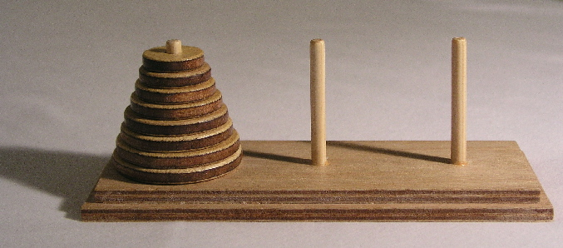
Move all the disks to last pole Note how each disk is a little smaller than the one above
Sounds easy…. Ah, but there are rules to follow

Slide 25
You can only move one ring at a time, and only to another pole
You can never put a bigger ring on top of a smaller ring

Slide 26
Original problem
There were 64 rings of gold to move
This task was given to some ancient order of monks
It is said that when they accomplished the task that their temple would turn to dusk, and the world would end.

Slide 27
How many moves would 64 disks take?
18,446,744,073,709,551,615 which is 2⁶⁴-1
At one move per second, it would take
584,942,417,355 years (584.9 billion years)
The estimated age of the universe is only
13,820,000,000 ( 13.82 billion years)

Slide 28
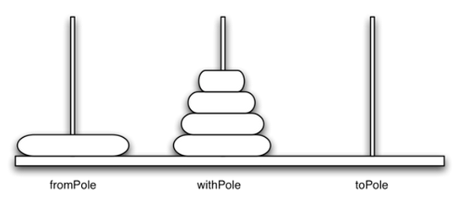
Recursive high level:
A
B
C
picture of poles after step 2
Move a tower of heigth-1 to an intermediate pole using the final pole.
Move the remaining disk to the final pole (bigger than all moved in step 1)
Move the tower of height-1 from the intermediate pole to the final pole using the original pole.

Slide 29
check out the code
it prints the steps to follow to solve the problem
check out animation in firefox at
http://towersofhanoi.info/Animate.aspx

