Slide 1
Minimum number of coins to make change
Introduction to dynamic programming

Slide 2
optimization problems
there are many problems in computer science where you want to optimize some value.
find the shortest path between two points
find a line that best fits a set of points
find the smallest set of objects that meet a criteria
choose the fastest set of connections though a network

Slide 3
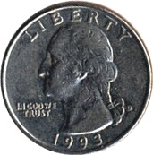
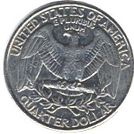
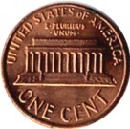
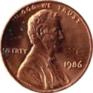
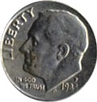
Making change optimally
Suppose you make change for a customer for 63 cents. What is the smallest number of coins to make the change.
Answer is 6 coins
2 Quarters + 1 dime + 1 nickel + 3 pennies
25 + 25 + 10 + 1 + 1 + 1 = 68

Slide 4
minimum for 63 cents
This method of starting with the biggest coin first, use all quarters and then all dimes, and then all nickels and finally pennies called the greedy algorithm approach
Try to solve a big part of the problem right away. (using the largest coin)
it works for American coins but what about the imaginary country: Lower Elbonia where they have coins for 1, 5, 10, 25 and a special 21 cent piece.

Slide 5
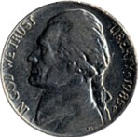
21 cent
With the extra 21 cent piece our algorithm will not work. We would still have a 6 coin solution. by picking the largest coins: 25 + 25 we would then have 13 cents left, so next we would pick the dime, we would have 3 cents left and we would pick a nickel and three pennies.
But with the 21 cent piece available we can just choose to pay with three 21 cent pieces = 63 cents

Slide 6
Our Recursive Solution
Each recursive step we try each possible coin:
25, 21, 10, 5 and 1 And then pick the one with the minimum number of coins for the smaller problem:
1 + minChange(amt-1)
1 + minChange(amt-5)
minChange(amt)= min of 1 + minChange(amt-10)
1 + minChange(amt-25)

Slide 7
code:
def minChange(coinValueList,change): minCoins = change if change in coinValueList: return 1 else: for i in [c for c in coinValueList if c <= change]: numCoins = 1 + minChange(coinValueList,change-i) if numCoins < minCoins: minCoins = numCoins return minCoins print(minChange([1,5,10,25],63))

Slide 8
Why does it take so long
it turns out this code is very slow. It will take over a minute to run
try it, but be patient
It requires 67,716,925 recursive calls to solve the 63 cent change problem with American money.
Lets look at the top of the call chart for solving for making 26 cents in change, which takes 377 calls:

Slide 9
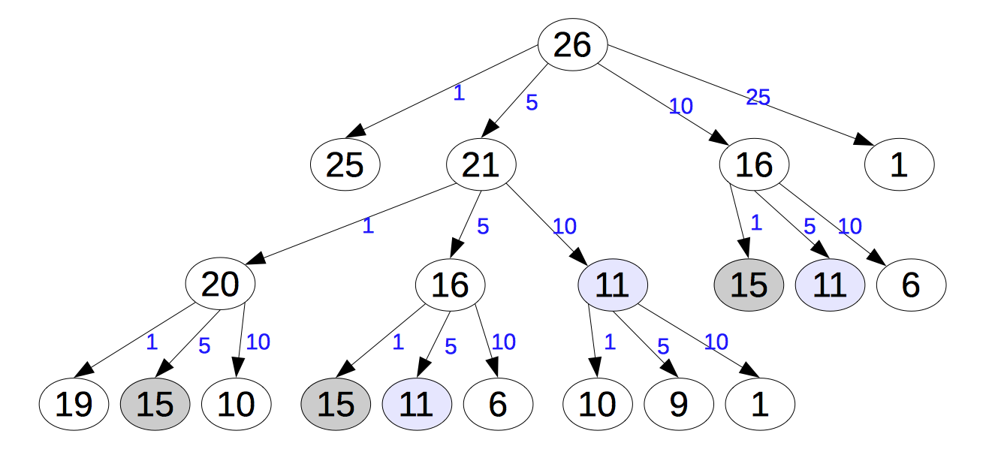
Note: blue numbers are the coin value subtracted, number in circle represents recursive call value
Top of Tree with 377 function calls note some of the duplicate function calls marked in same colors

Slide 10
How to speed up this solution
since there are many calls that have the same argument passed, they end up duplicating the work over and over again, we will use a form of caching called memoization:
In computing, memoization is an optimization technique used primarily to speed up computer programs by storing the results of expensive function calls and returning the cached result when the same inputs occur again. -- Wikipedia

Slide 11
We use a dictionary and store the argument as a key and the value will be the result.
Pseudo code of this idea, supposing we start with a empty dictionary called cache:
def func( a ): if a in cache: return cache[a] # return stored value
else:
calculate value
cache[a] = value # store result in cache
return value # return value calculated

Slide 12
Using Memoization for this problem
Although this technique really speeds up this coin problem, you still will have the overhead of a lot of extra function calls and the associated memory.
Lets look at a better way … dynamic programming

Slide 13
Dynamic Programming
In recursion solutions we write the code to solve a big problems by working toward a simpler problem.
Some times this results in a lot of redundancy of recursive steps
Dynamic programming offers a better solution to some of these problems by starting with a simple problem and building on these smaller problems to solve the bigger ones.
reference: http://www.cs.yale.edu/homes/aspnes/pinewiki/DynamicProgramming.html

Slide 14
How it will work for coins
this creates a look up table (similar to the memoization technique) but it does it by building a table of all the solutions up to the size of the problem we are solving.
It is kind of like the opposite philosophy of recursion:

Slide 15
opposite direction to recursive
Recursion work from big problem toward simpler problem and eventually the base case
Dynamic Programming, you start with the base case, and solve every problem in complexity up to the big problem. storing the solutions along the way and using them for each new bigger step.

Slide 16
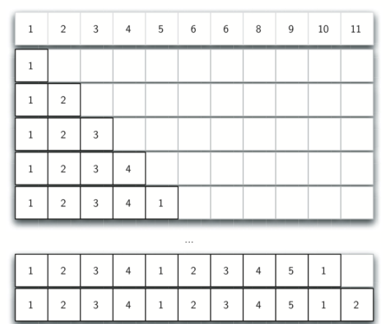
Build our table (coins 1, 5, 10, 25)
solution for input
step 1
step 2
step 3
step 4
step 5
step 6
step 7

Slide 17
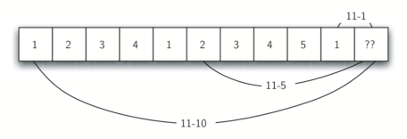
Step 11, each step has to find best solution for each coin
A penny plus the minimum number of coins to make change for 11−1=10 cents (1)
A nickel plus the minimum number of coins to make change for 11−5=6 cents (2)
A dime plus the minimum number of coins to make change for 11−10=1 cent (1)
table lookup for: 1 2 3 4 5 6 7 8 9 10 11

Slide 18
The code

