Slide 1
Trees – Chapter 6
some illustrations and text from the textbook: "problem Solving with Algorithms and Data Structures using Python" by Miller and Ranum ©2011 Franklin Beedle and Associates

Slide 2
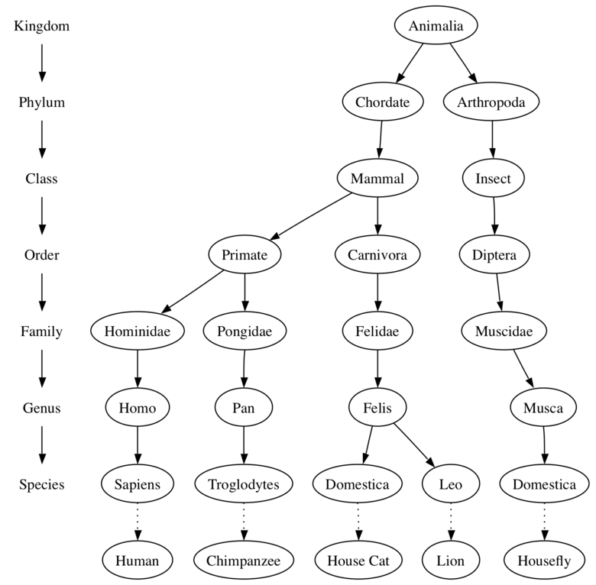
Tree example: Taxonomy of some animals

Slide 3
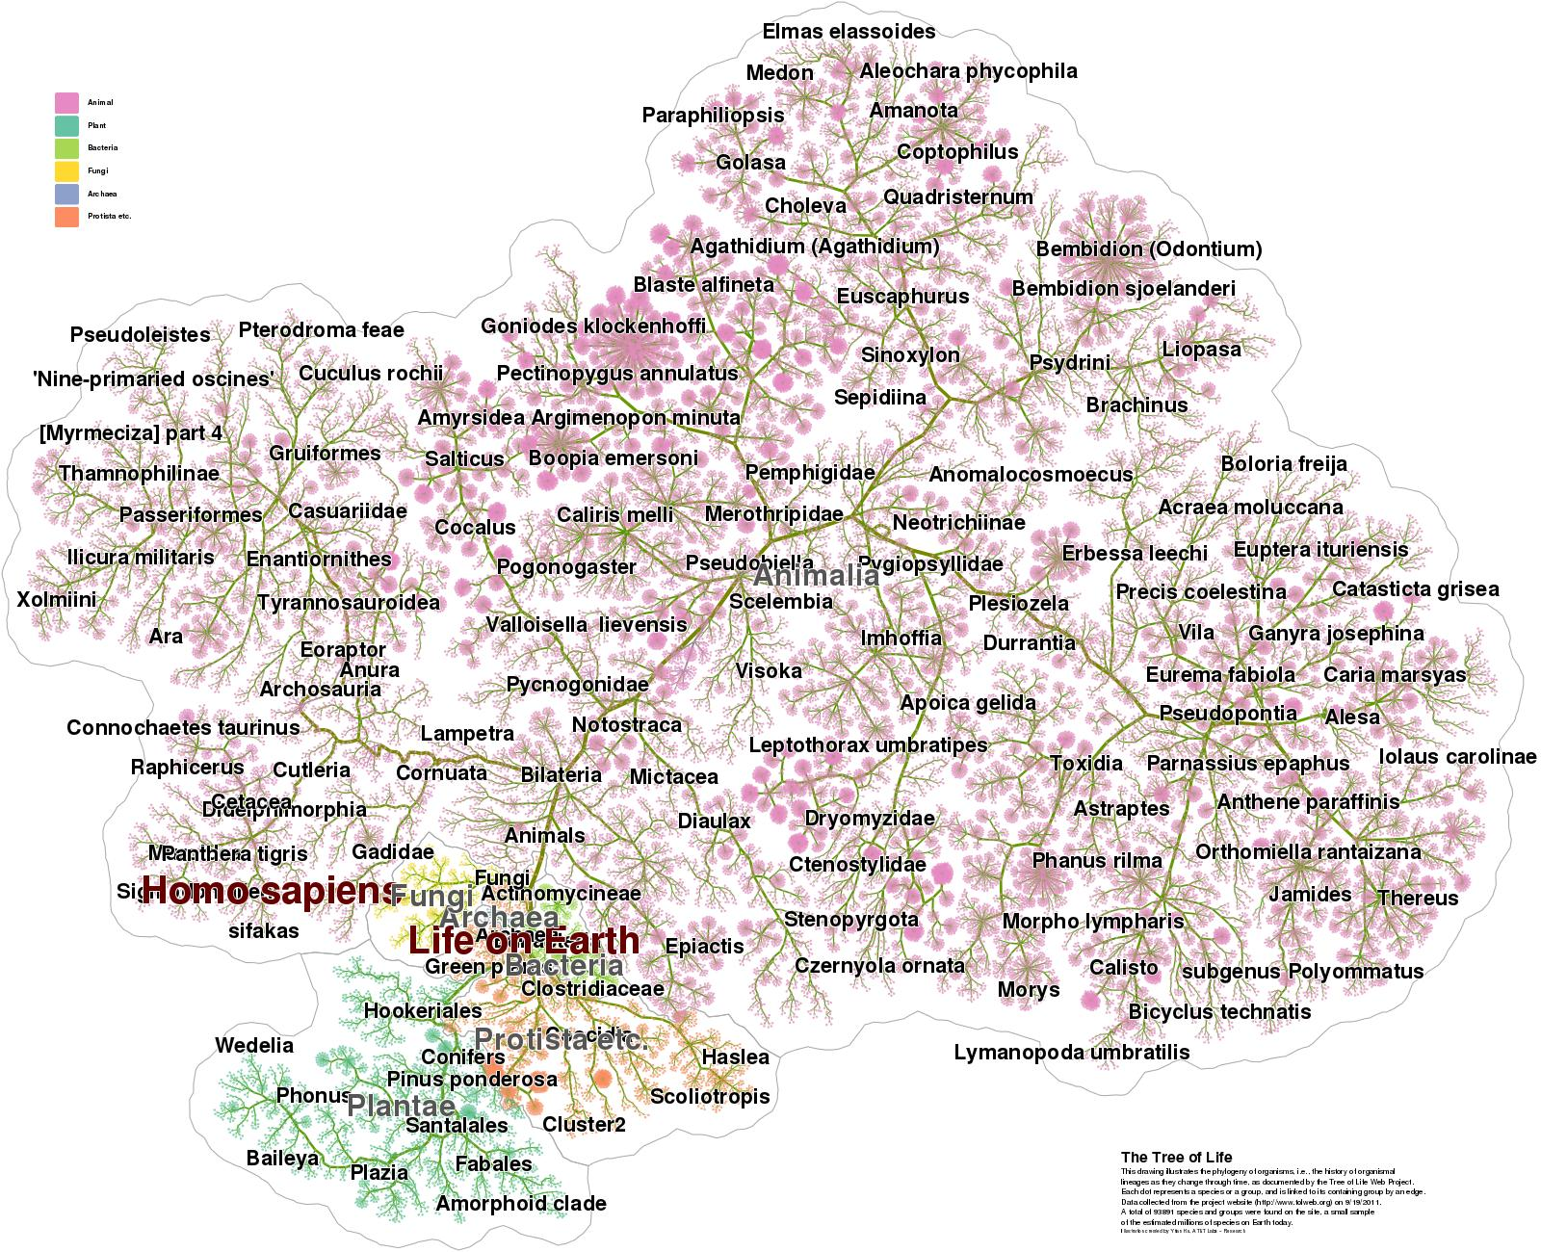
All Life Click

Slide 4
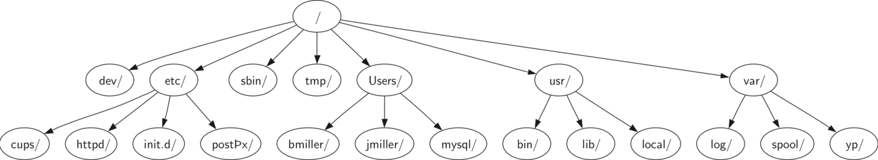
Unix directory structure (top)

Slide 5
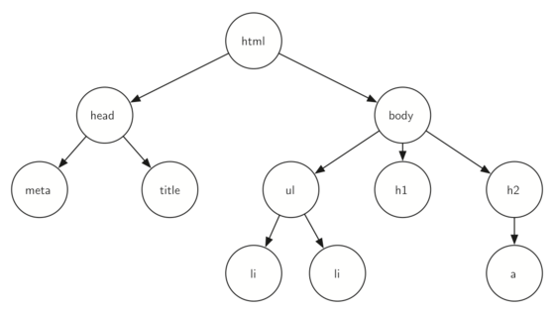
<html xmlns="http://www.w3.org/1999/xhtml"
xml:lang="en" lang="en">
<head>
<meta http-equiv="Content-Type"
content="text/html; charset=utf-8" />
<title>simple</title>
</head>
<body>
<h1>A simple web page</h1>
<ul>
<li>List item one</li>
<li>List item two</li>
</ul>
<h2><a href="http://www.cs.luther.edu">Luther CS </a><h2>
</body>
</html>
Web site HTML

Slide 6
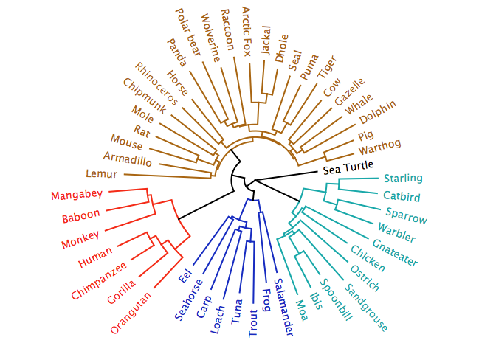

Slide 7
Terminology
a
Node:
A node is a fundamental part of a tree. It can have a name, which we call the “key.”
A node may also have additional information. We call this additional information the “payload.” While the payload information is not central to many tree algorithms, it is often critical in applications that make use of trees.
x
k
z
r

Slide 8
Terminology
Edge:
An edge is another fundamental part of a tree.
An edge connects two nodes to show that there is a relationship between them.
Every node (except the root) is connected by exactly one incoming edge from another node. Each node may have several outgoing edges.

Slide 9
Terminology
Root:
The root of the tree is the only node in the tree that has no incoming edges.

Slide 10
Terminology
a
Path:
A path is an ordered list of nodes that are connected by edges.
For example the path a > x > r is the way from the root node a to the node r in the tree to the left
x
k
z
r

Slide 11
Terminology
a
Children:
The set of nodes c that have incoming edges from the same node to are said to be the children of that node.
For example the children of node x in the tree to left are z and r
x
k
z
r

Slide 12
Terminology
a
Parent:
A node is the parent of all the nodes it connects to with outgoing edges.
To left, the parent of z and r is x, also note that x is a child of a and a is a parent of x
x
k
z
r

Slide 13
Terminology
a
Sibling:
Nodes in the tree that are children of the same parent are said to be siblings.
The nodes z and r are siblings in the tree to the left
x
k
z
r

Slide 14
Terminology
a
Subtree:
A subtree is a set of nodes and edges comprised of a parent and all the descendants of that parent.
A subtree can be a part of a bigger tree.
In the tree to the left x, z, and r form one subtree.
Note that k is also a subtree by itself.
x
k
z
r

Slide 15
Terminology
a
Leaf Node
A leaf node is a node that has no children.
All the leaf nodes of the tree to the left are z, r and k.
x
k
z
r

Slide 16
Terminology
Level:
a
0
Level
The level of a node n is the number of edges on the path from the root node to n.
Height:
The height of a tree is equal to the maximum level of any node in the tree. The height of the tree to left is 2
1
x
k
2
z
r

Slide 17
Definition one of a tree:
A tree consists of a set of nodes and a set of edges that connect pairs of nodes. A tree has the following properties:
One node of the tree is designated as the root node.
Every node n, except the root node, is connected by an edge from exactly one other node p, where p is the parent of n.
A unique path traverses from the root to each node.
If each node in the tree has a maximum of two children, we say that the tree is a binary tree.

Slide 18
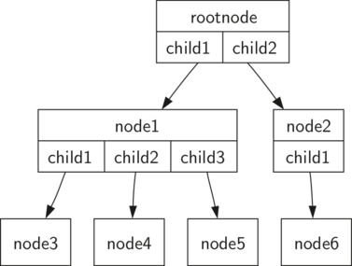
This illustrates a tree that fits definition one. The arrowheads on the edges indicate the direction of the connection.

Slide 19
Recursive Definition of a tree:
A tree is either empty or consists of a root and zero or more subtrees, each of which is also a tree.
The root of each subtree is connected to the root of the parent tree by an edge.

Slide 20
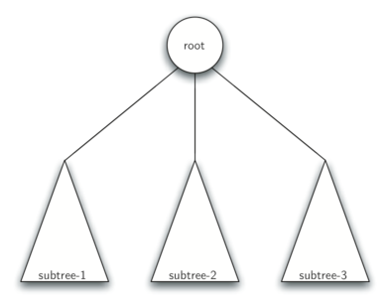
This figure illustrates this recursive definition of a tree.
Using the recursive definition of a tree, we know that the tree in this figure has at least four nodes, since each of the triangles representing a subtree must have a root. It may have many more nodes than that, but we do not know unless we
look deeper into
the tree.

Slide 21
There are many ways to represent a tree in a diagram:http://en.wikipedia.org/wiki/Tree_structure#Representing_trees
node link diagrams
Nested Sets
Layered "icicle" diagrams
outline
Nested parentheses
Radial Trees

Slide 22
Tree Implementations in Python

Slide 23
Binary List implementation of a tree
Recursive view: [ key, left subtree, right subtree ]
Each tree or sub tree (t) consist of a list with three elements:
t[0] is the node key
t[1] is the left sub tree or [] for no child on left
t[2] is the right sub tree or [] for no child on right

Slide 24
Example
t = ["a", ["b", # a left ["d", [], []], # b left ["e", [], []] # b right ], ["c", [], []] # a right ]
or ['a', ['b', ['d', [], []], ['e', [], []]], ['c', [], []]]

Slide 25
functions to work with tree list
def Bintree(r): return [r, [], []]
def insertLeft(root, newBranch):
t = root[1] # get current left
root[1] = [newBranch, t, []]
return root
def insertRight(root,newBranch):
t = root[2] # get current right
root[2] = [newBranch, [], t]
return root
def getRootVal(root): return root[0]
def setRootVal(root,newVal): root[0] = newVal
def getLeftChild(root): return root[1]
def getRightChild(root): return root[2]

Slide 26
def insertLeft(root, newBranch):
t = root[1] # get current left
root[1] = [newBranch, t, []]
return root
11
5
2
9
t = Bintree(1) insertLeft(t,5) insertRight(t,2) insertLeft(getRightChild(t),9)

Slide 27
Implement as linked structure in Class
class BinaryTree: def __init__(self,rootObj): self.key = rootObj self.leftChild = None self.rightChild = None def insertLeft(self,newNode): oldLeft = self.leftChild self.leftChild = BinaryTree(newNode) self.leftChild.leftChild = oldLeft def insertRight(self,newNode): oldright = self.rightChild self.rightChild = BinaryTree(newNode) self.rightChild.rightChild = oldright
def getRightChild(self): return self.rightChild def getLeftChild(self): return self.leftChild def setRootVal(self,obj): self.key = obj def getRootVal(self): return self.key

Slide 28
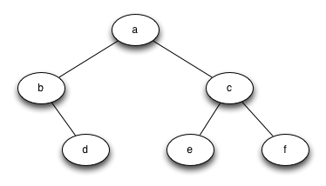
do this

Slide 29
How to do it:
# a # / \ # b c # \ / \ # d e f r = BinaryTree('a') r.insertLeft('b') r.getLeftChild().insertRight('d') r.insertRight('f') r.insertRight('c') r.getRightChild().insertLeft('e') r.diagram() # gjenkins draw diagram

