Slide 1
Parse Tree

Slide 2
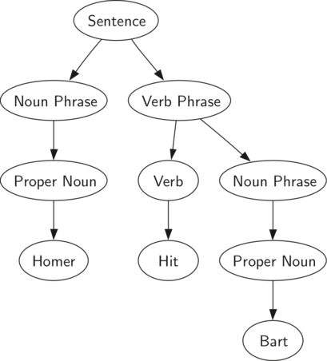
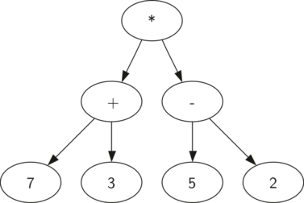
You can use parse tree for structured languages like english or math
Figure 2: Parse Tree for ((7+3)∗(5−2))

Slide 3
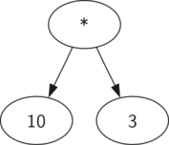
doing math expression parse tree:
In the rest of this section we are going to examine parse trees in more detail. In particular we will look at
How to build a parse tree from a fully parenthesized mathematical expression.
How to evaluate the expression stored in a parse tree.
How to recover the original mathematical expression from a parse tree.
A Simplified Parse Tree for ((7+3)∗(5−2))

Slide 4
Breaking into tokens
We will be input fully parenthesized expressions
We need to break it into the following tokens:
Left parentheses: (
or right parentheses: )
operators: + - * /
operands: a number such as 109

Slide 5
What we know if we examine some trees
A left ( will mark a new tree
A right ) will mark the finish of and operand – operator - operand
The leafs of the tree will be operands
The parent of two leaf operands will be a operator
a subtree will be a operand for a parent operator

Slide 6
Using the information from above we can define four rules as follows:
If the current token is a '(', add a new node as the left child of the current node, and descend to the left child.
If the current token is in the list ['+','-','/','*'], set the root value of the current node to the operator represented by the current token. Add a new node as the right child of the current node and descend to the right child.
If the current token is a number, set the root value of the current node to the number and return to the parent.
If the current token is a ')', go to the parent of the current node.

Slide 7
Examine step by step operation
for this expression parsed into tokens:
['(', '3', '+', '(', '4', '*', '5' ,')',')']
or as an list
Now let's follow the rules one token at a time
( | 3 | + | ( | 4 | * | 5 | ) | )

Slide 8
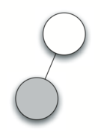
( | 3 | + | ( | 4 | * | 5 | ) | )
^
Start, create an empty tree, with one node
If the current token is a '(', add a new node as the left child of the current node, and descend to the left child.
1

Slide 9
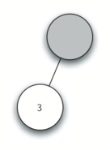
( | 3 | + | ( | 4 | * | 5 | ) | )
 | ^
If the current token is a number, set the root value of the current node to the number and return to the parent.
2

Slide 10
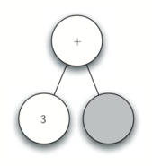
( | 3 | + | ( | 4 | * | 5 | ) | )
 |  | ^
If the current token is in the list ['+','-','/','*'], set the root value of the current node to the operator represented by the current token. Add a new node as the right child of the current node and descend to the right child.
3

Slide 11
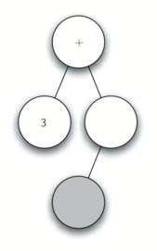
( | 3 | + | ( | 4 | * | 5 | ) | )
 |  |  | ^
If the current token is a '(', add a new node as the left child of the current node, and descend to the left child.
4

Slide 12
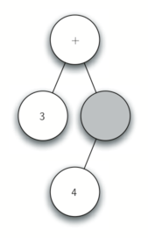
( | 3 | + | ( | 4 | * | 5 | ) | )
 |  |  |  | ^
If the current token is a number, set the root value of the current node to the number and return to the parent.
6

Slide 13
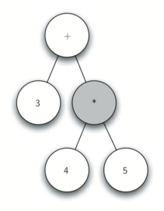
( | 3 | + | ( | 4 | * | 5 | ) | )
 |  |  |  |  | ^
If the current token is a number, set the root value of the current node to the number and return to the parent.
7

Slide 14
( | 3 | + | ( | 4 | * | 5 | ) | )
 |  |  |  |  |  | ^
If the current token is in the list ['+','-','/','*'], set the root value of the current node to the operator represented by the current token. Add a new node as the right child of the current node and descend to the right child.
8

Slide 15
( | 3 | + | ( | 4 | * | 5 | ) | )
If the current token is a ')', go to the parent of the current node.
We apply this rule for the last two ) tokens and we end up with this
+
3
*
4
5
9-10

Slide 16
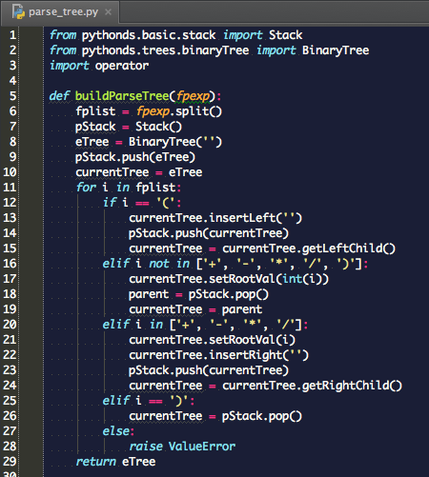
Check out the code for building Parse tree

Slide 17


evaluate it, recall we can replace subtrees with the result as shown:
30

Slide 18
Evaluation: how to recurse
base case, look for both children being a leaf ( leaf is a node that has no children)
For leaf, we just return the value
For other non leaf nodes, we need to perform the operator on the two child subtree values

Slide 19
user of operator python module
Note we are going to use the operator module to access the methods for add, subtract (sub), multiply (mul) and divide (truediv), and because functions can be stored in variables, we will store the correct function in a dictionary that maps the token to the correct operator python function
opers = {
'+':operator.add, '-':operator.sub, '*':operator.mul, '/':operator.truediv}

Slide 20
Check out the code for evaluation of parse tree

