Slide 1
Chapter 3 Basic Data Structures
Linear Structures:
stacks, queues, deques, lists

Slide 2
Linear Structure
Linear structure is a data structure for holding multiple items
The items can be added in different ways, but once added the retain a relation to their neighbors' that does not change.
x
b
m
z
a
d
q

Slide 3
Linear Structures
In other words once a item is added it stays in that position relative to the other items that came before it and came after it.
Think of a line of cars in a line that follow the rules that once in the line, they can not pass another car to change places. and where they can leave and join the line depends on the rules of the particular data structure (list, stack, queue, deque, ordered list, etc.)

Slide 4
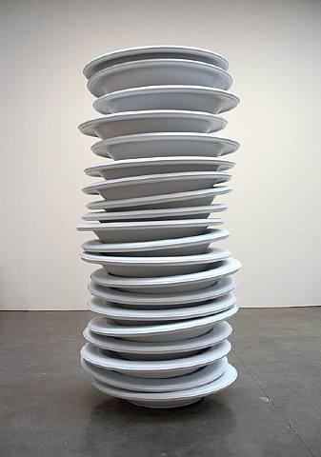

Slide 5
Stack
pop (remove item to top, and return it)
push (add item to top)
peek (return reference to top item, but don't remove it)≈
size(return number of items in stack)
isEmpty ( return True if no items on the stack, False otherwise
Stack() create a new empty stack and return a reference to it

Slide 6
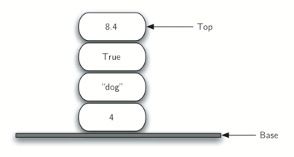

Slide 7
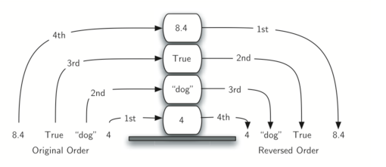
Last in first out = LIFO
good for reversing order
good for matching up nested structures ( ( ) ( ()() ) )

Slide 8
Stack ADT (abstract data type)
Stack() creates a new stack that is empty. It needs no parameters and returns an empty stack.
push(item) adds a new item to the top of the stack. It needs the item and returns nothing.
pop() removes the top item from the stack. It needs no parameters and returns the item. The stack is modified.
peek() returns the top item from the stack but does not remove it. It needs no parameters. The stack is not modified.
isEmpty() tests to see whether the stack is empty. It needs no parameters and returns a boolean value.
size() returns the number of items on the stack. It needs no parameters and returns an integer.

Slide 9
Stack Operation | Stack Contents | Return Value
s = Stack() | []
s.isEmpty() | [] | TRUE
s.push(4) | [4]
s.push('dog') | [4,'dog']
s.peek() | [4,'dog'] | 'dog'
s.push(True) | [4,'dog',True]
s.size() | [4,'dog',True] | 3
s.isEmpty() | [4,'dog',True] | FALSE
s.push(8.4) | [4,'dog',True,8.4]
s.pop() | [4,'dog',True] | 8.4
s.pop() | [4,'dog'] | TRUE
s.size() | [4,'dog'] | 2
Note: top is on left

Slide 10
Implementation
Show code for using list with last item of list is top of stack
Show code for using list with first item on list is top of stack
Note that the ability to change to a different implementation without affecting the operation of the ADT set of methods is the essence of and abstract data type

Slide 11
Stack for balance parentheses
(defun square(n) ( * n n ) ) – lisp language creates square method
lisp has a huge number of parentheses
languages that use parentheses must use them in a balanced way, also true for lots of other computer language things
{ }, [ ], <tag> </tag>, < >

Slide 12
consider
balanced?
( ( ) ( ) ( ) )
( ( ( ( ) ) ) )
( ( ) ( ( ( ) ) ( ) ) )
) ) ) ) ( ( ( (
( ) ) )
( ( ) ( ) ( ( )

Slide 13
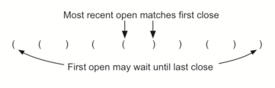
The program challenge
write an algorithm that will read a string of parentheses from left to right and decide whether the symbols are balance.
Closing symbols ) match opening symbols ( in the reverse order of their appearance.

Slide 14
function parChecker(s)
Pseudocode:
create stack
for each symbol in string:
if ( then push it on stack
else
if stack is empty then return False
else pop stack
if done scanning and stack is empty
return true
else
return false

Slide 15
General balanced symbols
Code to handle ( ), { }, and [ ]
only need to push if we detect (, { or [
and when we pop, verify that it matches its opposite pair
See code

Slide 16
Converting decimal to binary
and more

Slide 17
Binary is especially important to CS and programming since the computer stores everything in binary one and zeros:
110101100011
Hex is another base that is easier then binary but each hex digit represents 4 bits
1101 0110 0011 would be D63
Hex uses the digits 0123456789ABCDEF

Slide 18
The decimal number 233₁₀ and its corresponding binary equivalent 11101001₂ are interpreted respectively as
2×10²+3×10¹+3×10⁰
and
1×2⁷+1×2⁶+1×2⁵+0×2⁴+1×2³+0×2²+0×2¹+1×2⁰

Slide 19
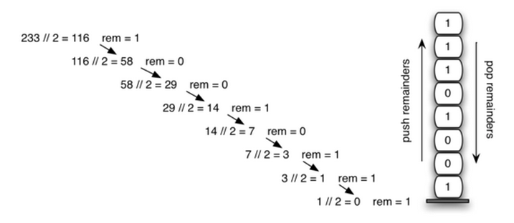
Easy divide by 2 and collect remainders
Decimal: 233
2⁰ digit
Binary: 11101001
2⁷ digit

Slide 20
Check out code now for
method divide_by_2(n) which will convert n to binary and return it in a string.

Slide 21
do any base
if we want to convert to base 8 we can divide by 8 and get the remainder i % 8
in a particular base, the modulus operator can return the last digit of any number in that base:
digit = number % base
and then you can remove the last digit in that base by dividing by the base
remaining = remaining // base
See code

