Slide 1
inFix, prefix, postfix and evaluation
using stacks
with some file IO thrown in

Slide 2
infix
when you write an expression
C * D
you know form the form that you multiply the value of variable C by the value in variable D
This type of notation is know as infix since the operator * is in between the two operators C and D

Slide 3
more infix
consider
B + C * D
this is more complicated, which do you do first, B + C or C * D
Well you know because you have been doing this that the order of precedence tells you when what to do first. The only exception to precedence is adding ( )

Slide 4
Fully Parenthesized
If you add a pair of parentheses around every operation in a way to indicate the order needed
B + C * D becomes ( B + ( C * D ) )
When you do this, you don't need precedence rules.
This use one pair of ( ) per operator, if you have 4 operators, you will have 4 pairs of parentheses

Slide 5
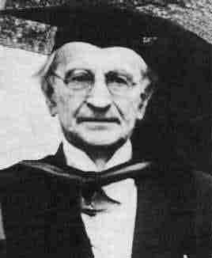
prefix
There are two other ways of writing expressions you may have never heard before
The first is prefix or also known as polish notation invented by the great polish logician Jan Lukasiewicz
you write the operator before the two operand, so A + B becomes + A B in prefix notation.

Slide 6
postfix, also called Reverse polish notation (RPN)
in prefix you put the operator after the two operands :
A + B becomes A B +
Infix | prefix | postfix
A + B | + A B | A B +
A + B * C | + A * B C | A B C * +
A * B – C / D | - * A B / C D | A B * C D / -

Slide 7
other examples
Infix | prefix | postfix
A + B * C + D | + + A * B C D | A B C * + D +
(A + B) * ( C + D) | * + A B + C D | A B + C D + *
A * B + C * D | + * A B * C D | A B * C D * +
A + B + C + D | + + + A B C D | A B + C + D +
Note that the operands stay in their original order

Slide 8
Algorithm to convert infix to postfix
when you fully parenthesize an expression every pair of parentheses denotes two operands with an operator in the middle
( A + ( B * C ) )
highest priority parentheses

Slide 9
Algorithm to convert infix to postfix
when you fully parenthesize an expression every pair of parentheses denotes two operands with an operator in the middle
( A + ( B * C ) )
1 --------2--------
next priority of parentheses

Slide 10
Algorithm to convert infix to postfix
when you fully parenthesize an expression every pair of parentheses denotes two operands with an operator in the middle
( A + ( B * C ) )
move operator to postfix position

Slide 11
Algorithm to convert infix to postfix
when you fully parenthesize an expression every pair of parentheses denotes two operands with an operator in the middle
( A + ( B C * ) )

Slide 12
Algorithm to convert infix to postfix
when you fully parenthesize an expression every pair of parentheses denotes two operands with an operator in the middle
( A + ( B C * ) )
1 --------2--------
move operator to postfix position

Slide 13
Algorithm to convert infix to postfix
when you fully parenthesize an expression every pair of parentheses denotes two operands with an operator in the middle
( A ( B * C ) + )
1 --------2--------
remove all parentheses, we don't need them

Slide 14
Algorithm to convert infix to postfix
when you fully parenthesize an expression every pair of parentheses denotes two operands with an operator in the middle
A B * C +
A B * C +
take out extra spaces:

Slide 15
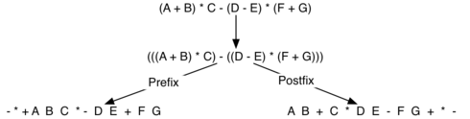
You do prefix by just moving operator to left, but other wise it is the same:

Slide 16
The algorithm
we will be evaluating converting a infix expression (not fully parenthesized) to postfix
We will design a function named infixToPostfix( string parameter) that return a new string expression in postfix. The string expression must have a space between every token of ( ) a number of operator

Slide 17
Algorithm
Consider
( A + B ) * C -> becomes A B + C *
when we see ( we know that what is in the () is high precedence and can be done when we see the matching ) pair -> A B +
But for the expression A + B * C the result is:
A B C * +, we need to reverse the operators when the precedence dictates it. since reversal is nicely handled with a stack, that is what we will use

Slide 18
check out code for
infixToPostfix(s)

Slide 19
Postfix evaluation if simple
process from left to right, if the token is an operand push it onto stack
if the token is an operator, pop the two operands off stack perform the operator on them and then push the result back onto the stack.
when you run out of tokens, you should only have one value on stack, just pop it and return it

Slide 20
You need to look at code for the post fix evaluations on your own.
It has a big problem, it only handles number of one digit. Can you fix it?
Does the converter from infix to postfix have the same problem?

