Slide 1
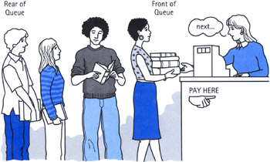
Queue pronounced like the letter Q

Slide 2
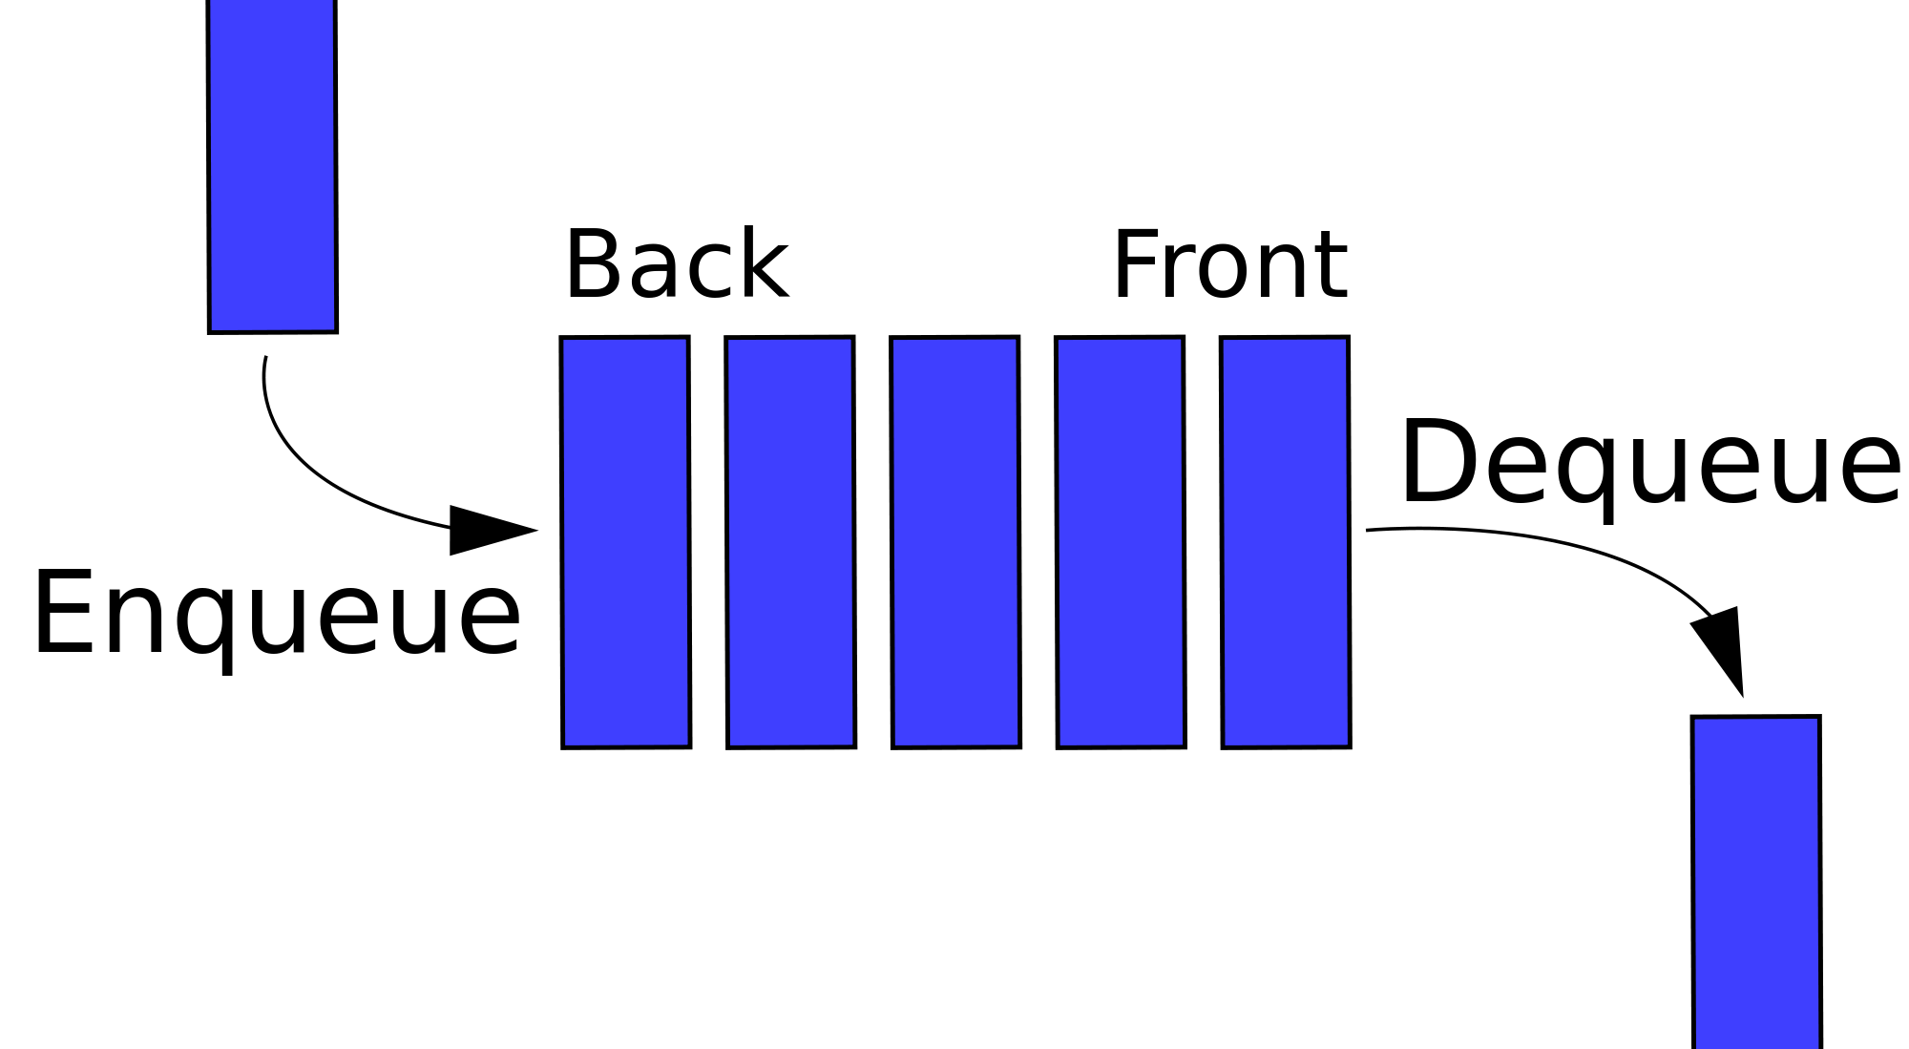
Important operations are enqueue and dequeue

Slide 3
Queue = FIFO
First in First out FIFO
The most recently added item (enqueued) is has to wait till every thing else on the queue is removed from the queue (dequeued) before it can removed.

Slide 4
Computer Queues
Keyboard buffer, you type keys and if the computer is busy, they are queued up
Printer Queue, the print jobs wait their turn to be printed
process scheduling of tasks on the computer work with queues
In general anytime you have communication of data between two entities that work at different speeds, you need to queue the information between the two entities.

Slide 5
ADT for Queue
Queue() - create empty queue and return object
a.enqueue(item) – add item to queue a
a.dequeue() – remove item from queue and return it
a.isEmpty() – return boolean True if queue is empty
a.size() – return size of queue a

Slide 6
Sequence of operations
Queue Operation | Queue Contents | Return Value
q = Queue() | [] | empty queue
q.isEmpty() | [] | TRUE
q.enqueue(4) | [4]
q.enqueue('dog') | ['dog',4]
q.enqueue(True) | [True,'dog',4]
q.size() | [True,'dog',4] | 3
q.isEmpty() | [True,'dog',4] | FALSE
q.enqueue(8.4) | [8.4,True,'dog',4]
q.dequeue() | [8.4,True,'dog'] | 4
q.dequeue() | [8.4,True] | 'dog'
q.size() | [8.4,True] | 2

Slide 7
Computer Simulation
A computer simulation is a simulation, run on a single computer, or a network of computers, to reproduce behavior of a system.
The simulation uses an abstract model (a computer model, or a computational model) to simulate the system.
- Wikipedia

Slide 8
Game of Hot potato
Read about game in book
Start with a group of people in circle.
One person is holding a potato.
Each turn the person passes it N people to his left.
Then the person with the potato gives it to the person to his left and leaves the circle.
The repeat step 2
Try out the code in book

Slide 9
Simulate Computer Lab Printing
It may be less expensive to simulate a system prior to investing in building it
Examples:
airplane and car design
bridge loads
space craft and rockets
network simulator

Slide 10
How many printers, and how fast
next example of book show how to simulate a bunch of computers printing in a lab using a simulation to find out the maximum and average wait times for getting a printout prior to buying the printers
The simulation uses a main loop the simulates time by having each iteration of the loop stand for 1 second.

Slide 11
Use of Object Oriented Programming
this example also shows the use of object design
A Printer class is written to create objects is used to represent each printer
And Task class is written to represent the each printing task
And then two functions are created to run the simulation

Slide 12
Here is the main simulation.
Create a queue of print tasks. Each task will be given a timestamp upon its arrival. The queue is empty to start.
For each second (currentSecond):
Does a new print task get created? If so, add it to the queue with the currentSecond as the timestamp.
If the printer is not busy and if a task is waiting,
Remove the next task from the print queue and assign it to the printer.
Subtract the timestamp from the currentSecond to compute the waiting time for that task.
Append the waiting time for that task to a list for later processing.
Based on the number of pages in the print task, figure out how much time will be required.
The printer now does one second of printing if necessary. It also subtracts one second from the time required for that task.
If the task has been completed, in other words the time required has reached zero, the printer is no longer busy.
After the simulation is complete, compute the average waiting time from the list of waiting times generated.

Slide 13
Deque – ( say 'deck')
Deque is a double ended queue
You can add an item to either end
You can remove an item from either end
ADT – instead of enqueue() and dequeue() it has the following four methods:
addFront(item)
addRear(item)
removeFront(item)
removeRear(item)
and also size() isEmpty() and Deque()

Slide 14
Palindrome - Checker
palindrome is a string that reads backward the same as it reads forward.
i.e. radar, toot, madam, racecar
The authors code does not work on phrases, but the phrase:
A man, a plan, a cat, a ham, a yak, a yam, a hat, a canal-Panama!
- from http://www.palindromelist.net/

Slide 15
