Slide 1
Searching with a hash table
fastest search possible

Slide 2
hash search
Hash searching take O(1) time!
what ever the number of items, it take the same amount of time.
Google gives you search results on close to a billion web sites in seconds. --- primarily because of hash search techniques

Slide 3
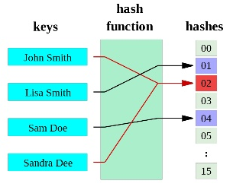
Wikipedia:
A hash function is any function that can be used to map digital data of arbitrary size to digital data of fixed size. The values returned by a hash function are called hash values, hash codes, hash sums, or simply hashes.

Slide 4
Hash functions can be indicated by the following notation: h(item)
It is a function that has the input of the item and the result is a integer in the range 0 to m-1
The integer becomes an index into a array, list, or table of slots.
For storing integer items, we are going to use:
h(item) = item % m, in our example m will be 11

Slide 5
items, and hash values
item | hash value: item % 11
54 | 10
26 | 4
93 | 5
17 | 6
77 | 0
31 | 9
add the items to a 'hash table' using a list at the index that matches the hash values:
hash table | 77 | None | None | None | 26 | 93 | 17 | None | None | 31 | 54
index | 0 | 1 | 2 | 3 | 4 | 5 | 6 | 7 | 8 | 9 | 10

Slide 6
try some code
# testing concepts of hash table
hash_table = [None]*11 # create empty table
def h(item): return item % 11
def put(item): hash_table[h(item)] = item
def contains(item):
return hash_table[h(item)] == item
# add 6 numbers
put(54)
put(26)
put(93)
put(17)
put(77)
put(31)
print(hash_table)
print( "contains(22): ", contains(22))

Slide 7
hash table | 77 | None | None | None | 26 | 93 | 17 | None | None | 31 | 54
index | 0 | 1 | 2 | 3 | 4 | 5 | 6 | 7 | 8 | 9 | 10
The resulting hash table that has 11 slots, now has 6 slots filled in.
So the table is 6/11 full = 54.5 % full
Definition How full the hash table is is called the load factor, it is indicated by the lambda symbol: λ
Load Factor:

Slide 8
Now to insert anything into the hash table just take a constant amount of time: O(1)
But this will only work if every item finds a unique hash value
consider inserting the item 22 into the above table
h(22) = 22 % 11 = 0, so 22 has to go into the same slot as 77
This is called a collision or clash, what do we do now!
hash table | 77 | None | None | None | 26 | 93 | 17 | None | None | 31 | 54
index | 0 | 1 | 2 | 3 | 4 | 5 | 6 | 7 | 8 | 9 | 10

Slide 9
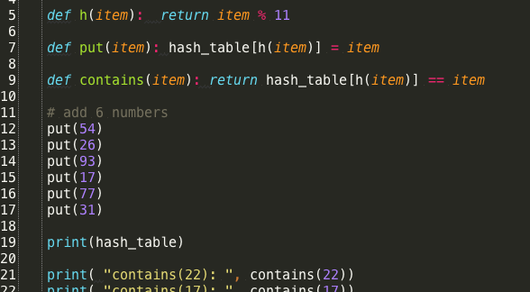
Lets try a collision in our code

Slide 10
Perfect Hash
If you know the data items in advance and they will not change, it is possible to design a hash function h(item) that creates a unique has value for every item. This is called a Perfect Hash function.
One way to create a perfect hash is to make the table big enough that no two items have the same hash value.

Slide 11
non-perfect hash functions
but as long as the load is low -> the number of slots used for data is just a fraction of the size of the table, we will be close to O(1)
Our goal then is to have a hash function that minimizes the number of collisions (items with same hash value).
We also want a hash function that is easy to compute (fast)

Slide 12
phone # items and folding
suppose we want to store phone numbers, to create a hash we can use a technique called folding.
break the phone number into several equal size pieces. (436)555-4601, divide them in to two digit groups: (43, 65, 55, 46, 01)
then add them and modulus by the table size
(43 + 65 + 55 + 46 + 01) % 11 = 10 (slot #)

Slide 13
the mid square method
if your items are numbers, or even you can reduce your item to a number.
You square the number and just use the middle digits.
For item 44 44² is 1936
The middle digits of 1936 are 93
so we take 93 modulus the table size of 11
93 % 11 = 5

Slide 14
way to do hash of string data
each character in a string has a Unicode value.
you can get the integer value by using the python ord() function.
ord('c') returns 99
ord('a') returns 87
ord('t') returns 116

Slide 15
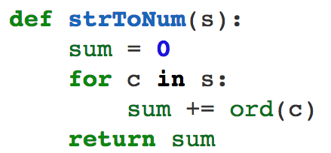
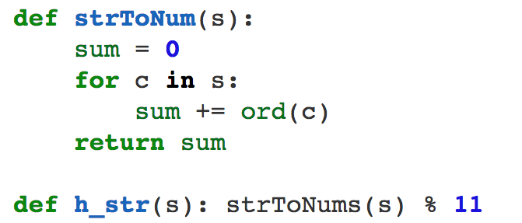
hash's for strings
The h_str(s) hash will add all the character numeric values up and then modulo 11 to get the slot number

Slide 16
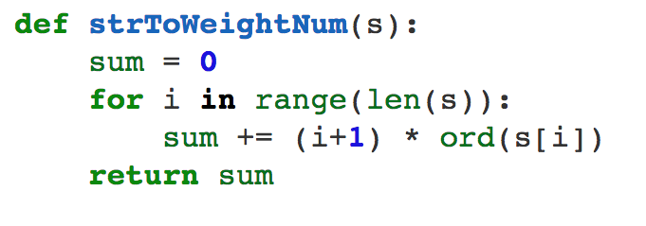
any two strings with the same letters (anagram) will sum to the same number creating a collision, if you apply a weight to each letter this can solve that:

Slide 17
Collision and Resolution
When you try to put two items in the same slot, then if you have a systematic method to add the item to the hash table, this is called
Collision resolution

Slide 18
Some Collision Resolutions techniqes:
open addressing types: (data in table)
linear probing
rehashing
quadratic probing
chaining

Slide 19
Linear probe
when inserting the item into the hash
detect if an item is already in the slot
if yes, then find the next slot to right that is empty and use it for the new item
when checking if the item is in the hash
go to the slot for the hash function and check
if it is not in that slot, then check each slot to right, if a slot is empty return false, if a slot has the item then return true
Notes:
point out that you go though the same steps in checking as you do in inserting the item.

Slide 20
hash table | 77 | 44 | None | None | 26 | 93 | 17 | None | None | 31 | 54
index | 0 | 1 | 2 | 3 | 4 | 5 | 6 | 7 | 8 | 9 | 10
44
Ok, if we insert 44,
h(44) is 0,
slot 0 already has 77
so we add one to 0 and try slot 1
its is empty, so we store 44 in slot 1
Now if we insert 55, it's h(55) is also 0,
so we have to skip from 0 to 1 to 2

Slide 21
hash table | 77 | 44 | 55 | None | 26 | 93 | 17 | None | None | 31 | 54
index | 0 | 1 | 2 | 3 | 4 | 5 | 6 | 7 | 8 | 9 | 10
55
Now if we insert 55
h(55) is also 0
so we have to skip from 0 to 1 to 2
2 is the first empty slot, so we put 55 there

Slide 22
hash table | 77 | 44 | 55 | None | 26 | 93 | 17 | None | None | 31 | 54
index | 0 | 1 | 2 | 3 | 4 | 5 | 6 | 7 | 8 | 9 | 10
55
after we put in the 55, we have created a cluster of slots 0, 1 and 2
This cluster really affected trying to insert 20, since slots 9 and 10 were also used.

Slide 23
hash table | 77 | 44 | 55 | 20 | 26 | 93 | 17 | None | None | 31 | 54
index | 0 | 1 | 2 | 3 | 4 | 5 | 6 | 7 | 8 | 9 | 10
20
Now if we insert 20
h(20) is 20 % 11 = slot 9
but slot 9 and 10 are full, we wrap around to 0
since (10+1)%11 = 11 % 11 = 0
and keep searching
0, 1, 2 are used, and we finally fill slot 3

Slide 24
Linear probing problem
Linear probing tends to cluster a lot of items in adjacent slots, called clustering.
When clustering starts it then tends to propagate, since as more adjacent slots are filled, they tend to cause more collision that cause even more clustering.
Lets look at solving this…

Slide 25
rehashing
Ok, instead of just picking the next empty slot, we will go a certain distance to the right called the skip distance
so if we are trying slog pos from the first has, the rehash(pos) = (pos+skip)%sizeOfTable
This is where it is important that the table size be a prime number, or we will never pick some slots in the table when rehashing

Slide 26
quadratic probing
Another open addressing collision resolution variation is called quadratic
Linear is rehash(pos) = pos + skip
Quadratic is you add a constant to skip every time, so the skip values could be
1, 3, 5, 7, 9 would be the skip values, but the actual slots end up looking like this
H, H+1², H+2², H+3², H+4², H+5² Which would be slots h+0, h+1, h+4, h+9, h+16, h+25

Slide 27
Chaining
Another Idea is to use a process called chaining. (you will do this in an exercise)
Instead of trying to store each item inside the list used for the hash_table, you create a list when you insert a item. If you have a conflict at the same slot, you just add the new item (chain) to the end of the list
You can also use single linked nodes to chain

Slide 28
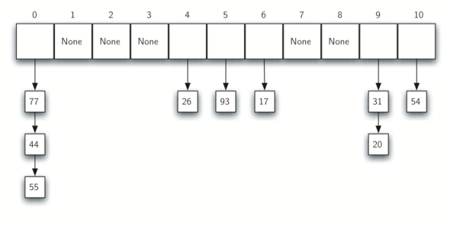
chain after inserting 54,26,93,17,77,31,44,55,20

