Slide 1
FOD ROBOT — COMPUTER VISION
Runtime benchmark and detection findings
What the Pi 5 and Hailo-8 actually deliver, why live detection first failed, and what that changes about the plan.
Proof-of-concept · measured on hardware · August 2026
All figures reproducible from runs/bench_pi/ in the project repository
Notes:
Goal of this deck: (1) what the hardware delivers, (2) how it was measured, (3) what it means for the project plan. The headline is not the speed number - it is that the public dataset cannot take us further.

Slide 2
1 · ENVIRONMENT
The hardware under test
Every number in this deck was measured on this board. Nothing is cited.
Component | Specification
Compute | Raspberry Pi 5 Model B - Cortex-A76 4-core @ 2.4 GHz, Active Cooler
Accelerator | Hailo-8 on dual M.2 HAT - 26 TOPS (not the 13-TOPS Hailo-8L)
Camera | Camera Module 3 (imx708) - 4608x2592, 66 deg lens, autofocus
Storage | NVMe SSD on the shared PCIe link
Model | YOLO11n, 4 classes, deployed at 480x480
Build host | Apple M4 - training and export only
The accelerator is a measurement, not yet a decision.
PRD v2 commits to Pi 5 CPU-only; adopting the Hailo-8 is a BOM change gated on advisor sign-off. No Apple M4 figure appears anywhere in this deck - it does not transfer to Arm.
2
Notes:
Hailo-8 vs Hailo-8L matters: Ultralytics defaults to the 8L and that .hef will not load on this board. The Mac is used only to train and export, because the LiteRT converter has no aarch64 wheel - it cannot run on the Pi.

Slide 3
2 · METHOD
How it was measured
Two things decide whether a benchmark means anything: the split, and the board.
Datasets - three splits, three jobs
Board control - all five required
Split | Size | Used for
fod-a | 510 / 90 | the v1 model
fod-a-3k | 2,550 / 450 | training v2 only
fod-a-clean | 263 val | ALL scoring here
CPU governor pinned to performance (default idles at 1.6 GHz)
120 s cooldown to 66 C between every cell
No desktop session - costs the CPU path 16% invisibly
Drift control re-runs the first cell at the end
A CPU format measured first, never the accelerator
fod-a-clean holds only scenes that contributed no training frame to either model - the reason appears on slide 8.
This run: drift -2.3%, throttled 0x0, 2.4 GHz throughout.
3
Notes:
The first Pi run went 61->80 C and drift hit +20.3% - position in the loop outweighed the runtime being measured. Every rule here exists because skipping it produced a wrong ranking at least once.

Slide 4
3 · RESULT
Benchmark: every runtime and precision
poc-v2 model, 480x480, 4 threads, idle board. 50 runs per cell after 5 warm-up.
Runtime | Prec | Median ms | FPS | Size MB | mAP50-95
hailo | int8 | 17.83 | 56.1 | 7.68 | 0.851
litert | int8 | 23.36 | 42.8 | 3.03 | 0.732
ncnn | fp32 | 43.27 | 23.1 | 10.48 | 0.856
ncnn | fp16 | 43.94 | 22.8 | 5.33 | 0.856
mnn | fp32 | 56.82 | 17.6 | 10.45 | 0.856
mnn | int8 | 57.39 | 17.4 | 2.81 | 0.847
openvino | fp16 | 62.90 | 15.9 | 5.61 | 0.856
openvino | fp32 | 63.44 | 15.8 | 10.70 | 0.856
litert | fp32 | 76.65 | 13.0 | 10.59 | 0.856
onnx | int8 | 87.30 | 11.5 | 2.99 | 0.805
onnx | fp32 | 88.00 | 11.4 | 10.53 | 0.856
openvino | int8 | 167.20 | 6.0 | 3.34 | 0.830
Hailo-8: 17.8 ms, 56 FPS
2.4x the fastest CPU runtime, and it barely touches the CPU - 0.4 ms of postprocess against ~1.0 ms elsewhere, because NMS is compiled onto the chip.
Software INT8 does not compute
MNN INT8 is slower than its own FP32; ONNX INT8 lands within 1 ms of its own. The file shrinks 3.7x, the arithmetic never changes.
Not buildable: NCNN INT8 has no export path at all, and the Hailo-8 is INT8-only silicon. Those gaps are toolchain facts, not omissions.
4
Notes:
Read mAP50-95, never mAP50: on this split mAP50 saturates at 0.995 for almost every cell, so it reports every INT8 cell as free. OpenVINO INT8 at 167 ms is a 2.6x regression against its own FP32 - Arm executes quantised graphs in float simulation. Source: runs/bench_pi/results_480_poc_v2_matrix.csv

Slide 5
4 · RESULT
The measurement that decides the architecture
A robot running SLAM cannot give four cores to vision. So measure it at two.
Runtime | 4 cores | 2 cores | Change
NCNN FP16 (best CPU) | 43.94 ms | 57.67 ms | +31.2%
Hailo-8 INT8 | 17.83 ms | 17.82 ms | -0.1%
Sustained load, 600 s
43.4 FPS sustained
26,042 frames. Drift first quarter to last: +1.4%. Temperature flat at 68 C, clock never left 2.4 GHz, 4.05 W median.
43.4 FPS is the figure to plan a robot around; 56 belongs to the leaderboard.
Halving the cores costs the CPU a third of its throughput and the accelerator nothing.
Hailo's inference is not on the CPU at all, so the gap widens from 2.46x to 3.24x. At two cores the CPU path drops to 17.3 FPS while the accelerator holds 56.
5
Notes:
The two-core result is the strongest argument for the accelerator and it is not about speed - it is about what the CPU is free to do. Soak is lower than the burst mainly because it cycles 263 images: cache locality, not thermal decay. A true sustained figure needs a fixed frame, which is what a camera delivers.

Slide 6
5 · RESULT
What INT8 quantisation costs
All FP32 and FP16 cells score 0.856 mAP50-95. That is the reference.
Backend | INT8 mAP50-95 | Loss | Real INT8 compute?
Hailo-8 | 0.851 | -0.6% | yes
MNN | 0.847 | -1.1% | no - weight-only
OpenVINO | 0.830 | -3.0% | no - float sim on Arm
ONNX | 0.805 | -6.0% | no
LiteRT | 0.732 | -14.5% | yes - XNNPACK
A previous conclusion was wrong
Earlier work concluded "INT8 is dead for this project" because LiteRT lost 34% of its accuracy. That write-up also flagged its own doubt: the calibration set was only 510 images.
Re-run with 2,550 calibration images:
LiteRT -34% -> -4.0%
ONNX -16% -> 0.0%
Most of the collapse was the calibration set, not the runtime.
Only the accelerator buys both size and speed.
MNN matches it on accuracy but not latency; LiteRT is fast but is the only path losing real accuracy.
6
Notes:
This is the slide to be honest on: we published a conclusion, the conclusion was wrong, and the earlier write-up had already named the reason to re-test. The ranking survives - LiteRT is still worst - but 'INT8 is dead' does not.

Slide 7
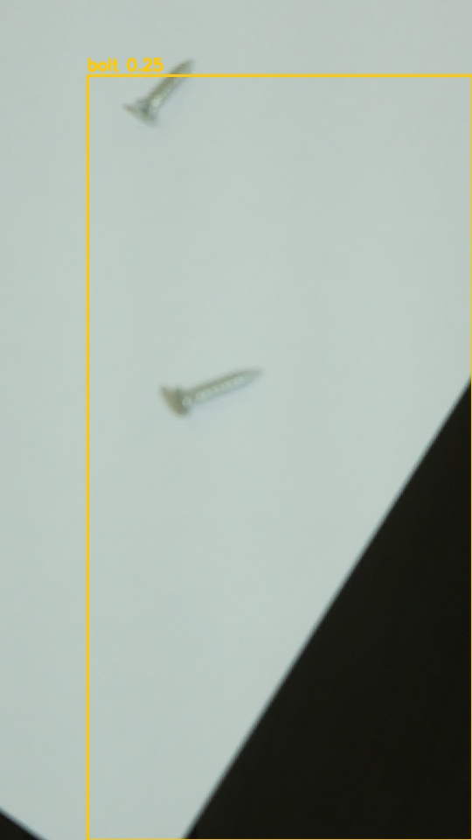
6 · FINDING
Pointed at real fasteners, it detected almost nothing
The benchmark said the model was good. The camera said otherwise. Three causes.
1. The lens was parked at 1.00 m
Autofocus was never enabled - libcamera defaults to manual at one metre, and nothing in our code set it. Every frame ever captured was focused at 1 m regardless of the object. Fixed: focus score 180 -> 757, no frame cost.
2. The model had seen ten screws
The training set was capped at 600 images as a smoke test and never uncapped. Nail and screw - the two objects that failed - were the two weakest classes. Lifting the cap took screws from 10 to 36 instances.
3. The data contains no cluttered scenes
See the next slide. This one is not fixable from the public dataset.
Median detection confidence: 0.534 -> 0.936
Two screws, plainly visible to a person, and one junk box. Out of focus - not a model failure.
7
Notes:
Zoom and input resolution were both ruled out by measurement, not assumed: a 40 mm screw is already at training scale at 0.28 m with no zoom, which is the PRD working distance. The hand-written preprocessing was also verified against the standard toolchain - IoU 0.82-0.95. So the pipeline was never the problem.

Slide 8
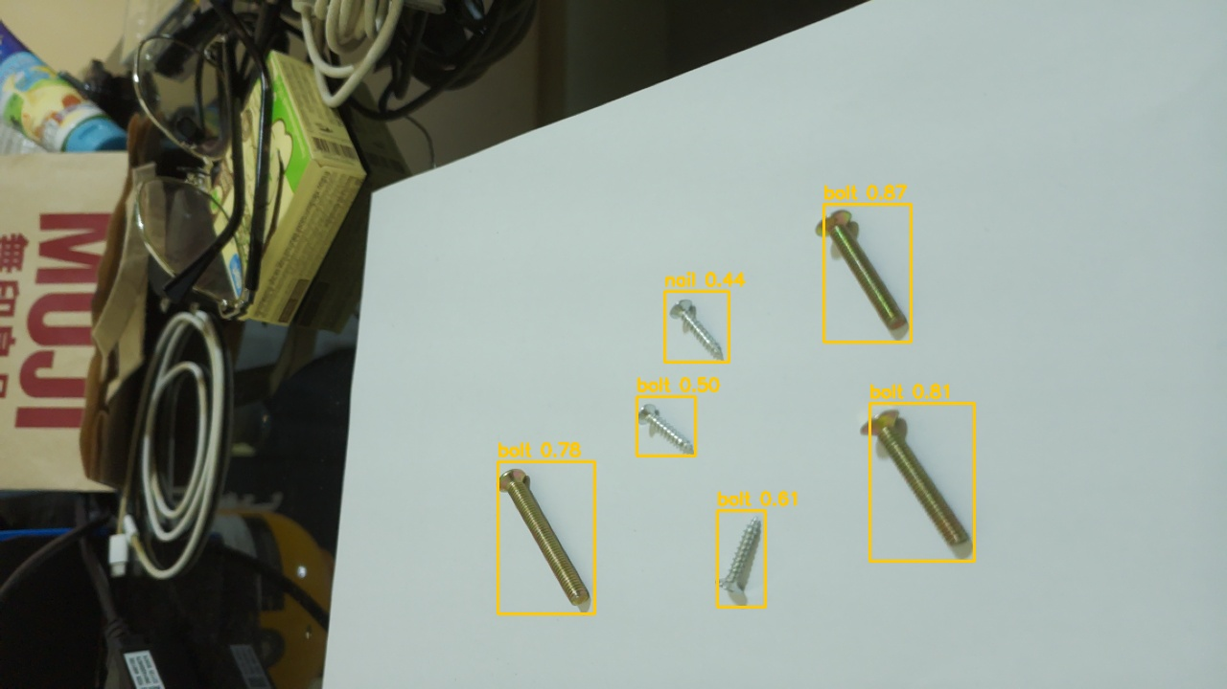
7 · RESULT
The same camera, after the fixes
Autofocus enabled, model retrained on 5x the data, unknown class suppressed.
12 of 12 fasteners found
Across two frames, every object detected, boxes tight, confidence 0.42 to 0.87.
Nothing fired on the clutter
The bag, cables, glasses and boxes on the left are all ignored. That is the exact failure that produced full-frame boxes before.
Still wrong: the class
Screws are labelled bolt. Detection and localisation are solved; naming is not, and 36 screw instances is why.
Honest limit: the fasteners sit on a plain sheet, so this is not yet a cluttered-floor test. The clutter is behind them, not around them.
Live frame, Hailo-8 on the Pi. Confidence printed on each box.
8
Notes:
This is the result the whole investigation was aiming at, and it arrived after the deck was drafted. Before: almost nothing detected, full-frame boxes on furniture. After: 12/12 with no false positives. Be honest in the room about two things - the class confusion is real and expected from the training counts, and the objects are on a white sheet, so the arena-floor case is still untested.

Slide 9
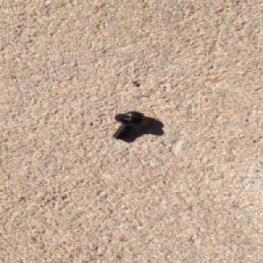
8 · FINDING
The dataset is the ceiling
FOD-A is not 9,623 independent images. It is about 38 scenes.
Image pair | Similarity
adjacent frames | 0.975
+10 frames | 0.949
unrelated pair | 0.778
Which broke the split
74% of the validation frames used to train v2 had a near-duplicate in its own training set. That model scores 0.948 on it - recall of an almost identical frame, not generalisation. All scoring in this deck uses a scene-disjoint split instead.
And the images are the wrong kind
Every training image holds exactly one object on an empty plane. So a model trained on it cannot abstain - pointed at a desk it labels a mouse and a keyboard as debris. It has never been shown a scene.
More of this data cannot fix false positives on furniture, because it contains no furniture.
Video-derived and heavily redundant: 38 runs cover 96% of the images, and half of everything sits in the largest six.
A typical training image: one object, blank ground, no clutter, no second object.
9
Notes:
This is the most important slide in the deck. It says the next step is not more benchmarking or more public data - it is collecting our own arena images, which PRD section 10 already specifies. Note also: once you train on 2,550 of FOD-A's frames, zero untouched images remain even 30 frames away from a training frame. There is no clean holdout left inside it.

Slide 10
9 · DECISIONS
What this settles
Each decision with the measurement behind it.
Decision | Because
Deploy at 480x480, not 640 | same accuracy, 1.87x faster. 320 loses 37%
Hailo-8 is the only real INT8 path | -0.6% accuracy, 2.4x fastest CPU, 3.2x at two cores
Drop "NCNN INT8" from the spec | no export path exists in this toolchain
Drop OpenVINO INT8 | 2.6x slower than its own FP32, replicated twice
LiteRT INT8 usable but lossy | fastest CPU INT8, but -14.5% accuracy
YOLO26n rejected | 45.5 ms vs YOLO11n's 44.8 - no gain
Enable autofocus, always | it was never set; focus score 180 -> 757
Score on a scene-disjoint split | the per-image shuffle leaked 74%
10
Notes:
Every row here replaces a claim that was previously assumed or cited rather than measured. Three of them amend the PRD: FR-2 (image size), FR-1 (the NCNN INT8 and OpenVINO INT8 entries).

Slide 11
10 · NEXT
What happens next
Toolchain answered, detection working on hardware. The data question is not.
1. Collect the arena dataset (PRD section 10)
Now the critical path, not an eventual refinement. The public dataset cannot supply a single cluttered negative, and clutter is what produces the false positives.
2. Group the split by scene before training on it
A per-image shuffle cannot give a trustworthy score on video-derived data - arena footage will be video too.
3. Fix the class confusion, or drop to one class
Screws are detected reliably and named wrong. The specification asks for a single metal_fastener class anyway, with per-class recall recovered from the seeding log.
Smaller, still open
Viewpoint augmentation written for this camera geometry, never run
USB power meter to replace the PMIC estimate
Calibrate INT8 on arena images, not FOD-A
Accelerator adoption is a BOM change and stays gated on sign-off.
11
Notes:
Close on this: the benchmark work is finished and the answer is clear, but the thing standing between here and a working robot detector is data collection, and that needs the arena.

