Slide 1


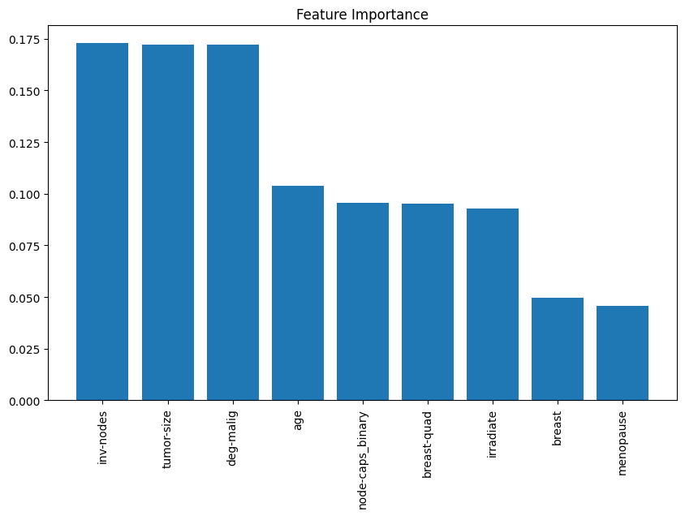
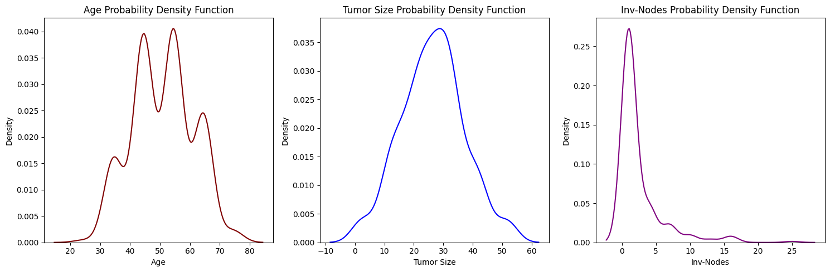
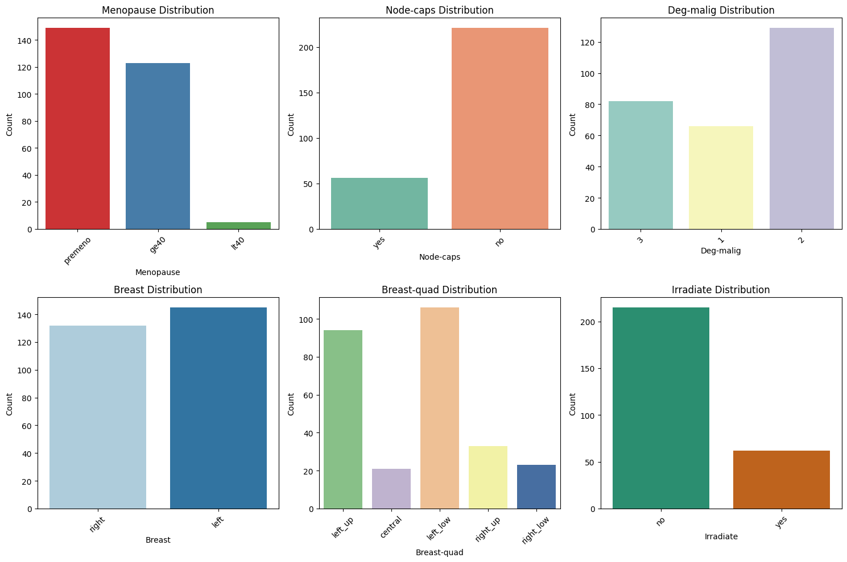
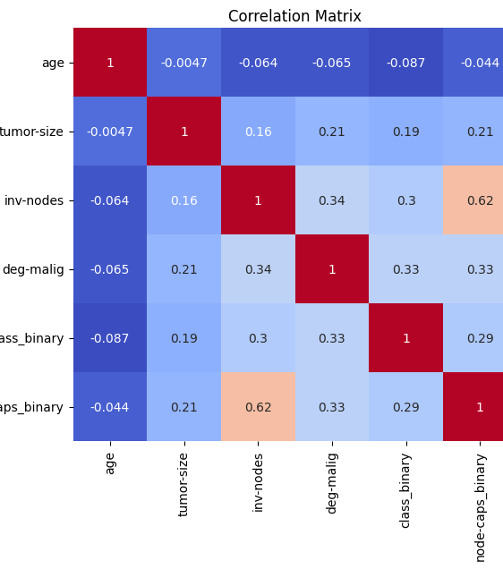
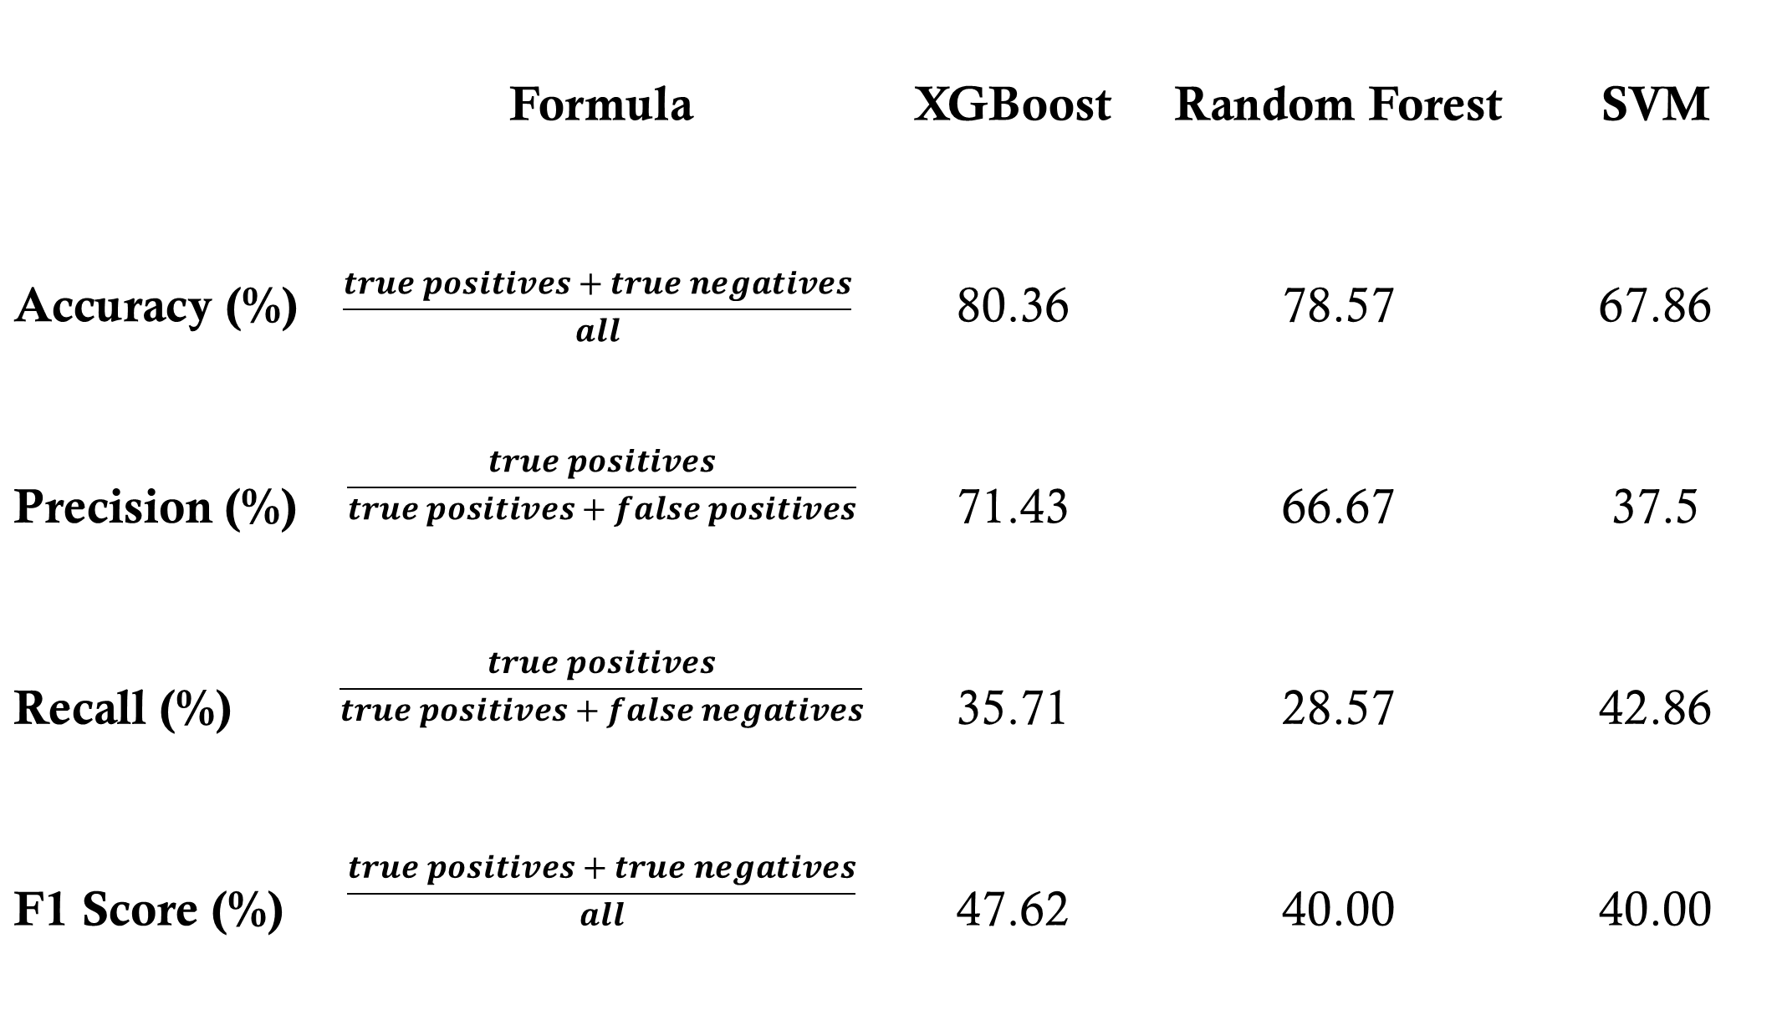
Beyond the Cure: Modeling the Risk of Breast Cancer Recurrence
Brandon W. Thomas¹, Sayani Sarkar Ph.D²
Bellarmine University Data Science Program, Louisville, KY
1bthomas@bellarmine.edu, 2ssarkar@bellarmine.edu
Exploratory Data Analysis (EDA)
Abstract
Wilson W. Wyatt Fellowship for Academic Excellence and the Fred Cand Florence Koster Scholarship awards- Spring 2025
Breast cancer recurrence poses a critical challenge, affecting long-term survival and treatment planning. This study employs machine learning to enhance recurrence risk prediction using clinical and demographic data. Models including XGBoost, Random Forest, and SVM were evaluated on the Kaggle Breast Cancer dataset. Key predictors identified were tumor size, lymph node involvement, and malignancy degree. While XGBoost achieved the highest accuracy, recall performance remains an area for improvement. This research underscores the potential of AI-driven risk assessment to support personalized treatment decisions and improve patient outcomes.
Figure 3 – Random Forest Feature Importance Plot
Introduction and Objectives
The most important features by decreasing importance are: inv-nodes, tumor-size, deg-malig, and age.
Project Goal: Develop a machine learning-based predictive model to improve breast cancer recurrence risk assessment and support clinical decision-making.
Research Question(s)
What are the most influential clinical and demographic variables in predicting breast cancer recurrence?
How accurately can machine learning models predict recurrence risk compared to existing clinical tools?
Clinical Relevance:
Enhances current prediction models by integrating high-dimensional patient data for personalized risk assessment.
Aims to improve early intervention strategies and treatment planning for better patient outcomes.
Model Evaluation & Interpretation:
Visualization: Using Matplotlib and Seaborn to present model performance and insights.
Feature Importance: Based on Random Forest feature ranking.
Performance Metrics: Accuracy, precision, recall, and F1-score.
Figure 1 – Distribution of Variables
²
Conclusion/Future Work
No model achieved high recall, which is critical for detecting cancer recurrence and minimizing false negatives.
XGBoost demonstrated the best overall performance, balancing accuracy and precision, though recall remained a challenge.
Random Forest exhibited signs of overfitting, as evident from the gap between cross-validation and test accuracy.
SVM performed the weakest across all metrics, making it the least viable model.
Additionally, applying SMOTE for class balancing did not significantly improve overall model performance.
Figure 2 – Correlation of Numerical Variables
Wilson W. Wyatt Fellowship for Academic Excellence and the Fred C. and Florence Koster Scholarship awards- Spring 2025
Results
Table 1 – Machine Learnine Evaluator Comparison
 | Formula | XGBoost | Random Forest | SVM
Accuracy (%) | $$\frac{true positives+true negatives}{all}$$ | 80.36 | 78.57 | 67.86
Precision (%) | $$\frac{true positives}{true positives+false positives}$$ | 71.43 | 66.67 | 37.5
Recall (%) | $$\frac{true positives}{true positives+false negatives}$$ | 35.71 | 28.57 | 42.86
F1 Score (%) | $$\frac{true positives+true negatives}{all}$$ | 47.62 | 40.00 | 40.00
References
Materials and Methods
Blows, F. M., Driver, K. E., Schmidt, M. K., et al. (2010). Subtyping of breast cancer by immunohistochemistry to investigate a relationship between subtype and short and long term survival: a collaborative analysis of data for 10,159 cases from 12 studies. PLoS medicine, 7(5), e1000279.
Early Breast Cancer Trialists' Collaborative Group (EBCTCG). (2021). Long-term outcomes after radiotherapy or surgery for early-stage breast cancer. The Lancet Oncology.
Gao, Z., Zhang, Y., Styblo, T. M., et al. (2022). Machine learning applications in predicting breast cancer recurrence and treatment response. Cancer Informatics, 21, 117693512211073.
Lichman, M.: UCI machine learning repository, University of California, School of Information and Computer
Science, Irvine, CA (2019). http://archive.ics.uci.edu/ml/datasets/breast+cancer
Yasaka, K., Akai, H., Kunimatsu, A., et al. (2018). Deep learning with convolutional neural network for differentiation of liver masses at dynamic contrast-enhanced CT: a preliminary study. Radiology, 286(3), 887-896.
Zhang, X., Yang, P., & Xu, Z. (2020). Applications of machine learning in breast cancer diagnosis and prognosis. Cancer Biology & Medicine, 17(4), 943.
Programming & Data Processing
Python with Pandas & NumPy for data cleaning and preprocessing
scikit-learn for feature engineering and initial model development
Machine Learning Models
XGBoost – Captures complex relationships and improves predictive accuracy
Random Forest – Provides feature importance and reduces overfitting
SVM (Support Vector Machine) – Handles high-dimensional data for classification
Development & Optimization
Jupyter Notebook for interactive development
SMOTE for handling class imbalance

