Slide 1
Exponential SVD Embeddings for Trajectory Inference of Oligodendrocytes
Blake Wilson
Birck Nanotechnology Center and Purdue Quantum Science and Engineering Institute, West Lafayette, IN

Slide 2
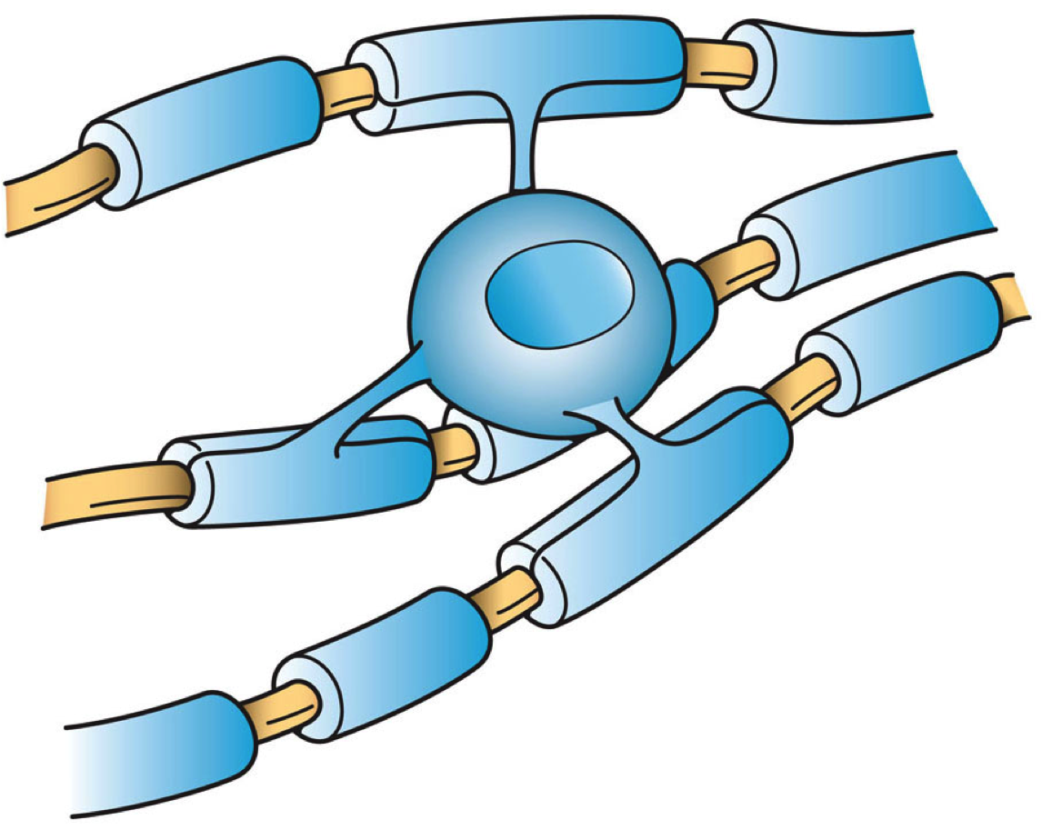
Oligodendrocytes
Oligodendrocyte
Axon
Myelin
Marques et al. 2016
Artwork by Holly Fischer - http://open.umich.edu/education/med/resources/second-look-series/materials - CNS Slide 9

Slide 3
Diseases Associated to Oligodendrocyte Trajectories
Damage to oligodendrocytes can reduce the production of myelin which puts you at risk for the following disorders.
Schizophrenia
Multiple Sclerosis
Bipolar Disorder
Paralysis

Slide 4
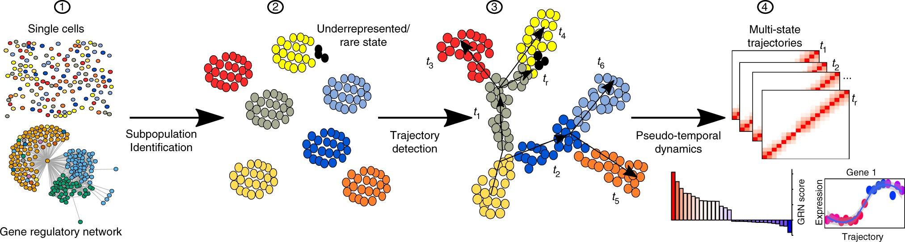
Trajectory Inference
Lummertz da Rocha, E., Rowe, R.G., Lundin, V. et al. Nat Commun 9, 892 (2018).

Slide 5
Trajectory Inference
Lummertz da Rocha, E., Rowe, R.G., Lundin, V. et al. Nat Commun 9, 892 (2018).

Slide 6
Trajectory Inference
“Principle” Component 2
“Principle” Component 1
Lummertz da Rocha, E., Rowe, R.G., Lundin, V. et al. Nat Commun 9, 892 (2018).

Slide 7


Trajectory Inference
Damaged cells
Healthy Cells
“Principle” Component 2
“Principle” Component 1
Lummertz da Rocha, E., Rowe, R.G., Lundin, V. et al. Nat Commun 9, 892 (2018).

Slide 8
Trajectory Inference for Patient Diagnosis
Your cells have this kind of expression
Lummertz da Rocha, E., Rowe, R.G., Lundin, V. et al. Nat Commun 9, 892 (2018).

Slide 9
Trajectory Inference for Patient Diagnosis
Your cells are about here along the trajectory.
Creeping closer to demyelination diseases.
“Principle” Component 1
Lummertz da Rocha, E., Rowe, R.G., Lundin, V. et al. Nat Commun 9, 892 (2018).

Slide 10







Data Set
Gene Expression
Cell
$$D_{1,1}$$
$$D_{1,2}$$
$$D_{1,p}$$
$$D_{2,1}$$
$$D=$$
$$D_{n,1}$$
$$D_{n,p}$$
Lin et al. 2021

Slide 11

Problem
Given the gene expression data: $D$
Compute the latent cell trajectories
Lin et al. 2021

Slide 12






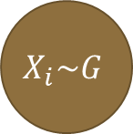

Inner Product Graphical Model
Cell latent space
Gene latent space
$$X∈ℝ^{n×k}$$
$$X_{i}\sim G$$
$$Y_{j}\sim H$$
$$Y∈ℝ^{p×k}$$
$$θ_{ij}$$
$$θ_{ij}=X_{i}^{T}Y_{j}$$
Exponential Family
$$D_{ij}$$
$$p\left(D_{ij} | θ_{ij}\right)=h\left(D_{ij}\right)e^{{η(θ_{ij})}^{⊤}T\left(D_{ij}\right)−g(θ_{ij})}$$
Lin et al. 2021

Slide 13
Inner Product Graphical Model
Cell latent space
$$X∈ℝ^{n×k}$$
$$X_{i}\sim G$$
$$Y_{j}\sim H$$
$$θ_{ij}$$
Our goal is to compute the cell latent space given only the cell/gene expression data
$$D_{ij}$$
Lin et al. 2021

Slide 14
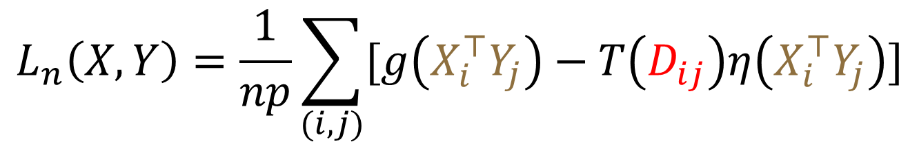
Loss Function
$$L_{n}\left(X,Y\right)=\frac{1}{np}\sum_{(i,j)}{[g\left(X_{i}^{⊤}Y_{j}\right)−T\left(D_{ij}\right)η\left(X_{i}^{⊤}Y_{j}\right)]}$$
Lin et al. 2021

Slide 15
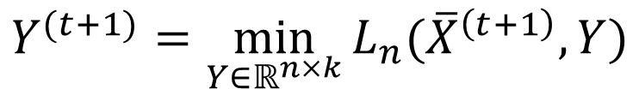
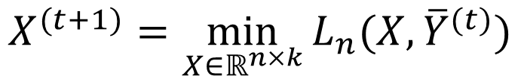

eSVD
$$X^{(t+1)}=\min_{X∈ℝ^{n×k}}{L_{n}(X,{\overline{Y}}^{(t)})}$$
$${\overline{X}}^{(t+1)}=\sqrt{n}{LeftSVD(X^{(t+1)})}$$
$$Y^{(t+1)}=\min_{Y∈ℝ^{n×k}}{L_{n}({\overline{X}}^{\left(t+1\right)},Y)}$$
$${\overline{Y}}^{(t+1)}=\sqrt{p}{LeftSVD(Y^{(t+1)})}$$
Alternate between optimizing the cell and the gene latent variables

Slide 16
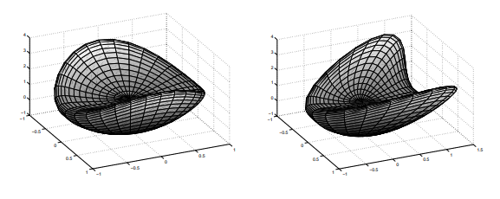
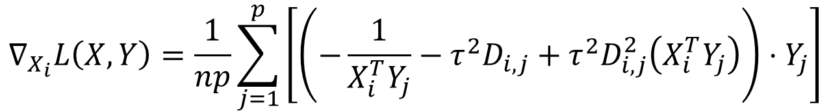
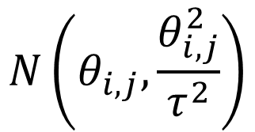

Curved Gaussian
$$N\left(θ_{i,j},\frac{θ_{i,j}^{2}}{τ^{2}}\right)$$
$$θ_{ij}=X_{i}^{⊤}Y_{j}$$
$$∇_{X_{i}}L\left(X,Y\right)=\frac{1}{np}\sum_{j=1}^{p}{\left[\left(−\frac{1}{X_{i}^{T}Y_{j}}−τ^{2}D_{i,j}+τ^{2}D_{i,j}^{2}\left(X_{i}^{T}Y_{j}\right)\right)⋅Y_{j}\right]}$$
Lin, Juan & Dayan, Peter. (2000). Curved Gaussian Models with Application to the Modeling of Foreign Exchange Rates.

Slide 17
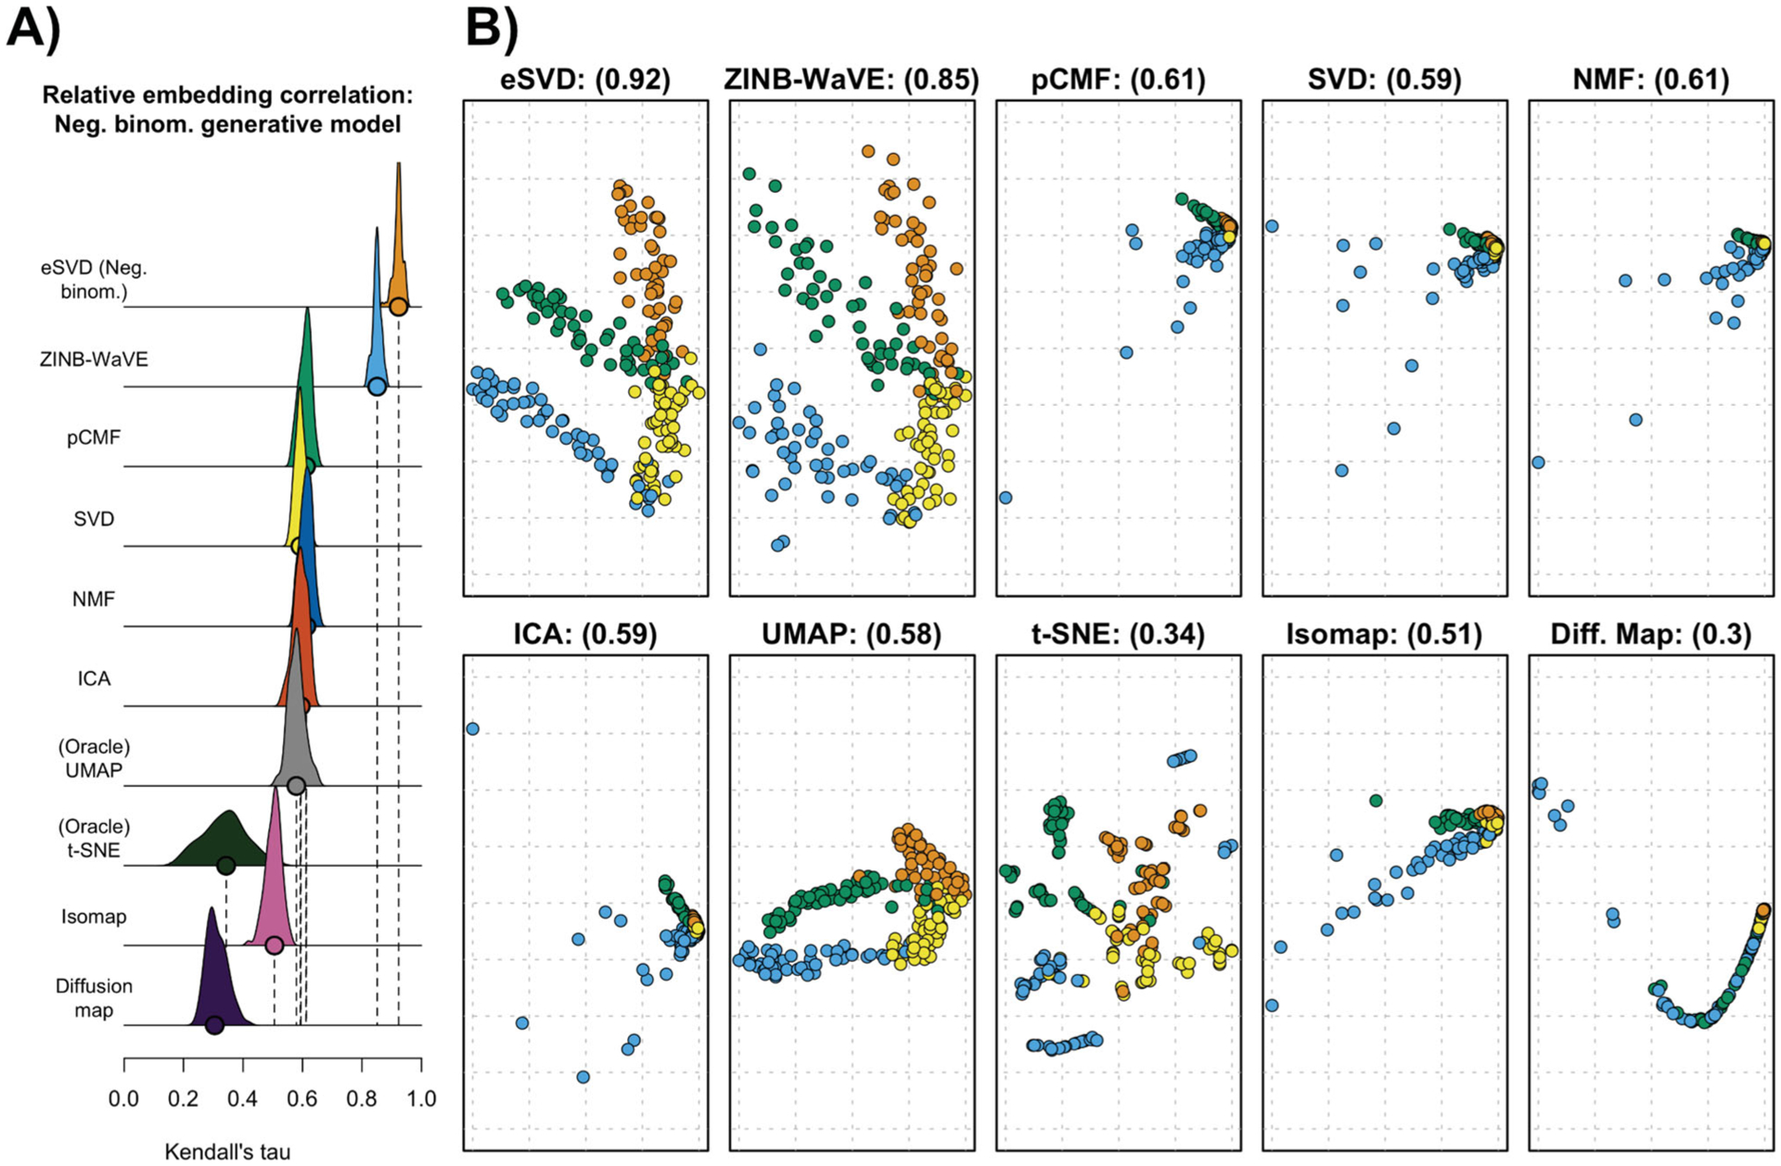
eSVD Results
Lin et al. 2021
Notes:
Main contribution of the work was to develop an alternating SVD method for decomposing A.

Slide 18
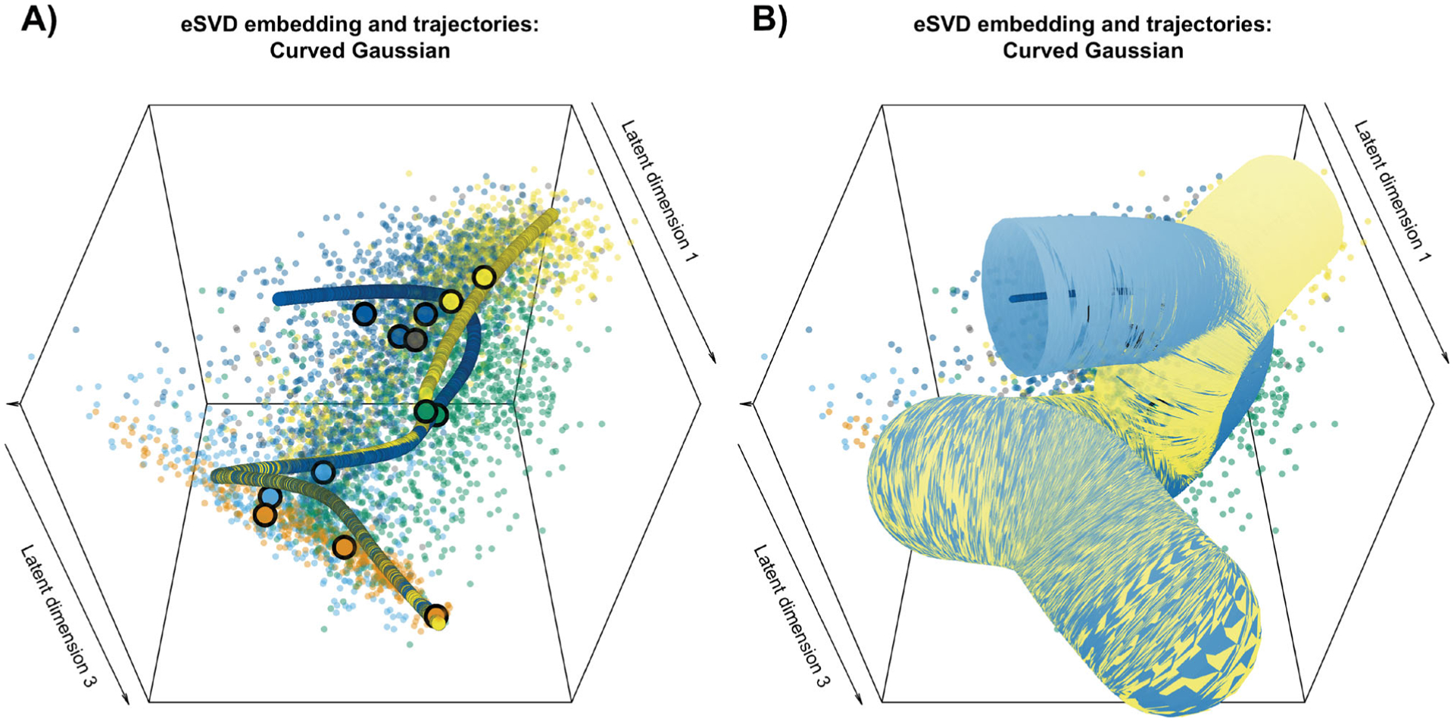
eSVD Results
Lin et al. 2021
Notes:
Main contribution of the work was to develop an alternating SVD method for decomposing A.

Slide 19
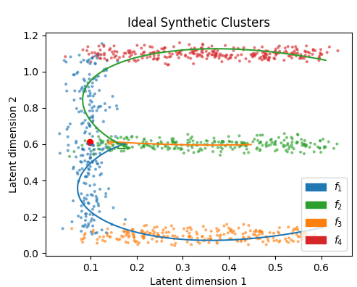
Synthetic Data

Slide 20
Distributions
Add Gaussian noise centered at that point
Pick a trajectory
$$X_{i}\sim P\left(x_{i} | μ_{i},Σ_{i}\right)P\left(μ_{i},Σ_{i} | l_{i}=f\right)P\left(l_{i}=f\right)$$
Pick a point on that trajectory
Lin et al. 2021

Slide 21

Data
$$X_{i}\sim P\left(x_{i} | μ_{i},Σ_{i}\right)P\left(μ_{i},Σ_{i} | l_{i}\right)P\left(l_{i}=f\right)$$
$$Y_{j}\sim N(0.5,0.02)$$

Slide 22

Distributions
$$X_{i}\sim P\left(x_{i} | μ_{i},Σ_{i}\right)P\left(μ_{i},Σ_{i} | l_{i}=f\right)P\left(l_{i}=f\right)$$
$$Y_{j}\sim N(0.5,0.02)$$
Lin et al. 2021

Slide 23
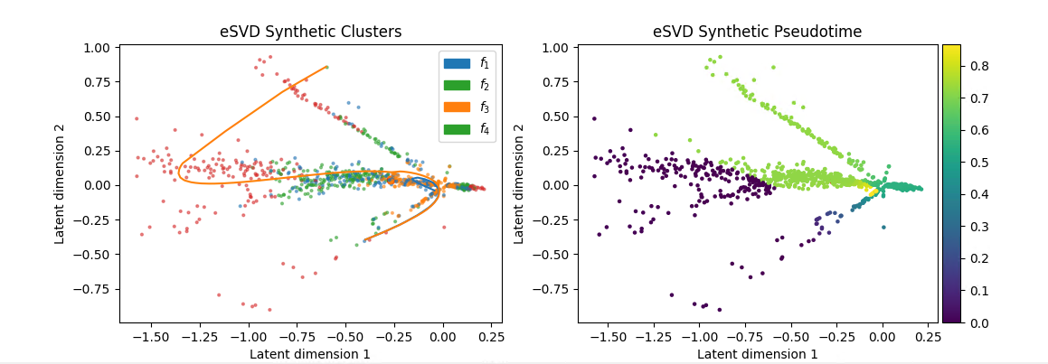
Results

Slide 24


Reparameterization for EM
$$X_{i}\sim P\left(x_{i} | μ_{i},Σ_{i}\right)P\left(μ_{i},Σ_{i} | l_{i}=f\right)P\left(l_{i}=f\right)$$
$$a_{1}$$
$$μ_{i}=t(a_{0}−a_{1})$$
$$a_{0}$$

Slide 25
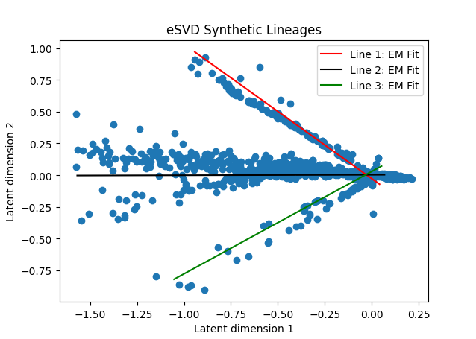
EM Fit

Slide 26
Discussion
To Do:
Use the Marques oligodendrocyte dataset
My work:
Re-implemented eSVD in Python
Constructed synthetic gene expression dataset
Derived EM approach for fitting cell latent space

Slide 27
References
Lin KZ, Lei J, Roeder K. Exponential-Family Embedding With Application to Cell Developmental Trajectories for Single-Cell RNA-Seq Data. J Am Stat Assoc. 2021;116(534):457-470. doi:10.1080/01621459.2021.1886106
Lummertz da Rocha, E., Rowe, R.G., Lundin, V. et al. Reconstruction of complex single-cell trajectories using CellRouter. Nat Commun 9, 892 (2018). https://doi.org/10.1038/s41467-018-03214-y
Marques S, Zeisel A, Codeluppi S, et al. Oligodendrocyte heterogeneity in the mouse juvenile and adult central nervous system. Science. 2016;352(6291):1326-1329. doi:10.1126/science.aaf6463
Taco Cohen, Max Welling., Harmonic Exponential Families on Manifolds Proceedings of the 32nd International Conference on Machine Learning, PMLR 37:1757-1765, 2015.
Tkachev D, Mimmack ML, Ryan MM, et al. (September 2003). "Oligodendrocyte dysfunction in schizophrenia and bipolar disorder". Lancet. 362 (9386): 798–805. doi:10.1016/S0140-6736(03)14289-4. PMID 13678875. S2CID 7511585.

Slide 28


Thank You
Contact Information
Email: wilso692@purdue.edu
@Blake_A_Wilson

Slide 29
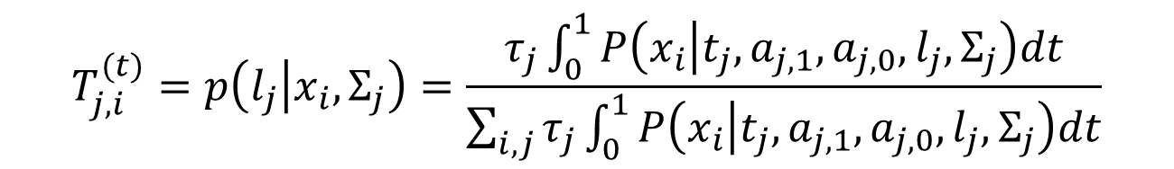
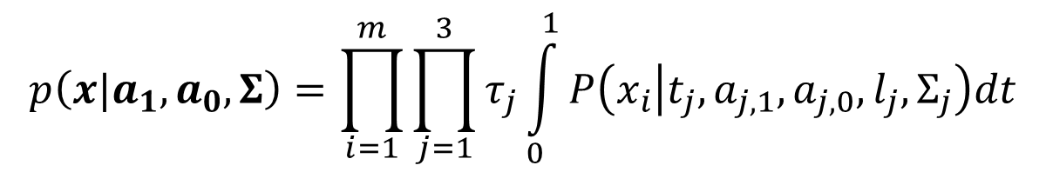
E-Step
$$p\left(x|a_{1},a_{0},Σ\right)=\prod_{i=1}^{m}{\prod_{j=1}^{3}{τ_{j}\int_{0}^{1}{P\left(x_{i} | t_{j},a_{j,1},a_{j,0},l_{j},Σ_{j}\right)dt}}}$$
Likelihood
$$T_{j,i}^{(t)}=p\left(l_{j} | x_{i},Σ_{j}\right)=\frac{τ_{j}\int_{0}^{1}{P\left(x_{i} | t_{j},a_{j,1},a_{j,0},l_{j},Σ_{j}\right)dt}}{\sum_{i,j}{τ_{j}\int_{0}^{1}{P\left(x_{i} | t_{j},a_{j,1},a_{j,0},l_{j},Σ_{j}\right)dt}}}$$

Slide 30
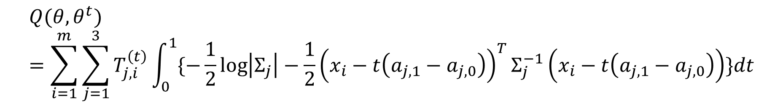
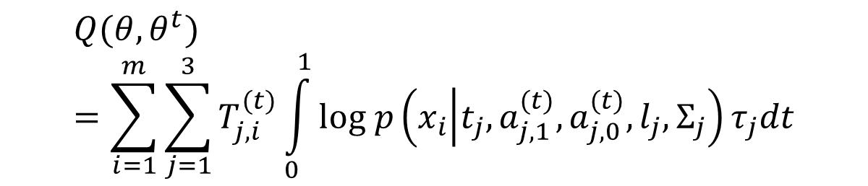
E-Step
$$Q(θ,θ^{t})=\sum_{i=1}^{m}{\sum_{j=1}^{3}{T_{j,i}^{(t)}\int_{0}^{1}{log p\left(x_{i} | t_{j},a_{j,1}^{(t)},a_{j,0}^{(t)},l_{j},Σ_{j}\right)τ_{j}dt}}}$$
$$Q(θ,θ^{t})=\sum_{i=1}^{m}{\sum_{j=1}^{3}{T_{j,i}^{\left(t\right)}\int_{0}^{1}{\{−\frac{1}{2}\log\left|Σ_{j}\right|−\frac{1}{2}{\left(x_{i}−t\left(a_{j,1}−a_{j,0}\right)\right)}^{T}Σ_{j}^{−1}\left(x_{i}−t\left(a_{j,1}−a_{j,0}\right)\right)}}}\}dt$$

Slide 31


M-step
$$τ_{j}^{(t+1)}=\sum_{i=1}^{m}{\sum_{j=1}^{3}{T_{j,i}^{(t)}}}$$
$$∇_{a_{j,0}}=\frac{1}{3}\left({\left(Σ_{j}^{−1}\right)}^{T}−Σ_{j}^{−1}\right)μ_{j}−\frac{1}{2}\sum{(x_{i}^{T}Σ^{−1})}$$
$$∇_{Σ}=x_{i}x_{i}^{T}+\frac{1}{3}\left(μ_{j}μ_{j}^{T}\right)−\frac{1}{2}μ_{j}x_{i}^{T}−\frac{1}{2}x_{i}μ_{j}^{T}$$
where $μ_{j}=(a_{j,1}−a_{j,0})$

