Slide 1
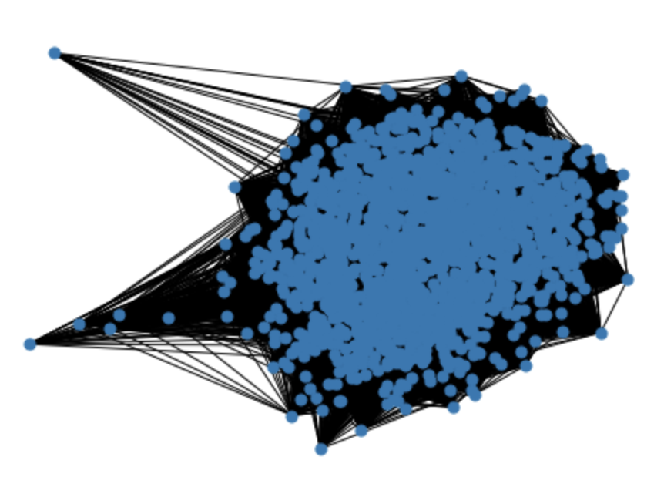
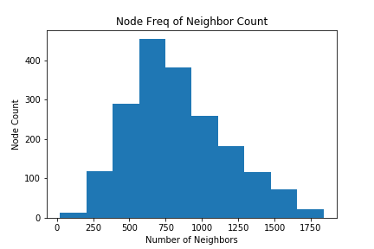
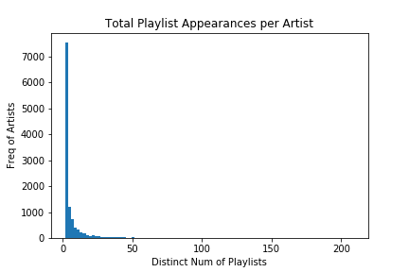
Community Detection of Music Genres
Andrew Mokhtarzadeh | Brandon Tran | Dare Hunt | Junjie Li
Research Question/Frame what we’re trying to do?
- Can we categorize artists into genres through association of ……..
The Model:
Communities from Edge Structure Attributes (CESNA)
This model uses relationships and node attributes to assign nodes to communities
Typical community detection just considers the edges and their weights
Our implementation:
Edges exist between two artists added to the same playlist
Edges are weighted by the frequency that artists appear in the same playlist
Node attribute is_____
Playlist Data
Spotify Dataset of 161,530 playlists shared by various users
We sample 5,000 playlists for our network to build in efficient time while still producing significant results
The sample includes:
34,250 artists
347,305 songs
1,910 artists appearing on at least 10 playlists
Placeholder for updated network
Genre Data
Spotify defines a list of genres associated to a particular artist
We use Spotify’s API to retrieve the genres linked to the artists being used as nodes
This data is only used for accuracy metrics and separate from what the model uses
Results
# of communities
Largest community
Accuracy
How its calculated…
Can modify bin size on this fig for best look; cell is in practice.ipynb
Insignificant number of edges…what is that and do we filter out?
Community Classification
- how

