Slide 1
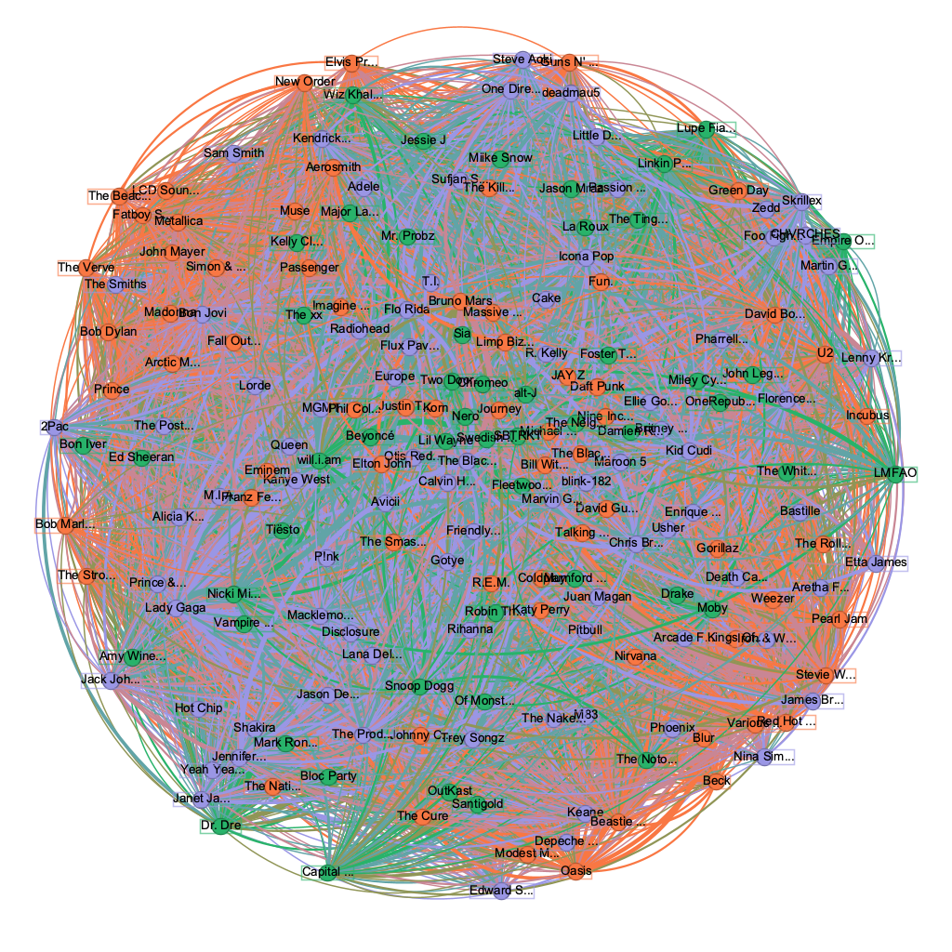
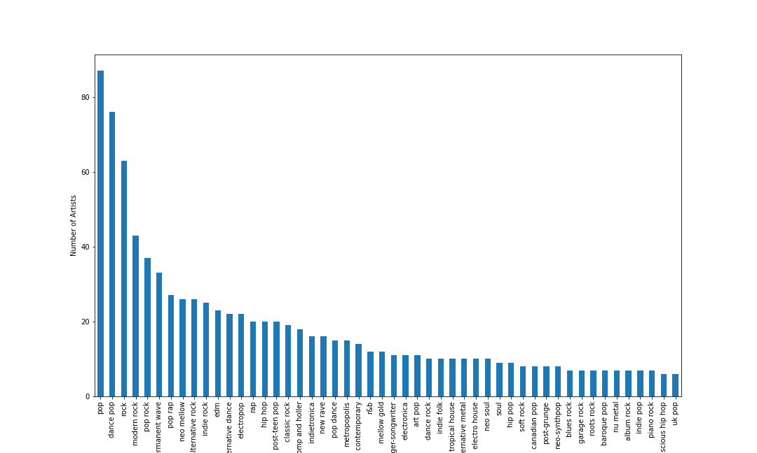
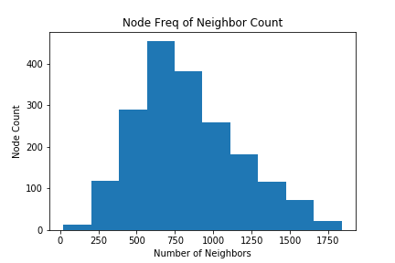
Community Detection of Music Genres
Andrew Mokhtarzadeh | Brandon Tran | Dare Hunt | Junjie Li
Research Question
Can we categorize artists by genres based on the playlists they are in?
Results
The Model
Communities from Edge Structure Attributes (CESNA)
This model uses a probability distribution and node attributes to predict the probability of a node belonging to each community before assignment
Typical community detection just considers the graph structure and weights
Our implementation:
Edges exist between two artists added to the same playlist
Edges are weighted by the frequency that artists appear in the same playlist
Node Features:
Artist popularity[0,100], Is top 25% of appearances [0, 1]
Data Collection
The Spotify Dataset is on Kaggle and artist genres were retrieved using Spotify’s API
The Data
Spotify Dataset of 161,530 playlists shared by various users
We sample 5,000 playlists for our network to build in efficient time while producing significant results
The sample includes:
34,250 artists
347,305 songs
1,910 artists appearing on at least 10 playlists
Number of Artists by Genre
When detecting 3 communities, the model achieved an accuracy of 95%.
How the accuracy is computed
We take the top three Genres per community and check if the nodes have any of these three Genres
Edges with a weight less than 1 is removed to improve the model
The algorithm involves maximizing the likelihood that a node belongs to a given community through gradient descent. The likelihood function is defined as l(F) = log P(G|F) where G is the underlying graph and F is the affiliation matrix.

