Slide 1
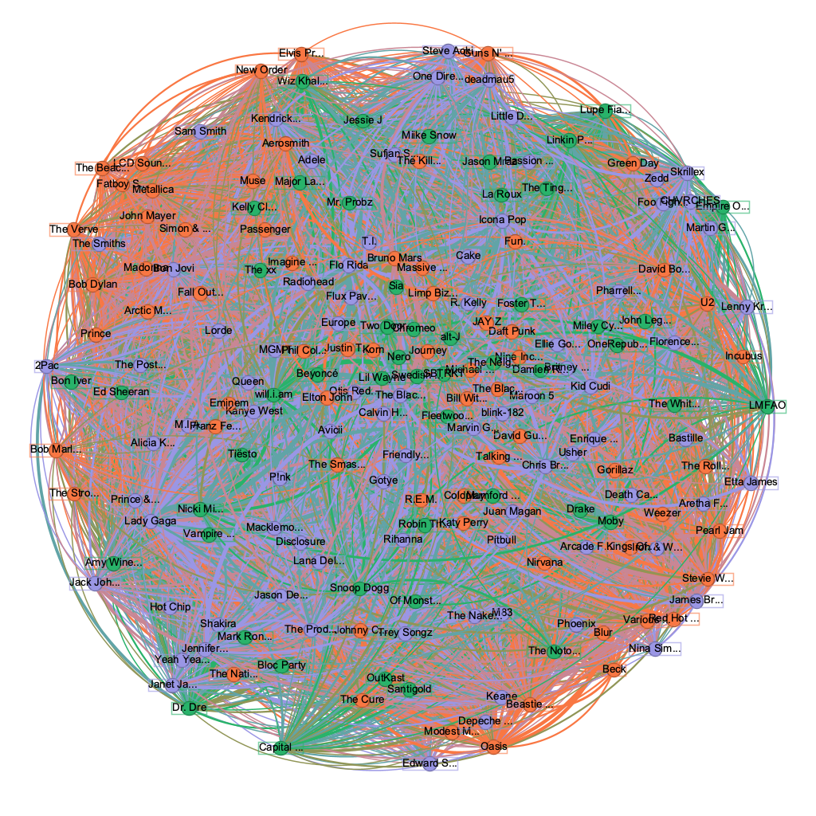
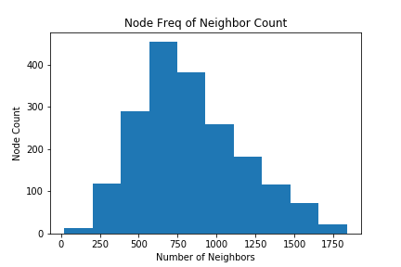
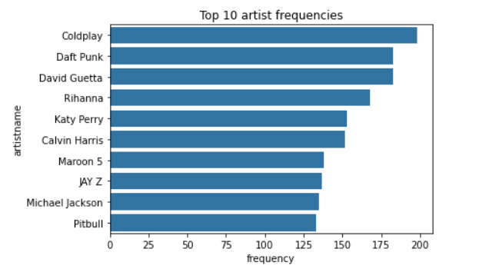
Community Detection of Music Genres
Andrew Mokhtarzadeh | Brandon Tran | Dare Hunt | Junjie Li
Research Question (What are we trying to do?)
- Can we categorize artists into genres through association of the playlists they are in? (To add: Node attribute TBD)
Results
The Model:
Communities from Edge Structure Attributes (CESNA)
This model uses relationships and node attributes to assign nodes to communities
Typical community detection just considers the edges and their weights
Our implementation:
Edges exist between two artists added to the same playlist
Edges are weighted by the frequency that artists appear in the same playlist
Node attribute TBD
Data Collections
The Spotify Dataset is retrieved using Spotify’s API
Playlist Data
Spotify Dataset of 161,530 playlists shared by various users
We sample 5,000 playlists for our network to build in efficient time while still producing significant results
The sample includes:
34,250 artists
347,305 songs
1,910 artists appearing on at least 10 playlists
Genre Data
Spotify defines a list of genres associated to a particular artist
We use Spotify’s API to retrieve the genres linked to the artists being used as nodes
This data is only used for accuracy metrics and separate from what the model uses
When detecting 3 communities, the model achieved an accuracy of 95%.
What is considered a ‘Correct Prediction’?
(WIP) A prediction is correct when a node has the same genre with any node within same community. Additionally, we will add a node attribute (TBD) to the model and see how it will affect the model’s accuracy.
Works Cited
Yang, Jaewon, et al. “Community Detection in Networks with Node Attributes.” 2013 IEEE 13th International Conference on Data Mining, 2013, https://doi.org/10.1109/icdm.2013.167.
Edges with a weight of 1 is removed to improve the efficiency of the model
The algorithm involves maximizing the likelihood that a node belongs to a given community through gradient descent. The likelihood function is defined as l(F) = log P(G|F) where G is the underlying graph and F is the affiliation matrix.

