Slide 1
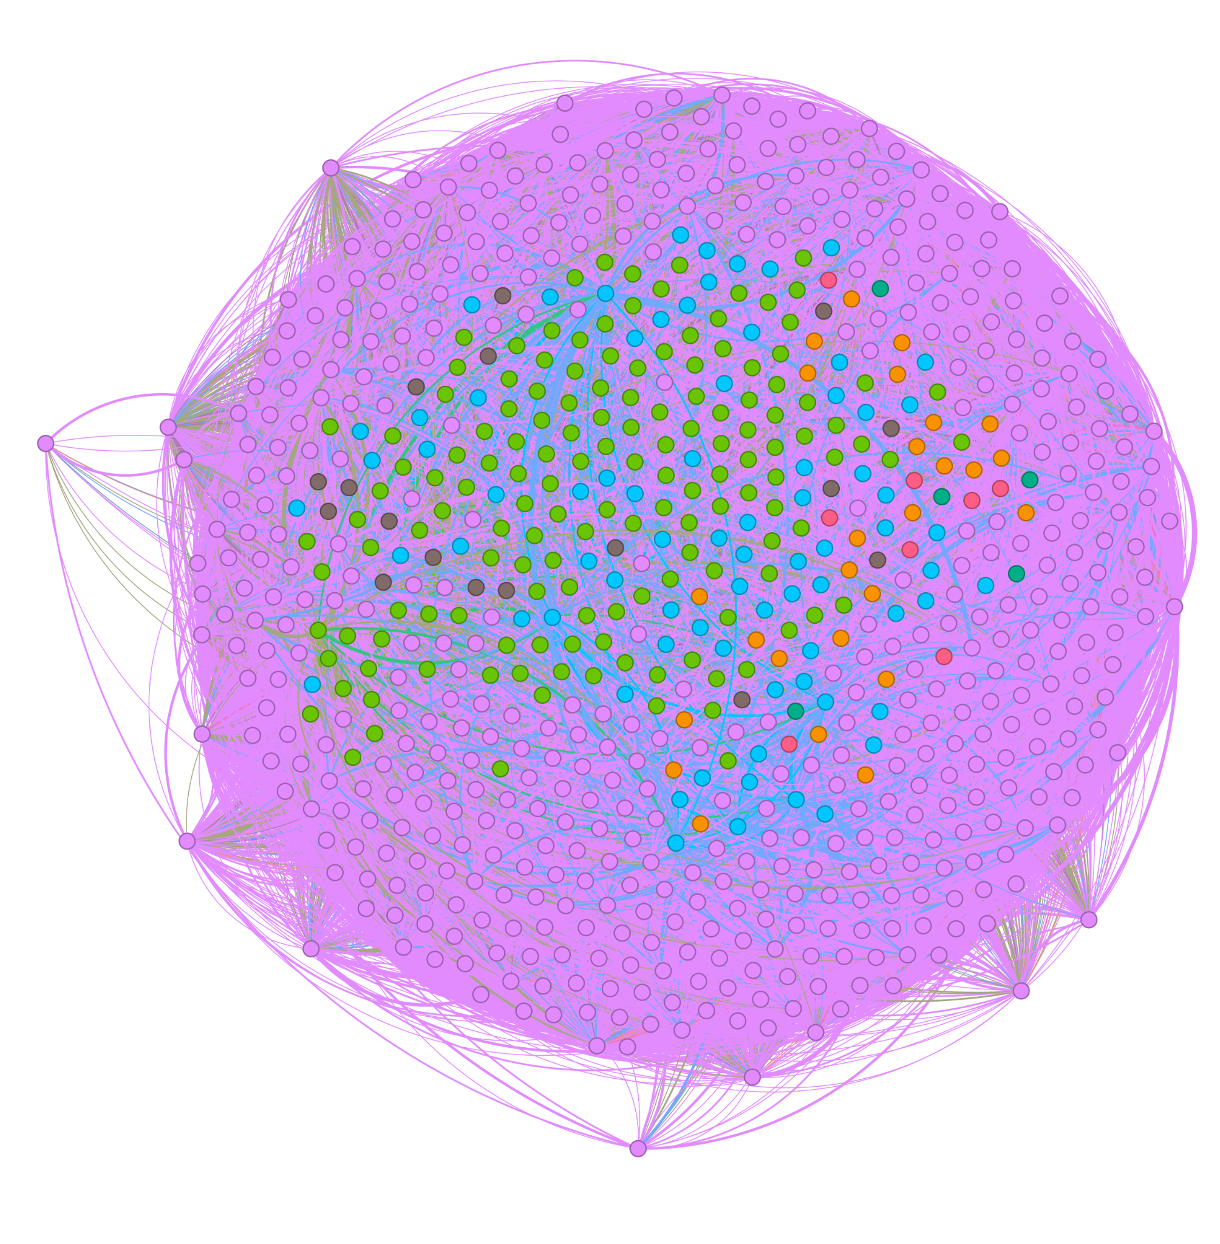
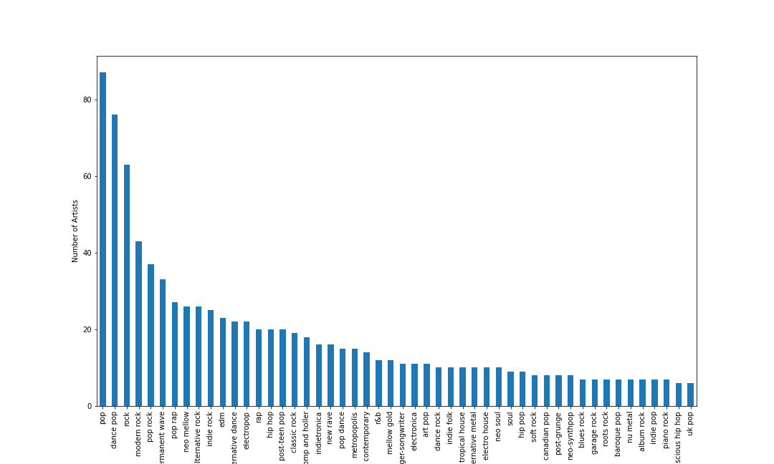
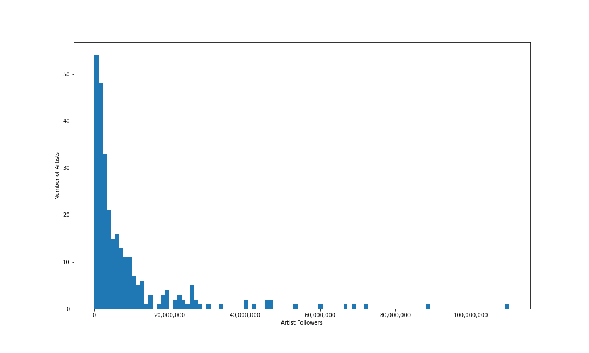
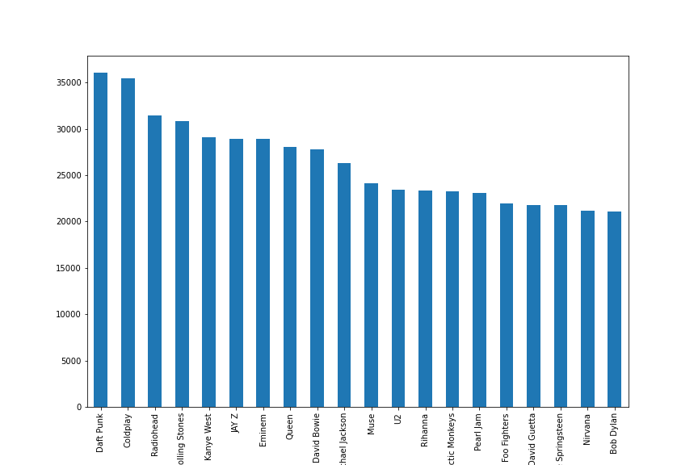
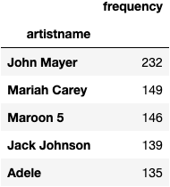
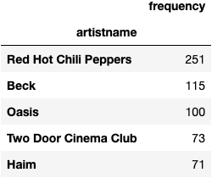
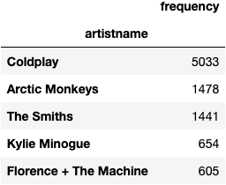
Community Detection of Music Genres
Andrew Mokhtarzadeh | Brandon Tran | Dare Hunt | Junjie Li
Research Question
Can we categorize artists by genres based on the playlists they are in?
Results
When detecting 7 communities, the accuracy for the original genres associated with each artist is 53% and 82% when generalizing the genres (meshing indie-pop and dance-pop as pop)
The Model
Communities from Edge Structure Attributes (CESNA)
This model uses a probability distribution and node attributes to predict the probability of a node belonging to each community before assignment
Typical community detection just considers the graph structure and weights
Our implementation:
Edges exist between two artists added to the same playlist
Edges are weighted by the frequency that artists appear in the same playlist
Node Features:
Artist popularity[0,100], Is top 25% of appearances [0, 1]
Data Collection
The Spotify Dataset is on Kaggle and artist genres were retrieved using Spotify’s API
The Data
Spotify Dataset of 161,530 playlists shared by various users
We sample 2,000 playlists for our network to build in efficient time while producing significant results
The sample includes:
18,139 artists
126,537 songs
623 artists appearing on at least 10 playlists
Number of Artists by Genre
Artists to Follower Count
How the accuracy is computed
We take the top three Genres per community and check if the nodes have any of these three Genres
Example Communities from our Algorithm
Top 20 Artist Appearances
Edges with a weight less than 2 is removed to improve model efficiency
The algorithm involves maximizing the likelihood that a node belongs to a given community through gradient ascent. The Objective function is defined as
l(F) = LG + LX where LG = log P(G|F) and
LX = log P(X|F, W) where G is the underlying Graph, F is the affiliation matrix, X is the attribute matrix, and W are the associated weight vectors of X.

