Slide 1
■ COMMUNITY ENGAGEMENT PROJECT · TYBSCIT 2026–27
■ SIX OBJECTIVES
Tracez
Show what a browser tells any website
Show what an ad blocker changes
Teach the signs of a fake profile and where to report
Read the hidden metadata in your own photos
Explain password managers, one-time codes, passkeys, in adoption order
Offer privacy sessions booked without a password
Social Media Safety & Digital Footprint Awareness. An interactive website on trackers, scams, photo metadata and account security.
■ TEAM & COLLEGE
■ THE PROBLEM
Sayyed Mohammad Mukarram Zafrul Hasan (30)
Ahmed Farooq Gardi (70)
Ebrahim Muhammed Shaikh (35)
Shaikh Rehan Aslam (65)
Guide: Ms. Heena Ansari
A. E. Kalsekar Degree College, Department of IT, University of Mumbai
People give away personal data online without meaning to. Websites read browser details with no permission prompt, ads follow people, phone photos carry hidden GPS. Fake profiles and scams are hard to spot, and many students don't know which report to file.
Tracez | CEP 2026-27 | A. E. Kalsekar Degree College
1
Notes:
We started Tracez as our Community Engagement Project for TYBScIT at A. E. Kalsekar College. Most students know ads follow them, but almost nobody realizes a standard website reads their battery level, time zone, and screen resolution without any permission prompt. We built six interactive tools to demonstrate these exposure points live, guided by Ms. Heena Ansari, focusing on practical digital habits rather than dry legal lectures.

Slide 2
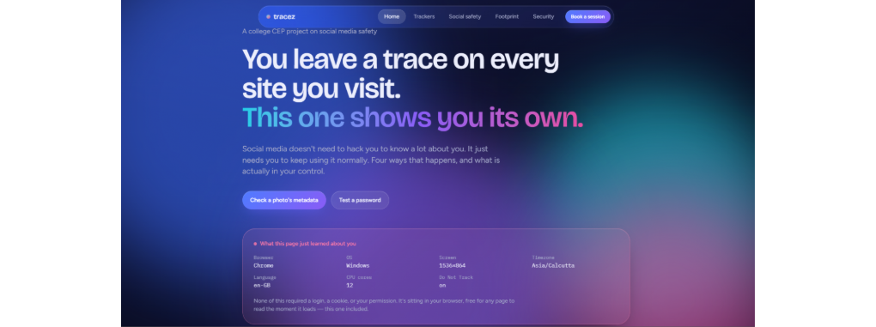
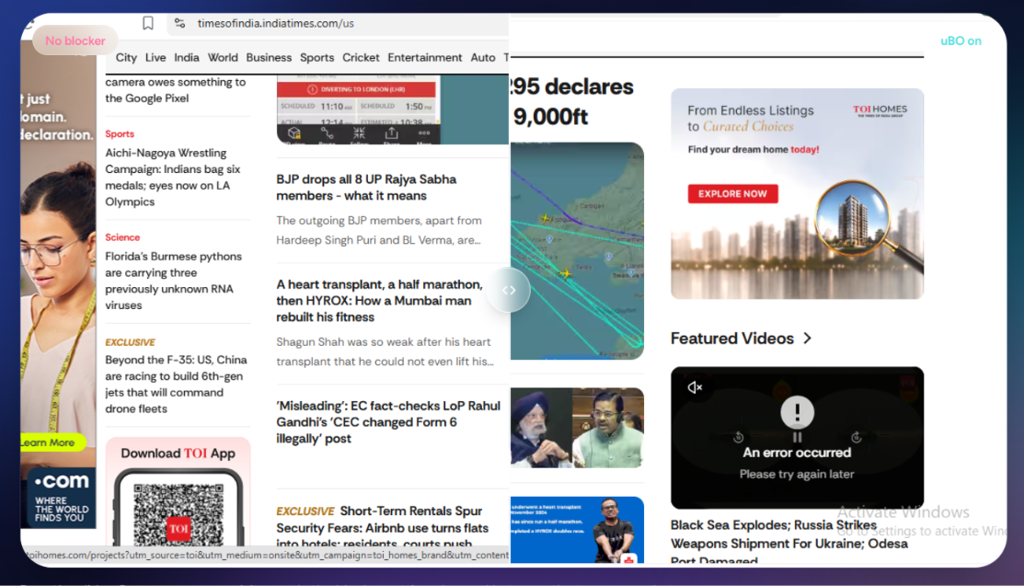
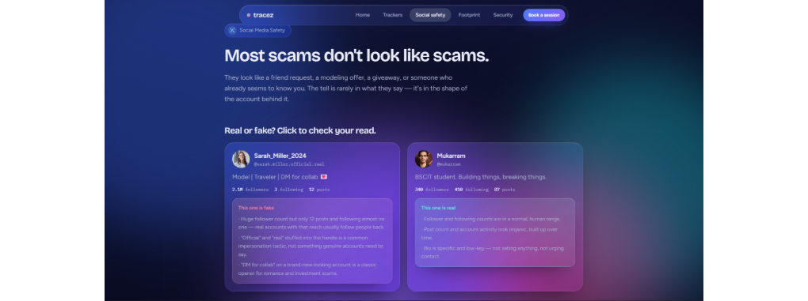
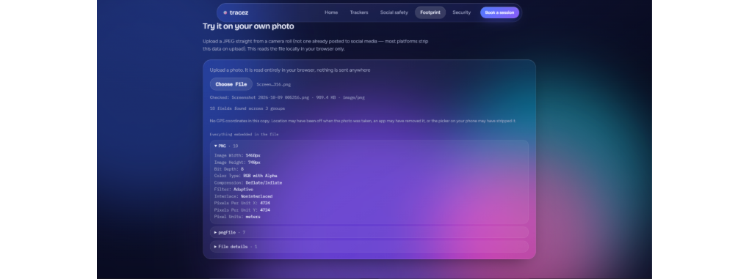
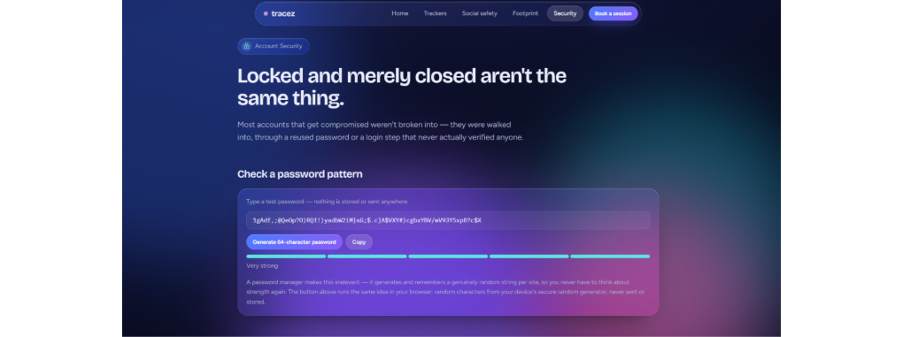
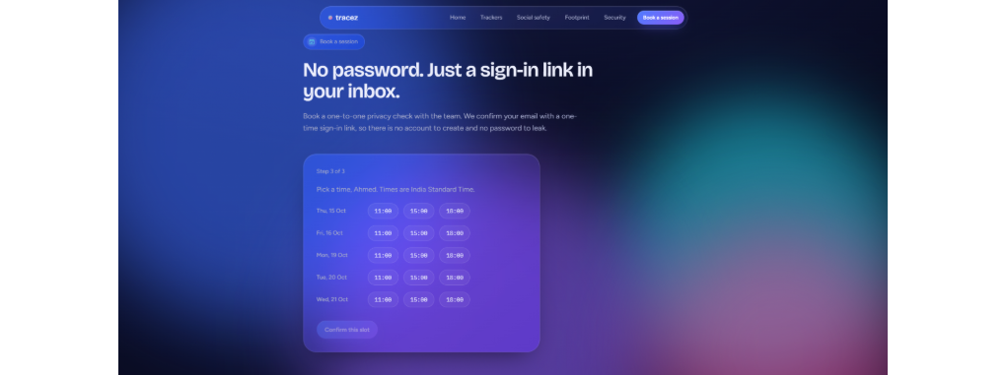
Six pages, one idea: pink marks what is exposed, cyan marks what is protected
Home /
Trackers & Ads /trackers
Social Safety /social-safety
Footprint /footprint
Security /security
Booking /book
Tracez | CEP 2026-27 | A. E. Kalsekar Degree College
2
2
Notes:
We structured the entire interface around a single visual cue: exposed data appears in vibrant pink, while protected states appear in cyan. When a visitor lands on any page, they instantly see their risk level without decoding technical jargon. The trackers tile was designed to showcase an interactive split comparison between an ad-heavy page and a filtered view, which we built as an in-browser slider for local workshops.

Slide 3
What each page does and how it works
Page | Visitor does | How it works
Home | Reads device facts | Browser, OS, screen, time zone; no login
Trackers & Ads | Drags before/after slider | Times of India, ad blocker off and on; 4 blocks became 1
Social Safety | Judges real or fake profile | Reasons and reporting form; IT Act 66C and 66D
Footprint | Picks a photo | Reads Exif, XMP, IPTC; GPS opens on OpenStreetMap
Account Security | Tests and generates passwords | Entropy score 0 to 5; 64-character generator
Book a session | Picks a privacy slot | Emailed sign-in link; Supabase Auth, no stored passwords
Every demo runs in your browser. Only booking sends data: name, email, slot.
Tracez | CEP 2026-27 | A. E. Kalsekar Degree College
3
3
Notes:
We insisted on zero backend data collection for the diagnostic tools. In our news tracker demo, four intrusive blocks became one clean article body when filtering was applied. The footprint tool uses client-side ExifReader to parse raw photo headers directly in memory. A user can verify their camera serial number and exact coordinates without uploading the binary image to our servers.

Slide 4
■ ENGINEERING METHODOLOGY
How we followed the SDLC
■ PLANNING
Four themes, six objectives; students and teachers as audience; work divided among four of us.
■ REQUIREMENT ANALYSIS
Three privacy rules; checked 22 sources; dropped two claims we could not support.
■ DESIGN
Two versions; the live one uses dark panels, pink for exposed, cyan for protected.
■ DEVELOPMENT
React 19, React Router 7, Vite 8, Tailwind CSS 4, ExifReader 4, Supabase.
■ TESTING
Run locally before every push; fixed Supabase error 42501 without widening read access.
■ DEPLOYMENT
Every push to main builds with GitHub Actions and publishes to GitHub Pages.
■ MAINTENANCE
Static facts go stale; planned last-checked dates, Marathi and Hindi versions, feedback form.
Tracez | CEP 2026-27 | A. E. Kalsekar Degree College
4
4
Notes:
We treated the software lifecycle strictly. During requirements gathering, we checked 22 separate technical and legal sources, discarding two unverified tracking claims. In testing, we ran into Supabase error 42501 when configuring row-level security for session booking. Rather than loosening permissions, we tightened the policy so only authenticated service workers write slots, keeping user contact records fully private.

Slide 5
What came out of it
■ FIELD PILOT & FINDINGS
■ HABITS & LIMITS
The live site has six pages: home, four topic pages and booking. Three interactions with 4 students each on 9 October 2026:
In the live demo, most did not know a site reads screen size and time zone without asking. A phone photo showed camera model and GPS; several said they would turn off location tagging. In one booked session, we set up an authenticator app on one email account.
A page reads device facts with no prompt. A photo can reveal where someone lives; the sharing route matters as much as the phone setting. Impersonation, deepfakes and scam ads each need a different report.
Check what a photo carries before sending it. Secure your email first, then add an authenticator app. For a fake account, take screenshots, report through the matching form and file at cybercrime.gov.in.
For the college: a short privacy session in the first week of each year, with the site as demo material.
We showed the features work and students reacted; we have not measured whether people change what they do.
https://btwebrahim.github.io/social-media-safety/
Tracez | CEP 2026-27 | A. E. Kalsekar Degree College · 5
5
Notes:
We held three interactions with five students each on 9 October 2026. We showed the live site and discussed the device facts a page can read without a prompt. We also showed metadata on a student's phone photo, including its camera model and GPS. Several students said they would turn off location tagging. In one booked session, we set up an authenticator app on one email account. We have not measured whether people change their habits.

