Slide 1

Melanoma Classification
Model Using Deep Learning
Introduction
Group ( 108)
By :
Background section
Mohammed Al-Kulaib
Khaled Al-Qahtani
Saad Al-Dossari
Fahad Al-Taher
440007409
440009030
439007523
439006194
Supervised by:
Dr. Mohammed Abu Al-Rub

Slide 2


Introduction
Table Of Content
Problem statement
Method
Implementation
Results
Conclusion and future work

Slide 3
INTRODUCTION
- Skin cancer develops when abnormal skin cells grow out of control, causing the skin to quickly proliferate and develop cancerous tumors.
- The number of new aggressive Melanoma cases significantly increased by 54% between 2008 and 2019 .
- People under 40, particularly women, appear to be at increased risk for Melanoma.
1

Slide 4
INTRODUCTION(cont...)
- It is possible to prevent the spread of skin cancer by being aware of the warning signals of the condition.
- Early detection is key to the successful treatment of Melanoma.
- Most skin lesions become malignant because of a failure to pay attention to skin lesions on their body's surface or a lack of access to skilled dermatologists.
2

Slide 5
Problem Statement
Most skin lesions become malignant as a result of a failure to pay attention to skin lesions on their body's surface or a lack of access to skilled dermatologists.
Researchers have discovered that skin cancer increases the chance of other cancers, thus early detection of skin cancer is critical since it can dramatically reduce death from this dangerous malignancy .
Clinicians frequently misdiagnosed skin lesions
3

Slide 6
Method
Requirement Gathering Techniques Guidelines
Proposed Business Process Guidelines
Functional Requirements Guidelines
Non-functional Requirements Guidelines
User Interfaces Guidelines
System Modelling
Data Modelling
Detailed Interface Design
4

Slide 7
Implementation
!.System Specification
Hardware Specifications
Software Specifications
Hardware | Requirements
Processor | Processor – i3
Hard Disk | 4 GB
RAM | 1GB RAM
Software | Role
Jupyter Notebook | To build model
Windows 10, Linux, Mac OS | Operating System Requirement
Visual Studio 2019 | To build a desktop application
5

Slide 8
Implementation (cont…)
!!.System Testing
A table describing all test cases, their objectives, inputs, anticipated results, pass/fail criteria, and test outcomes for each test individually are provided together with a description of the system aspects that have been assessed.
6

Slide 9
Implementation/!!.System Testing(cont…)
Project Name: Melanoma Classification
Test Case [1]
Test Case | Database
Test Priority (Low/Medium/High): | High
Poupous of test case | Make that the database is connected properly.
Entering the wrong database into the system | Fail
Entering the correct database into the system | Pass
Input | Melanoma Database File
Expect output | The system started to work.
Test result | The system will start, and it will detect melanoma from the image entered
Pre-conditions: Verify the system's database is present.
Project Name: Melanoma Classification
Test Case [2]
Test Case | Accuracy Score
Poupous of test case | Make sure the melanoma database system is accurate.
Input | Database
Expect output | percentage accuracy Score
Test result | Accuracy score: 0.94
Pre-conditions: Knowledge of Accuracy Score
7

Slide 10
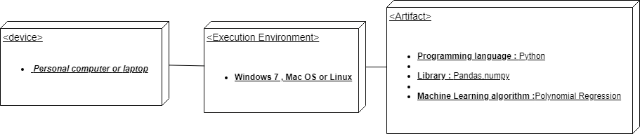
Implementation (cont…)
!!!.System Deployment
entails providing the capability to the ultimate user and assigning responsibility for support and maintenance to the post-deployment support organization (or organizations).
Deployment Diagram:
8

Slide 11
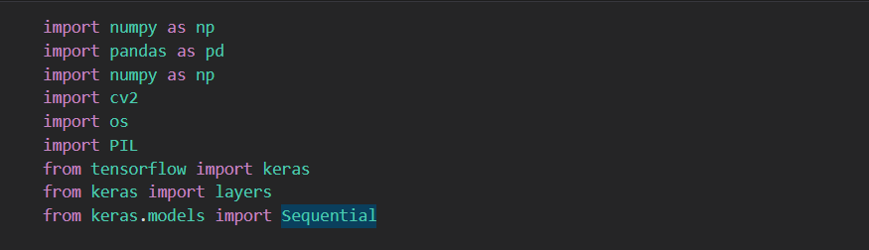
Results
Database
9

Slide 12
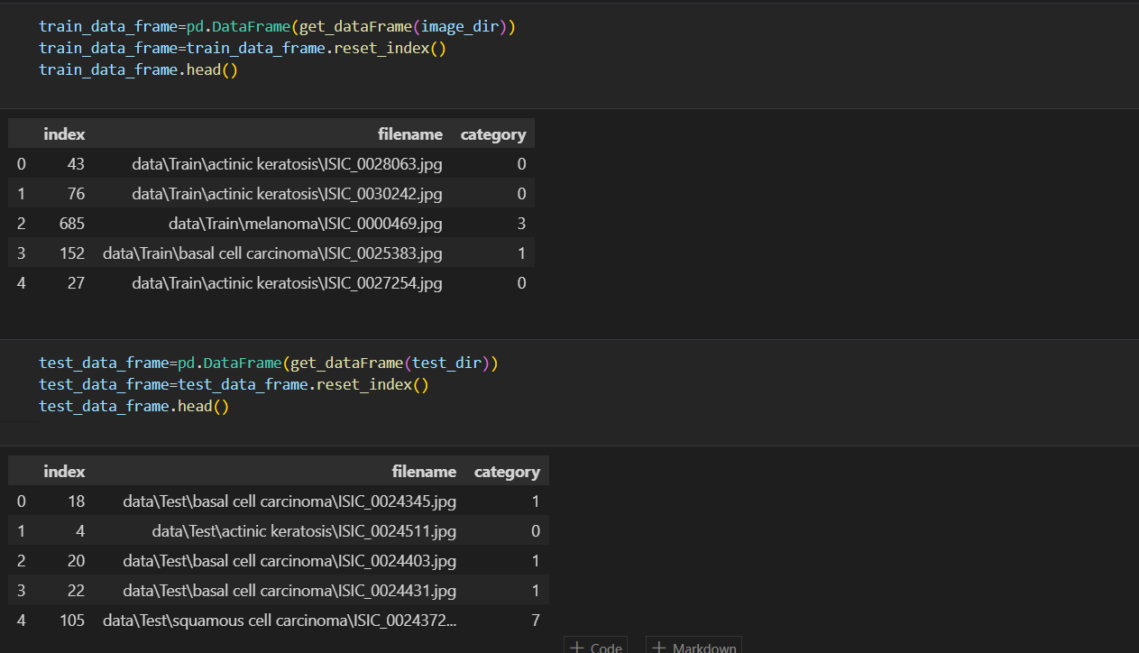
Results (cont…)
Output
10

Slide 13
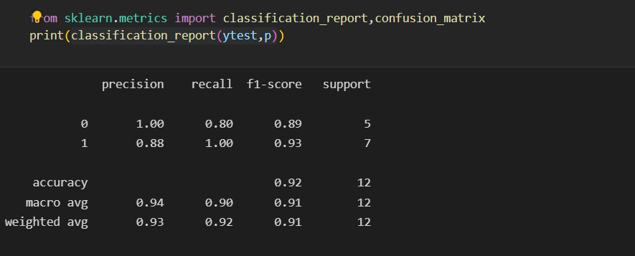
Results (cont…)
Accuracye
11

Slide 14
Conclusion and Future Work
Conclusion:
The failure to detect melanoma early at the time resulted in significant harm and the loss of human lives. Because it was challenging to address all of these issues, we created an artificial intelligence system for melanoma early detection. The following outcomes were attained: a Python-based artificial intelligence system with a model based on melanoma detection.
12

Slide 15
Conclusion and Future Work(cont…)
Future Work:
The system's potential has not been fully realized. There is constant room for development. There can be additional approaches to implementing the system. To make the system as engaging as feasible, I did my best. Because of the system's adaptable nature, changes may be made quickly and easily. There are various issues with the existing system that will probably be resolved in the future: Make a prototype of the system to see it. Developing an idea for a system and connecting it to a bigger database.
13

Slide 16


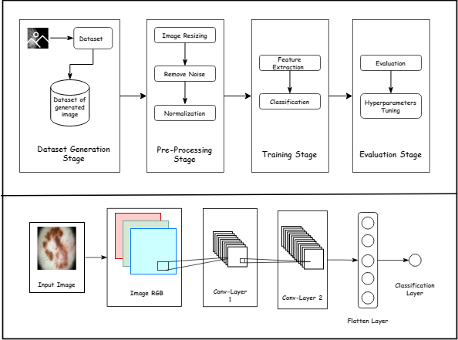
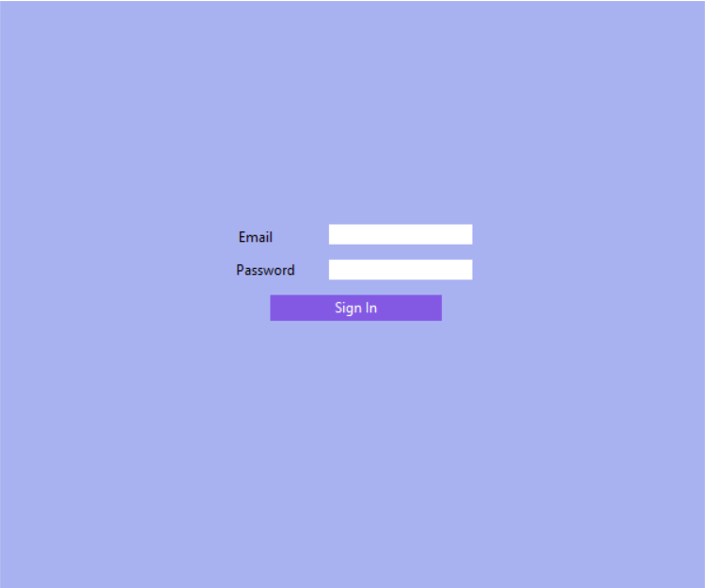
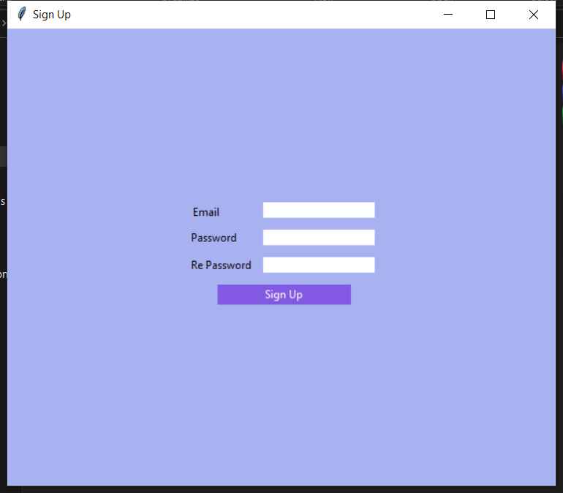
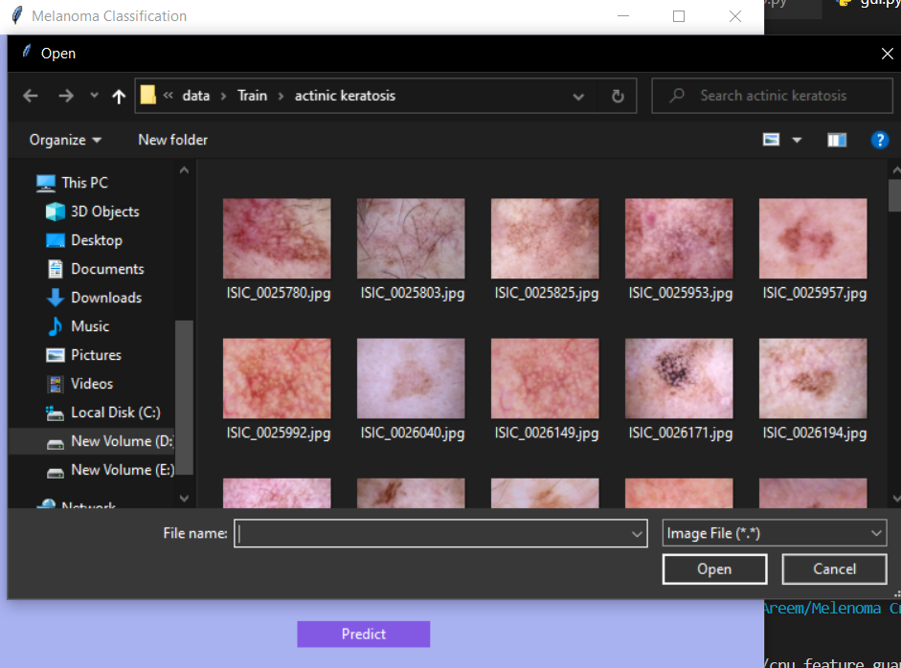
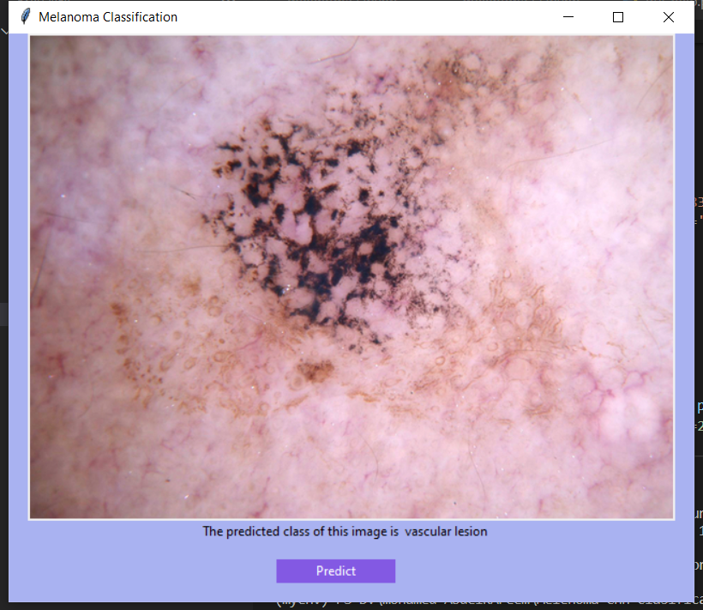
Melanoma Classification Model Using Machine Learning
Al Imam Mohammad ibn Saud Islamic University
College of Sharia and Islamic Studies in Al-Ahsa
Computer and Information Science Department
By: Mohammed Al-Klulaib, Khaled Al-Qahtani, Saad Al-Dossari, Fahad Al-Taher
Supervised by: Dr. Mohammed Abu Al-Rub
Skin cancer develops when
abnormal skin cells grow out of control, causing the skin to quickly proliferate and develop cancerous tumors. The number of new aggressive Melanoma cases significantly increased by 54% between 2008 and 2019 . People under 40, particularly women, appear to be at increased risk for Melanoma. It is possible to prevent the spread of skin cancer by being aware of the warning signals of the condition. Early detection is key to the successful treatment of Melanoma. Most skin lesions become malignant because of a failure to pay attention to skin lesions on their body's surface or a lack of access to skilled dermatologists.
clinicians frequently misdiagnosed skin lesions
Researchers have discovered that skin cancer increases the chance of other cancers, thus early detection of skin cancer is critical since it can dramatically reduce death from this dangerous malignancy .
Introduction
Aims and Objectives
In this project, we aim to build a model using machine learning with a classification model for classifying the images as Melanoma or not by CNN.
Objectives:
To reduce the ill effects and different artifacts such as hair that may be present in thermoscopic images.
To determine the location of a lesion using the image segmentation technique.
To choose the most accurate model.
Automated melanoma detection in dermo copy images is a very difficult task. To address these difficulties, based on what has been provided before from systems similar to ours, there are a few aspects that need to be enhanced to achieve a perfect system. To acquire the best accuracy, use a variety of classification algorithms and adjust the hyperparameters of each kind. Second, the solution should be applied to an appropriate dataset, not only to thermoscopic images.
Method
Reference
[1]Pillay, Pillay V., Hirasen, D., Viriri, S., & Gwetu, M. (2020). Melanoma Skin Cancer Classification Using Transfer Learning. Advances in Computational Collective Intelligence, 287–297 https://doi.org/10.1007/978-3-030-63119-2_24.
[2]Melanoma - Symptoms and causes. (2022, June 18). Mayo Clinic. Retrieved September 12, 2022, from https://www.mayoclinic.org/diseases-conditions/Melanoma/symptoms-causes/syc-20374884#:%7E:text=Melanoma%2C%20the%20most%20serious%20type,in%20your%20nose%20or%20throat.
[3]Society AC. Cancer Facts and Figures 2020. Atlanta: American Cancer Society; 2020; available from:https://www.aimatMelanoma.org/about-Melanoma/Melanoma-stats-facts .
Conclusion
Results
Problem Statement

Slide 17

Thanks Any Question?

