Slide 1
Data Preprocessing
王宗尧
E-mail: wzy@dlmu.edu.cn

Slide 2
Why Data Preprocessing?
Real data are notoriously dirty!
The biggest challenge in many data mining projects
Incomplete
Occupancy = “ ”
Noisy
Salary = “-100”
Inconsistent
Age = “42” vs. Birthday = “01/09/1985”
Redundant
Too much data or too many features for analytical analysis
Others
Data types
Imbalanced datasets

Slide 3

Missing Data
Data are not always available.
One or more attributes of a sample may have empty values.
Many data mining algorithms cannot handle missing values directly.
May cause significant troubles.
Possible Reasons
Equipment malfunction
Data not provided
Not Applicable (N/A)
Different Types
Missing completely at random
Missing conditionally at random
Not missing at random

Slide 4

How to handle missing data?
Ignore
Remove samples/attributes with missing values
The easiest and most straightforward way
Work well with low missing rates
Fill in the missing values manually
Recollect the data
Domain knowledge
Tedious/Infeasible
Fill in the missing values automatically
A global constant
The mean or median
Most probable values
More art than science

Slide 5
缺失数据插值
请看实例0

Slide 6
Sampling
A database/data warehouse may store terabytes of data.
Processing limits: CPU, Memory, I/O …
Sampling is applied to reduce the time complexity.
In statistics, sampling is applied often because obtaining the entire set of data is expensive.
Aggregation
Change of scale:
Cities → States; Days → Months
More stable and less variability
Sampling can be also used to adjust the class distributions.
Imbalanced dataset

Slide 7
Outliers离群点
Outliers
y
y = x + 1
x

Slide 8
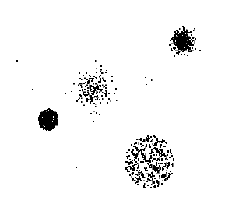
Outliers
Outliers

Slide 9



Local Outlier Factor 局部异常因子
$${distance}_{k}\left(O\right)$$
k=3
(A)
p₂
A
p₁
$${distance}_{k}\left(A,B\right)=max\left\{{distance}_{k}\left(B\right),d\left(A,B\right)\right\}$$
p₃
p₄
$$lrd\left(A\right)=1/{\left(\frac{\sum_{B∈N_{k}\left(A\right)}{{distance}_{k}\left(A,B\right)}}{\left|N_{k}\left(A\right)\right|}\right)}$$
local reachability density：局部可达密度
$${LOF}_{k}\left(A\right)=\frac{\sum_{B∈N_{k}\left(A\right)}{\frac{lrd\left(B\right)}{lrd\left(A\right)}}}{\left|N_{k}\left(A\right)\right|}={\frac{\sum_{B∈N_{k}\left(A\right)}{lrd\left(B\right)}}{\left|N_{k}\left(A\right)\right|}}/{lrd\left(A\right)}$$
local locallocal outlier：局部离群因子

Slide 10
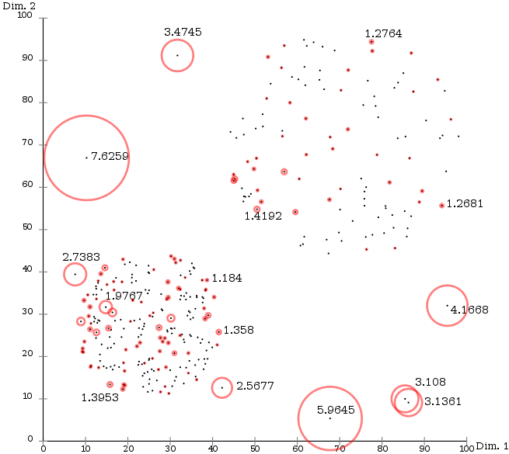
Local Outlier Factor

Slide 11
离群点检测
请看实例1

Slide 12
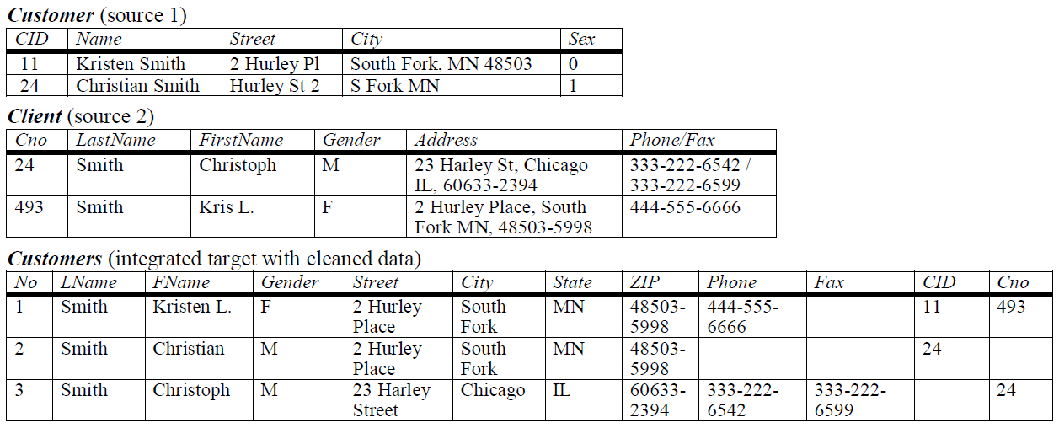
Duplicate Data

Slide 13
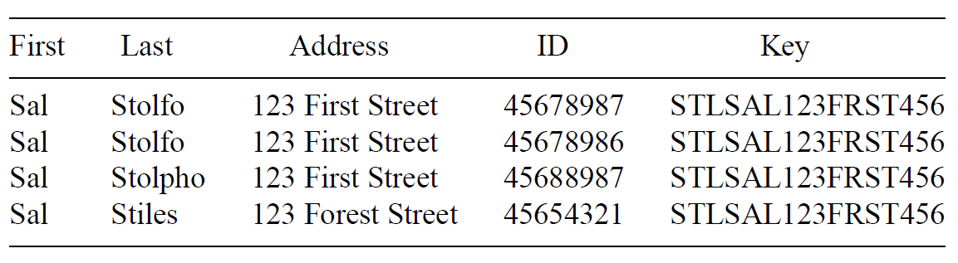
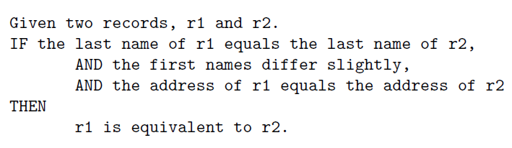
Duplicate Data
Create Keys
Sort
Merge

Slide 14
Pandas数据库操作
请看实例2

Slide 15
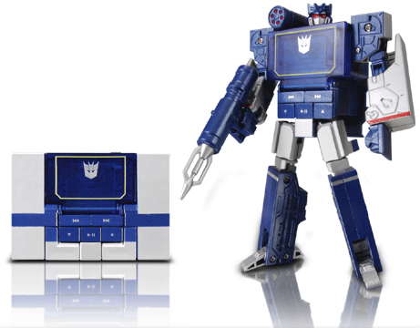
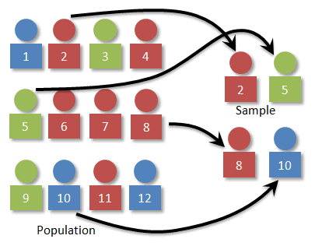
Data Transformation
Now we have an error free dataset.
Still needs to be standardized.
Type Conversion
Normalization
Sampling

Slide 16
Attribute Types
Continuous
Real values: Temperature, Height, Weight …
Discrete
Integer values: Number of people …
Ordinal
Rankings: {Average, Good, Best}, {Low, Medium, High} …
Nominal
Symbols: {Teacher, Worker, Salesman}, {Red, Green, Blue} …
String
Text: “Tsinghua University”, “No. 123, Pingan Avenue” …

Slide 17
在机器学习算法中，我们经常会遇到分类特征，例如：人的性别有男女，国籍有中国，美国，法国等。这些特征值并不是连续的，而是离散的，无序的。通常我们需要对其进行特征数字化。
例子如下：
性别特征：["男"，"女"]
祖国特征：["中国"，"美国，"法国"]
运动特征：["足球"，"篮球"，"羽毛球"，"乒乓球"]
假如某个样本，他的特征是这样的["男","中国","乒乓球"]，我们可以用 [0,0,4] 来表示，
但是这样的特征处理并不能直接放入机器学习算法中。因为类别之间是无序的（运动数据就是任意排序的）。
这时需要采用One-Hot编码

Slide 18
One-Hot编码
性别特征：["男","女"]，按照N位状态寄存器来对N个状态进行编码，处理后应该是这样的：
男 => 10
女 => 01
国籍特征：["中国"，"美国，"英国"]
中国 => 100
美国 => 010
法国 => 001
运动特征：["足球"，"篮球"，"羽毛球"，"乒乓球"]：
足球 => 1000
篮球 => 0100
羽毛球 => 0010
乒乓球 => 0001
所以，当一个样本为["男","中国","乒乓球"]的时候，完整的特征数字化的结果为：
[1，0，1，0，0，0，0，0，1]

Slide 19
Type Conversion
from sklearn import preprocessing
enc = preprocessing.OneHotEncoder()
enc.fit([[0,0,3],[1,1,0],[0,2,1],[1,0,2]]) #这里一共有4个数据，3种特征
array = enc.transform([[0,1,3]]).toarray() #这里使用一个新的数据来测试
print array # [[ 1 0 0 1 0 0 0 0 1]]

Slide 20
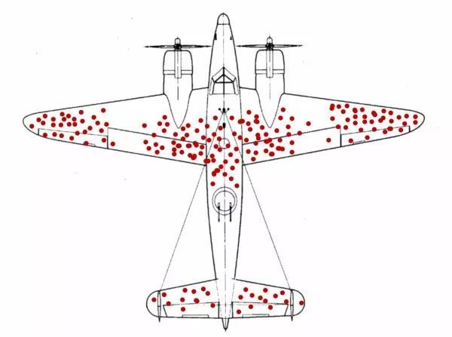
幸存者偏差

Slide 21
Imbalanced Datasets
LHS RHS
10%
5%
85%
Classifier A
Classifier B

Slide 22
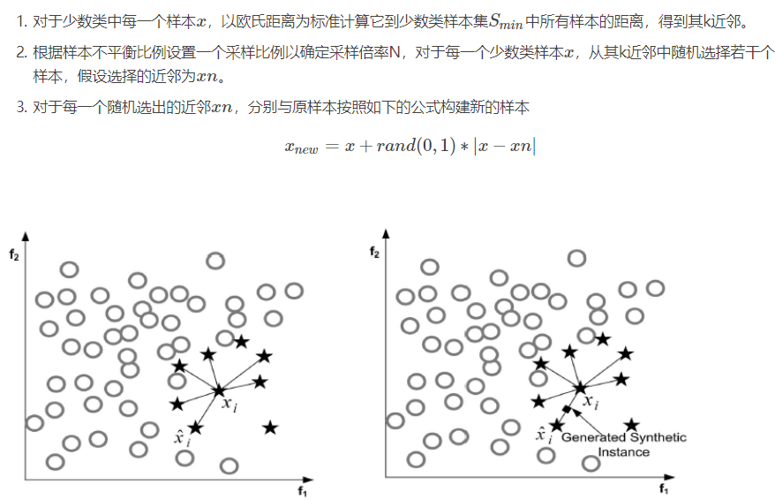
SMOTE

Slide 23
请看实例3

Slide 24


Normalization
The height of someone can be 1.7 or 170 or 1700 …
Min-max normalization:
Let income range $12,000 to $98,000 be normalized to [0.0, 1.0]. Then $73,600 is mapped to
Z-score normalization (μ: mean, σ: standard deviation):
Let μ = 54,000, σ = 16,000. Then
$$v^{′}=\frac{v−min}{max−min} \left(new_max−new_min\right)+new_min$$
$$v^{′}=\frac{v−μ}{σ}$$

Slide 25
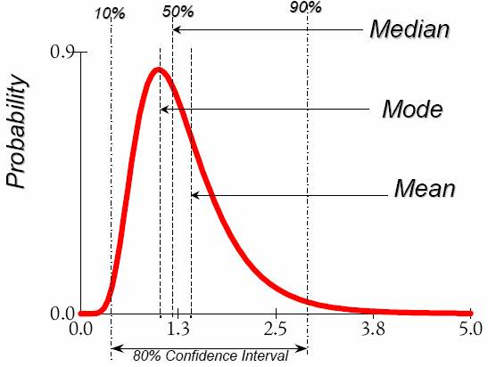




Data Description
Mean
Arithmetic mean
Median
Mode
The most frequently occurring value in a list
Can be used with non-numerical data.
Variance
Degree of diversity
$$\overline{x}=\frac{1}{n}\sum_{i=1}^{n}{x_{i}}=\frac{1}{n}\left(x_{1}+…+x_{n}\right)$$
$$P\left(X≤m\right)=P\left(X≥m\right)=\int_{−∞}^{m}{f\left(x\right)dx=}\frac{1}{2}$$
$$Var\left(X\right)=\int{{\left(x−μ\right)}^{2}f\left(x\right)dx}$$
$$Var\left(X\right)=E\left[{\left(X−μ\right)}^{2}\right]$$

Slide 26
请看实例4

Slide 27
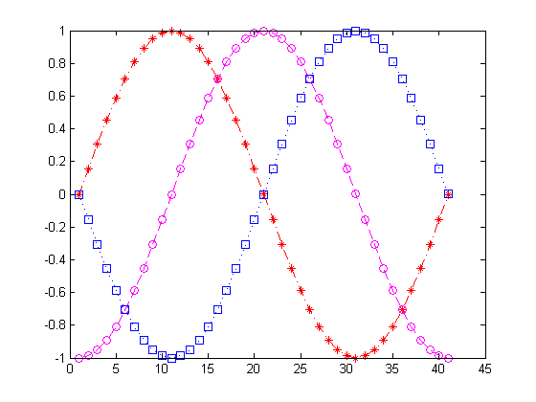
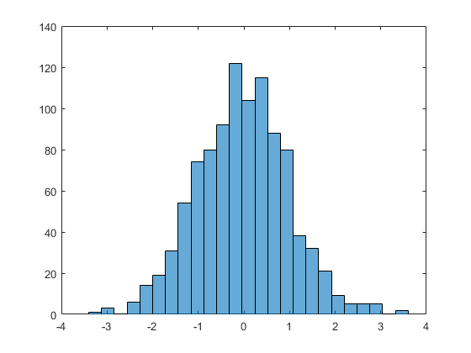
Data Visualization (1D)

Slide 28
Data Visualization (2D)
Notes:
load carsmall
plot(Displacement, Acceleration,'ro')
regress(Acceleration,[ones(100,1),Displacement])
hold on
line([0,19.35/0.021],[19.35,0])

Slide 29
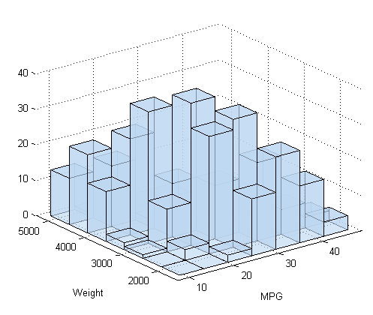
Surf Plots (3D)
Notes:
[X,Y]=meshgrid(-3:0.1:3,-3:0.1:3);
Z=peaks(X,Y);
surfc(X,Y,Z);
shading interp
colormap(gray);

Slide 30
Box Plots (High Dimensional)
Notes:
S=diag([1,2,0.5,1])
M=[0,1,3,-1];
Z=mvnrnd(M,S,10000);
boxplot(Z);

Slide 31
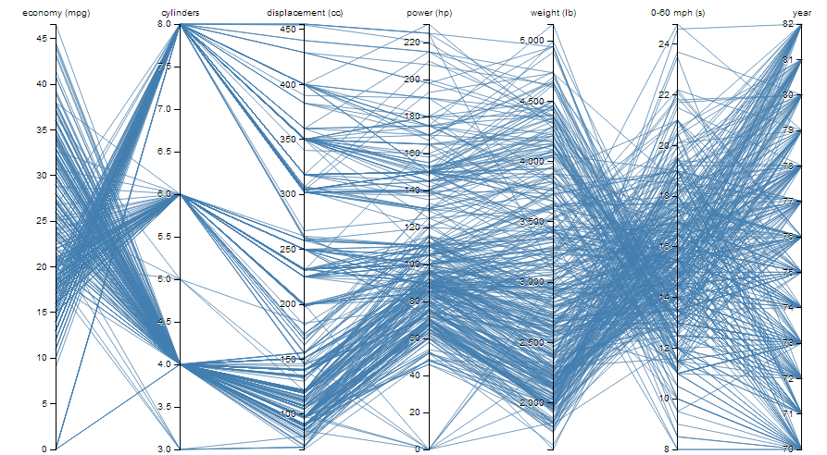
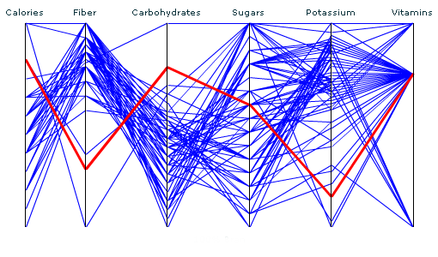
Parallel Coordinates (High Dimensional)

Slide 32
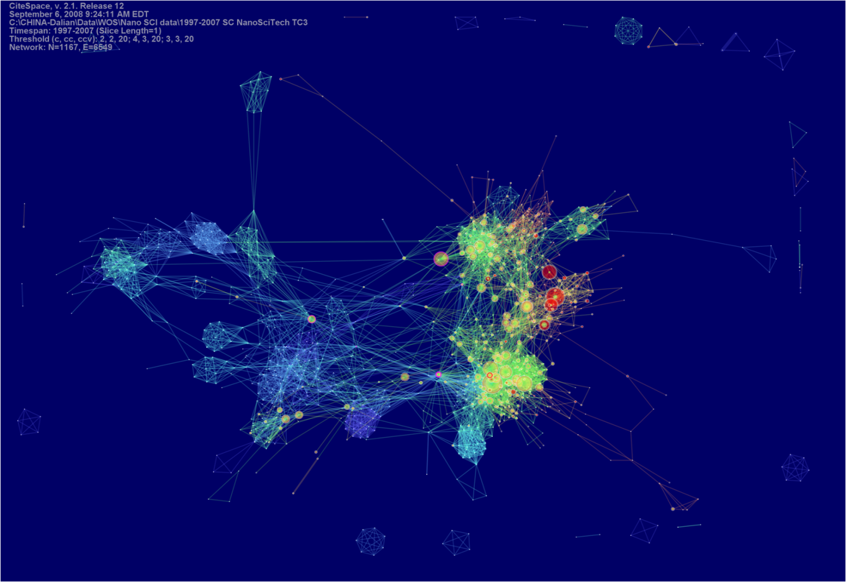
CiteSpace

Slide 33
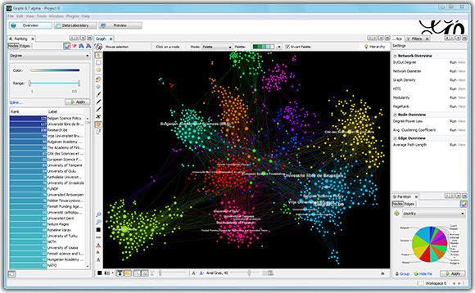
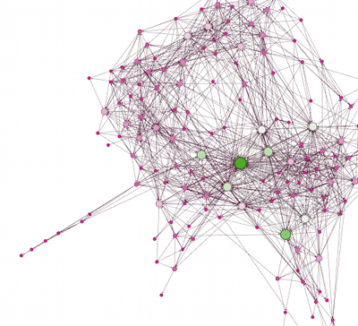
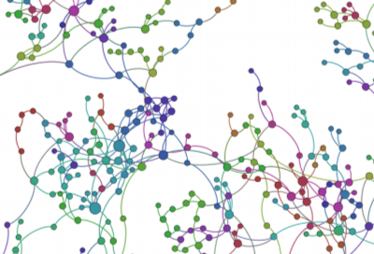
Gephi

