Slide 1
Association Rule
Lecturer: Dr. Wang Zongyao
E-mail: wzy@dlmu.edu.cn

Slide 2
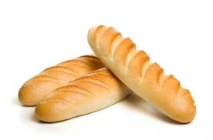

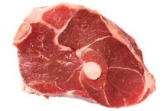
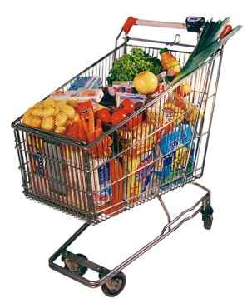


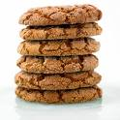

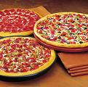

Overview
关联规则（Association Rules）是反映一个事物与其他事物之间的相互依存性和关联性，如果两个或多个事物之间存在一定的关联关系，那么，其中一个事物就能通过其他事物预测到。关联规则是数据挖掘的一个重要技术，用于从大量数据中挖掘出有价值的数据项之间的相关关系。

Slide 3
关联规则挖掘的最经典的例子就是沃尔玛的啤酒与尿布的故事，通过对超市购物篮数据进行分析，即顾客放入购物篮中不同商品之间的关系来分析顾客的购物习惯，
美国妇女们经常会叮嘱丈夫下班后为孩子买尿布，30%-40%的丈夫同时会顺便购买喜爱的啤酒，超市就把尿布和啤酒放在一起销售增加销售额。有了这个发现后，超市调整了货架的设置，把尿布和啤酒摆放在一起销售，从而大大增加了销售额。

Slide 4
Definitions
A transaction is a set of items: T={i_{a}, i_{b},…,i_{t}}
T is a subset of I where I is the set of all possible items.
The dataset D contains a set of transactions.
An association rule is in the form of
A set of items is referred to as itemset.
An itemset containing k items is called k-itemset.
An itemset can be seen as a conjunction of items.

Slide 5
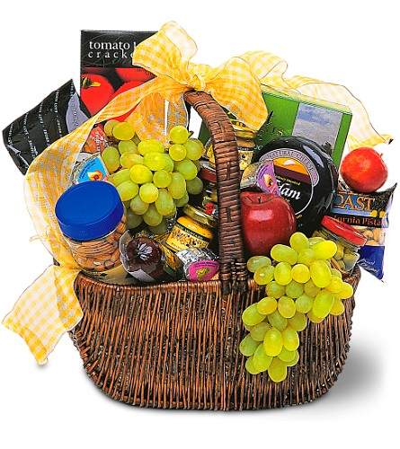
Transactions
Transactions | Items
1 | Bread, Jelly, Peanut, Butter
2 | Bread, Butter
3 | Bread, Jelly
4 | Bread, Milk, Butter
5 | Chips, Milk
6 | Bread, Chips
7 | Bread, Milk
8 | Chips, Jelly
Searching for rules in the form of: Bread → Butter

Slide 6
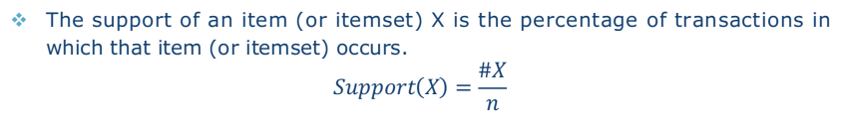
Support of an Itemset
The support of an item (or itemset) X is the percentage of transactions in which that item (or itemset) occurs.
$$Support\left(X\right)=\frac{\#X}{n}$$
Transactions | Items
1 | Bread, Jelly, Peanut, Butter
2 | Bread, Butter
3 | Bread, Jelly
4 | Bread, Milk, Butter
5 | Chips, Milk
6 | Bread, Chips
7 | Bread, Milk
8 | Chips, Jelly
Itemset | Support | Itemset | Support
Bread | 6/8 | Bread, Butter | 3/8
Butter | 3/8 | Bread, Butter, Chips | 0/8
Chips | 2/8 | Bread, Butter, Chips, Jelly | 0/8
Jelly | 3/8 | Bread, Butter, Chips, Jelly, Milk | 0/8
Milk | 3/8 | Bread, Butter, Chips, Jelly, Milk, Peanut | 0/8
Peanut | 1/8 | …

Slide 7
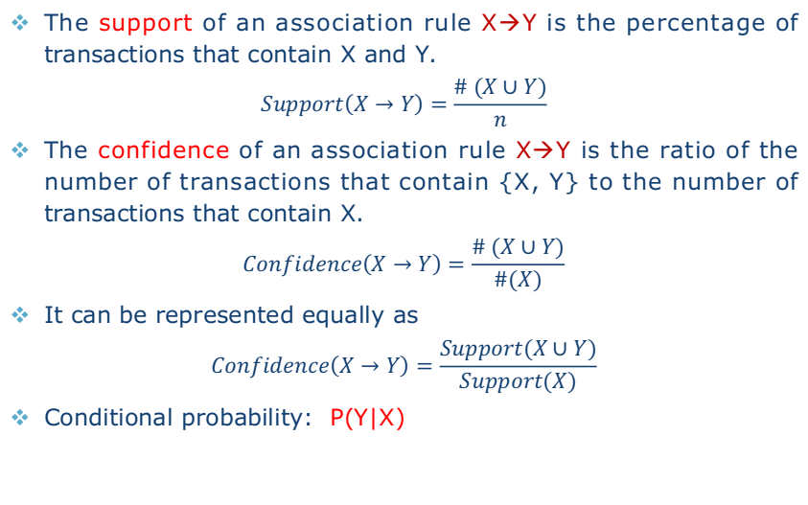
Support & Confidence of Association Rule
The support of an association rule X→Y is the percentage of transactions that contain X and Y.
$$Support\left(X→Y\right)=\frac{\# (X∪Y)}{n}$$
The confidence of an association rule X→Y is the ratio of the number of transactions that contain {X, Y} to the number of transactions that contain X.
$$Confidence\left(X→Y\right)=\frac{\# (X∪Y)}{\#(X)}$$
It can be represented equally as
$$Confidence\left(X→Y\right)=\frac{Support(X∪Y)}{Support(X)}$$
Conditional probability: P(Y|X)

Slide 8
Support & Confidence of Association Rule
Support measures how often the rule occurs in the dataset.
Confidence measures the strength of the rule.
Transactions | Items
1 | Bread, Jelly, Peanut, Butter
2 | Bread, Butter
3 | Bread, Jelly
4 | Bread, Milk, Butter
5 | Chips, Milk
6 | Bread, Chips
7 | Bread, Milk
8 | Chips, Jelly
Bread → Milk
Support: 2/8
Confidence: 1/3
Milk → Bread
Support: 2/8
Confidence: 2/3

Slide 9
Support and Confidence are bounded by thresholds:
Minimum support σ
Minimum confidence Φ
A frequent (large) itemset is an itemset with support larger than σ.
A strong rule is a rule that is frequent and its confidence is higher than Φ.
Association Rule Problem
Given I, D, σ and Φ, to find all strong rules in the form of X→Y.
The number of all possible association rules is huge.
Brute force strategy is infeasible.
A smart way is to find frequent itemsets first.

Slide 10
The Big Picture
Step 1: Find all frequent itemsets.
Step 2: Use frequent itemsets to generate association rules.
For each frequent itemset f
Create all non-empty subsets of f.
For each non-empty subset s of f
Output s → (f-s) if support (f) / support (s) > Φ
a b → c
a c → b
b c → a
{a, b, c}
The key is to find frequent itemsets.
a → b c
b → a c
c → a b

Slide 11
Itemset Generation
Ø
A
B
C
D
AB
AC
AD
BC
BD
CD
ABC
ABD
ACD
BCD
ABCD

Slide 12
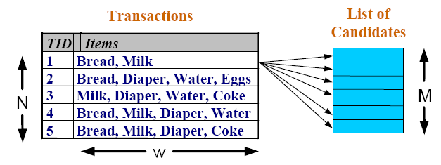

Itemset Calculation

Slide 13
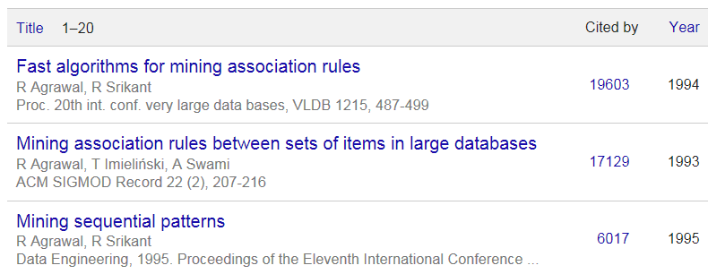
The Apriori Method
One of the best known algorithms in Data Mining
Key ideas
A subset of a frequent itemset must be frequent.
{Milk, Bread, Coke} is frequent → {Milk, Coke} is frequent
The supersets of any infrequent itemset cannot be frequent.
{Battery} is infrequent → {Milk, Battery} is infrequent

Slide 14
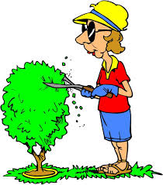
Candidate Pruning
Ø
A
B
C
D
AB
AC
AD
BC
BD
CD
ABC
ABD
ACD
BCD
ABCD

Slide 15
General Procedure
Generate itemsets of a particular size.
Scan the database once to see which of them are frequent.
Use frequent itemsets to generate candidate itemsets of size=size+1.
Iteratively find frequent itemsets with cardinality from 1 to k.
Avoid generating candidates that are known to be infrequent.
Require multiple scans of the database.
Efficient indexing techniques such as Hash function & Bitmap may help.

Slide 16
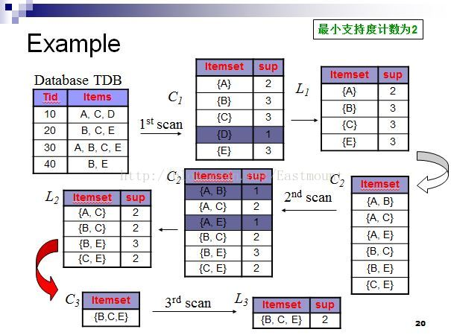

Slide 17
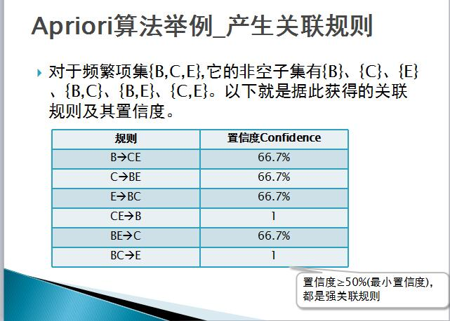
请看example1

Slide 18
Recommendation Algorithms
Lecturer: Dr. Wang Zongyao
E-mail: wzy@dlmu.edu.cn

Slide 19
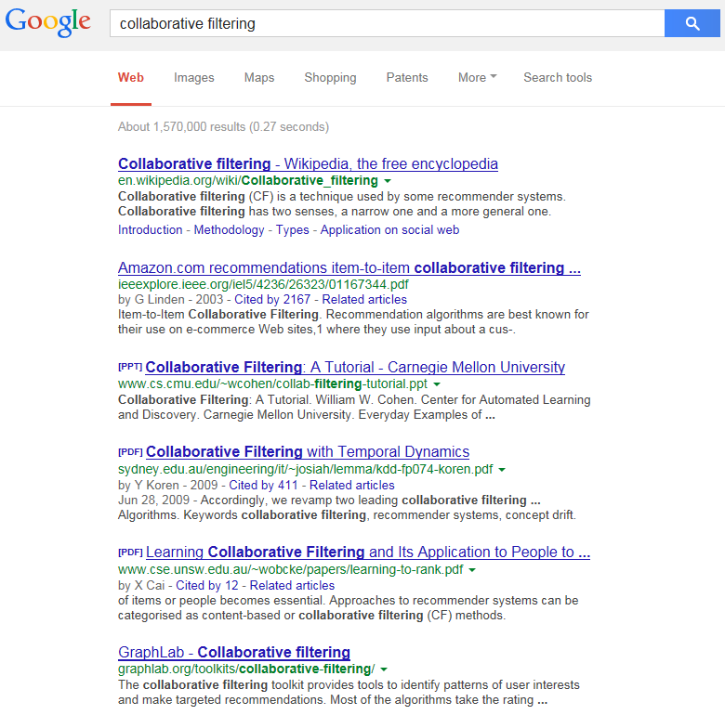
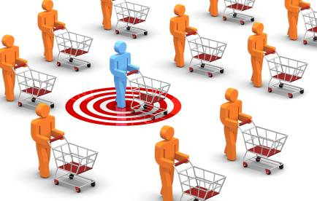
Overview
TF-IDF
Vector Space Model
Latent Semantic Analysis
PageRank
Collaborative Filtering
more relevant
less relevant

Slide 20



Recommendation Systems
A system that predicts a user’s rating or preference to an item.
Help people discover interesting or informative stuff that they wouldn't have thought to search for.
One of the most influential applications of data mining.
Content-Based Filtering
Focuses on the characteristics of items.
Recommends items similar to those that a user liked in the past.
Collaborative Filtering
Predicts what users will like based on their similarity to other users.
Similar to asking the opinions of friends.
Does not rely on machine analysable contents.

Slide 21
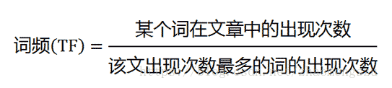
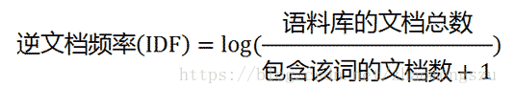
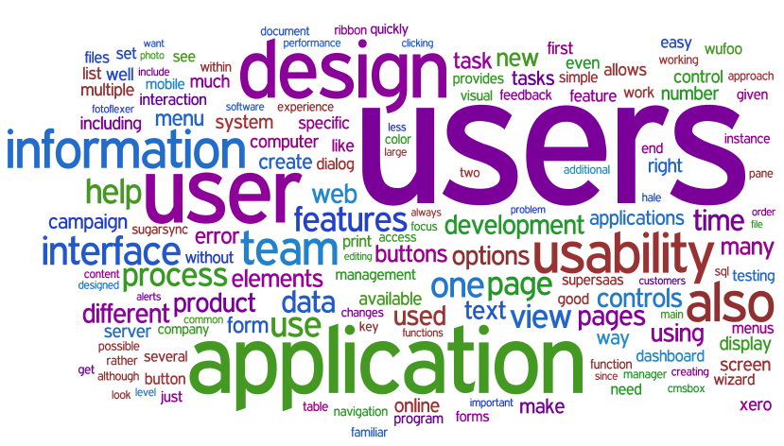

Tf-idf
Given a collection of documents and a query word, how relevant is a document to the word?
Some words appear more frequently than others.
Term Frequency (TF)
Raw frequency
$tf\left(t,d\right)=\frac{n_{t,d}}{\sum_{k}{n_{k,d}}}$
Inverse Document Frequency (IDF)
$idf(t, D)=\log{\frac{|D|}{|\{d∈D:t∈d\}|}}$
Tf-idf
tf-idf (t, d, D) = tf(t, d)×idf(t, D)

Slide 22

Tf-idf
Multiple query words
$$Score\left(q,d\right)=\sum_{t∈q}{tf−idf(t,d,D)}$$
 | Doc 1 | Doc 2 | Doc 3 | Doc 4
the | 20 | 10 | 15 | 8
best | 0 | 1 | 0 | 2
car | 3 | 5 | 0 | 0
Term-Document Matrix
请看example2

Slide 23
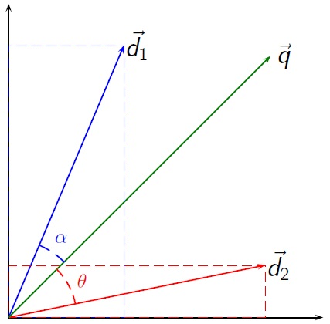
Vector Space Model
An algebraic model for representing text documents as vectors.
Cosine Similarity
请看example3

Slide 24
Latent Semantic Analysis
m是单词数量，n是文章数量

Slide 25
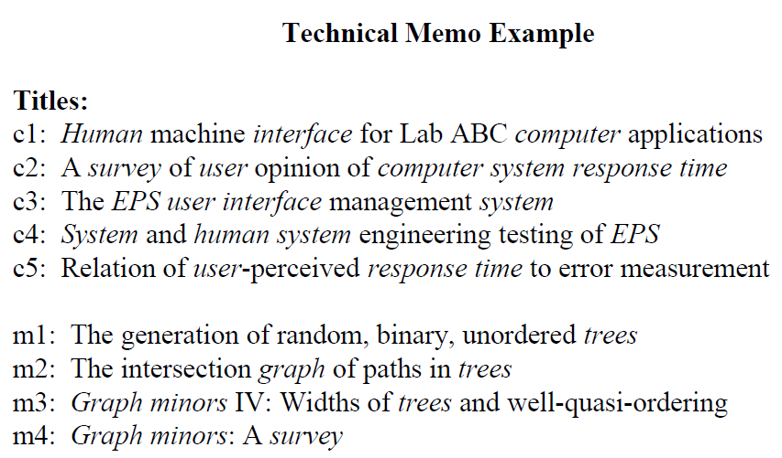
Latent Semantic Analysis

Slide 26
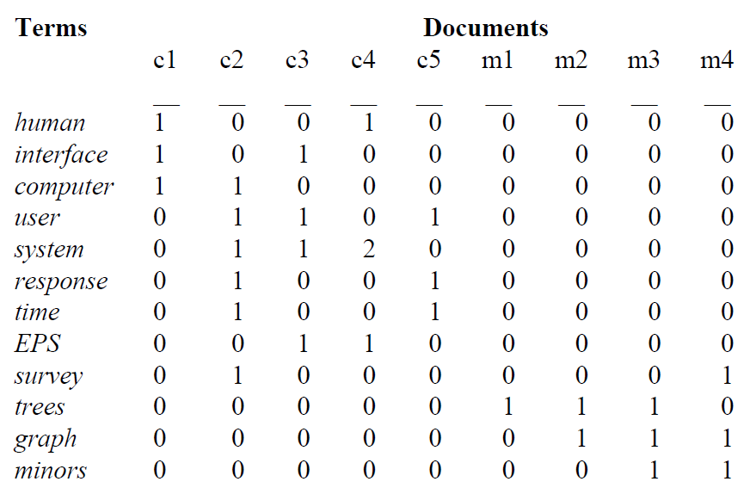
Original Matrix

Slide 27
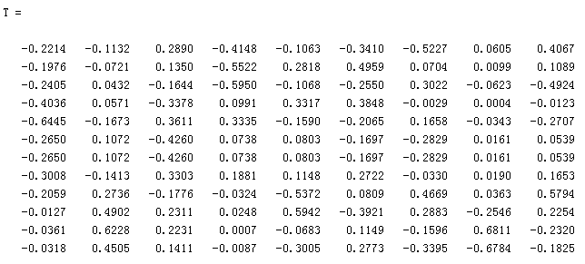
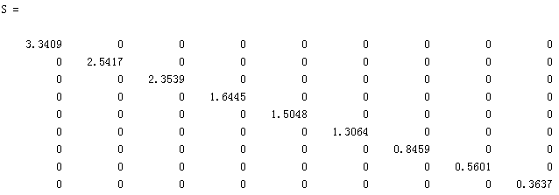
Decomposition

Slide 28
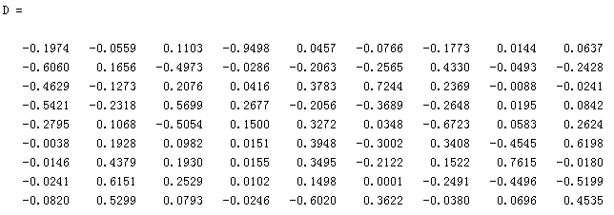
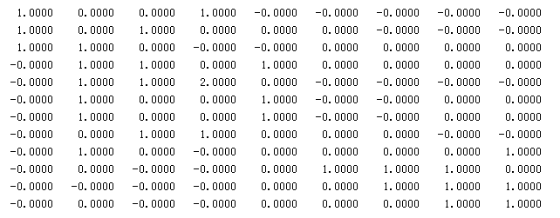
Decomposition
请看example4

Slide 29
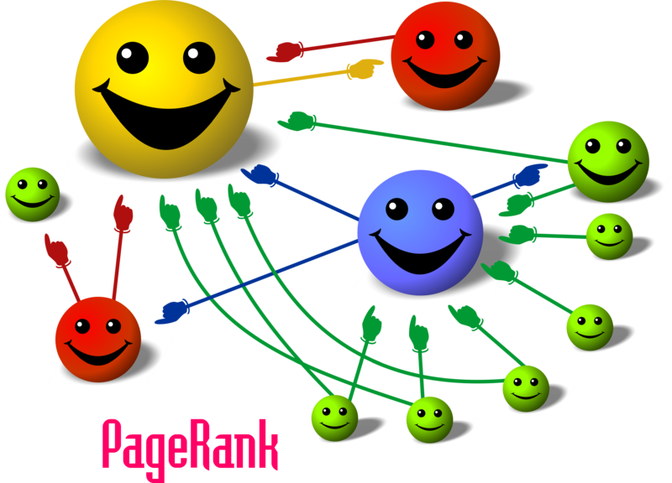
Linked Documents

Slide 30


PageRank
A
B
$$PR\left(P_{i}\right)=\sum_{p_{j}∈M(p_{i})}{\frac{PR(p_{j})}{L(p_{j})}}$$
C
D
$$PR\left(P_{i};t+1\right)=\frac{1−d}{N}+d\sum_{p_{j}∈M(p_{i})}{\frac{PR(p_{j};t)}{L(p_{j})}}$$
d: damping factor (0.85)

Slide 31
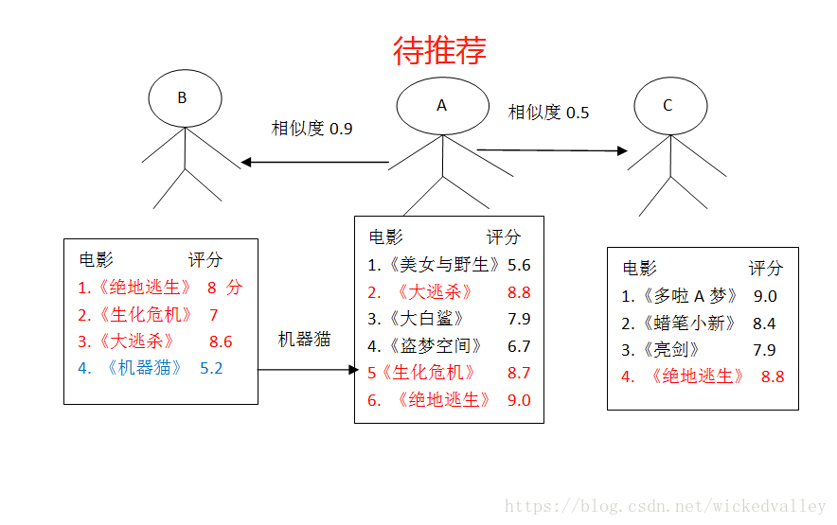
Collaborative Filtering
推荐算法应用比较广,主要是计算出与当前需要推荐用户的最相似用户，从而根据最相似的用户喜欢的物品来推荐当前可能喜欢的物品。

Slide 32
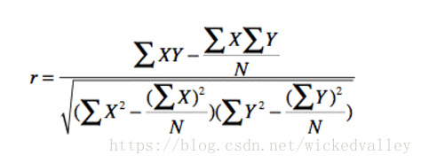
相似度计算
Pearson相关系数用来衡量两个数据集合之间的相似性。比如在一个关于电影的资料网站中，很多用户都可能对其中的电影进行打分。Pearson相关系数可以用来帮助更好的找到兴趣相似的用户，从而进行相关的推荐。这种推荐的基本思路是如果A和B兴趣相似，那么A喜欢看的，B就有很大可能会喜欢看，就可以把A的喜欢看的推荐给B。
Pearson相关系数的具体计算公式为：
具体介绍参考https://blog.csdn.net/wickedvalley/article/details/80095007
s1 = np.array([3/5, 2/5, 0/5, 1/5, 4/5])
s2 = np.array([5/5, 3/5, 3/5, 0/5, 5/5])
分子：(sum(s1*s2) -sum(s1)*sum(s2)/5)
分母：(np.sqrt(sum(s1*s1)-sum(s1)*sum(s1)/5)
*(sum(s2*s2)-sum(s2)*sum(s2)/5))
请看example5

