Slide 1
Eaglesoft Modernization Proposal discussion
September 2026
1
Notes:
1
Original authored content retained for provenance:
source-2-copy:
September 2026
source-4-copy:
Eaglesoft Modernization Proposal discussion
WMDS foundation reference; synthetic labels. Source files and exact font identities are in layout-report.json. This Go layout profile requires PowerPoint qualification.

Slide 2
Our Understanding
2
Notes:
Original authored content retained for provenance:
source-3-copy:
Our Understanding
WMDS foundation reference; synthetic labels. Source files and exact font identities are in layout-report.json. This Go layout profile requires PowerPoint qualification.

Slide 3
OUR UNDERSTANDING
Modernize Eaglesoft without disruption
ARCHITECTURE
PATTERSON’S ASK
ASSURANCE
Separate the layers
A maintainable platform with future options
Release assurance
Create reusable services and APIs that decouple UI logic from governed data access.
Test desktop, APIs, services and infrastructure with telemetry and release gates.
Modernize the desktop product while preserving a path to browser or cloud capabilities.
EXPERIENCE
PowerBuilder desktop dental platform
DELIVERY
Priority journeys
Business rules span UI, code and SQL
Product reliability
PostgreSQL environment already exists
Upgrade selected PowerBuilder workflows and UI experiences incrementally.
Establish reusable layers without destabilizing Eaglesoft; preserve future browser and cloud options.
Source: Source proposal discussion; full source wording retained in notes.
3
Notes:
3
Original authored content retained for provenance:
source-8-copy:
OUR UNDERSTANDING
Patterson is seeking to modernize Eaglesoft by creating a reusable data and API layer, upgrading selected PowerBuilder and UI workflows, and building automated performance testing to ensure the product remains reliable
source-20-copy:
What We Heard
Eaglesoft is a desktop dental practice management platform built mainly on PowerBuilder
PowerBuilder code still accesses SQL Anywhere directly through embedded SQL, DataWindows, dynamic SQL, and transaction logic
Rules are distributed across the UI, application code, database queries and stored procedures, making change and testing difficult
A working PostgreSQL environment already exists, so the primary need is architectural decoupling and modernization
The platform needs a reusable service and API foundation that supports current desktop modernization while preserving options for future browser or SaaS development
source-22-copy:
Desired Outcomes
Establish a reusable service and data layer that modernizes the UI and implements a 3-tier architecture to decouple UI logic from direct data access without destabilizing the current product
Initiate an incremental modernization of priority workflows and selected UI experiences
Build automated full-stack performance testing, telemetry, and release gates to validate performance across the desktop, APIs, services, database, and infrastructure
Develop a maintainable platform with a path toward future browser or cloud capabilities
WMDS bound template. Content classification: supplied_content. Frozen source and binding provenance are recorded in layout-report.json and binding-report.json.

Slide 4
DISCUSSION DRAFT
Approach considerations
A technical modernization approach that keeps…
Content pending
4
Notes:
Original authored content retained for provenance:
source-7-copy:
A technical modernization approach that keeps
source-6-copy:
Key considerations driving the approach…
WMDS foundation reference; synthetic labels. Source files and exact font identities are in layout-report.json. This Go layout profile requires PowerPoint qualification.

Slide 5




Our Understanding
MATURITY LEGEND
ABOVE PAR
AT PAR
BELOW PAR/GAP
The desktop estate couples experience, services and data
Fast Check-In
(.NET )
Eaglesoft API
1
Practice-local client/server design supports single offices but faces constraints above 30 users.
Dental Office
2
C++ and PowerBuilder UI technologies make hiring and ongoing maintenance harder.
Server
External Interfaces
Generic Imaging Devices (Twain)
Digital Radiography Devices (Direct)
DICOM File
PACS
App Layer
Patterson App Server
(.NET C#)
3
C++ / .NET backend and 32-bit libraries complicate a 64-bit transition. Source notes .NET 4.6 and planned 4.8 in v24.20.
Clinical
(PowerBuilder)
DB Upgrade
(.NET C#)
Client (PowerBuilder)
4
Source identifies SQL Anywhere support ending January 2025 and an extensive database migration.
Server Status
(.NET C#)
5
Roughly 1,500 stored procedures hold substantial business logic, limiting scale and a web-based multi-tenant foundation.
Data Layer
Eaglesoft DB (SQL Anywhere)
5
Notes:
Original authored content retained for provenance:
source-8-copy:
Eaglesoft Architecture – What We Know & Understand Today
source-9-copy:
Our Understanding
source-4-copy:
Dental Office
source-5-copy:
Data Layer
source-11-copy:
App Layer
source-13-copy:
Patterson App Server
(.NET C#)
source-17-copy:
Server Status
(.NET C#)
source-34-copy:
Eaglesoft DB (SQL Anywhere)
source-35-copy:
Client (PowerBuilder)
source-37-copy:
DB Upgrade
(.NET C#)
source-39-copy:
Fast Check-In
(.NET )
source-42-copy:
Clinical
(PowerBuilder)
source-44-copy:
Eaglesoft API
source-46-copy:
External Interfaces
Generic Imaging Devices (Twain)
Digital Radiography Devices (Direct)
DICOM File
PACS
source-51-copy:
Server
issue-18-issue-1-copy:
Designed as a traditional client-server architecture, the application and database reside on a central server, typically located at a dental office, and interact with end-user desktops (clients). While this model works well for single-office setups, it struggles to support larger dental groups with more than 30 users
issue-18-issue-2-copy:
Frontend UI is built on C++ and PowerBuilder, technologies that are outdated and less commonly used in modern software development making resources in the market difficult to find to maintain and update
issue-18-issue-3-copy:
Backend business logic is written in C++, but modernization efforts have introduced .NET 4.6, with plans to upgrade to .NET 4.8 in version 24.20. but many areas of the application still rely on outdated 32-bit libraries (eg. LeadTools, TXTextControl, and CodeJock) posing challenges in transitioning to modern 64-bit systems
issue-18-issue-4-copy:
Application database is SQL Anywhere, a lightweight and self-contained database engine; however, support for this database is ending in January 2025, prompting an extensive migration to a new database
issue-18-issue-5-copy:
Business logic is embedded in the data layer, comprising the majority of the application's functionality across 1,500 stored procedures. This design limits scalability and makes the system unsuitable as the foundation for a web-based, multi-tenant application capable of supporting thousands of customers
source-20-copy:
1
source-21-copy:
2
source-25-copy:
ABOVE PAR
source-26-copy:
MATURITY LEGEND
source-29-copy:
BELOW PAR/GAP
source-31-copy:
AT
PAR
source-32-copy:
3
source-38-copy:
4
source-52-copy:
5
WMDS foundation reference; synthetic labels. Source files and exact font identities are in layout-report.json. This Go layout profile requires PowerPoint qualification.

Slide 6
PowerBuilder Data Access & UI Modernization Approach
6
Notes:
Original authored content retained for provenance:
source-3-copy:
PowerBuilder Data Access & UI Modernization Approach
WMDS foundation reference; synthetic labels. Source files and exact font identities are in layout-report.json. This Go layout profile requires PowerPoint qualification.

Slide 7
OUR PERSPECTIVE
Two goals: separate the architecture and modernize the UI
CURRENT STATE
Practice-local PowerBuilder desktop
UI, business logic and data access are coupled
Devices and partners shape journey transitions
Screen-only replacement preserves that coupling
VISION FOR THE FUTURE
Prioritize complete user journeys so modernization and testing support desirable, performant, validated changes.
A reusable application foundation
MODERNIZE THE UI
Move toward a web-based UI that supports hiring and future deployment options; retire PowerBuilder incrementally.
SEPARATE THREE TIERS
Maintain and upgrade UI, service/domain operations and data access independently.
DELIVER ON PREMISES
React browser/PWA in the practice network; embedded or desktop routes remain transition options.
MOVE WHOLE JOURNEYS
Pilot priority personas or roles, align end-to-end tests and minimize disruption within each journey.
Independently maintainable experience, business operations and governed data access—with a journey-based PowerBuilder exit.
7
Notes:
Original authored content retained for provenance:
source-7-copy:
West Monroe recommends 2 goals for this modernization effort: aligning Eaglesoft to a classic 3-tier architecture and modernizing the user interface stack
source-3-copy:
OUR PERSPECTIVE
source-4-copy:
West Monroe recommends taking a user-journey focused approach to the modernization program. But identifying and prioritizing user journeys, we can align the modernization and testing strategy approach to ensure that changes are desirable, performant and validated.
source-9-copy:
VISION FOR THE FUTURE
source-1095-copy:
CURRENT STATE
PowerBuilder supports a practice-local application where the user experience, business behavior, and data access have grown together.
The user experience remains tied to a legacy desktop runtime.
Business rules and transaction behavior span UI code and direct data paths.
Device and partner dependencies shape each journey transition.
Screen-only replacement preserves the existing business and data coupling.
source-14-copy:
An independent application foundation
source-17-copy:
Outcome
An independent user experience, reusable business operations, governed data access, and a clear path to PowerBuilder retirement.
source-5-copy:
POWERBUILDER RETIREMENT
PowerBuilder has become a niche, legacy application stack. West Monroe recommends modernizing to a web-based user interface layer to ensure Pattern can continue to hire skilled engineers, to support a potential SaaS-ification of the product, and alignment with potential desktop and mobile deployment capabilities.
source-6-copy:
THREE-TIER RESPONSIBILITY
Modern application architecture practices over the last 15 years recommend a 3-tier structure: data access, service/domain, and user interface to ensure each layer can be maintained and upgraded separately. West Monroe recommends aligning to this high-level approach as an outcome of the modernization.
source-8-copy:
WEB EXPERIENCE ON PREMISES
React provides browser or PWA delivery within the practice network. Embedded and desktop routes remain transition choices. WAN network support could potentially allow multi-site expansion for practices with that network capability.
source-12-copy:
JOURNEY-LED DELIVERY
By using a journey-led approach, the disruption inside individual critical user journeys is minimized. Piloting specific personas or roles holistically can create a more seamless transition experience for customers. In addition, end to end testing for specific flows can be aligned with the testing workstream.
WMDS foundation reference; synthetic labels. Source files and exact font identities are in layout-report.json. This Go layout profile requires PowerPoint qualification.

Slide 8
TARGET ARCHITECTURE · HIDDEN SOURCE ALTERNATIVE
Decouple the on-premises target layers
PRACTICE NETWORK
Move complete journeys
1 USER INTERFACE
React + TypeScript staff and customer journeys
ALL LAYERS
Assurance
Retire a PowerBuilder journey only after its modern replacement meets acceptance criteria.
2 API / DOMAIN
Business rules, authorization and transactions
Tests
Performance
3 DATA ACCESS
Centralized, governed PostgreSQL interaction
Telemetry
Release gates
4 EXISTING ESTATE
PostgreSQL, documents, imaging and integrations
TRANSITION
PowerBuilder remains only for journeys that have not moved
Source: On-premises target; initial-phase validation is required. Full source detail in notes.
8
Notes:
Architecture shown is a proposal recommendation. All deployment remains on premises. Confirm application boundaries, PostgreSQL readiness, practice server capacity, device integration, and deployment support during the initial phase.
Patterson public Eaglesoft product information: https://www.pattersondental.com/cp/software/dental-practice-management-software/eaglesoft-
Internal RFP understanding: /Users/rscott/Documents/clients/private equity/patient square capital/patterson companies/Deliverables/2026-09-23 UTC - Patterson Eaglesoft Our Understanding.md
Internal technical narrative: /Users/rscott/Documents/clients/private equity/patient square capital/patterson companies/Working/2026-09-23 UTC - Patterson Eaglesoft Technical Narrative Revision 2.md
Historical diligence, validation context only: /Users/rscott/Documents/clients/private equity/patient square capital/patterson companies/Context/2026-09-23 UTC - Patterson Eaglesoft Prior Deliverables Evidence Store.md
8
Original authored content retained for provenance:
source-22-copy:
TARGET ARCHITECTURE
source-23-copy:
Recommended target architecture for Eaglesoft user journeys
source-58-copy:
A user journey is the end-to-end work a staff member or customer completes to achieve an outcome. Modernize complete journeys through a three-tier architecture that separates the user interface, API and domain services, and data access.
source-5-copy:
PRACTICE NETWORK
source-38-copy:
PowerBuilder during transition
source-39-copy:
Only for user journeys that have not moved
source-66-copy:
Complete journey moves
source-71-copy:
1 USER INTERFACE LAYER
source-72-copy:
Modern Eaglesoft application
source-73-copy:
React and TypeScript
Complete staff and customer journeys
source-87-copy:
2 API LAYER
source-91-copy:
3 DATA ACCESS LAYER
source-92-copy:
Centralized, governed PostgreSQL interaction
source-95-copy:
ON-PREMISES DATA AND INTEGRATIONS
source-96-copy:
PostgreSQL, documents, imaging, and approved practice integrations
source-100-copy:
CORE RECOMMENDATION
Identify end-to-end user journeys for PowerBuilder retirement. After a journey meets acceptance criteria, retire its screen and runtime, rebuild its UI logic in React, and route business rules and data access through the API and data access layers.
source-102-copy:
Initial phase: define journey boundaries and validate PostgreSQL readiness, practice server capacity, device and integration dependencies, and deployment support before selecting the first journey.
source-88-copy:
Domain services
Business rules, authorization, and transaction control
source-98-copy:
Shared engineering controls
source-99-copy:
Automated testing, performance evidence, telemetry, and release controls
WMDS bound template. Content classification: supplied_content. Frozen source and binding provenance are recorded in layout-report.json and binding-report.json.

Slide 9
TARGET ARCHITECTURE
Retire PowerBuilder through an accepted three-tier journey
USER INTERFACE LAYER
React + TypeScript
CORE RECOMMENDATION
Define each journey and its acceptance criteria
Rebuild UI logic in React + TypeScript
Route business rules through APIs / domain services
Govern PostgreSQL access; retain documents / imaging
Retire the old screen and runtime only after acceptance
PARTNER INTEGRATIONS
Continuous support
API + data access paths
API LAYER
Domain services
DATA ACCESS LAYER
PostgreSQL access
ON-PREMISES DATA
Documents + imaging
MODERNIZATION PRINCIPLES
JOURNEY-BY-JOURNEY
TRANSITION PLAN
PARTNER CONTINUITY
KEY DESIGN DECISION
Complete one journey, accept it, then retire its PowerBuilder screen.
Plan coexistence, testing, deployment and support for a controlled transition.
Preserve approved partner integrations across API and data-access paths.
Decide whether each journey needs a reimagined experience or largely as-is migration.
9
Notes:
Our Differentiators:
- Easier technology due diligence in future transactions
- Improved SOX readiness through:
Clear data lineage
Modern controls
Documented architecture
- Platform extensibility:
Multi-entity support
Future acquisitions
- Reduced dependency on tribal knowledge
9
Original authored content retained for provenance:
source-16-copy:
Recommended target architecture for Eaglesoft user journeys
source-10-copy:
CORE RECOMMENDATION
Retire PowerBuilder journey by journey
Identify end-to-end user journeys and define acceptance criteria
Retire each screen and runtime only after its journey is accepted
Rebuild UI logic in React + TypeScript
Route business rules through API and domain services
Centralize PostgreSQL access and preserve on-premises documents and imaging
source-7-copy:
TARGET ARCHITECTURE
source-9-copy:
DATA ACCESS LAYER
PostgreSQL access
source-8-copy:
API LAYER
Domain services
source-6-copy:
USER INTERFACE LAYER
React + TypeScript
source-20-copy:
ON-PREMISES DATA
Documents + imaging
source-151-copy:
PARTNER INTEGRATIONS
Continuous support
API + data access paths
source-4-copy:
MODERNIZATION PRINCIPLES
source-13-copy:
JOURNEY-BY-JOURNEY
source-14-copy:
Modernize one complete user journey at a time; retire its PowerBuilder screen only after cutover.
source-23-copy:
TRANSITION PLAN
source-24-copy:
Sequence coexistence, testing, deployment, and support so legacy and modern experiences can run safely in parallel.
source-28-copy:
PARTNER CONTINUITY
source-29-copy:
Continuously support approved partner integrations throughout migration, whether they use APIs or data access.
source-32-copy:
KEY DESIGN DECISION
source-33-copy:
For each journey, decide whether to reimagine the experience or migrate it largely as is.
WMDS foundation reference; synthetic labels. Source files and exact font identities are in layout-report.json. This Go layout profile requires PowerPoint qualification.

Slide 10
DISCUSSION DRAFT
Voice of Customer
Customer findings and journey priorities
Content pending
10
Notes:
Original authored content retained for provenance:
source-7-copy:
Tyler to add slide
VoC and customer feedback – what is our perspective on what journeys should be prioritized
WMDS foundation reference; synthetic labels. Source files and exact font identities are in layout-report.json. This Go layout profile requires PowerPoint qualification.

Slide 11
EXPERIENCE TRANSITION
Pilot the right React entry route
Option 1: Embedded PowerBuilder WebView
Validate in Phase 0
Retain desktop shell → React journey → shared API
WebView runtime fit
Desktop/device integration
Coexist with PowerBuilder while selected journeys modernize.
Deployment and support
Option 2: Browser / PWA · preferred pilot hypothesis
Validate in Phase 0
Practice-network browser → React journey → shared API
Practice connectivity
Devices and integrations
Modern web experience on premises; validate workflow and integration fit.
Performance / packaging
Option 3: Desktop companion
Validate in Phase 0
Desktop companion → React journey → shared API
Framework choice
Distribution / updates
An alternative when browser or embedded delivery does not meet journey needs.
Supportability
Source: All routes share React / TypeScript, APIs and governed PostgreSQL access. Browser/PWA is the preferred pilot hypothesis, not a validated decision.
11
Notes:
The browser application or PWA is the current pilot hypothesis because users can open a practice-network URL without installing or updating a desktop application. This reduces user effort and deployment friction.
In Phase 0, work with Patterson to select the appropriate pilot route and test that route with a real workflow. The intent is not to spike all three routes. Compare the relevant trade-offs and consider another option if the selected journey exposes a gap.
An installed desktop companion can render the same React application through Electron, Tauri, or a .NET WebView2 host. It can support printing and tighter device access, but may require users or practice IT to install and update software on each workstation. Assess how much native integration the selected journey actually needs.
React and TypeScript remain the recommendation. Phase 0 can assess Vue, Svelte, Angular, or Blazor and .NET when organizational standards or language alignment justify the trade-offs.
All modern entry routes call the Eaglesoft API layer. The API layer uses the segregated, governed practice data ecosystem. All deployment remains on premises.
Patterson public Eaglesoft product information: https://www.pattersondental.com/cp/software/dental-practice-management-software/eaglesoft-
Appeon PowerBuilder runtime notes: https://docs.appeon.com/pb/release_bulletin_for_pb/Build-2797-MR-UpgradeNotes.html
Appeon WebBrowser packaging reference: https://docs.appeon.com/pb2025/pbug/Packaging_WebBrowser.html
Internal RFP understanding: /Users/rscott/Documents/clients/private equity/patient square capital/patterson companies/Deliverables/2026-09-23 UTC - Patterson Eaglesoft Our Understanding.md
Internal technical narrative: /Users/rscott/Documents/clients/private equity/patient square capital/patterson companies/Working/2026-09-23 UTC - Patterson Eaglesoft Technical Narrative Revision 2.md
Historical diligence, validation context only: /Users/rscott/Documents/clients/private equity/patient square capital/patterson companies/Context/2026-09-23 UTC - Patterson Eaglesoft Prior Deliverables Evidence Store.md
11
Original authored content retained for provenance:
source-2-copy:
TRANSITION ARCHITECTURE
source-3-copy:
React entry points during the PowerBuilder transition
source-4-copy:
West Monroe currently sees three potential paths forward for maintaining PowerBuilder screens in parallel with modernizing the user interface to be a modern web stack. We currently recommend redirecting users towards a browser based application; however, the exact approach will be validated during Phase 0.
source-7-copy:
PRACTICE NETWORK
source-16-copy:
Embedded PowerBuilder web view
source-17-copy:
Retains the Eaglesoft window. Use only when the installed PowerBuilder runtime supports the required behavior and the adoption value is clear.
source-48-copy:
CURRENT PILOT HYPOTHESIS
source-50-copy:
Browser application or PWA
source-51-copy:
Users open a practice network URL without installing or updating a desktop application. This is currently our preferred pilot for a bounded journey with limited native device needs.
source-66-copy:
Installed desktop companion
source-67-copy:
A React UI can run in Electron, Tauri, or a .NET WebView2 shell. Useful for printing and tighter device access, but it may require an added workstation install. Phase 0 will assess how much native integration is needed.
source-76-copy:
PHASE 0 VALIDATION
source-77-copy:
Work with Patterson to select one pilot route and test the assumptions that matter for that journey. Assess runtime behavior, identity, printing, imaging, device access, deployment, recovery, and user effort.
source-78-copy:
Current belief: browser or PWA offers the easiest user access.
source-82-copy:
Recommended modern web application
source-86-copy:
React + TypeScript is the recommendation
source-87-copy:
Phase 0 can assess Vue, Svelte, Angular, or Blazor/.NET if alternatives to React are considered desireable.
source-91-copy:
Eaglesoft API layer
source-92-copy:
Domain operations, authorization, and transaction control
source-96-copy:
Segregated data ecosystem
source-97-copy:
Governed PostgreSQL and related practice data
source-98-copy:
Phase 0. Work with Patterson to select one route to test. Use user effort, runtime compatibility, printing, device needs, deployment support, and recovery evidence to choose the pilot.
draft-28-copy:
Tyler – pull through carestream and prior modernization examples
WMDS bound template. Content classification: supplied_content. Frozen source and binding provenance are recorded in layout-report.json and binding-report.json.

Slide 12
MODERNIZATION METHOD
Modernize and prove a complete journey before retiring it
Choose the product experience first; replace the complete dependency chain and prove the business outcome.
JOURNEY MIGRATION PATH
1 Map the journey
3 Choose the experience
5 Prove and retire
Map the staff or customer outcome and current execution path.
Preserve, improve or defer the journey based on product needs and dependency readiness.
Prove behavior, performance and supportability; then remove replaced PowerBuilder dependencies.
2
4
1
3
2 Expose the dependency chain
4 Build the modern journey
Trace screens, DataWindows, events, SQL, integrations, devices and tests.
Build React around shared authorization, transaction behavior and governed data access.
5
OPEN PRODUCT QUESTION
RETIREMENT RULE
Preserve the experience, materially improve it, or move later?
Retire journey by journey; leave no unowned legacy dependency.
Acceptance means a correct outcome, dependable performance and a supportable release.
12
Notes:
The browser application or PWA is the current pilot hypothesis because users can open a practice-network URL without installing or updating a desktop application. This reduces user effort and deployment friction.
In Phase 0, work with Patterson to select the appropriate pilot route and test that route with a real workflow. The intent is not to spike all three routes. Compare the relevant trade-offs and consider another option if the selected journey exposes a gap.
An installed desktop companion can render the same React application through Electron, Tauri, or a .NET WebView2 host. It can support printing and tighter device access, but may require users or practice IT to install and update software on each workstation. Assess how much native integration the selected journey actually needs.
React and TypeScript remain the recommendation. Phase 0 can assess Vue, Svelte, Angular, or Blazor and .NET when organizational standards or language alignment justify the trade-offs.
All modern entry routes call the Eaglesoft API layer. The API layer uses the segregated, governed practice data ecosystem. All deployment remains on premises.
Patterson public Eaglesoft product information: https://www.pattersondental.com/cp/software/dental-practice-management-software/eaglesoft-
Appeon PowerBuilder runtime notes: https://docs.appeon.com/pb/release_bulletin_for_pb/Build-2797-MR-UpgradeNotes.html
Appeon WebBrowser packaging reference: https://docs.appeon.com/pb2025/pbug/Packaging_WebBrowser.html
Internal RFP understanding: /Users/rscott/Documents/clients/private equity/patient square capital/patterson companies/Deliverables/2026-09-23 UTC - Patterson Eaglesoft Our Understanding.md
Internal technical narrative: /Users/rscott/Documents/clients/private equity/patient square capital/patterson companies/Working/2026-09-23 UTC - Patterson Eaglesoft Technical Narrative Revision 2.md
Historical diligence, validation context only: /Users/rscott/Documents/clients/private equity/patient square capital/patterson companies/Context/2026-09-23 UTC - Patterson Eaglesoft Prior Deliverables Evidence Store.md
12
Original authored content retained for provenance:
source-20-copy:
MODERNIZATION METHOD
source-21-copy:
Journey based PowerBuilder migration and retirement
source-26-copy:
Modernize a complete staff or customer journey, then retire the PowerBuilder components that served it.
source-64-copy:
JOURNEY MIGRATION PATH
source-112-copy:
1 Map the journey
source-113-copy:
Document the customer or staff outcome and its current execution path.
source-122-copy:
2 Expose the dependency chain
source-123-copy:
Link screens, DataWindows, event logic, SQL, stored procedures, integrations, devices, and existing test coverage to the journey.
source-124-copy:
3 Choose the experience
source-125-copy:
Make the product decision first. Preserve an experience that still works. Improve workflows that need material change. Sequence the journey later when a dependency blocks a responsible move.
source-126-copy:
4 Build the modern journey
source-127-copy:
Build the chosen experience, not just new interface technology. React uses shared business operations for authorization, transaction behavior, and data access.
source-130-copy:
5 Prove and retire
source-132-copy:
Integrate migration with automated behavior and performance tests. Use high-confidence evidence to confirm supportability, then remove the PowerBuilder dependencies the journey replaces.
source-165-copy:
Acceptance follows the journey: correct business outcome, dependable performance, and a supportable release.
source-166-copy:
1
source-167-copy:
2
source-168-copy:
3
source-169-copy:
4
source-170-copy:
5
source-171-copy:
✓
source-174-copy:
OPEN PRODUCT QUESTION
source-176-copy:
Should this journey preserve today’s experience, materially improve it, or move later?
source-177-copy:
RETIREMENT RULE
source-179-copy:
PowerBuilder exit occurs journey by journey, with no unowned legacy dependency left behind.
WMDS foundation reference; synthetic labels. Source files and exact font identities are in layout-report.json. This Go layout profile requires PowerPoint qualification.

Slide 13
MODERNIZATION LIFECYCLE
Rationalize, build and sustain value
1 Rationalize
2 Build
3 Sustain
Decide what should change and why.
Deliver capability in controlled waves.
Operate, evolve and retire legacy.
Thesis alignment
Design
Operate
Define the outcome and questions.
Architecture, processes and prototypes.
Ownership, service levels and cost control.
Assessment
Build
Evolve
Establish systems, risks and dependencies.
Bounded software and integration increments.
Maintain knowledge and the product backlog.
Reimagine
Validate
Decommission
Test process and experience options.
Parity, controls, performance and acceptance.
Clear dependencies and retire legacy cost.
Plan
Transition
Select economics, roadmap and first wave.
Controlled data, operating and release waves.
13
Notes:
The phases overlap as teams learn.
Business value, process, people, and technology continue through each phase.
Plan closes Rationalize with dispositions, economics, roadmap, and initial wave.
Validation includes functional parity, security, performance, controls, data reconciliation, and business acceptance.
Decommissioning is required to remove old cost and risk.
The lifecycle defines when decisions and delivery occur. The Seven Rs define the path each application or capability should take.
Original authored content retained for provenance:
source-8-copy:
Modernization follows a standard lifecycle from strategy through sustained value.
source-12-copy:
Rationalize, Build, and Sustain organize connected subphases, each with a clear purpose and value contribution.
source-28-copy:
RATIONALIZE
source-30-copy:
Decide what should change and why
source-36-copy:
BUILD
source-38-copy:
Deliver capability in controlled waves
source-43-copy:
SUSTAIN
source-45-copy:
Operate, evolve, and retire legacy
source-47-copy:
01
source-48-copy:
THESIS ALIGNMENT
source-49-copy:
Define the business outcome and questions that justify action.
source-50-copy:
02
source-51-copy:
ASSESSMENT
source-52-copy:
Establish how work, systems, risks, and dependencies operate today.
source-53-copy:
03
source-54-copy:
REIMAGINE
source-55-copy:
Test future process and experience options before target design hardens.
source-56-copy:
04
source-57-copy:
PLAN
source-58-copy:
Select dispositions, economics, roadmap, and the first investable wave.
source-59-copy:
01
source-60-copy:
DESIGN
source-61-copy:
Turn high-level plans into target processes, architecture, and working prototypes.
source-62-copy:
02
source-63-copy:
BUILD
source-64-copy:
Create bounded software and integration increments from approved rules and decisions.
source-65-copy:
03
source-66-copy:
VALIDATE
source-67-copy:
Prove parity, controls, performance, and acceptance with traceable evidence.
source-68-copy:
04
source-69-copy:
TRANSITION
source-70-copy:
Move data, operations, and people through controlled release waves.
source-71-copy:
01
source-72-copy:
OPERATE
source-73-copy:
Establish ownership, service levels, observability, security, and cost control.
source-74-copy:
02
source-75-copy:
EVOLVE
source-76-copy:
Keep knowledge and the product backlog current so the capability improves with measured performance.
source-78-copy:
FOUR THREADS SHAPE EVERY PHASE GATE AND DELIVERY DECISION
source-79-copy:
Business value & economics • Process & experience • People & change • Technology & delivery
source-82-copy:
03
source-83-copy:
DECOMMISSION
source-84-copy:
Clear remaining dependencies, then retire legacy code, data paths, controls, contracts, and cost.
WMDS foundation reference; synthetic labels. Source files and exact font identities are in layout-report.json. This Go layout profile requires PowerPoint qualification.

Slide 14

SOFTWARE MODERNIZATION
Intellio® Evolve turns legacy code into delivery intelligence
Beyond code generation: structured legacy understanding, agentic delivery workflows and co-creation with client teams.
PURPOSE-BUILT FOR DELIVERY
CLI, Hub UI, MCP and API
Agentic evidence updates
Portable or scalable storage
Engineers and agents working together
ANALYSIS INPUTS
Source code and documentation
Data dictionaries and schemas
OOABL, .NET, Java, Python, COBOL
DELIVERY INTEGRATIONS
Claude, Codex and Cursor
Jira and Azure DevOps
GitHub Actions and Azure Pipelines
Agentic intelligence queries and enriches evidence from source analysis and user input
Evidence Database
SQLite | PostgreSQL | Neo4j
Analysis engine
MCP server
Reports & chat
Planning tools
VALUE
DELIVERED
Less than 12 months
to modernize, where it used to take 3–5 years
10+ pre-built workflows
leveraging AI for code understanding and rebuild
Up to 80% savings
in migration and re-engineering effort
14
Notes:
Coding agents help developers write code faster (improve developer efficiency). Intellio Evolve helps enterprises modernize entire systems—faster, smarter, and with better business outcomes (40-50% faster modernization timelines).
Intellio Evolve includes prompt-engineered purpose-built workflows for modernization. Coding agents require users to design prompts, workflows, and guardrails manually.
Intellio Evolve helps modernize software based on current business needs, not just converting old code into new code. Coding agents primarily generate or refactor code based on prompts.
Intellio Evolve deepens legacy software understanding (context at scale). It uses AI to analyze legacy codebases (COBOL, .NET, AngularJS, etc.), map dependencies and business logic and converts “tribal knowledge” into structured insight. Coding agents are limited to what fits within a prompt/context window.
Software modernization is as much architecture + change + business alignment as code modernization. Intellio Evolve combines agentic workflow + AI in SDLC delivery approach + co-creation with client teams. Coding agents are pure tools with no embedded delivery approach.
14
Original authored content retained for provenance:
source-22-copy:
SOFTWARE MODERNIZATION
source-23-copy:
Intellio® Evolve combines AI with advanced code analysis to guide modernization that not only rebuilds code but enhances the product itself.
source-25-copy:
ANALYSIS INPUTS
Source Code
OOABL / OpenEdge
C# / .NET
PowerHouse
Java • Python • COBOL
Documentation
Specs, runbooks, wiki
Data Dictionaries
Schemas, ERDs, configs
source-29-copy:
Agentic Intelligence: Queries, enriches, and updates evidence from user input and source analysis
source-30-copy:
Evidence Database
SQLite | PostgreSQL | Neo4j
source-31-copy:
Analysis engine
source-32-copy:
Reports & chat
source-33-copy:
MCP server
source-34-copy:
Planning tools
source-36-copy:
INTEGRATIONS
Coding Agents
Claude / Anthropic
Codex / OpenAI
Cursor
Project Trackers
Jira, Azure DevOps
CI / CD
GitHub Actions
Azure Pipelines
source-42-copy:
PURPOSE-BUILT TO ACCELERATE
Multiple Engagement Modes
CLI, Hub UI, MCP, and API—local
or cloud
Agentic Intelligence
Queries and updates evidence from
user input and code findings
Flexible Storage
SQLite for portability, PostgreSQL,
or Neo4j for scale
Built for Delivery Teams
Consultants, engineers, and coding agents working together
source-50-copy:
10+ pre-built workflows
leveraging AI for code understanding and rebuild
source-51-copy:
Up to 80% savings
in migration and re-engineering effort
source-52-copy:
Less than 12 months
to modernize, where it used to take 3–5 years
source-53-copy:
VALUE
DELIVERED
source-58-copy:
Unlike coding agents, Intellio® Evolve goes beyond just code modernization. It deepens legacy software understanding—converting “tribal knowledge” into structured insight. And it combines agentic workflows and an AI-powered SDLC delivery approach with co-creation alongside client teams to ensure a successful and sustained transformation.
WMDS foundation reference; synthetic labels. Source files and exact font identities are in layout-report.json. This Go layout profile requires PowerPoint qualification.

Slide 15
Automated Performance Testing and Operability Approach
15
Notes:
Original authored content retained for provenance:
source-3-copy:
Automated Performance Testing and Operability Approach
WMDS foundation reference; synthetic labels. Source files and exact font identities are in layout-report.json. This Go layout profile requires PowerPoint qualification.

Slide 16
PERFORMANCE ASSURANCE
Prove each change across the full stack
DELIVERY ACCELERATOR
RELEASE EVIDENCE
AI-assisted modernization
Measure and diagnose performance
AI can accelerate source analysis, code conversion, testing and documentation.
Test desktop, API, service, database and infrastructure performance; include concurrency, scale and soak conditions.
Engineers retain accountability for correct behavior and a supportable release.
Full-stack testing and telemetry show whether changes are correct, fast and ready for release.
16
Notes:
Original authored content retained for provenance:
source-2-copy:
How the team measures and diagnoses desktop, API, service, database, infrastructure, concurrency, scale, and soak performance.
Ai-assisted modernization
Ai can accelerate analysis, code conversion, testing and documentation
Performance and release
Full stack testing and telemetry show changes are correct, fast, and ready for release
source-5-copy:
Performance Assurance
source-6-copy:
Context:
WMDS bound template. Content classification: supplied_content. Frozen source and binding provenance are recorded in layout-report.json and binding-report.json.

Slide 17
INTEGRATED ROADMAP · DISCUSSION DRAFT
Modernization and performance progress together
M1
M2
M3
M4
M5
M6
M7
M8
M9
M10
M11
M12
Modernization · content pending
Performance · content pending
12-month planning horizon · baseline → modernization + performance → production handoff
17
Notes:
Original authored content retained for provenance:
source-104-copy:
Output:
Agreed baseline, KPIs, success measures, workflow changes, and priority adoption needs
source-105-copy:
Output:
Usage expectations established, reinforcement underway, and adoption / friction backlog actively managed
source-107-copy:
Output:
Performance trends, value implications, intervention priorities, risks, and instrumentation needs
source-108-copy:
Output:
Adoption playbook, sustained measurement cadence, scale roadmap, ownership transition, and framework for validating longer-term value
source-103-copy:
Output:
Confirmed starting point, key unknowns and priority questions documented, and refined six-week plan
source-48-copy:
Activity:
Extend the playbook across additional Workers’ Comp cells and lines of business
Sustain measurement and reinforcement
Validate longer-term workforce and margin outcomes
Transition ownership to EnableComp
source-5-copy:
Our six-week sprint will refine the work around deployed AI, drive adoption in one Workers’ Comp cell team, and prepare the model to scale
source-2-copy:
PROPOSED OVERALL PROJECT APPROACH
source-6-copy:
Activity:
Confirm scope, owners, cadence, and success measures
Validate baseline, KPIs, targets, and measurement approach
Confirm workflow fit, required process changes, and human-control points
source-8-copy:
Activity:
Embed in existing operating routines
Reinforce role-level usage expectations and training
Support leader coaching and frontline feedback
Identify and resolve workflow, usability, and behavior friction
source-10-copy:
Activity:
Review in-scope AI capabilities and Workers’ Comp workflow
Confirm what is built, deployed, and documented
Identify the initial cell team, dependencies, and key kickoff questions
source-11-copy:
Activity:
Track adoption, quality, and productivity against baseline
Diagnose where results vary and why
Translate findings into targeted interventions
Maintain issues, decisions, risks, and instrumentation cadence
source-15-copy:
ALIGN &
VALIDATE
Weeks 1-2
source-17-copy:
DRIVE
ADOPTION
Weeks 2-5
source-18-copy:
DISCOVER &
MOBILIZE
Pre-Engagement
source-27-copy:
00
source-37-copy:
PROPOSED SIX-WEEK ENGAGEMENT
source-59-copy:
MEASURE &
ITERATE
Weeks 3-6
source-60-copy:
SCALE &
HANDOFF
Post-Phase 1
source-81-copy:
01
source-85-copy:
02
source-91-copy:
04
source-93-copy:
03
draft-9-copy:
Update
Integrated 12-month roadmap - How modernization and performance work progress together from baseline through production handoff.
WMDS foundation reference; synthetic labels. Source files and exact font identities are in layout-report.json. This Go layout profile requires PowerPoint qualification.

Slide 18
Execution, Evidence, and Commitment
18
Notes:
Original authored content retained for provenance:
source-3-copy:
Execution, Evidence, and Commitment
WMDS foundation reference; synthetic labels. Source files and exact font identities are in layout-report.json. This Go layout profile requires PowerPoint qualification.

Slide 19
INITIAL PHASE
One journey inventory connects modernization and assurance
One journey inventory guides architecture decisions, early delivery planning, and testing investment.
1
Source and environment discovery
3
Target architecture validation
5 READY BACKLOG
AND DECISION PACKAGE
SHARED JOURNEY INVENTORY
Scan code and dependencies; inspect tests, environments, data, telemetry and machine profiles.
Link each journey to customer value, dependencies, release pain, tests, performance and deployment conditions.
Validate on-premises UI, service, data and operating patterns using selected journey candidates.
PRIORITIZED ROADMAP
CUSTOMER VALUE
TWO-SPRINT READY BACKLOG
TOOL-ASSISTED SCAN
Intellio Evolve + Codex
COLLECTS INTO
CODE + DEPENDENCIES
STAFFING + DEPENDENCY ASSUMPTIONS
RELEASE PAIN POINTS
2
Journey and release prioritization
TEST COVERAGE
4
Testing and performance pilot
EVIDENCE TO PROCEED, RESCOPE, OR STOP
Rank journeys by value, release pain, risk and dependency readiness with product, engineering, quality and support.
PERFORMANCE EVIDENCE
Strengthen automation and baseline a priority workflow; connect experience timing to diagnostic evidence.
DEPLOYMENT CONDITIONS
Leave Phase 0 with a tested direction for the next delivery increments.
Tools accelerate analysis; engineers and Patterson retain design, quality, security and release authority.
19
Notes:
Original authored content retained for provenance:
source-7-copy:
INITIAL PHASE
source-8-copy:
Integrated initial phase for modernization and assurance
source-10-copy:
One journey inventory guides architecture decisions, early delivery planning, and testing investment.
source-14-copy:
SHARED JOURNEY INVENTORY
source-15-copy:
Connect every priority journey to its code and dependency chain, customer impact, release pain points, current test coverage, performance evidence, and deployment conditions.
source-18-copy:
CUSTOMER VALUE
source-22-copy:
CODE + DEPENDENCIES
source-26-copy:
RELEASE PAIN POINTS
source-30-copy:
TEST COVERAGE
source-34-copy:
PERFORMANCE EVIDENCE
source-38-copy:
DEPLOYMENT CONDITIONS
source-41-copy:
1
source-42-copy:
Source and environment discovery
source-43-copy:
Scan the codebase and map dependencies with Intellio Evolve, Codex, and engineer review. Inspect test assets, environments, data, telemetry, and machine profiles.
source-46-copy:
TOOL-ASSISTED SCAN
source-47-copy:
Intellio Evolve + Codex
source-48-copy:
2
source-49-copy:
Journey and release prioritization
source-50-copy:
Interview product, engineering, quality, and support. Rank journeys by customer value, release pain, risk, and dependency readiness.
source-51-copy:
3
source-52-copy:
Target architecture validation
source-53-copy:
Confirm the on premise UI, service, data, deployment, and operational patterns. Test the fit on selected journey candidates.
source-54-copy:
4
source-55-copy:
Testing and performance pilot
source-56-copy:
Reuse and strengthen existing automation. Establish a controlled baseline for a priority workflow and connect experience timing to technical evidence for diagnosis.
source-68-copy:
COLLECTS INTO
source-71-copy:
5 READY BACKLOG
AND DECISION PACKAGE
source-72-copy:
PRIORITIZED ROADMAP
source-74-copy:
TWO-SPRINT READY BACKLOG
source-76-copy:
STAFFING + DEPENDENCY ASSUMPTIONS
source-78-copy:
EVIDENCE TO PROCEED, RESCOPE, OR STOP
source-80-copy:
Patterson leaves the initial phase with a tested direction for the next delivery increments.
source-83-copy:
Tool assisted analysis speeds the work. Engineers and Patterson leaders retain design, quality, security, and release authority.
WMDS foundation reference; synthetic labels. Source files and exact font identities are in layout-report.json. This Go layout profile requires PowerPoint qualification.

Slide 20
INTEGRATED INITIAL PHASE
Use one journey inventory to decide the next delivery increments
SHARED JOURNEY INVENTORY
01
02
03
04
05
SOURCE & ENVIRONMENT
DISCOVERY
JOURNEY & RELEASE
PRIORITIZATION
TARGET ARCHITECTURE
VALIDATION
TESTING & PERFORMANCE
PILOT
READY BACKLOG &
DECISION PACKAGE
Activity:
Map code and PowerBuilder dependencies
Inspect reusable tests and environments
Apply approved tools and engineer review
Activity:
Interview product, engineering, quality and support
Rank value, release pain, risk and readiness
Trace priority journeys
Activity:
Confirm on-premises target patterns
Test selected journey candidates
Record decisions and open questions
Activity:
Strengthen existing test automation
Baseline a priority workflow
Link timing to diagnostic evidence
Activity:
Prepare roadmap and ready backlog
Confirm staffing and dependencies
Retain Patterson release authority
Output: Validated source inventory, dependency patterns and baseline
Output: Journeys ranked by value, pain, risk and readiness
Output: Validated target patterns and pilot candidates
Output: Controlled baseline and an enduring pilot use case
Output: Roadmap, two-sprint backlog and proceed / rescope / stop evidence
20
Notes:
Original authored content retained for provenance:
source-104-copy:
Output:
Prioritized journeys linked to value, release pain, risk, and readiness
source-105-copy:
Output:
Validated on premise target patterns and selected pilot candidates
source-107-copy:
Output:
Controlled performance baseline and a pilot use case that can endure
source-108-copy:
Output:
Roadmap, two-sprint ready backlog, assumptions, and evidence to proceed, rescope, or stop
source-103-copy:
Output:
Validated source inventory, dependency patterns, reusable tests, and environment baseline
source-48-copy:
Activity:
Prepare the roadmap and two-sprint ready backlog
Confirm staffing, dependencies, and delivery sequence
Retain Patterson authority over design, quality, security, and release
source-5-copy:
One shared journey inventory directs Eaglesoft’s next delivery increments
source-2-copy:
INTEGRATED INITIAL PHASE
source-6-copy:
Activity:
Interview product, engineering, quality, and support
Rank journeys by value, release pain, risk, and dependency readiness
Trace priority journeys through the shared inventory
source-8-copy:
Activity:
Confirm on premise UI, service, data, deployment, and operating patterns
Test selected journey candidates
Record architecture decisions and open questions
source-10-copy:
Activity:
Map the codebase and PowerBuilder dependencies
Inspect reusable tests, environments, data, telemetry, and machine profiles
Accelerate source understanding with approved tools and engineer review
source-11-copy:
Activity:
Reuse and strengthen testing automation
Baseline one priority workflow under controlled conditions for performance testing spike
Link experience timing to diagnostic evidence
source-15-copy:
JOURNEY & RELEASE
PRIORITIZATION
source-17-copy:
TARGET ARCHITECTURE
VALIDATION
source-18-copy:
SOURCE & ENVIRONMENT
DISCOVERY
source-27-copy:
01
source-37-copy:
SHARED JOURNEY INVENTORY
source-59-copy:
TESTING & PERFORMANCE
PILOT
source-60-copy:
READY BACKLOG &
DECISION PACKAGE
source-81-copy:
02
source-85-copy:
03
source-91-copy:
05
source-93-copy:
04
WMDS foundation reference; synthetic labels. Source files and exact font identities are in layout-report.json. This Go layout profile requires PowerPoint qualification.

Slide 21
DISCUSSION DRAFT
Migration decision matrix
Journey migration choices
Content pending
21
Notes:
Original authored content retained for provenance:
source-7-copy:
Tyler to add slide
POV on migration…decision matrix? Ways to think about migration…lessons learned from others, etc.
WMDS foundation reference; synthetic labels. Source files and exact font identities are in layout-report.json. This Go layout profile requires PowerPoint qualification.

Slide 22

PHASE 0 WORKPLAN
Prove a journey, then launch pods
PILOT
ARCH/TEST SET
PILOT PROOF
PODS READY
WORKSTREAM · ACTIVITY
PRE
W1
W2
W3
W4
W5
W6
W7
Mobilize
Access and kickoff
Mobilize
Inventory
Current state + journeys
Assess + inventory
Prepare
PHASE 0
Priority, design and tests
Prioritize + design
Pilot
W3 prep; W4–5 build + test
Prepare → two-week pilot
Transition
W6 roadmap; W7 pods
Roadmap → transition
Governance
GOV
Decisions, risks and readouts
Recurring throughout Phase 0
Phase activity
Recurring governance
Gate
22
Notes:
22
Original authored content retained for provenance:
source-5-copy:
WORKPLAN
cell-51-r0-c0-copy:
Week
cell-51-r0-c1-copy:
Pre
cell-51-r0-c2-copy:
1
cell-51-r0-c3-copy:
2
cell-51-r0-c4-copy:
3
cell-51-r0-c5-copy:
4
cell-51-r0-c6-copy:
5
cell-51-r0-c7-copy:
6
cell-51-r0-c8-copy:
7
cell-51-r1-c0-copy:
00: Access, Onboarding & Mobilize
cell-51-r2-c0-copy:
Confirm system access, environments, tooling, and data; conduct onboarding and kickoff workshop
cell-51-r3-c0-copy:
01: Current State & Journey Inventory
cell-51-r4-c0-copy:
Assess the current architecture and active modernization initiatives
cell-51-r5-c0-copy:
Inventory user journeys, queries, PowerBuilder screens, dependencies, reusable tests, and data
cell-51-r6-c0-copy:
02: Prioritize, Design & Prepare
cell-51-r7-c0-copy:
Prioritize the catalog and select the pilot journey
cell-51-r8-c0-copy:
Finalize target architecture, implementation plan, and acceptable test standard
cell-51-r9-c0-copy:
03: Integrated Two-Week Pilot
cell-51-r10-c0-copy:
Prepare pilot backlog, environments, baseline data, instrumentation, and regression harness
cell-51-r11-c0-copy:
Modernize the selected journey on the target architecture; build, test, and iterate
cell-51-r12-c0-copy:
Run performance baseline/pilot and regression testing against the selected journey
cell-51-r13-c0-copy:
04: Roadmap & Pod Transition
cell-51-r14-c0-copy:
Roadmap and prioritize the remaining journey catalog into implementation waves
cell-51-r15-c0-copy:
Prepare pod onboarding documentation, backlog, dependencies, and technical plans
cell-51-r16-c0-copy:
Recurring: Governance, architecture/test decisions, risk management, and stakeholder readouts
source-3-copy:
Architecture + test
standard locked
source-12-copy:
Two-week pilot readout
source-15-copy:
Pods ready
to launch
source-23-copy:
Pilot journey selected
source-4-copy:
Phase 0 aligns the current state, target architecture, and test standard before a two-week pilot,
then roadmaps remaining journeys and prepares modernization pods to launch
source-9-copy:
Pre-week confirms access and onboarding readiness; detailed dependencies will be refined during kickoff
WMDS foundation reference; synthetic labels. Source files and exact font identities are in layout-report.json. This Go layout profile requires PowerPoint qualification.

Slide 23
Phase 0 team and client counterparts
Six full-time West Monroe roles pair with Eaglesoft leadership
PHASE 0 TEAM | 6 WEST MONROE FULL-TIME RESOURCES + PART-TIME LEADERSHIP / SMEs
PROPOSED TEAM STRUCTURE
EAGLESOFT LEADERSHIP ROLES
WEST MONROE
EAGLESOFT
WM Executive Leadership
Executive Sponsor
EXECUTIVE SPONSOR
Strategic direction, blockers, major decisions
Program / Product Manager
Eaglesoft Program Lead
PROGRAM LEAD
Integrated planning, dependencies, status, RAID
TECHNICAL SMEs
Onboarding, access, technical questions, shared areas
Program Architect
Eaglesoft Technical SMEs
KEY
Modernization Technical Lead
Testing / Quality Technical Lead
SMEs
WM FULL TIME
Specialists engaged
as needed
WM PART TIME
Fullstack Senior Engineer
Senior Quality Engineer
EAGLESOFT PART TIME
23
Notes:
Original authored content retained for provenance:
source-4-copy:
West Monroe will scale delivery pods by workstream, working side by side with Eaglesoft and transitioning platform maintenance over time
source-5-copy:
Team Structure
source-12-copy:
PHASE 0 TEAM | 6 WEST MONROE FULL-TIME RESOURCES + PART-TIME LEADERSHIP / SMEs
source-15-copy:
WEST MONROE ROLE DEFINITIONS
source-16-copy:
Add brief role definitions here
source-17-copy:
Program / Product Manager
source-22-copy:
[add concise definition]
source-28-copy:
Program Architect
source-29-copy:
[add concise definition]
source-32-copy:
Modernization Technical Lead
source-33-copy:
[add concise definition]
source-35-copy:
Testing / Quality Technical Lead
source-37-copy:
[add concise definition]
source-39-copy:
Fullstack Senior Engineer
source-41-copy:
[add concise definition]
source-45-copy:
Senior Quality Engineer
source-46-copy:
[add concise definition]
source-55-copy:
Leadership + SMEs are part-time / as needed.
source-63-copy:
PROPOSED TEAM STRUCTURE
source-70-copy:
WEST MONROE
source-71-copy:
EAGLESOFT
source-77-copy:
WM Executive Leadership
source-80-copy:
Executive Sponsor
source-82-copy:
Program / Product Manager
source-84-copy:
Eaglesoft Program Lead
source-85-copy:
Program Architect
source-91-copy:
Eaglesoft Technical SMEs
source-105-copy:
Modernization Technical Lead
source-106-copy:
Testing / Quality Technical Lead
source-107-copy:
SMEs
source-111-copy:
Fullstack Senior Engineer
source-112-copy:
Senior Quality Engineer
source-113-copy:
Specialists engaged
as needed
source-115-copy:
EAGLESOFT LEADERSHIP ROLES
source-116-copy:
EXECUTIVE SPONSOR
Strategic direction, blockers, major decisions
source-117-copy:
PROGRAM LEAD
Integrated planning, dependencies, status, RAID
source-118-copy:
TECHNICAL SMEs
Onboarding, access, technical questions, shared areas
source-120-copy:
KEY
source-122-copy:
WM FULL TIME
source-124-copy:
WM PART TIME
source-126-copy:
EAGLESOFT PART TIME
WMDS foundation reference; synthetic labels. Source files and exact font identities are in layout-report.json. This Go layout profile requires PowerPoint qualification.

Slide 24
Delivery pods and client participation
Validate patterns first, then scale journey delivery pods
PHASE 0 DELIVERY PODS | EAGLESOFT TIME ALLOCATIONS SHOWN IN ROLE BOXES
PROGRAM LEADERSHIP AND EAGLESOFT PARTICIPATION
WEST MONROE
EAGLESOFT
WM Executive Leadership
Executive Sponsor • 5%
Program / Product Manager
Eaglesoft Program Lead • 50%
Program Architect
Eaglesoft Technical SMEs • 10–25%
MODERNIZATION INNOVATION POD
MODERNIZATION FACTORY POD
TESTING POD
KEY
Establish architecture and delivery patterns, including the initial UX/design-system foundation.
Scale parallel journeys after Phase 0 validates architecture and the design system.
Enhance shared harnesses and test scenarios across modernized journeys.
WM FULL TIME
WM PART TIME
EAGLESOFT PART TIME
Pod Technical Lead
Platform Engineer
Pod Technical Lead
Pod Technical Lead
WM OPTIONAL ROLE
Fullstack Eng(s)
Data Engineer(s)
Fullstack Engineer(s)
Fullstack Engineer(s)
UX DESIGNER*
Initial UX. May roll off after ~4 sprints with an established design system; retain for pivotal redesign.
UX Designer*
Data Engineer(s)
Platform Engineer
US / Nearshore blend
Offshore after validation
US / Nearshore blend
24
Notes:
Original authored content retained for provenance:
source-4-copy:
West Monroe will scale delivery pods by workstream, working side by side with Eaglesoft and transitioning platform maintenance over time
source-5-copy:
Team Structure
source-72-copy:
PHASE 0 DELIVERY PODS | EAGLESOFT TIME ALLOCATIONS SHOWN IN ROLE BOXES
source-75-copy:
PROGRAM LEADERSHIP — ROLE DEFINITIONS ARE UNCHANGED FROM SLIDE 20
source-76-copy:
WM Executive Leadership
source-78-copy:
Executive Sponsor • 5%
source-79-copy:
Program / Product Manager
source-82-copy:
Eaglesoft Program Lead • 50%
source-83-copy:
Program Architect
source-85-copy:
Eaglesoft Technical SMEs • 10–25%
source-89-copy:
MODERNIZATION INNOVATION POD
source-90-copy:
Sets architecture and delivery patterns. UX is included initially—even for 1:1 conversion—and supports the design system or priority journey redesign.
source-92-copy:
MODERNIZATION FACTORY POD
source-93-copy:
Begins after Phase 0 validates the pattern; scales parallel journey delivery against the established architecture and design system.
source-95-copy:
TESTING POD
source-96-copy:
Builds or enhances shared test harnesses and executes pod scenarios across modernized journeys.
source-97-copy:
Pod Technical Lead
source-98-copy:
Platform Engineer
source-99-copy:
Fullstack Eng(s)
source-100-copy:
Data Engineer(s)
source-101-copy:
UX Designer*
source-102-copy:
Blend of US / Nearshore
source-103-copy:
Pod Technical Lead
source-104-copy:
Fullstack Engineer(s)
source-105-copy:
Data Engineer(s)
source-106-copy:
Offshore delivery after pattern validation
source-107-copy:
Pod Technical Lead
source-108-copy:
Fullstack Engineer(s)
source-109-copy:
Platform Engineer
source-110-copy:
Blend of US / Nearshore
source-112-copy:
KEY
source-114-copy:
WM FULL TIME
source-116-copy:
WM PART TIME
source-118-copy:
EAGLESOFT PART TIME
source-120-copy:
WM OPTIONAL ROLE
source-122-copy:
UX DESIGNER*
source-123-copy:
Plan for the role initially. It may roll off after ~4 sprints once the design system is established, or remain for pivotal journey redesign.
source-2-copy:
WEST MONROE
source-3-copy:
EAGLESOFT
WMDS foundation reference; synthetic labels. Source files and exact font identities are in layout-report.json. This Go layout profile requires PowerPoint qualification.

Slide 25
Context:
Scope Guardrails
Program Covers
Explicitly Outside Scope
Delivery Guardrails
Extend the existing performance framework
Restart the SQL Anywhere or Sybase to PostgreSQL migration
Validate the current baseline during Phase Zero
Build a governed service and data layer
A wholesale PowerBuilder rewrite
Reuse existing tools and assets where practical
Migrate agreed priority PowerBuilder workflows
C++/Chairside code modernization
Use business-oriented APIs instead of generic SQL or table endpoints
Modernize selected workflows through React
Internal modernization of Eaglesoft server-side SQL
Preserve behavior through coexistence, feature flags, testing, and rollback
Add full-stack performance testing, telemetry, and release gates
A full cloud migration during this phase
Use controlled datasets and environments
Design contracts that are cloud-capable
Rebuilding every Eaglesoft screen immediately
Make PostgreSQL changes only when required for correctness, performance, or the new data layer
25
Notes:
Original authored content retained for provenance:
source-5-copy:
Scope Guardrails
source-6-copy:
Context:
cell-7-r0-c0-copy:
Program Covers
cell-7-r0-c1-copy:
Explicitly Outside Scope
cell-7-r0-c2-copy:
Delivery Guardrails
cell-7-r1-c0-copy:
Extend the existing performance framework
cell-7-r1-c1-copy:
Restart the SQL Anywhere or Sybase to PostgreSQL migration
cell-7-r1-c2-copy:
Validate the current baseline during Phase Zero
cell-7-r2-c0-copy:
Build a governed service and data layer
cell-7-r2-c1-copy:
A wholesale PowerBuilder rewrite
cell-7-r2-c2-copy:
Reuse existing tools and assets where practical
cell-7-r3-c0-copy:
Migrate agreed priority PowerBuilder workflows
cell-7-r3-c1-copy:
C++/Chairside code modernization
cell-7-r3-c2-copy:
Use business-oriented APIs instead of generic SQL or table endpoints
cell-7-r4-c0-copy:
Modernize selected workflows through React
cell-7-r4-c1-copy:
Internal modernization of Eaglesoft server-side SQL
cell-7-r4-c2-copy:
Preserve behavior through coexistence, feature flags, testing, and rollback
cell-7-r5-c0-copy:
Add full-stack performance testing, telemetry, and release gates
cell-7-r5-c1-copy:
A full cloud migration during this phase
cell-7-r5-c2-copy:
Use controlled datasets and environments
cell-7-r6-c0-copy:
Design contracts that are cloud-capable
cell-7-r6-c1-copy:
Rebuilding every Eaglesoft screen immediately
cell-7-r6-c2-copy:
Make PostgreSQL changes only when required for correctness, performance, or the new data layer
WMDS foundation reference; synthetic labels. Source files and exact font identities are in layout-report.json. This Go layout profile requires PowerPoint qualification.

Slide 26
COMMERCIAL DRAFT
Proposed fees and team structure
Scope, success measures, assumptions and pricing
Content pending
26
Notes:
Original authored content retained for provenance:
source-4-copy:
The proposed fees and team structure will allow us to align on the required approach, while providing flexibility to adapt as the engagement evolves
source-5-copy:
Our approach
source-7-copy:
KEY NOTES
Scope Validation: Phase 1 is intended to validate the Traumasoft proposed implementation plan (including resourcing approach), operating-unit details that have been gathered already, contemplated rollout sequencing, to inform level of WM support required for subsequent phases
Ongoing Support: Phase 2 and 3 team composition and monthly fees will be confirmed at end of Phase 1 and may be adjusted over time based on rollout progress and PatientCare’s support needs (can be revisited at monthly project check-ins)
Execution Assumptions: Fees assume timely participation from PatientCare and Traumasoft stakeholders and continuous execution; material delays, pauses, or changes in sequencing may affect timing, resource availability, and cost. Documentation of current state processes is out of scope (engagement assumes PatientCare will be able to provide most current state documentation required to help establish implementation timeline and Traumasoft discovery/planning phases)
Expenses: Travel and other approved out-of-pocket expenses are excluded from professional fees and billed separately at cost
This is a draft Proposal for discussion only. Any final agreed to scope, fees and timing would be fully documented through a formal Statement of Work (SOW) and Professional Services Agreement (PSA)
source-9-copy:
Phase 1: Initial 3-Week Sprint
source-10-copy:
TIMING
source-11-copy:
1 Lead / PM, 2 Analysts & Quality Assurance
source-12-copy:
RESOURCES
source-13-copy:
$110,000 - $125,000
source-14-copy:
FEES
source-20-copy:
Phase 2: 3-6 months
Phase 3: TBD – Monthly as needed
source-22-copy:
1 Lead / PM, 1 Analyst, & Quality Assurance
(Phase 2 support model to be validated in Phase 1)
source-24-copy:
~$90,000 / month
(Potential to reduce/adjust in phase 3)
draft-18-copy:
Update
What Patterson will receive, how success will be measured, assumptions, dependencies, and pricing structure.
WMDS foundation reference; synthetic labels. Source files and exact font identities are in layout-report.json. This Go layout profile requires PowerPoint qualification.

Slide 27
DISCUSSION DRAFT
Decisions and next steps
Open decisions, immediate actions and response completion
Content pending
27
Notes:
Original authored content retained for provenance:
source-5-copy:
Decisions and next steps
source-6-copy:
Context:
draft-8-copy:
Update
Open decisions, immediate actions, and the proposed path to complete the response.
WMDS foundation reference; synthetic labels. Source files and exact font identities are in layout-report.json. This Go layout profile requires PowerPoint qualification.

Slide 28
Case Studies
28
Notes:
Original authored content retained for provenance:
source-3-copy:
Case Studies
WMDS foundation reference; synthetic labels. Source files and exact font identities are in layout-report.json. This Go layout profile requires PowerPoint qualification.

Slide 29
LEGACY 4GL CASE STUDY
AI accelerated a legacy 4GL rebuild
CHALLENGE
6+ months
A customized legacy product faced rising maintenance cost, delayed innovation and failed multi-year modernization attempts.
Planning condensed into weeks
~10x
APPROACH
Assess the codebase with Intellio Evolve. Prototype a Java / Spring rewrite with Claude Code and AWS Kiro, guided by domain design, technical specifications and architecture steering files.
Architecture-team productivity
~200K
“
Module LoC · one sprint
A big thank you to you and the West Monroe team.
CLIENT CEO · EXCERPT; FULL QUOTE IN NOTES
Source-reported results; not Eaglesoft outcomes. Full claim basis and quote in notes.
29
Notes:
Changed Aligned and excited architecture team by creating a holistic view of the architecture and dependencies
to Aligned and energized the architecture team by establishing a clear, end-to-end view of the architecture and its dependencies.
29
Original authored content retained for provenance:
source-5-copy:
Our client’s core product is built on legacy technologies and has been customized over time, increasing maintenance costs while losing market share and delaying innovation. Previous modernization efforts have taken multiple years and have failed due to the complexity of 4GL code transformation and migration strategies.
How we helped
Used an AI-first approach to evaluate the codebase and plan the strategic rewrite of one of the core modules
Utilized Intellio Evolve alongside commercial AI tooling (Claude Code, AWS Kiro) to build a rapid prototype of a full rewrite to a modern language (Java / Spring) in a fraction of the time it would have taken with traditional approaches
Best outcomes were driven by our approach using domain-driven design, technical specs, architecture steering files to guide AI agents with implementation
source-6-copy:
Building Smarter Solutions to Modernize Legacy Code with AI
source-7-copy:
Accelerated understanding, planning, and refactoring efforts of a legacy platform
source-18-copy:
Case study
source-21-copy:
6+
source-22-copy:
months condensed into weeks
source-23-copy:
Planning the rebuild strategy was complex and the team couldn’t agree on a starting point. Using our agentic modernization approach supported by Intellio Evolve, we condensed an activity that had taken months into days
source-25-copy:
A big thank you to you and the West Monroe team. We highly appreciate the partnership and all that WM has contributed to our current success. It would not have been possible without the team's work.
—Client CEO
source-27-copy:
10X
source-29-copy:
One of the platforms modules (~200K LoC) was targeted for transformation and performed inside a single sprint, an activity that would have taken 10 times longer using traditional approaches
source-12-copy:
Drove ~10x improvement in architecture team productivity by creating a shared, end-to-end view of the architecture and dependencies—reducing discovery time and rework so the team could deliver more with less.
Produced a highly granular build plan that would serve as the foundation for next-gen code generation
source-13-copy:
Created a repeatable, agentic workflow to serve as the go-forward development process
Enabled ongoing refinement with the leadership team to fine-tune the build based on their domain expertise
source-20-copy:
productivity
increase
WMDS foundation reference; synthetic labels. Source files and exact font identities are in layout-report.json. This Go layout profile requires PowerPoint qualification.

Slide 30
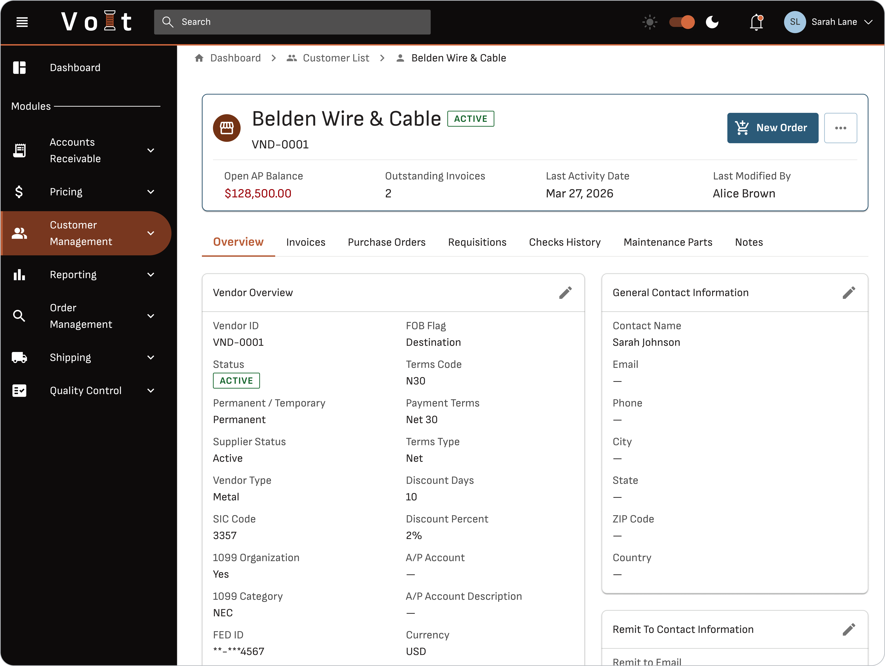
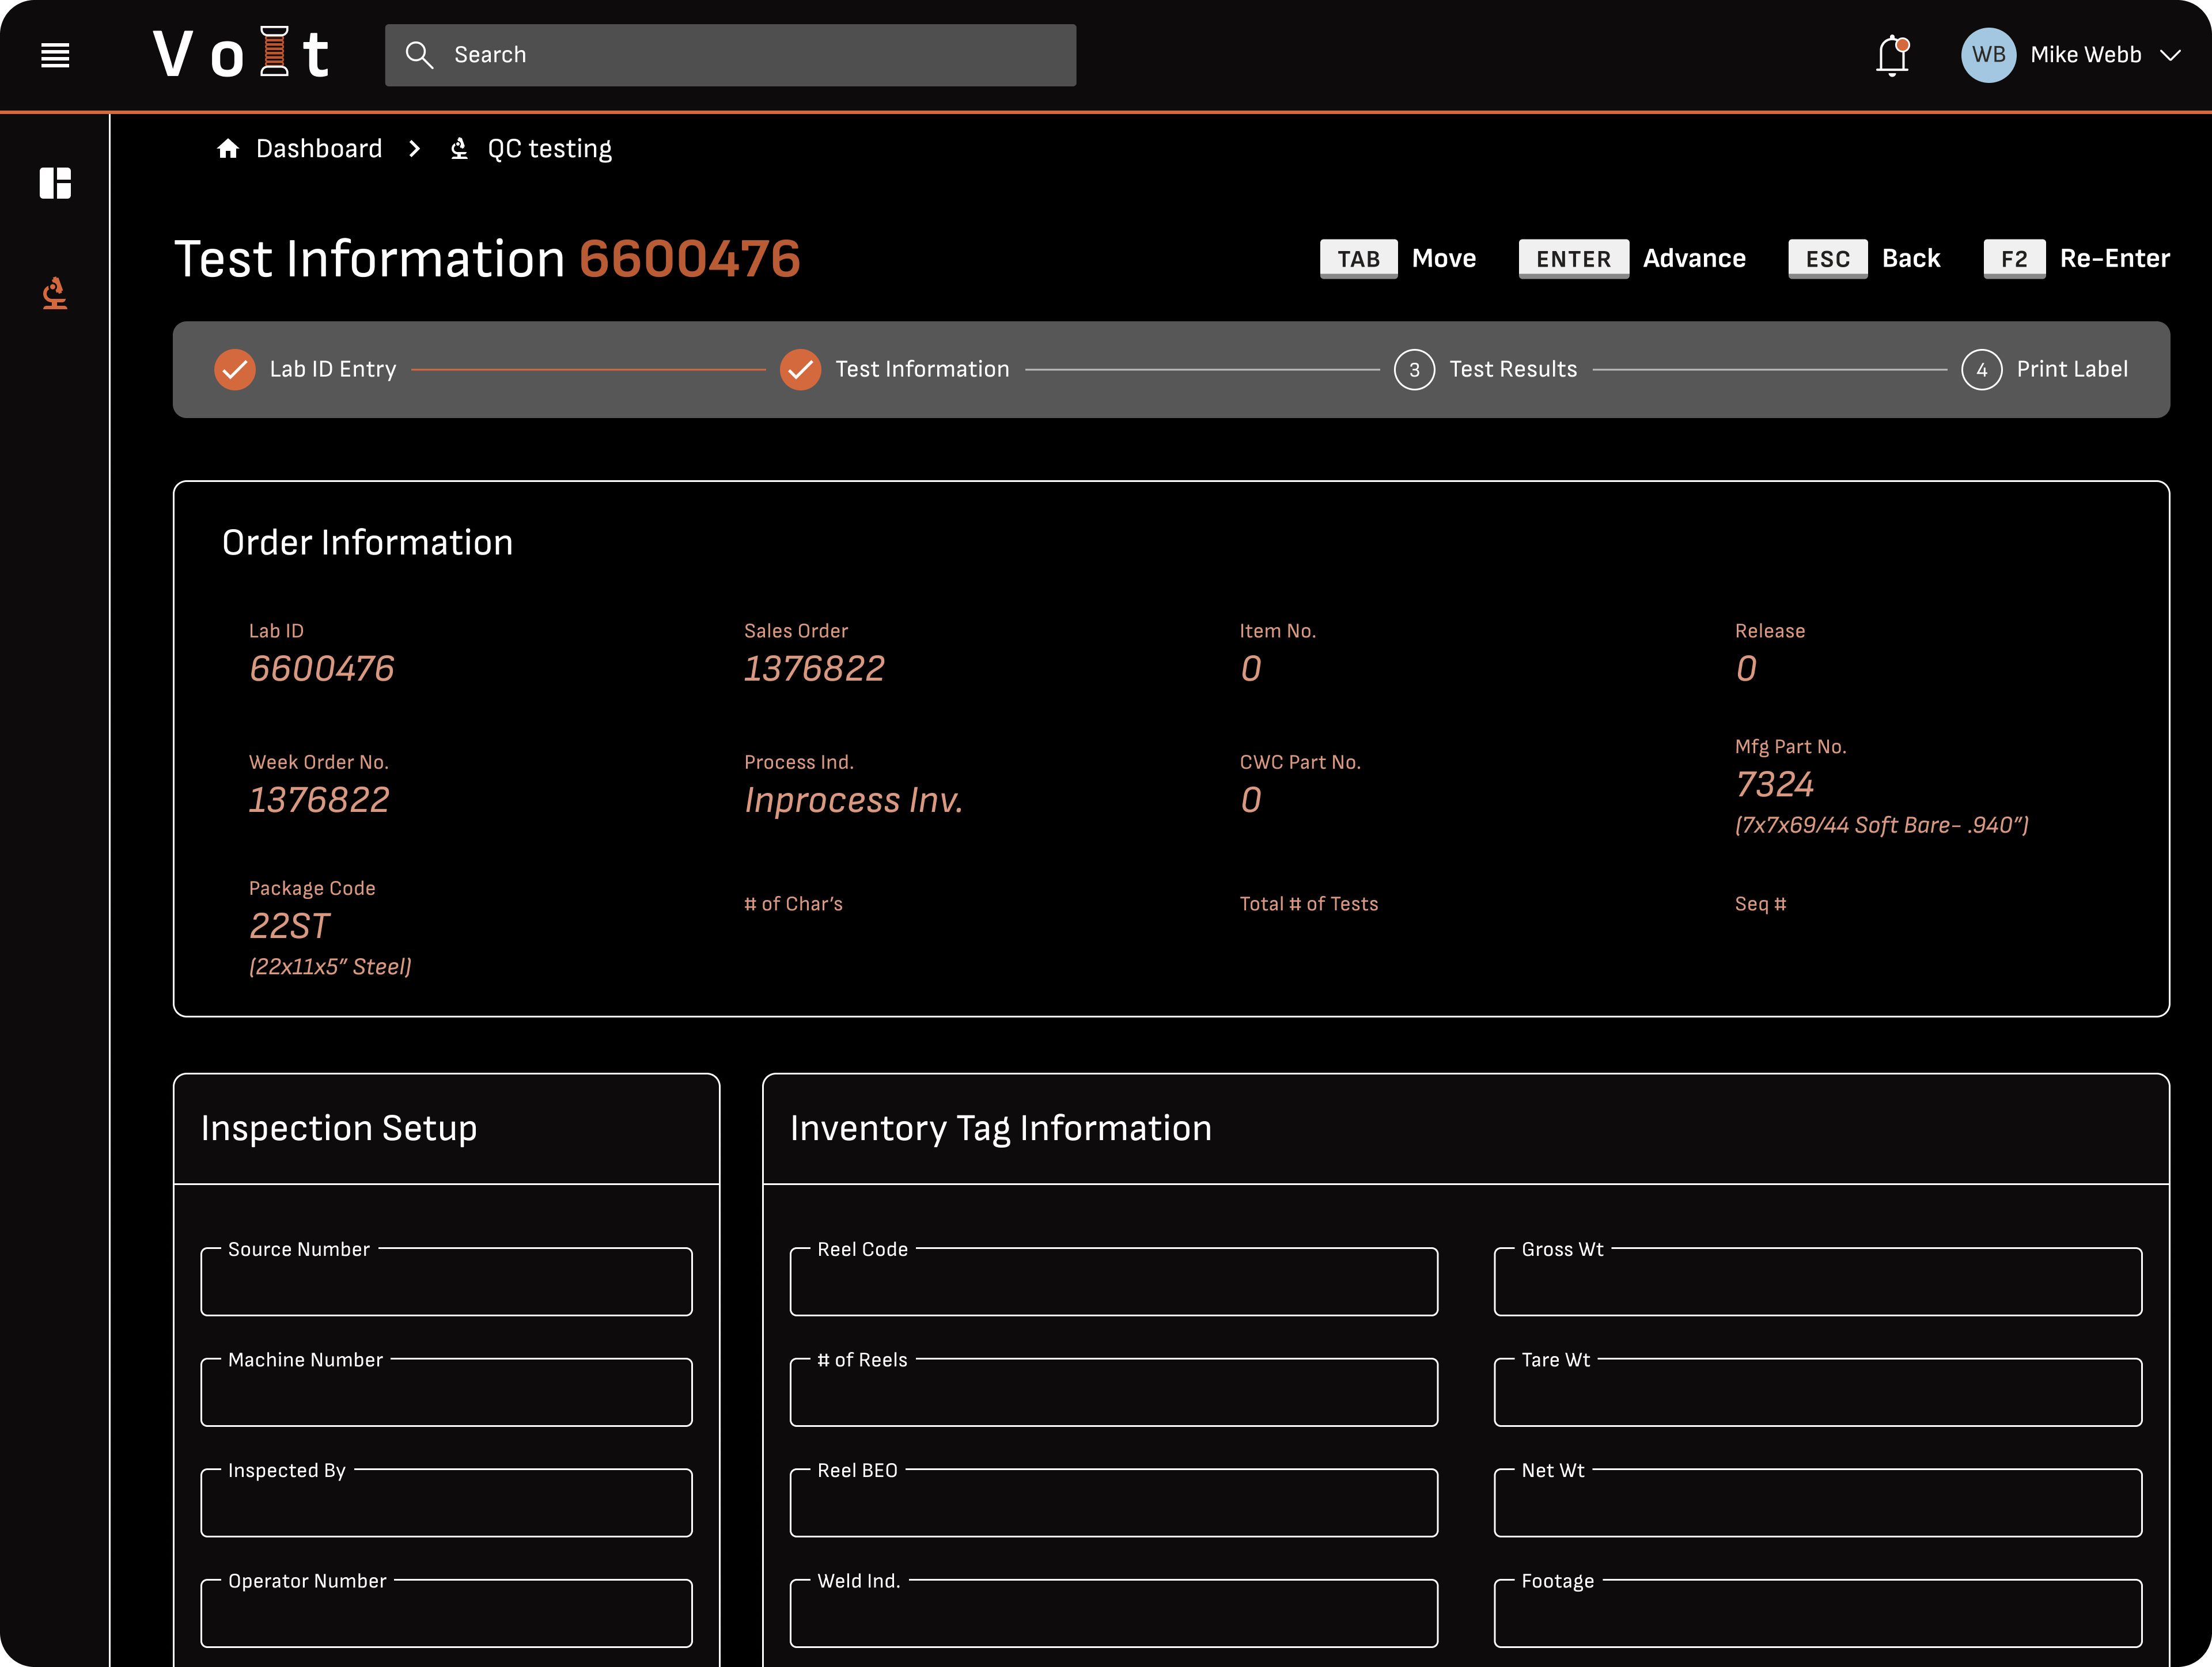
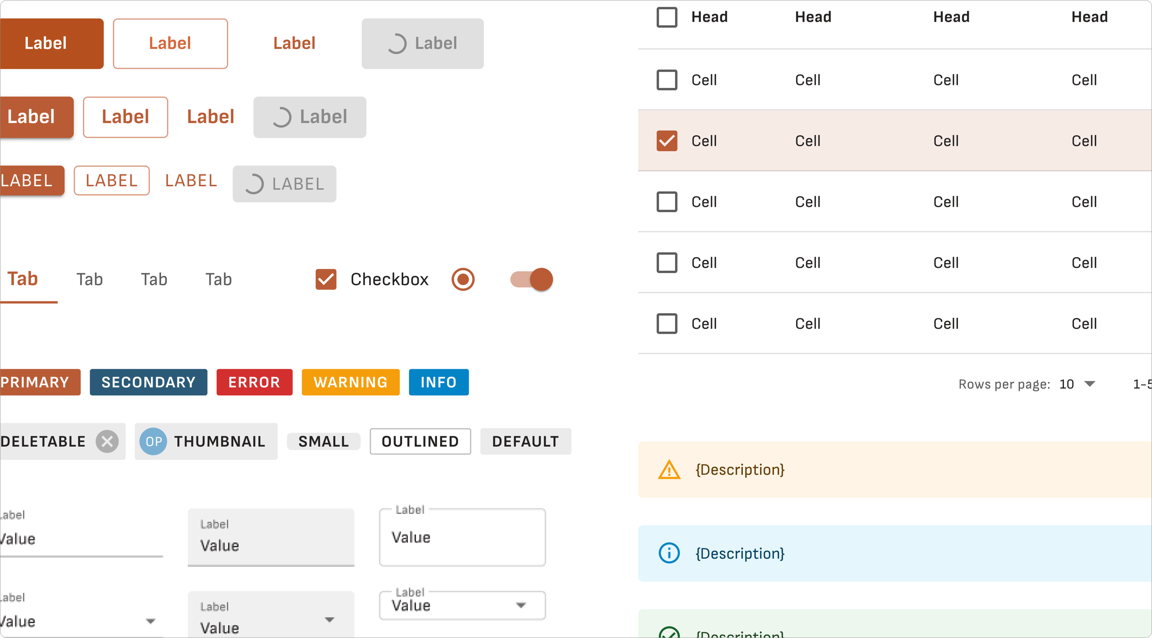
Case study
Volt ERP replaced legacy friction with a reusable design system
Pantheon case evidence: MUI patterns, working prototypes and AI-assisted handoff
International Wire Group’s VAX-based system created friction across factory and back-office work. Volt ERP established modern MUI patterns and a documented system that scales across domains.
How We Helped
400+
Estimated screens for the full ERP
Document reusable MUI interactions
Test edge cases in a working prototype
Use Figma + Claude for structured developer handoff
Maintain living documentation as components grow
20+
Screens designed to establish reusable patterns
1
Documented design system
30
Notes:
Original authored content retained for provenance:
source-5-copy:
International Wire Group, a copper wire manufacturer, relied on a decades-old VAX-based mainframe system across QC, customer management, AP documents, and scheduling, creating friction for factory floor and back-office teams alike. We designed Volt ERP, a modern MUI-based platform, establishing reusable patterns like split panels, drawer editing, and multi-step forms across each domain. The result is a scalable, documented design system and an AI-assisted design-to-dev workflow that keeps specs and engineering in sync as the platform grows.
source-6-copy:
Pantheon Volt
source-7-copy:
Designed the all-new Volt ERP experience, retiring decades of legacy mainframe operations
source-40-copy:
Case study
source-41-copy:
400+
source-42-copy:
Screens estimated to complete the full ERP system
source-47-copy:
How We Helped
source-11-copy:
Established a comprehensive MUI component system with documented interaction rules
Rapidly tested edge cases and alternate scenarios in a working prototype rather than static documentation
Built an AI-assisted workflow, exporting Figma designs and using Claude to generate structured, reusable documentation for developer handoff
Replaced inconsistent manual handoff processes with a living documentation system that scales as new components are added
source-17-copy:
20+
source-18-copy:
Screens designed, establishing the reusable system
source-20-copy:
1
source-21-copy:
Documented design system enabling that scale
WMDS foundation reference; synthetic labels. Source files and exact font identities are in layout-report.json. This Go layout profile requires PowerPoint qualification.

Slide 31
REPRESENTATIVE EMS MARKET CAPABILITIES
Six capabilities support controlled implementation
IMPLEMENTATION EXPERTISE
Controlled delivery
01
Governance
02
Multi-site
03
Coordination
Decision rights, executive reporting and program controls.
Phased deployments, milestones and readiness across operating units.
Align teams, vendors and third parties around dependencies.
West Monroe capabilities for complex, multi-site technology implementations.
04
Go-live
05
Processes
06
Adoption
Govern testing, cutover, stabilization and operations handoff.
Standardize practical workflows while accommodating local requirements.
Build stakeholder alignment, training and sustained adoption.
31
Notes:
Original authored content retained for provenance:
source-4-copy:
West Monroe brings relevant EMS market exposure and proven capabilities to support complex, multi-site technology implementations
source-5-copy:
Our expertise
source-7-copy:
Strategic PMO & Program Governance
Establish fit-for-purpose governance, decision rights, executive reporting, and program controls across scope, risk, issues, and dependencies
Multi-Site Implementation Management
Coordinate phased deployment plans, milestones, and readiness across operating units with differing processes and implementation needs
Vendor & Cross-Functional Coordination
Align business, technology, vendor, and third-party teams while actively managing interdependencies, risks, and issue resolution
Testing, Cutover & Go-Live Readiness
Govern testing, cutover, go-live, and stabilization activities to support a controlled deployment and smooth transition to operations
Process Optimization & Standardization
Align future-state workflows across locations, standardizing where practical while accommodating necessary local requirements
Organizational Change Management
Drive stakeholder alignment, communications, readiness, training, and adoption to support sustained ways of working
source-11-copy:
RELEVANT SCOPE & CAPABILITIES
source-13-copy:
REPRESENTATIVE EXPERIENCE
source-8-copy:
In Scope
source-12-copy:
WM has capability to support if needed
draft-15-copy:
Update
Insert other services we have worked with before
WMDS foundation reference; synthetic labels. Source files and exact font identities are in layout-report.json. This Go layout profile requires PowerPoint qualification.

Slide 32
Representative biographies
32
Notes:
Original authored content retained for provenance:
source-3-copy:
Representative Bio’s
WMDS foundation reference; synthetic labels. Source files and exact font identities are in layout-report.json. This Go layout profile requires PowerPoint qualification.

Slide 33

REPRESENTATIVE LEADERSHIP
Tyler Giesting
RELEVANT PERSPECTIVE
Helps healthcare and private equity clients assess, plan and implement technology initiatives that advance growth.
BACKGROUND
SELECTED EXPERIENCE
Former healthcare operator; 10+ years at West Monroe across payer, provider and healthcare IT sectors.
Supported 400+ transactions
EMR / practice-management platforms and multi-site services
Technology diligence, roadmap execution and implementation
Tyler
Managing Director · Healthcare M&A
33
Notes:
33
Original authored content retained for provenance:
source-6-copy:
Tyler Giesting
Managing Director, Healthcare M&A
source-7-copy:
Background
Tyler is a leader on West Monroe’s Healthcare M&A team, focusing on payer, provider and healthcare IT sectors. During his 10+ years at West Monroe, he’s supported 400+ transactions and has helped hundreds of private equity firms and portfolio companies assess, plan, and implement technology initiatives that advance growth objectives.
Tyler brings hands-on experience across multi-site, post-acute, and home-based services; revenue cycle and payment integrity; payer services and cost containment; EMR/PMS platforms; and value-based primary care models.
In 2025, he was named to M&A Advisors’ Emerging Leaders list and is a frequent source on healthcare M&A for CNBC, Axios, Modern Healthcare, and other leading outlets. Prior to joining WM, Tyler managed contact center operations and technology for a health system.
What makes Tyler different
A proud Indiana native, Tyler grew up during the heyday of Indiana college and pro basketball and enjoys catching a game when he can.
Where Tyler makes an impact
As a former healthcare operator, Tyler helps clients navigate complex and emerging industry dynamics to identify solutions that move the needle on cost, quality, and outcomes.
source-8-copy:
Industries served
Payer & Provider Services
Healthcare IT & Technology-Enabled Services
Private Equity
source-9-copy:
Skills & Specialties
Sell-side diligence & exit planning
Buy-side diligence & M&A integration
Commercial & competitive diligence
Value identification & roadmap execution; product strategy; vendor selection & implementation
LSS & process improvement
WMDS bound template. Content classification: supplied_content. Frozen source and binding provenance are recorded in layout-report.json and binding-report.json.

Slide 34
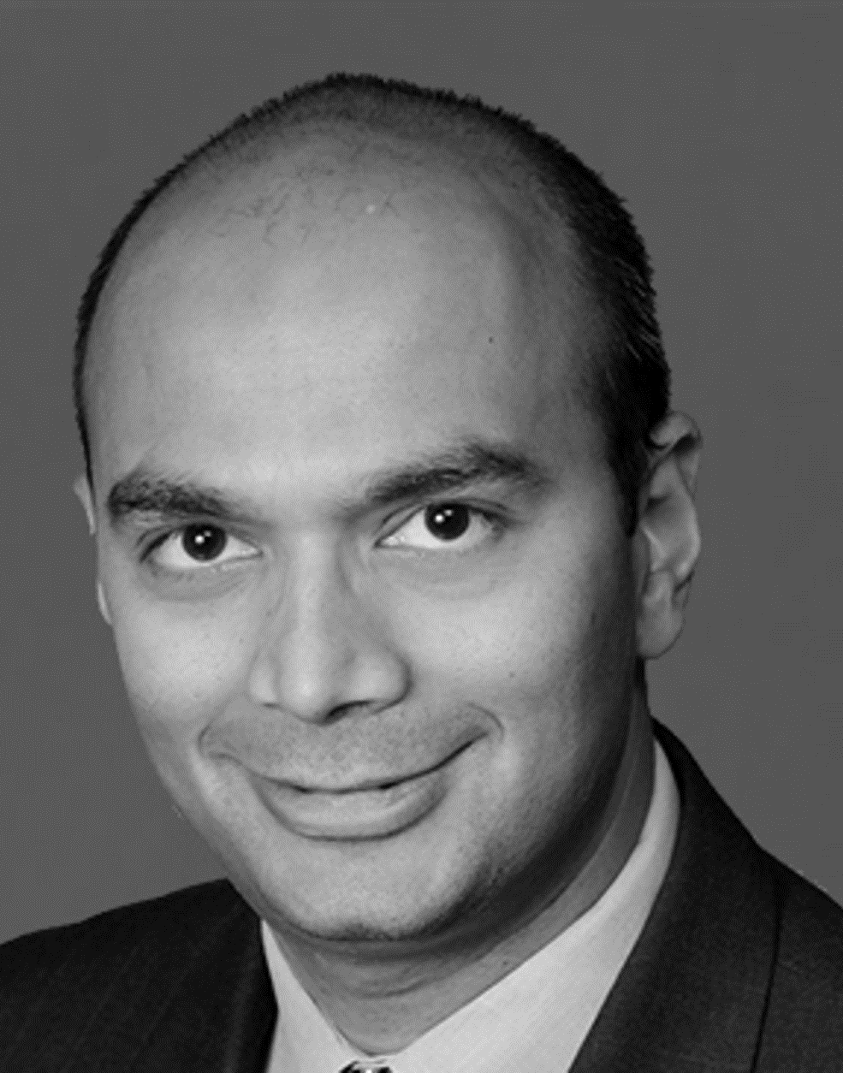
REPRESENTATIVE LEADERSHIP
Dhaval Moogimane
RELEVANT PERSPECTIVE
Helps software and technology companies build products, pursue growth and transition to subscription business models.
BACKGROUND
SELECTED EXPERIENCE
Decades of consulting experience; formerly a Waterstone Group managing director. Mumbai University and Indiana University degrees.
Tripled subscription revenue through an operating-model transformation
Increased SaaS customer retention
Launched subscription offerings delivering $200M+ in value
Dhaval
Senior Partner · High-Tech & Software
34
Notes:
34
Original authored content retained for provenance:
source-6-copy:
Dhaval Moogimane
Senior Partner, High-Tech & Software
source-7-copy:
Background
Leveraging decades of consulting experience, Dhaval specializes in helping software, technology, and IT services companies capitalize on emerging trends and drive growth. He has partnered with clients to create and grow new products, maximize value through M&A transactions, drive cross-functional initiatives, enable profitable growth through digital transformation, and transition to subscription-based business models. Dhaval energizes and aligns teams around growth opportunities and mentors junior consultants. Prior to joining West Monroe, he was a managing director at Waterstone Group. He holds degrees from Mumbai University and Indiana University.
What makes Dhaval different
A husband and father, Dhaval enjoys hiking, biking, and traveling. He has spent time in more than 25 countries and has lived and worked on three continents.
Where Dhaval makes an impact
Dhaval led the transformation of an enterprise software company’s operating model, tripling subscription revenue. He transformed a SaaS provider’s customer engagement model, increasing retention rates, and launched subscription offerings delivering over $200 million in value.
source-8-copy:
Industries served
Private Equity
source-9-copy:
Skills & Specialties
25+ Ops and Strategy engagements with enterprise software providers
$1 B Information Mgt Provider: Post sales operating model transformation
$1.4B Workforce Mgmt. Software: SaaS Transformation
$700M Higher Ed Software: Cloud offering launch and scale
WMDS bound template. Content classification: supplied_content. Frozen source and binding provenance are recorded in layout-report.json and binding-report.json.

Slide 35

REPRESENTATIVE LEADERSHIP
Erik Brown
RELEVANT PERSPECTIVE
Software engineer, entrepreneur and engineering leader using cloud and AI to drive business value.
BACKGROUND
SELECTED EXPERIENCE
Executive technical lead for West Monroe’s AI Lab; leads the PXEL engineering team. University of Illinois graduate.
Led a $20M technology roadmap project
Cut client technology costs by $10M+ annually
Rolled out an internal AI platform and client-facing accelerators
Erik
Senior Partner · PXEL
35
Notes:
Original authored content retained for provenance:
source-6-copy:
Erik Brown
Senior
Partner, Product
Experience and Engineering Lab
source-7-copy:
Background
Erik is a seasoned software engineer, entrepreneur, and leader who leverages innovative technology to drive business value. He led a $20 million technology roadmap project, enhancing a client’s risk modeling and cutting technology costs by over $10 million annually. As the executive technical lead for West Monroe’s AI Lab, he spearheaded the rollout of an internal AI chat platform and client-facing AI accelerators. Erik frequently speaks at industry events and hosts West Monroe’s “This is Digital” podcast. With extensive experience in software engineering, cloud computing, and AI, he leads the engineering team in PXEL practice. Erik holds a bachelor’s degree from the University
of Illinois.
What makes Erik different
Erik lives in Chicago with his family, enjoys music, and blends artistic expression with math and science through piano.
Where Erik makes an impact
Erik volunteers at St. Francis Xavier School, leading the Technology Committee; West Monroe designs their annual report.
source-8-copy:
Industries served
Healthcare
Private Equity
Capital Markets
source-9-copy:
Skills & Specialties
Machine Learning / Artificial Intelligence
Amazon Web Services
Microsoft Windows Azure
Enterprise messaging and distributed architecture
Java/JEE, Microsoft .NET & Python
WMDS bound template. Content classification: supplied_content. Frozen source and binding provenance are recorded in layout-report.json and binding-report.json.

Slide 36

REPRESENTATIVE LEADERSHIP
Ri Scott
PRACTICE FOCUS
Product engineering and software modernization; artificial intelligence and an AI-native product development lifecycle.
BACKGROUND AND EXPERIENCE
LISTED SPECIALTIES
Background and selected experience · content pending
Artificial intelligence and software modernization
Microsoft .NET, Go, Python and TypeScript
Web application development
Ri
Managing Partner · Product Engineering
36
Notes:
Original authored content retained for provenance:
source-6-copy:
Ri Scott
Managing Partner
Product Engineering & Software Modernization
source-7-copy:
Background
To fill in
What makes Ri different
To fill in
Where Erik makes an impact
To fill in
source-8-copy:
Industries served
Healthcare
Private Equity
Financial Services
Technology & Software
source-9-copy:
Skills & Specialties
Artificial Intelligence
Software Modernization
AI-Native Product Development Lifecycle
Microsoft .NET, Go, Python, TypeScript, Web Application Development
WMDS bound template. Content classification: supplied_content. Frozen source and binding provenance are recorded in layout-report.json and binding-report.json.

Slide 37
PHASE ZERO · DISCUSSION DRAFT
Mobilize Phase 0 and establish the baseline
FIRST 30 DAYS
Baseline before delivery
01
Estate
02
Tests
03
Environments
Validate the current technology estate.
Validate the existing performance suite.
Validate development and test environments.
Establish a shared starting point for architecture, modernization and performance assurance.
04
Datasets
05
Priorities
06
Measures
Validate the data needed for testing.
Align the priorities for initial delivery.
Define telemetry and acceptance measures.
37
Notes:
Our Differentiators:
- Easier technology due diligence in future transactions
- Improved SOX readiness through:
Clear data lineage
Modern controls
Documented architecture
- Platform extensibility:
Multi-entity support
Future acquisitions
- Reduced dependency on tribal knowledge
37
Original authored content retained for provenance:
source-16-copy:
Eaglesoft will eliminate critical business continuity concerns, preserve critical features, drive differentiation, and unlock future optionality for the enterprise.
source-10-copy:
RESULTS YOU CAN COUNT ON
Functional parity with the VAX
Improved SOX readiness through:
Clear data lineage
Modern controls
Documented architecture
Platform extensibility:
Multi-entity support
Future acquisitions
Reduced dependency on tribal knowledge
source-7-copy:
Scalable, secure & maintainable enterprise architecture
source-9-copy:
DATABASE
Azure SQL
source-8-copy:
BACK END
Node.js
source-6-copy:
FRONT END
React.js
source-20-copy:
REPORTING
PowerBI
source-21-copy:
INTEGRATIONS
Salesforce
source-53-copy:
KEY FEATURE
source-55-copy:
Scalable integration framework for future expansions
source-56-copy:
KEY FEATURE
source-57-copy:
Responsive UI
optimized for desktop users and capable of rendering on tablet and mobile devices
source-58-copy:
KEY FEATURE
source-60-copy:
Modernized reporting
and analytics
source-23-copy:
KEY FEATURE
source-24-copy:
Single language (JavaScript) for Front and Back End development
source-80-copy:
DEV
source-139-copy:
ENVIRONMENT SETUP
source-145-copy:
QA
source-146-copy:
TEST
source-147-copy:
PROD
draft-11-copy:
Update
Phase Zero mobilization and baseline - First 30 days to validate the estate, existing performance suite, environments, datasets, priorities, telemetry, and acceptance measures.
WMDS foundation reference; synthetic labels. Source files and exact font identities are in layout-report.json. This Go layout profile requires PowerPoint qualification.

Slide 38
MODERNIZATION FACTORY · DISCUSSION DRAFT
Move priority journeys from inventory to handoff
01
02
03
04
05
06
07
Inventory
Domain design
Conversion
Testing
Parallel operation
Rollout
Handoff
EXECUTION ACCELERATOR
CONTROLLED TRANSITION
AI can accelerate source analysis and coding throughout the modernization factory.
Testing, parallel operation, rollout and handoff remain explicit stages rather than a screen-only rewrite.
38
Notes:
Original authored content retained for provenance:
source-5-copy:
Working with your team (and our AI-tools and your source code), we’ve already identified the functional and
non-functional backlog that must be delivered.
source-8-copy:
545 Total Functional Features
Fairly evenly split between WM (250) and Pantheon (235) contributions
(not MECE)
Jointly identified scope: 51
Broken up into 232 Epics
54 Non-functional Requirements
All requirements are broken divided into 20 Business Capability Domains
source-6-copy:
Scalable, secure & maintainable enterprise architecture
domain-9-column-1-copy:
Customer Management
Order Management
Pricing
Complaint Tracking
Purchasing
Inventory
Warehouse
Toll Customer
Scheduling
QC Testing
domain-9-column-2-copy:
MOTARS
Engineering
AP
AR
GL
Payroll
Reporting
Security & Access Control
Error Handling & Exceptions
System Administration & Monitoring
draft-12-copy:
Update
Modernization Factory- How priority workflows move from inventory through domain design, conversion, testing, parallel operation, rollout, and handoff. Including AI as an execution accelerator for analysis and coding.
Milestones could include: inventory, prioritize, prove, migrate, scale
WMDS foundation reference; synthetic labels. Source files and exact font identities are in layout-report.json. This Go layout profile requires PowerPoint qualification.

Slide 39
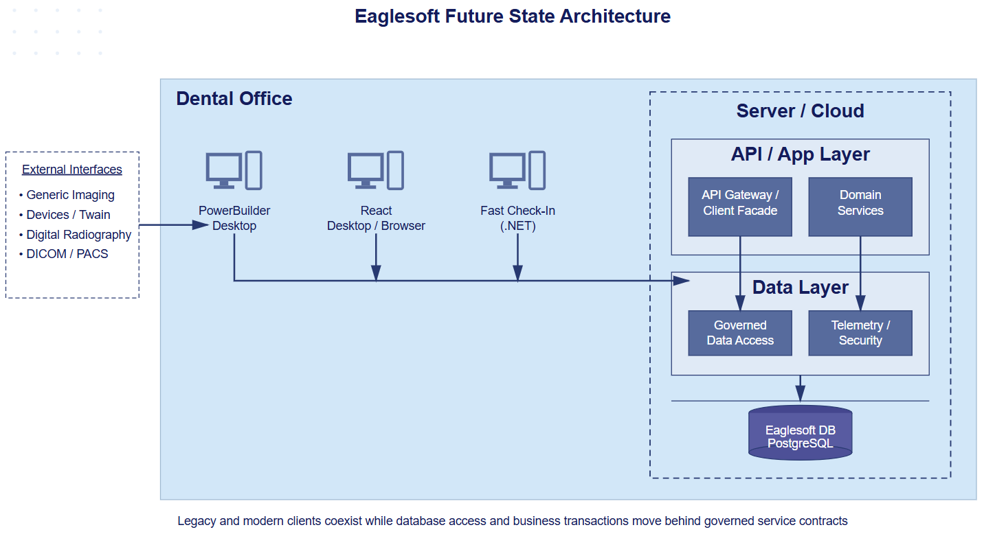
Reuse a governed service and domain foundation
Co-develop a foundation that decouples PowerBuilder from direct database access and supports future browser delivery.
Conceptual Future State Architecture
Remove direct PowerBuilder database access
Establish a stable API boundary and domain layer
Govern PostgreSQL interaction centrally
Preserve a path to future scale and security
Reusable across desktop workflows, browser experiences and potential SaaS products; target decisions require validation.
39
Notes:
Original authored content retained for provenance:
source-11-copy:
Conceptual Future State Architecture
source-4-copy:
We’ll design and
co-develop a scalable, flexible solution that will help enable Eaglesoft to transition from a database-coupled PowerBuilder architecture to a governed service and domain architecture that supports modernization and future browser-based deployment..
source-5-copy:
Scalable, secure & maintainable enterprise architecture
source-7-copy:
We’ll work hand-in-hand with you to design a future-state architecture that:
Removes direct database access from PowerBuilder
Introduces a stable service/API boundary
Establishes a domain-oriented application layer
Centralizes and governs PostgreSQL data access
Among other changes to enable future scalability and security
draft-12-copy:
Update
Reusable Data and API Foundation- Explain that the architecture is intended to be reused across PowerBuilder and desktop workflows, browser experiences, and SaaS products. Creates foundation for Saas Journey
WMDS foundation reference; synthetic labels. Source files and exact font identities are in layout-report.json. This Go layout profile requires PowerPoint qualification.

