Slide 1





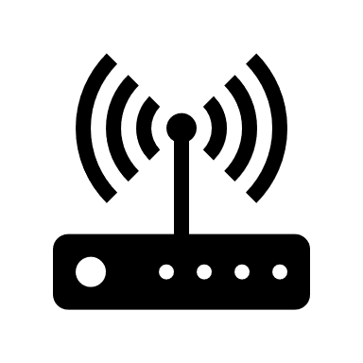
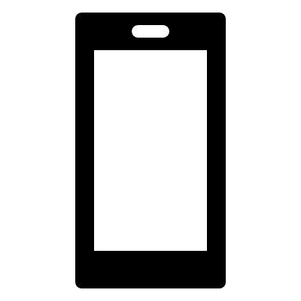
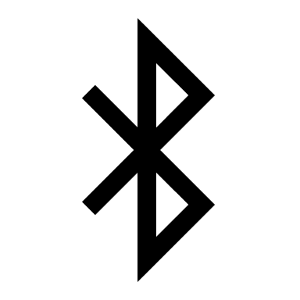



MQTT
MQTT
Bluetooth
WiFi
Bluetooth
WiFi
SCAMBIO DATI

Slide 2





Backend
Server
Frontend

