Slide 1

6th Winter Game Jam
Rover Vos

Slide 2


Slide 3
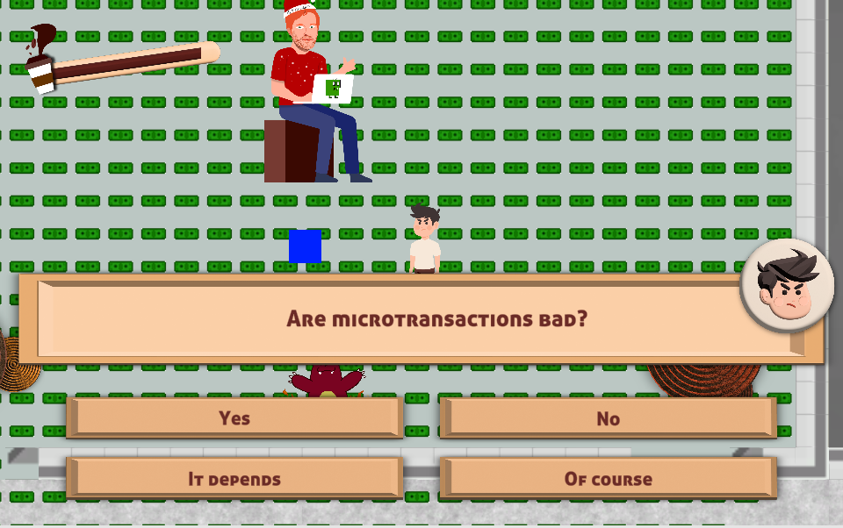
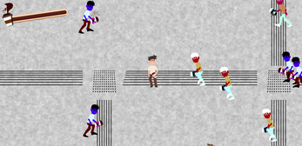

Slide 4
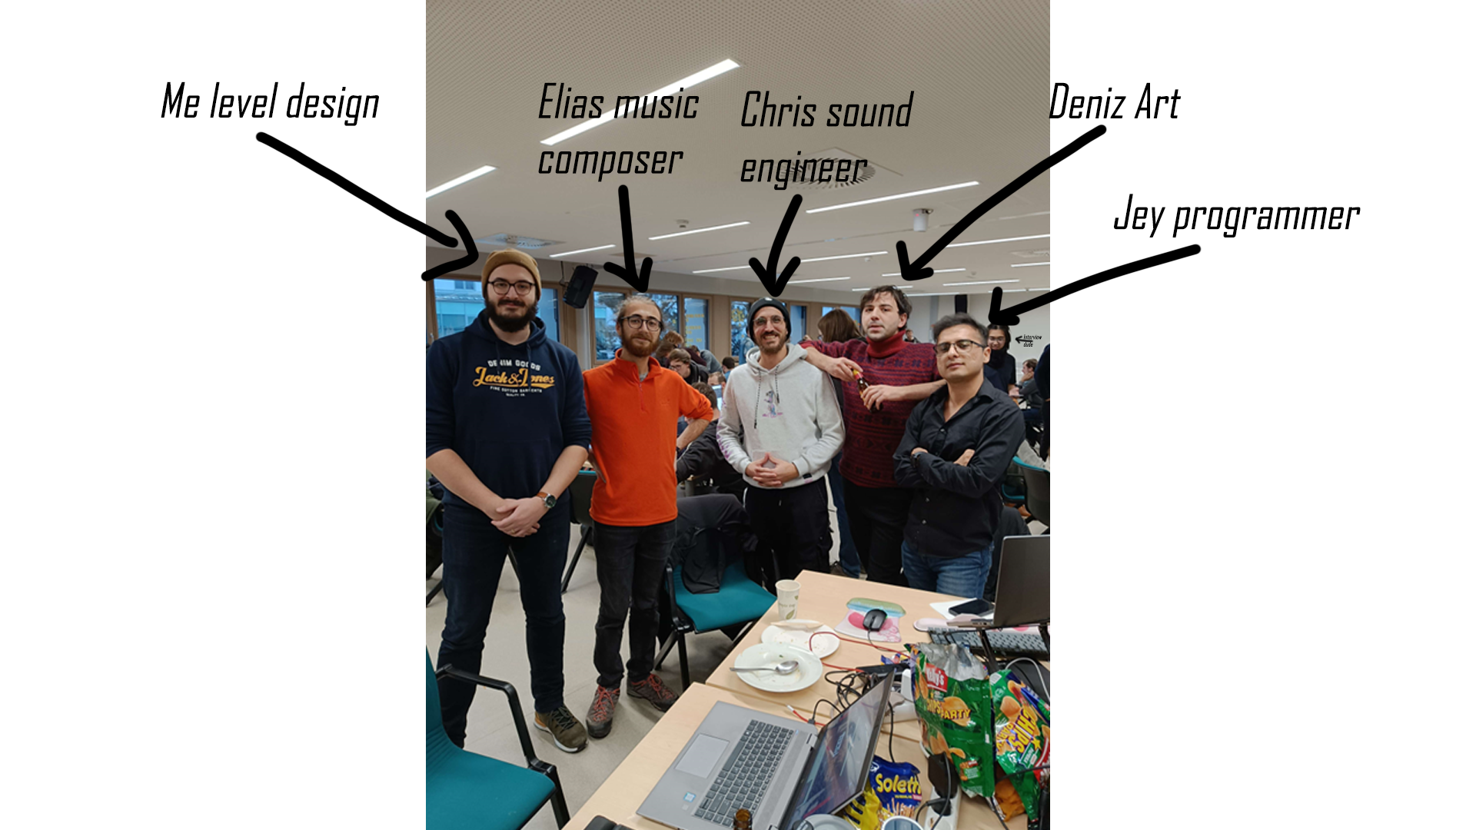

Slide 5
Game Jam take aways

Slide 6
IT WAS FUN

Slide 7
Planning ugh planning.
Burn it down.

Slide 8
Communication is bitter sweet

Slide 9
Can we get some better chairs/tables next time? I am way too tall.

