Slide 1
Laboratory work #2. Modeling of demographic processes
Course: Discrete Mathematical Modeling

Slide 2
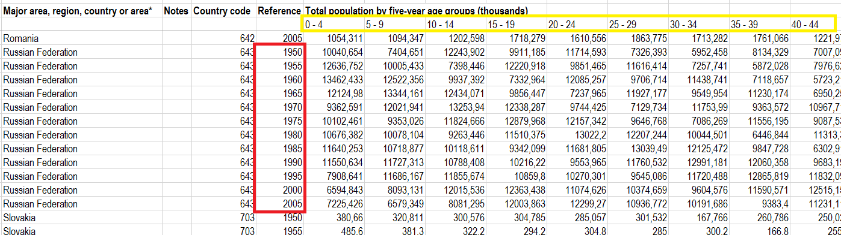
Demographic data
Source: United Nations, Population Division, Department of Economic and Social Affairs (2005) World Population Prospects: The 2004 Revision.

Slide 3
Demographic profile
The number of citizens in the corresponding age category for a given year
2005

Slide 4
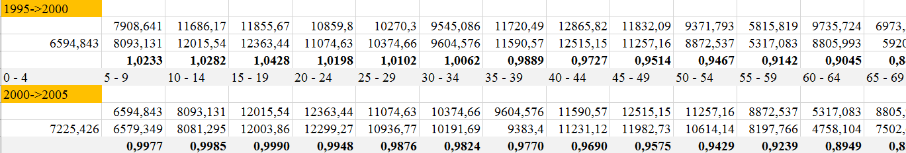
«Survival» rate

Slide 5
Population dynamics
People move from one age category to another with a gradual decrease in numbers

Slide 6
The difference between profile of men and women
The profile of men and women does not match
The number of newborn boys and girls is different

Slide 7
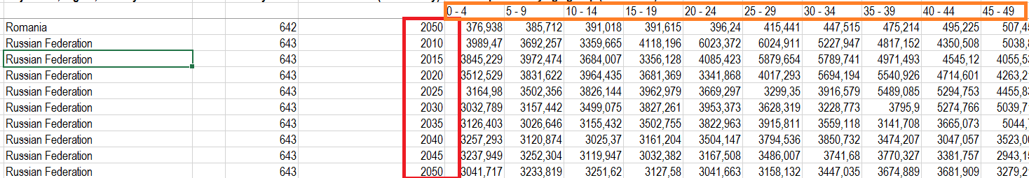
Existing forecast
Modeling at medium fertility rate

Slide 8
Uganda vs France

Slide 9
Task
Determine the «survival» rates independently for men and women for all age groups (“0-4” -> “5-9” -> “10-14” ...) according to 2000-2005 years (data for Russia or any other country)
Determine the fertility rate for women in the age category “20- ... -39”
Calculate boys/girls ratio for newborn children
Predict the change in the country's population and demographic profile for 100 years and compare with existing prediction with fixed determined parameters!
For that:
Write out equations for modeling
Define input/output data and parameters

Slide 10
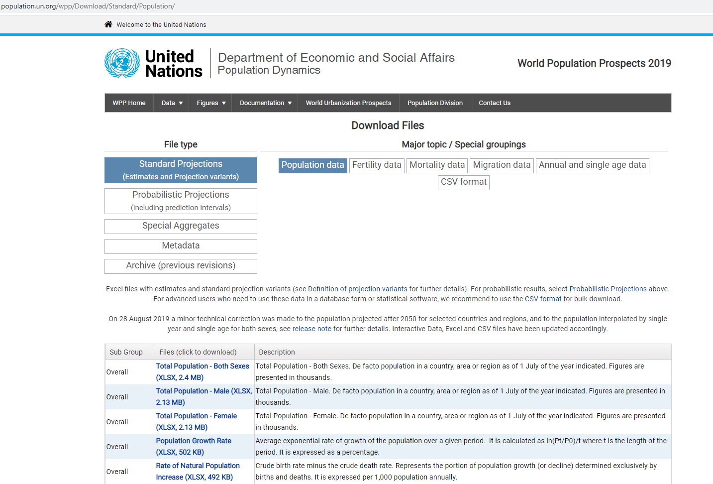
Updated data
https://population.un.org/wpp/Download/Standard/Population/

