Slide 1
A very brief intro to
Android development
Roland Fong ‘19
HackPrinceton 2016
Get everything you need here:
https://github.com/rfblue2/android-fall16-workshop
Download Android Studio:
https://developer.android.com/develop/index.html

Slide 2
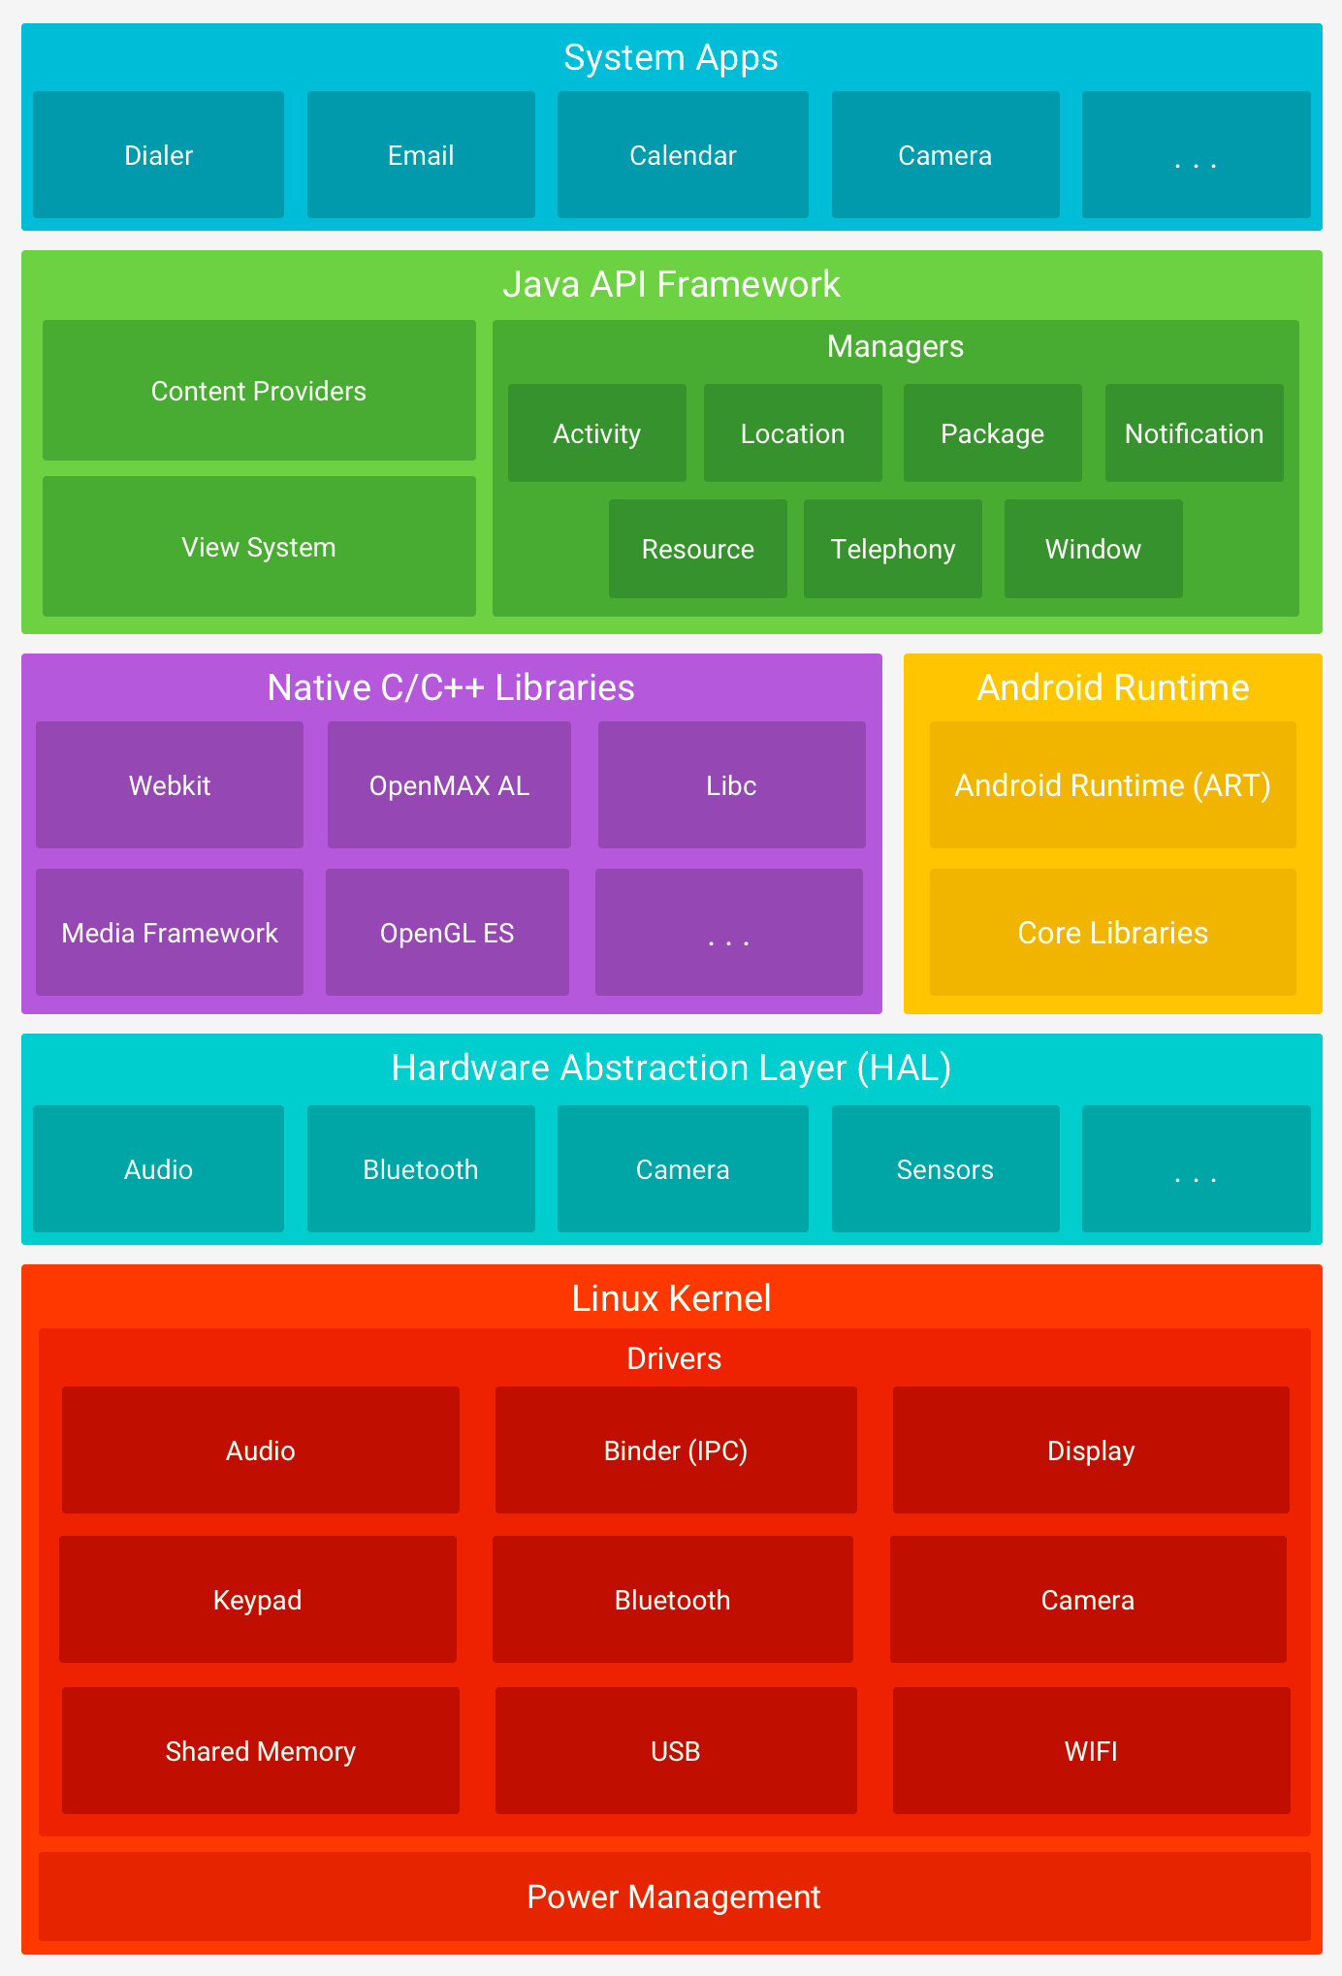
Layers of Android
https://developer.android.com/guide/platform/index.html

Slide 3
App Components
Activity – App entry point, visible interface to user, where all the action is
Service – Runs tasks in the background (also possible App entry point)
Broadcast Receiver – Enables delivering events outside regular user flow (can be used for cross-app communication)
Content Provider – Holds data typically shared between apps

Slide 4
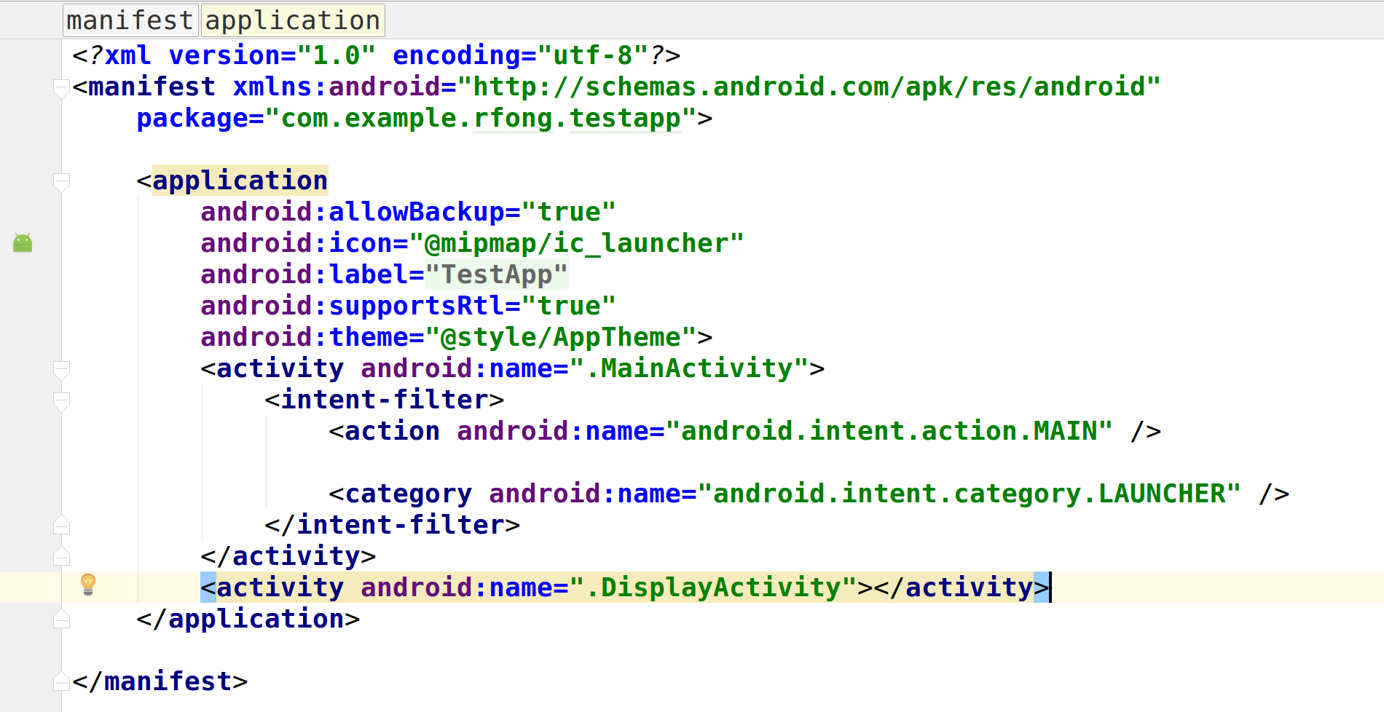
App Manifest

Slide 5
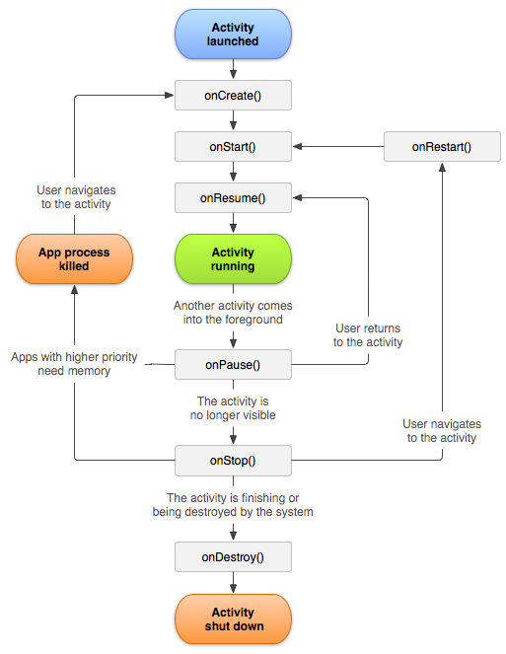
Android Activity Life Cycle
https://developer.android.com/guide/components/activities.html

Slide 6
Resources
MyProject/
src/
MyActivity.java
res/
drawable/
graphic.png
layout/
main_activity.xml
info_fragment.xml
mipmap/
icon.png
values/
strings.xml
Modified from https://developer.android.com/guide/topics/resources/providing-resources.html

Slide 7
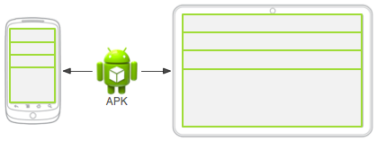
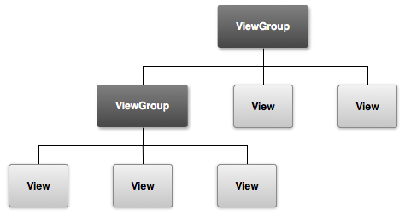
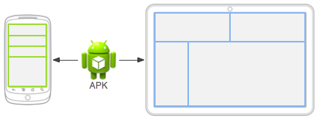
GUI Layout
https://developer.android.com/guide/topics/resources/overview.html

Slide 8
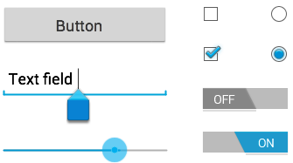
Views
https://developer.android.com/guide/topics/ui/controls.html

Slide 9
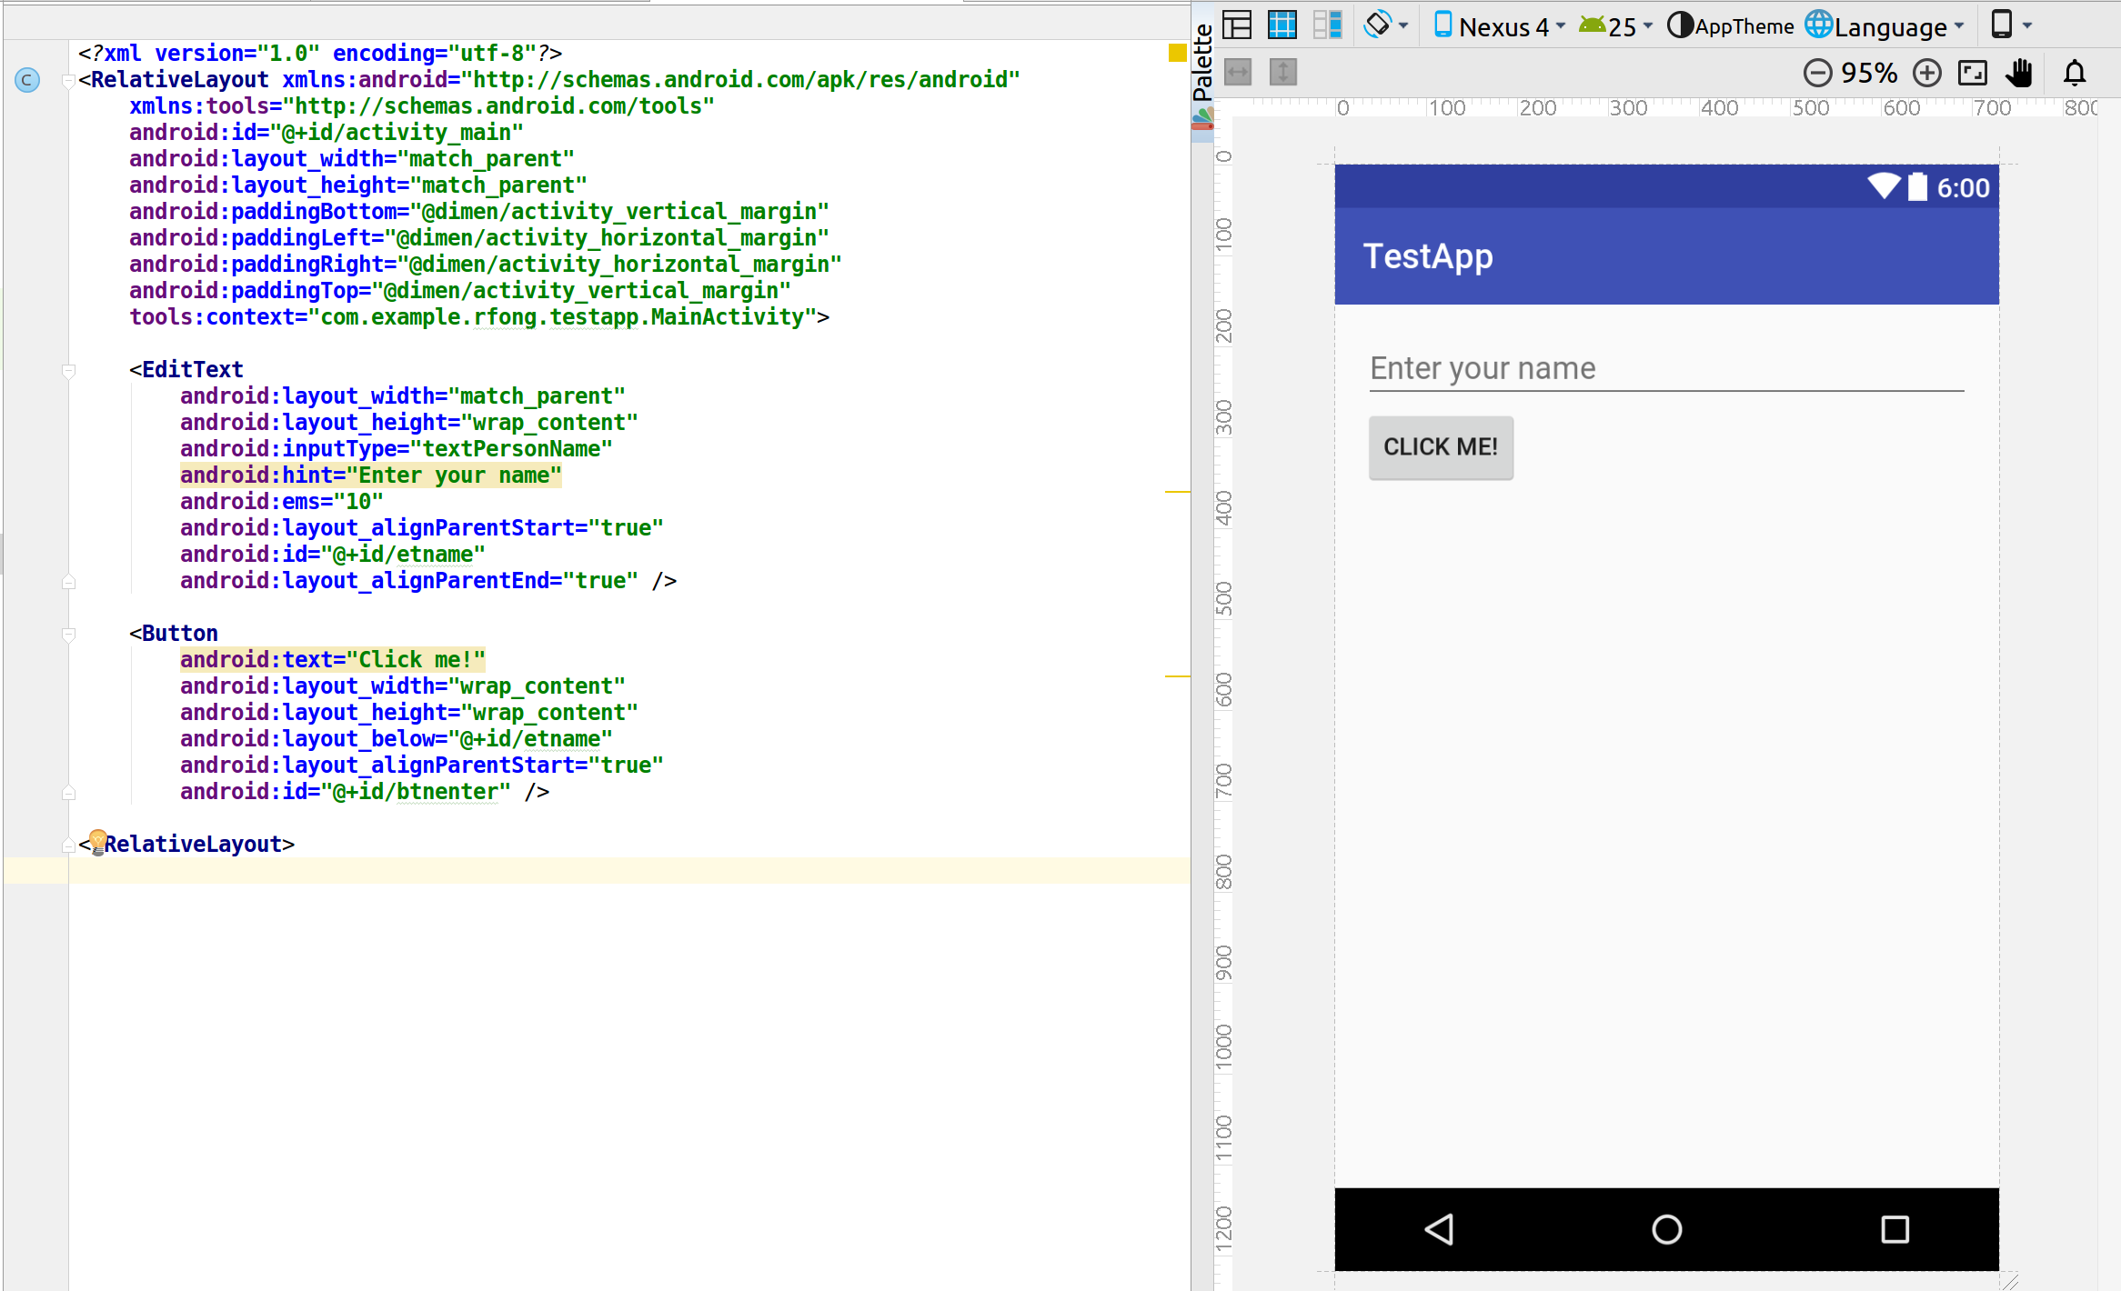
Example of Layout Res file
Gets a resource from dimen.xml
Should convert to resource in string.xml and reference using @string

Slide 10
Input Control
Use Event Listeners
e.g. Buttons have setOnClickListnener() method, taking object implementing OnClickedListener
Two styles:
1)
btn.setOnClickListener(new View.OnClickListener() {
public void onClick(View view) {
// do something
}
});
2)
class SomeActivity implements View.OnClickListener() {
public void someMethod() {
btn.setOnClickListener(this);
}
public void onClick(View view) {
// do something
}
}

Slide 11
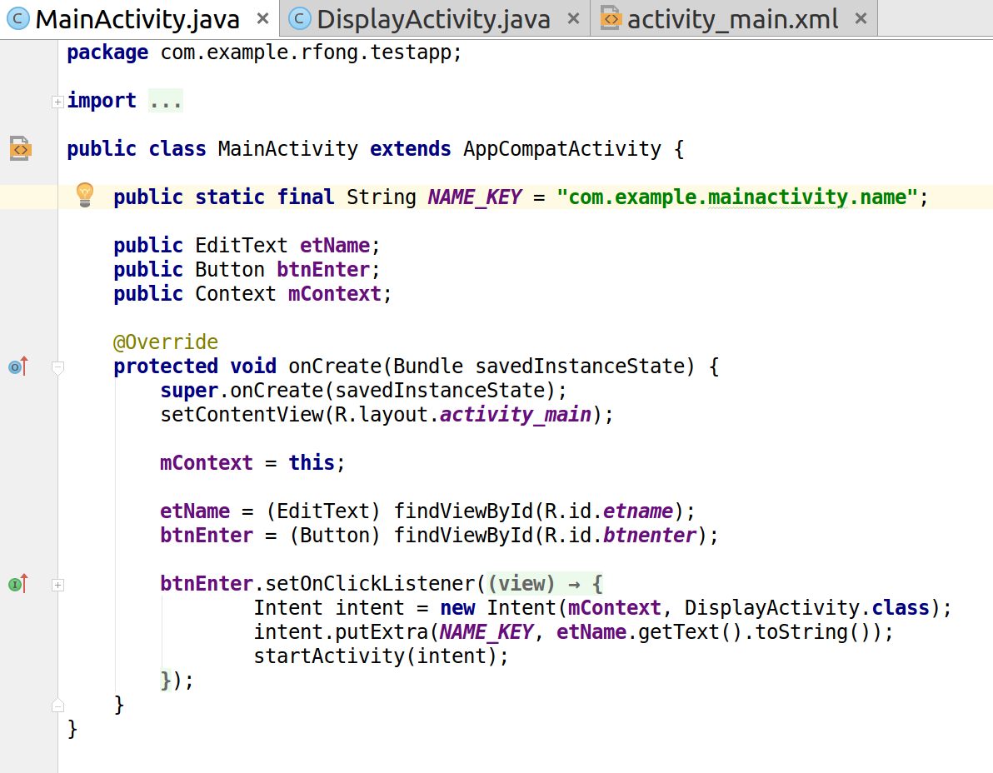
Example of Src file
Gets a layout resource
Gets a resource ID

Slide 12
Reference Material
For API references, tutorials, etc.
https://developer.android.com
Training Tutorials:
https://developer.android.com/guide/components/fundamentals.html

