Slide 1
A very brief intro to
Android development
Get everything you need here:
https://github.com/rfblue2/android-fall16-workshop
Download Android Studio:
https://developer.android.com/develop/index.html

Slide 2
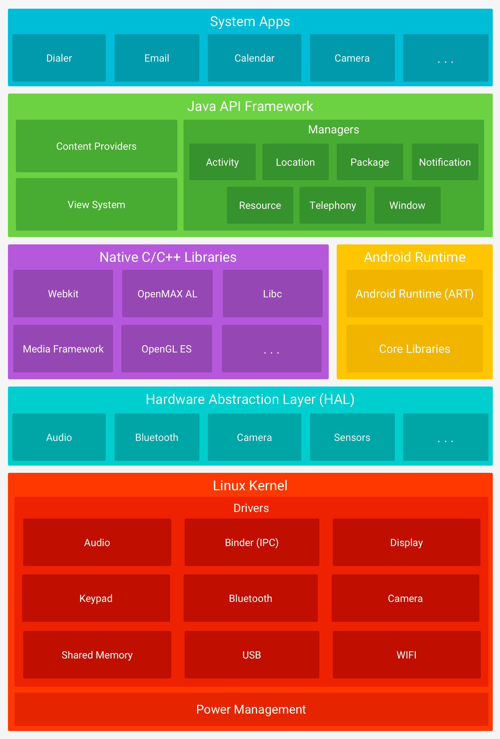
Layers of Android
https://developer.android.com/guide/platform/index.html

Slide 3
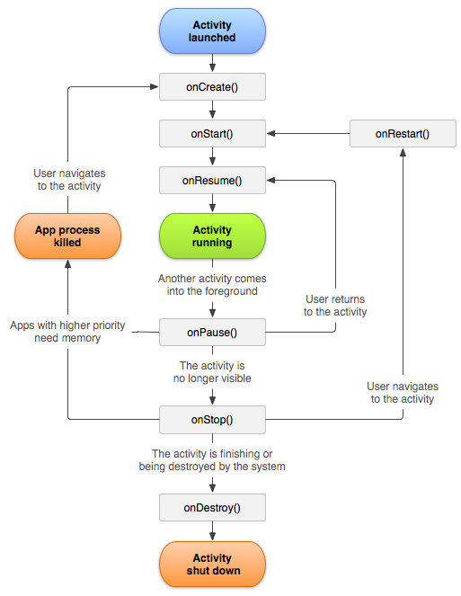
Android Activity Life Cycle
https://developer.android.com/guide/components/activities.html

Slide 4
Resources
MyProject/
src/
MyActivity.java
res/
drawable/
graphic.png
layout/
main_activity.xml
info_fragment.xml
mipmap/
icon.png
values/
strings.xml
Modified from https://developer.android.com/guide/topics/resources/providing-resources.html

Slide 5
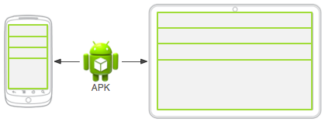
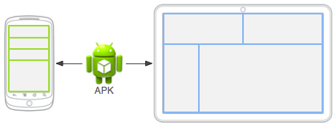
GUI Layout
https://developer.android.com/guide/topics/resources/overview.html

Slide 6
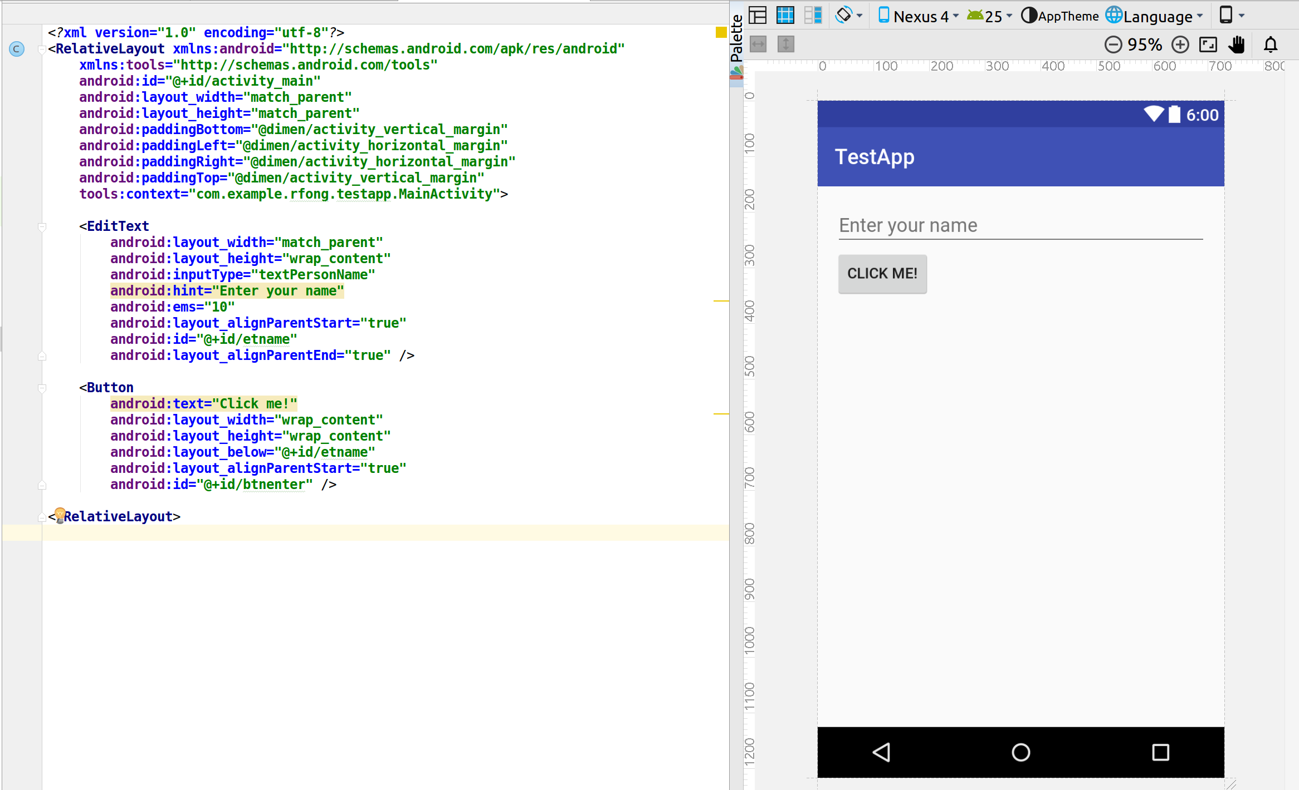
Example of Layout Res file
Gets a resource from dimen.xml
Should convert to resource in string.xml and reference using @string

Slide 7
GUI Layout
https://developer.android.com/guide/topics/resources/overview.html

Slide 8
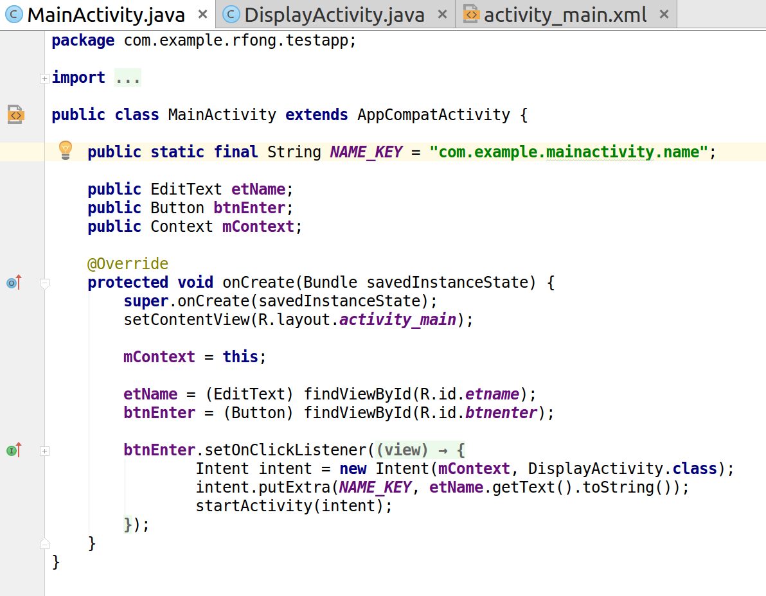
Example of Src file
Gets a layout resource
Gets a resource ID

Slide 9
Reference Material
For API references, tutorials, etc.
https://developer.android.com
Training Tutorials:
https://developer.android.com/guide/components/fundamentals.html

