Slide 1

基于ECG信号的抑郁症识别
任务成果汇报
小组成员： 王中壬 包博文 龚玉传 宋俊翰 张吉康
汇报人：王中壬

Slide 2
1
项目思路介绍
2
现阶段成果
目 录
3
CONTENTS
团队分工
4
下一步工作计划

Slide 3
01
Project Concept Introduction

Slide 4
01 Project Concept Introduction
(a). Background & Motivation
* The incidence of depression is high, with its main symptoms including emotional low mood, loss of interest, and sleep disorders.
* Electrocardiogram (ECG) signals can directly reflect changes in the autonomic nervous system function, which is closely related to mental state.
* By analyzing ECG characteristics, a fast and low-cost objective screening method for depression can be developed.
Therefore, our team utilized traditional machine learning methods to classify by extracting high-dimensional features (time domain + frequency domain), ultimately achieving a depression recognition model based on ECG.

Slide 5
01 Project Concept Introduction
(b). Utilized Datasets
ECSMP (Wearable ECG Monitoring Platform)
Published by Zhilin Gao et al. (2021), it includes multimodal physiological signals (EEG, ECG, etc.) from 89 healthy college students.
Depression levels were assessed using the SDS scale (Self-Rating Depression Scale) and labeled as positive/negative classes.
File format: *.bin (ECG).
Course project dataset
It includes ECG signals from 46 college students.
Similarly assessed and labeled as positive/negative using the SDS scale.
File format: *.mat (ECG).

Slide 6
01 Project Concept Introduction
(b). Utilized Datasets
ECSMP (Wearable ECG Monitoring Platform)
Published by Zhilin Gao et al. (2021), it includes multimodal physiological signals (EEG, ECG, etc.) from 89 healthy college students.
Depression levels were assessed using the SDS scale (Self-Rating Depression Scale) and labeled as positive/negative classes.
File format: *.bin (ECG).
Course project dataset
It includes ECG signals from 46 college students.
Similarly assessed and labeled as positive/negative using the SDS scale.
File format: *.mat (ECG).

Slide 7
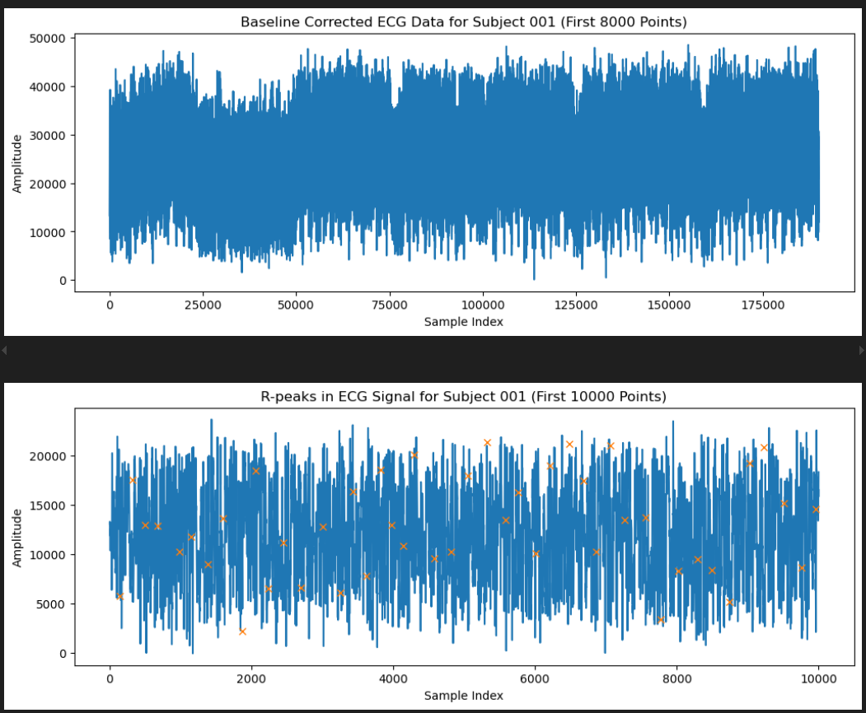
01 Project Concept Introduction
(b). Utilized Datasets

Slide 8
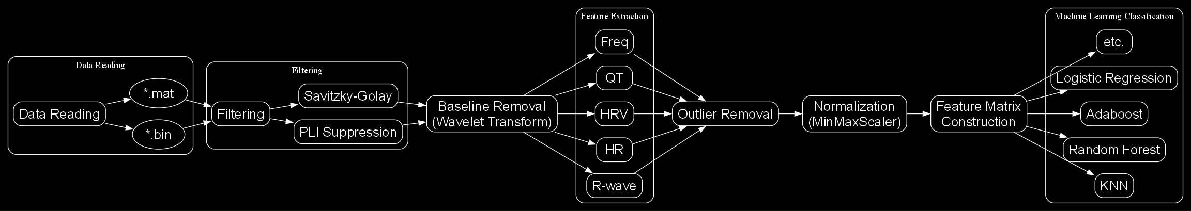
01 Project Concept Introduction
(c). Pipeline
* Data Reading (for .bin / .mat files);
* Filtering (Power Frequency Interference Suppression + Savitzky-Golay);
* Baseline Removal (Wavelet Transform);
* Feature Extraction (R-wave, HR, HRV, QT, etc., plus frequency domain features);
* Outlier Removal (Discard samples with missing data or abnormal features);
* Normalization (MinMaxScaler);
* Feature Matrix Construction/Merging (Positive/Negative + Labels);
* Machine Learning Classification (KNN, Random Forest, etc.).

Slide 9
01 Project Concept Introduction
(c). Pipeline：Data Reading and Preprocessing
Reading of .bin/.mat files:
Skip the first 528 bytes of the header, then parse the data using np.frombuffer(..., dtype=np.uint16)
Iterating through subfolders:
Store each subject's ECG array and corresponding label in a dictionary.
Persist the data using pickle.dump(...) for easy access in subsequent steps.

Slide 10
01 Project Concept Introduction
(c). Pipeline：Signal Filtering and Baseline Drift Correction
Power Frequency Interference Suppression:
Set the 50Hz frequency and its symmetric point to zero in the frequency domain to supress PLI, then transform back to the time domain using inverse FFT.
Savitzky-Golay Filtering:
Use savgol_filter(..., window_length=11, polyorder=3) to remove high-frequency noise.
Wavelet-Based Baseline Correction:
Decompose the signal using pywt.wavedec, set the approximation coefficients to 0, and reconstruct the signal using pywt.waverec.
Use the db4 wavelet with level=1 to remove low-frequency drift.

Slide 11
01 Project Concept Introduction
(c). Pipeline：Feature Extraction and Outlier Removal
Basic Features: Maximum and minimum values.
R-Wave Detection (Pan-Tompkins):
Obtain R-wave positions → Calculate HR (60 / RR interval) and HRV (standard deviation of RR intervals).
Q-T Interval Features:
Locate the Q-wave start and T-wave end using wavelet decomposition → Calculate QT, QTc, and QT dispersion.
Frequency Domain Features:
Perform FFT → Identify the top 60 peaks → Record their frequency positions, peak heights, and peak areas.
Outlier Removal:
BTW, discard samples with excessively high/low HRV or those where R-waves cannot be detected properly.

Slide 12
01 Project Concept Introduction
(c). Pipeline：Feature Normalization and Feature Matrix Construction
MinMaxScaler Normalization:
After feature extraction, to ensure consistency in the scale of different features and avoid excessive influence of certain features on the model, we need to normalize the extracted features.
Map features to the [0, 1] range to reduce dimensional differences and improve model convergence speed.
Feature Matrix Construction:
Process positive (P) and negative (N) feature matrices separately.
Reshape the matrix → Add labels (1 / 0) → Merge by rows.
The final unified combined_df is obtained, containing feature columns and the Label column.

Slide 13
01 Project Concept Introduction
(c). Pipeline：Machine Learning Models and Results
Load the feature matrix and split it into training and testing sets.
Select classifiers (KNN, Random Forest, Logistic Regression, AdaBoost, Gradient Boosting Tree, etc.).
Train and validate the models → Output metrics such as accuracy, recall, and F1 score.
Visualize the results (ROC curves, confusion matrices, etc.).

Slide 14
03
Algorithm Introduction & Result Presentation

Slide 15

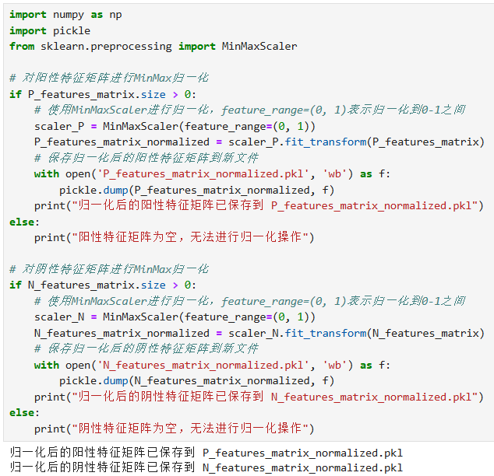
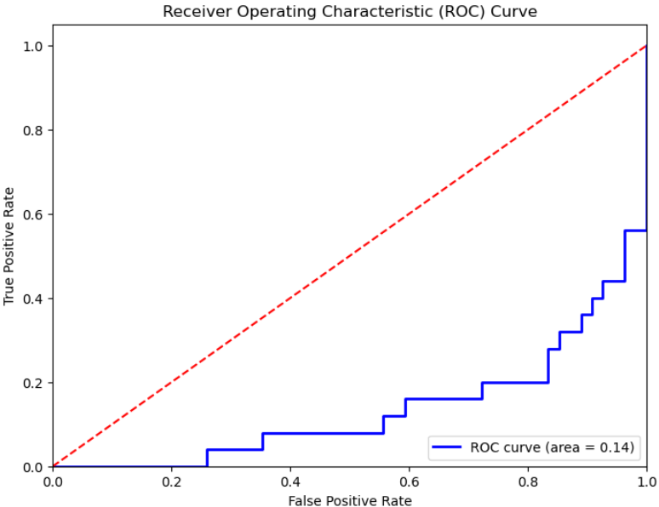
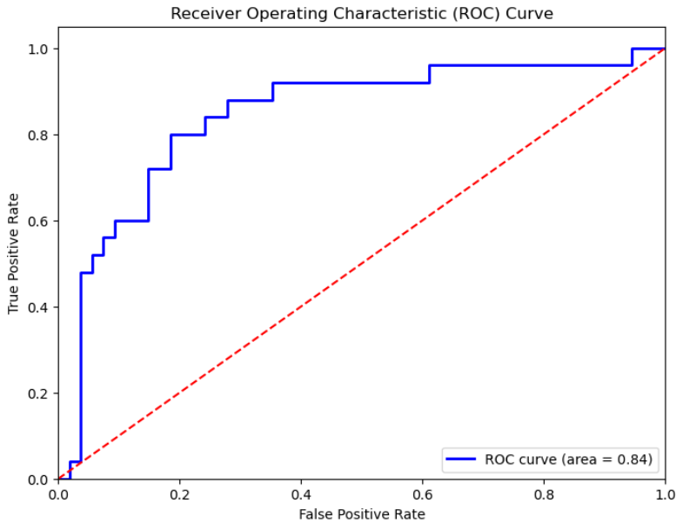
03 Algorithm Introduction & Result Presentation
(a). Normalization of the Feature Matrix
Min-Max Normalization is a linear transformation technique that rescales all feature values in the dataset to a specified range, typically between 0 and 1.
The impact of normalization on the ROC curve of the logistic regression model. The left figure shows the result of simple column-wise normalization.
The right figure shows the result using Min-Max Scaler normalization.
Min-Max Normalization brings all features onto the same scale, which is beneficial for many machine learning algorithms.
Notes:
“我们对特征矩阵采用的方式是最小-最大值归一化方式。它将原始数据中的所有特征缩放到一个指定的范围（通常是0到1）之间。
我们采用Min-Max归一化方式的原因是经过实验我们确定了此种方法对于模型效果的提升效果最好，尤其是逻辑回归模型的提升堪称巨大。“(放动画，简单解释)

Slide 16
03 Algorithm Introduction & Result Presentation
(b). Common examples of machine learning algorithms
i. Random Forest: Improves model performance by constructing multiple decision trees and aggregating their predictions.
Ensemble learning algorithms are methods that create a more powerful predictive model by combining multiple learning algorithms.
ii. AdaBoost: Builds a strong classifier by combining multiple weak classifiers.
iii. Gradient Boosting Classifier: Constructs a model by sequentially adding weak learners.
iv. Logistic Regression: A linear classification algorithm primarily used for binary classification problems.
Classification algorithms are algorithms that predict discrete labels or categories.
v. KNN: A non-parametric learning method that classifies a data point based on the majority vote of its K nearest neighbors in the feature space.
Notes:
左侧
“集成学习算法是一种通过组合多个学习算法来创建一个更强大的预测模型的方法。它的核心思想是多个模型集成可以提高预测的准确性和鲁棒性。分类算法是预测离散标签或类别的算法。分类算法的目标是学习一个能够根据输入特征预测出样本所属的类别的模型。“
(放动画)
右侧直接念这段文字：
“我们共计选择了5种机器学习算法，集成学习算法有随机森林、AdaBoost和梯度提升分类器；分类算法主要选择了线性分类算法——逻辑回归以及基于距离的分类算法KNN。”

Slide 17
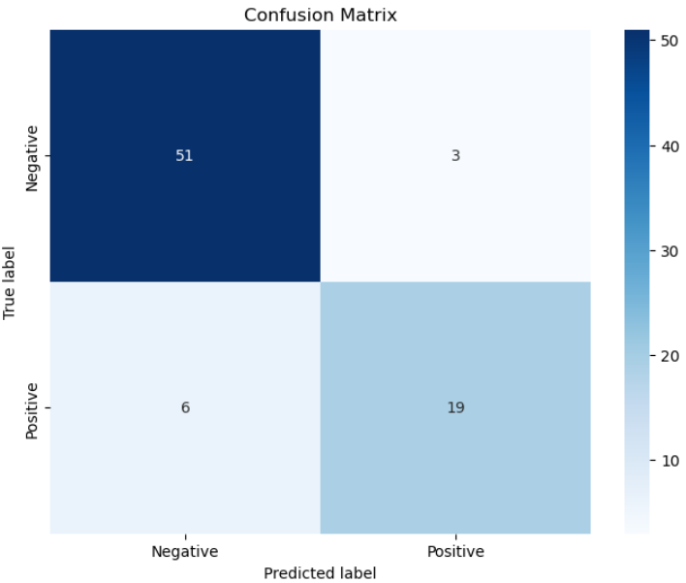
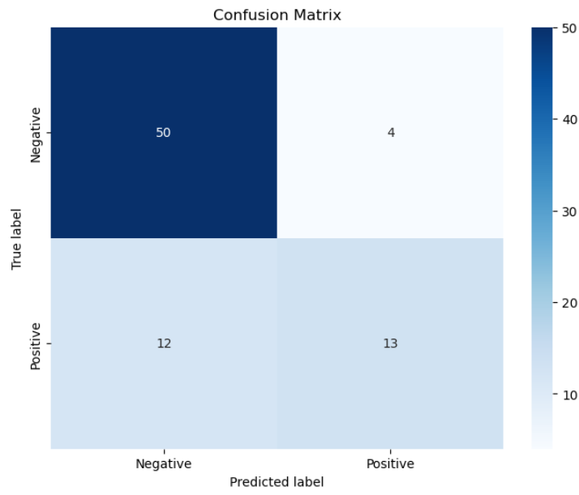
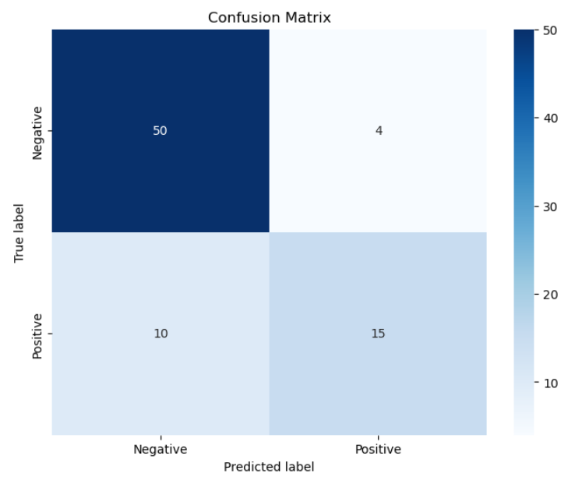
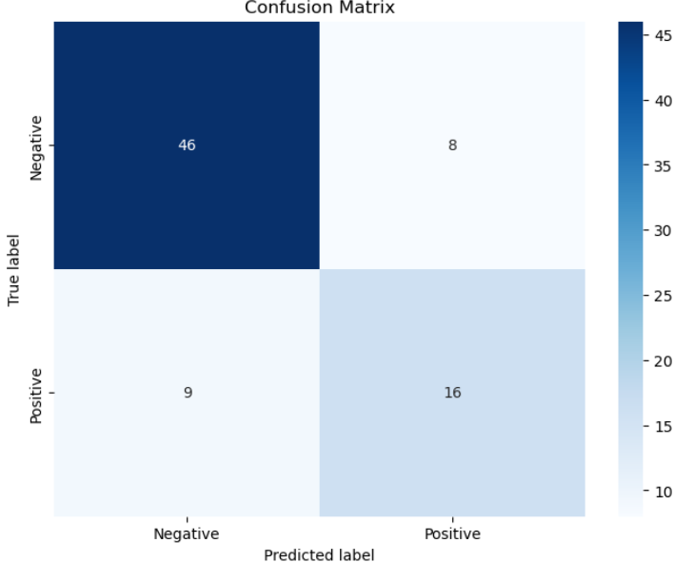
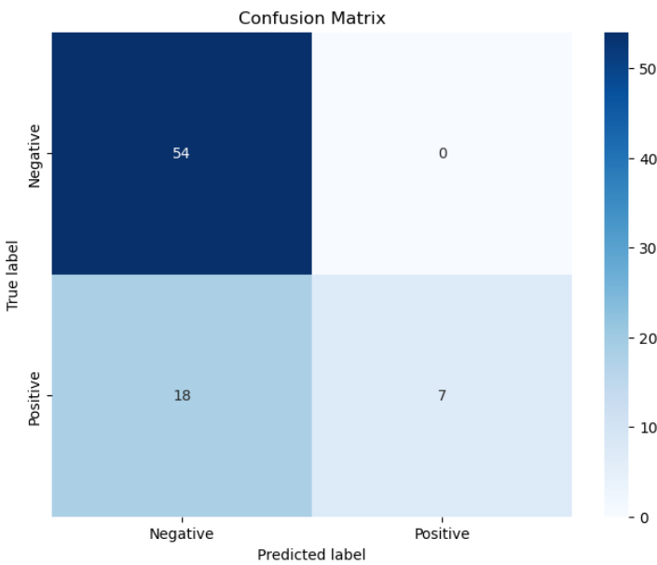
03 Algorithm Introduction & Result Presentation
(c). Performance Evaluation of Different Algorithms — Confusion Matrix
Gradient Boosting Classifier
Random Forest
AdaBoost
Logistic Regression
KNN
The Confusion Matrix is a tool for evaluating the performance of classification models, showing the relationship between the model's predicted outcomes and the actual labels. It helps us understand the types of errors made by the model, thereby allowing us to take targeted measures to improve the model.
Notes:
（结果评估部分开始）
“混淆矩阵（Confusion Matrix）是评估分类模型性能的一种工具，它显示了模型的预测结果与实际标签之间的关系。混淆矩阵可以帮助我们理解模型的错误类型，从而采取针对性的措施来改进模型。“
(放动画)
“如图是我们各种算法的混淆矩阵展示”
“例如我们可以看到KNN中假阴性的错误特别多，这或将提示我们改善模型的必要措施。”

Slide 18
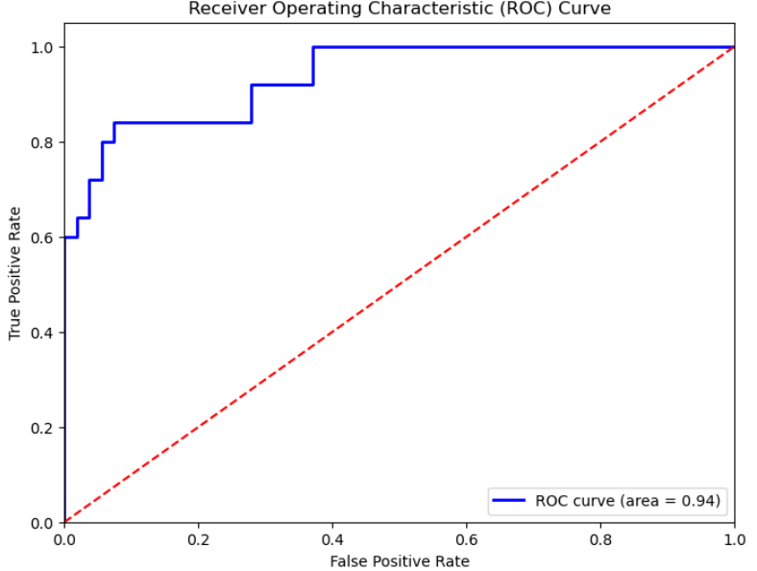
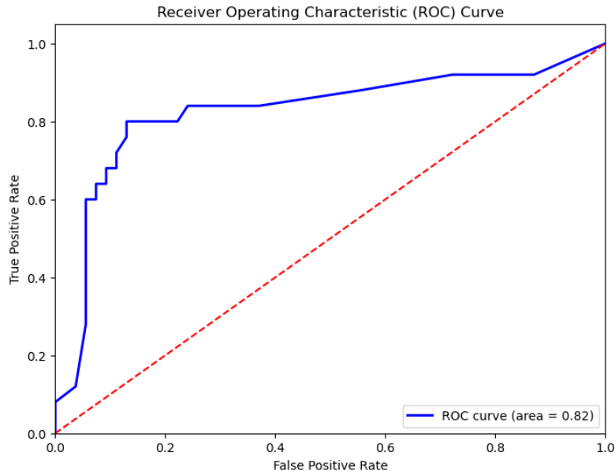
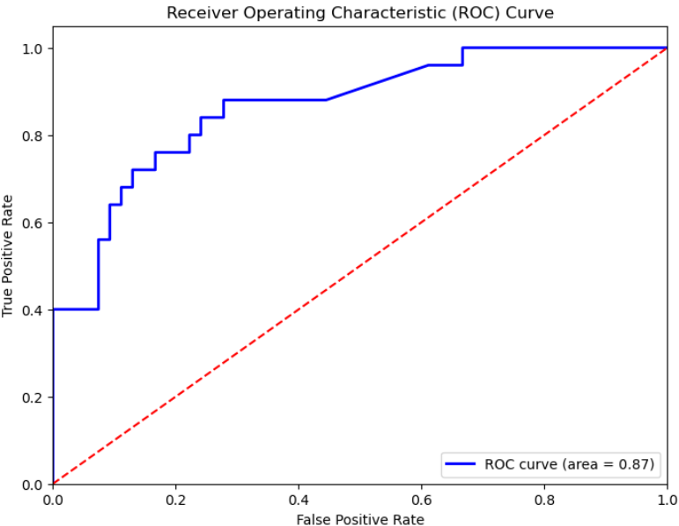
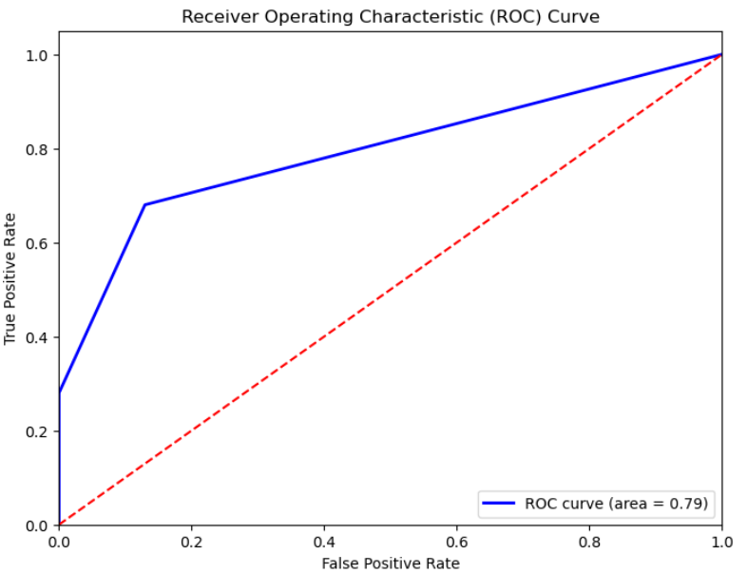
03 Algorithm Introduction & Result Presentation
(d). Performance Evaluation of Different Algorithms — ROC Curve
Gradient Boosting Classifier
Random Forest
AdaBoost
Logistic Regression
KNN
ROC is a tool used to assess the performance of binary classification models. It demonstrates the classification capability of a model by comparing the TPR and FPR at different thresholds. In datasets with class imbalance, the ROC curve and AUC value can better reflect the performance of a model than accuracy, as accuracy can be misleading due to the majority class's sample size.
Notes:
“ROC曲线是一种用于评估二分类模型性能的工具，它通过比较不同阈值下的真正例率和假正例率来展示模型的分类能力。在类别不平衡的数据集中，ROC曲线和AUC值比准确率（Accuracy）更能反映模型的性能，因为准确率可能会因为多数类别的样本数量而产生误导。”
(放动画)
“这是几种模型的ROC曲线，图示曲线越靠左上，则右下角的Area值越大，效果越好。我们可以看到，随机森林结果非常好，而KNN模型在这方面效果稍差。”

Slide 19
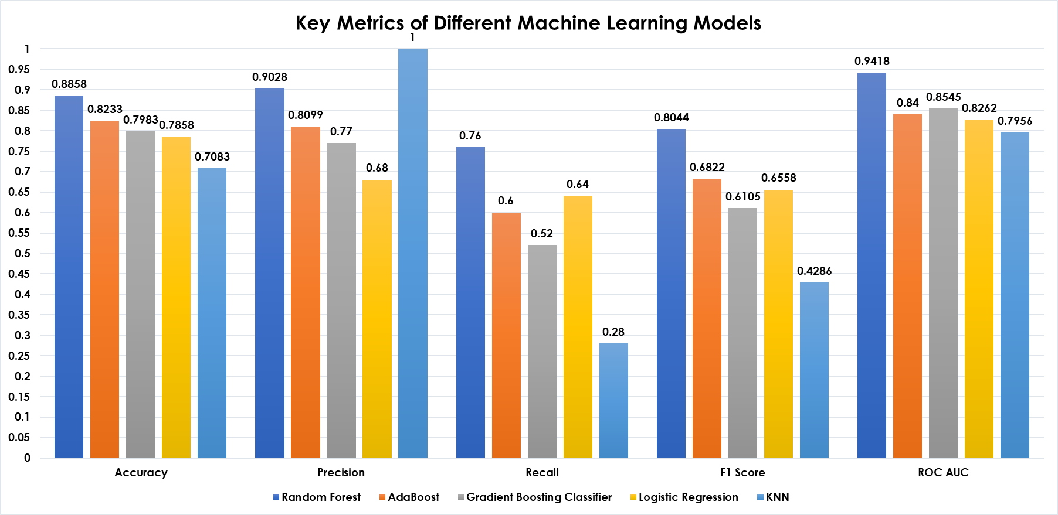
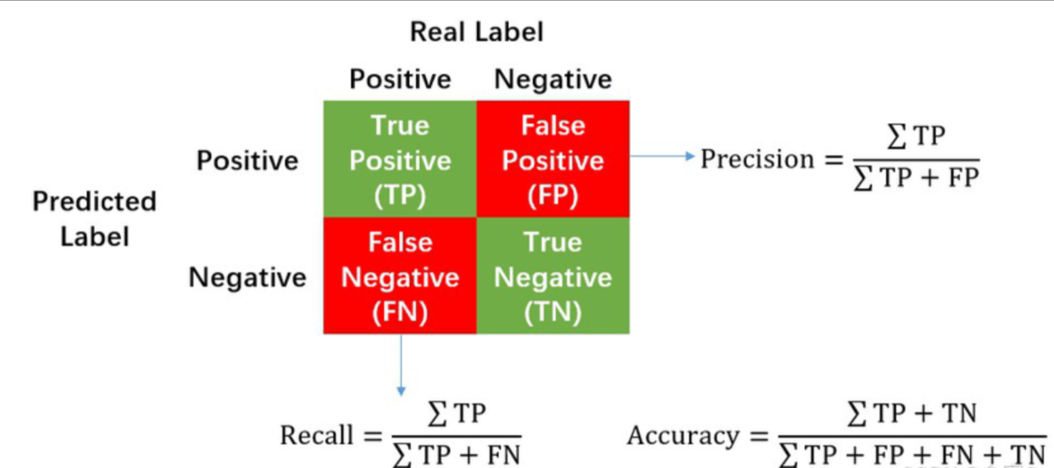
03 Algorithm Introduction & Result Presentation
(e). Performance Evaluation of Different Algorithms — Joint Assessment with Multiple Metrics
 | Random Forest | AdaBoost | Gradient Boosting Classifier | Logistic Regression | KNN
Accuracy | 0.8858 | 0.8233 | 0.7983 | 0.7858 | 0.7083
Precision | 0.9028 | 0.8099 | 0.7700 | 0.6800 | 1.0000
Recall | 0.7600 | 0.6000 | 0.5200 | 0.6400 | 0.2800
F1 Score | 0.8044 | 0.6822 | 0.6105 | 0.6558 | 0.4286
ROC AUC | 0.9418 | 0.8400 | 0.8545 | 0.8262 | 0.7956
The F1 Score is the harmonic mean of precision and recall.
AUC quantifies the area under the ROC curve, ranging from 0 to 1, with higher values indicating better model performance.
Notes:
首先由下方图片与文字简单解释5种参数的含义。（如果前面几组已经解释过就少说点或者直接跳过，否则可能面临超时威胁）
“准确率是指模型预测正确的样本占总样本的比例。如果模型预测100个样本，其中95个预测正确，那么准确率就是95%。
精确率是指在所有被模型预测为正类的样本中，实际为正类的比例。如果模型预测了10个正类样本，其中8个实际上是正类，那么精确率就是80%。
召回率是指在所有实际为正类的样本中，被模型正确预测为正类的比例。如果实际上有20个正类样本，模型只预测出了其中的15个，那么召回率就是75%。
F1是前两者的调和平均。
AUC是ROC曲线下的面积。值越高模型效果越好。“
（放动画）
接下来解释图表：
“我们完成了对5种模型的准确率评估，结果见上图表……”

Slide 20
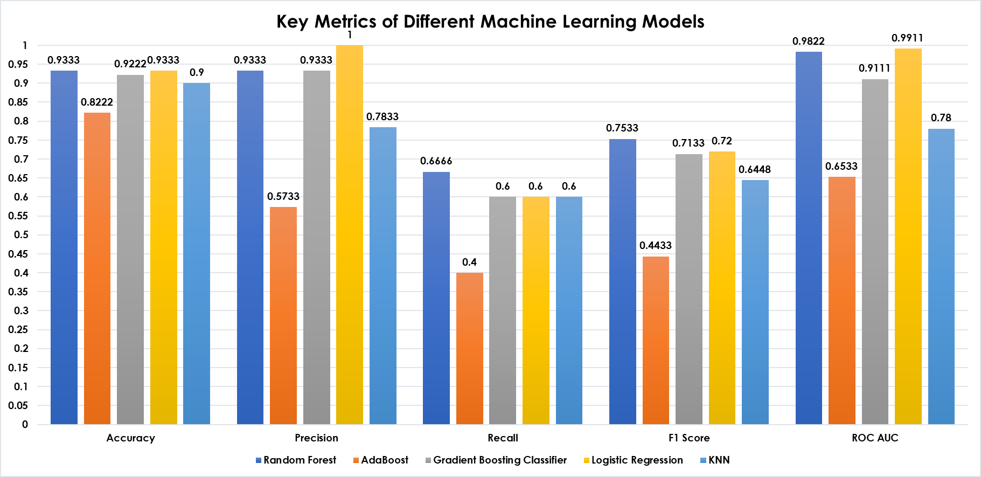
03 Algorithm Introduction & Result Presentation
(e). Performance Evaluation of Different Algorithms — Different Datasets
 | Random Forest | AdaBoost | Gradient Boosting Classifier | Logistic Regression | KNN
Accuracy | 0.9333 | 0.8222 | 0.9222 | 0.9333 | 0.9000
Precision | 0.9333 | 0.5733 | 0.9333 | 1.0000 | 0.7833
Recall | 0.6666 | 0.4000 | 0.6000 | 0.6000 | 0.6000
F1 Score | 0.7533 | 0.4433 | 0.7133 | 0.7200 | 0.6448
ROC AUC | 0.9822 | 0.6533 | 0.9111 | 0.9911 | 0.7800
This dataset is from the teacher. We can see some differences in the results between the datasets, but generally, our models are successful.
Notes:
(放动画)
直接翻译ppt最下面的字

Slide 21
恳请老师同学批评指正
小组成员： 王中壬 包博文 龚玉传 宋俊翰 张吉康
汇报人：王中壬

